Slide 1


The Mentor
Teacher
Alternative Teacher Certification Program
McLennan Community College

Slide 2
Course
Outline
Role of the Mentor Teacher
Qualifications and Responsibilities
What Makes a Good Mentor Teacher?
Working Effectively with an Intern
Critical Tasks Beginning Teachers Need Help With

Slide 3

Informal mentoring(buddy system) is not enough.
New educators often do not ask for the help they need.
Experienced teachers do not want to intrude.
Beginning teachers need to observe effective teaching models.
Informal mentoring does not tend to improve teaching over time.
Informal mentoring programs are difficult to support.
There is a need to identify who is obtaining support and the quality and quantity of that support.

Slide 4

The Role of the Mentor Teacher
The Mentor Teacher provides support to the Teacher Intern on his or her campus on a day-to-day basis, ensuring that the Teacher Intern has the necessary tools and support to successfully navigate campus and curricular expectations through modeling, conferencing and encouraging. This level of support will help the Teacher Intern use their knowledge and skills to effectively carry out the role of a classroom teacher at a successful level and retain them in that role.
Mentor Teachers are a part of the Professional Network in place for the Teacher Intern. In addition to the Mentor Teacher, the Building Principal, and the Field Supervisor make up the team that supports and promotes the personal and professional well-being of early career teachers.
The Alternative Teacher Certification staff is available to support both the Mentor teachers and the Teacher Interns in their collaboration.
This Photo by Unknown Author is licensed under CC BY-SA
First Skill
Second Skill
Third Skill
Conclusion

Slide 5


Qualifications and Responsibilities
Responsibilities
Provide to the Teacher Intern campus-based support and solution-oriented responses.
Meet regularly with the Teacher Intern to assist with teaching practice, planning, trouble-shooting and problem solving.
Observe the Teacher Intern a minimum of 4 times during the school year, completing forms for each and submitting and providing feedback to the Teacher Intern and allow Teacher Intern to observe Mentor Teacher with conferences to follow each.
Qualifications
Certification in the area and at the level of the Intern.
Employed as a teacher on the same campus as the Intern.
3-5 years teaching experience
Demonstrated success in improving student learning, as evidenced by data
A willingness to provide quality instruction and guidance through modeling, conferencing and encouraging the Teacher Intern.
Second Skill
First Skill
Third Skill
Conclusion

Slide 6
What Does a Mentor Teacher Provide?
Orientation to the logistics of the school- rules/procedures, resources, classroom management, lesson planning, establishing a positive classroom climate, getting off to a great start
Assistance- Collaborator, Coach, Role Model, Evaluator
Support- Advisor, Resource, Friend ( sometimes they just need a smile and some chocolate!)

Slide 7


Slide 8
What Makes a Good Mentor Teacher?
Mentoring is a form of teaching that benefits the Intern and the Mentor. Good Mentor Teachers understand the typical needs and challenges of the beginning teacher and they develop strategies to assist the beginning teacher. Good Mentor Teachers:
Model being a learning pro- share expertise, knowledge and professional skills. Show the Teacher Intern how and where to look for answers and how to use them effectively
Share why and how planning decisions are made.
Demonstrate a positive attitude and enthusiasm for teaching and mentoring
Keep children as learners at the forefront- primary focus. Model how things look through the lens of a child.
Participate in ongoing learning and growth. Learn from the Teacher Intern. Find topics of mutual interest.
Provide frequent constructive feedback to the Teacher Intern, starting with the positives. Frame questions and feedback to allow Intern to reflect and grow. Agree when and how to give feedback and agree that feedback is not criticism. Be explicit about teaching practice, but communicate that the Teacher Intern does not just need to copy the Mentor Teacher. Encourage them to develop their own practice and make their own decisions; but guide them with functional feedback and discussion to aid in developing solid practice.

Slide 9
What Makes a Good Mentor Teacher, continued
Work on one goal at a time. Classroom management is usually first. Decide when, where and how to step in and help when needed. Give acceptance and support.
Regularly meet with and build relationship with Teacher Intern to build trust and a safe and constructive relationship. Knowledge is developed through collaboration. Don’t allow things to build up.
Listen and allow Teacher Intern to come to own conclusions and solutions.
Celebrate successes and growth.
Show your own weaknesses in teaching. Share your stories. Give yourself permission to not know.
Feedback is a two way conversation- both must be willing to accept it.
Tell the truth no matter what. Voice mistakes; be honest and open-minded. Be direct, but not hurtful. Targeted feedback with suggested remedies. Ask questions.

Slide 10

What is targeted or functional feedback?
It is specific, accurate, clear without further explanation
It provides clear choices and tells the Teacher Intern exactly what to do and what effect it will have on student outcomes.
How to frame it:
What is the nature of the feedback?
What behavior does it target?
What kind of feedback seems useful to the Teacher Intern?
This Photo by Unknown Author is licensed under CC BY

Slide 11

Working Effectively with a Teacher Intern
Mentor teachers need to find ways to those initial conversations with the Teacher Intern, starting with those basic issues that all teachers need to think about and know how to do. Share information rather than give advice. Mentor Teachers are automatically wired to do these tasks well. Teacher Interns often don’t know what to ask and need direction.
Frame problems to get to what is relevant for a given situation to make things manageable. Deal with one thing at a time.
Examine the Teacher Intern’s thinking on the problems, then extend their thinking through questioning, conversation and feedback that is specific to get the Teacher Intern to consider thing they had not.
Third Skill
First Skill
Second Skill
Conclusion

Slide 12
Working Effectively with an Intern, continued
Mention what is good, comment on growth and point it out, celebrate it! We all need positive feedback, but it is important to get the Teacher Intern to be aware of the content of the feedback. Sometimes, what the Mentor Teachers sees as positive may be something the Teacher Intern was unaware of. Help the Teacher Intern set realistic, attainable goals for their growth.
Always focus on student-centered learning; encourage the Teacher Intern to see things through the lens of the student’s thinking and using that as a source of feedback on the effectiveness of their teaching. Then, help them connect that student learning to research and theory to help the Teacher Intern develop broader perspectives about their work.
Think aloud for the Teacher Intern, using examples from your own teaching to show the Teacher Intern processes and how you respond to a similar situation. Model for them your “wondering”- the mental work behind visible teaching. Examine and discuss different approaches and work to solve them together. Talk, ask questions, give feedback, analyze, negotiate and clarify.

Slide 13
Critical Tasks Beginning Teachers Need Help With
Classroom Management:
Arranging and setting up a classroom, bulletin boards
How to take attendance, handle emails
Use technology, phone and copier
Planning- format, requirements, software, deadlines
Teaching rules/policy (written and unwritten)
Managing student work/setting up gradebook
Establishing a positive classroom climate- does
campus/district have specific climate or behavior
management system
Supporting good student behavior (rewards)
Planning for and getting a substitute teacher
Getting off to a good start
Planning for Instruction
Available resources
Long-range, unit and daily plans
Cumulative records
Student data
Grouping
Pacing
Parental Involvement/PTA
Reporting to parents-conferences and
how to document those
School and district policies
Conclusion
First Skill
Second Skill
Third Skill

Slide 14

Tasks, Continued
Teaching Content
Curriculum guides
Special populations(504/IEP/GT/ESL/Dyslexia)
Testing-STAAR, TELPAS, others
Assessment expectations- diagnostic/
formative/summative
Professional resources
Motivating and engaging learners-centers,
groups work/PBL/use of technology/field
trips/labs/library
Professional Growth
PLC’s
Professional organizations- ATPE, AFT, TSTA
This Photo by Unknown Author is licensed under CC BY-SA-NC

Slide 15
What is EdTPA?
EdTPA is a performance-based, subject-specific assessment and support system that was piloted for the last two years by TEA. The State Board of Education did not approve exclusive use of EdTPA in Texas instead of the PPR exam. EdTPA is a portfolio-based assessment that focuses on planning, instruction and assessment. Teacher candidates prepare a portfolio of materials during their internship. Since it is an optional program at this time, you will receive information and training on your role as a Mentor Teacher of an Intern Teacher in EdTPA should your Intern Teacher choose to participate in EdTPA instead of PPR.

Slide 16
Ways to support an EdTPA candidate
Support the candidate’s thinking and learning, giving feedback and asking probing questions to encourage growth and help them analyze and reflect on their teaching throughout the year.
Emphasize the connections to T-Tess.
Encourage the Intern teacher to work on the portfolio in manageable pieces and check in with them on their progress. Help them set up a calendar.
Help them select a time of year to complete portfolio- where you are in the curriculum, etc., helping identify the TEKS and central focus for the learning segment.
Provide them access to the necessary materials- extra paper, color printing, IT support, hardware needed for video, permission slips for videoing students.
Provide understanding, patience, active listening and advice when the need arises.

Slide 18
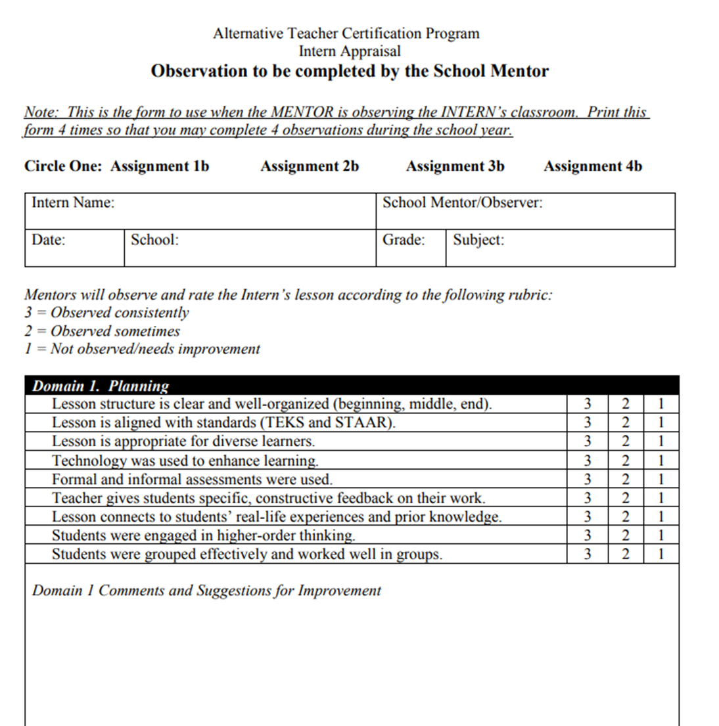
Formal Observations of the Teacher Intern
Observations should last 45 minutes.
Observe your Teacher Intern teach twice each semester (Sept, Nov, Jan, March).
Conference with the Teacher Intern to ask reflective questions and provide 1-2 suggestions.
Send a copy of each form with the Teacher Intern to Internship class as you complete these observations.
These forms will be provided and there are copies of them in your Mentor Teacher handbook.

Slide 19
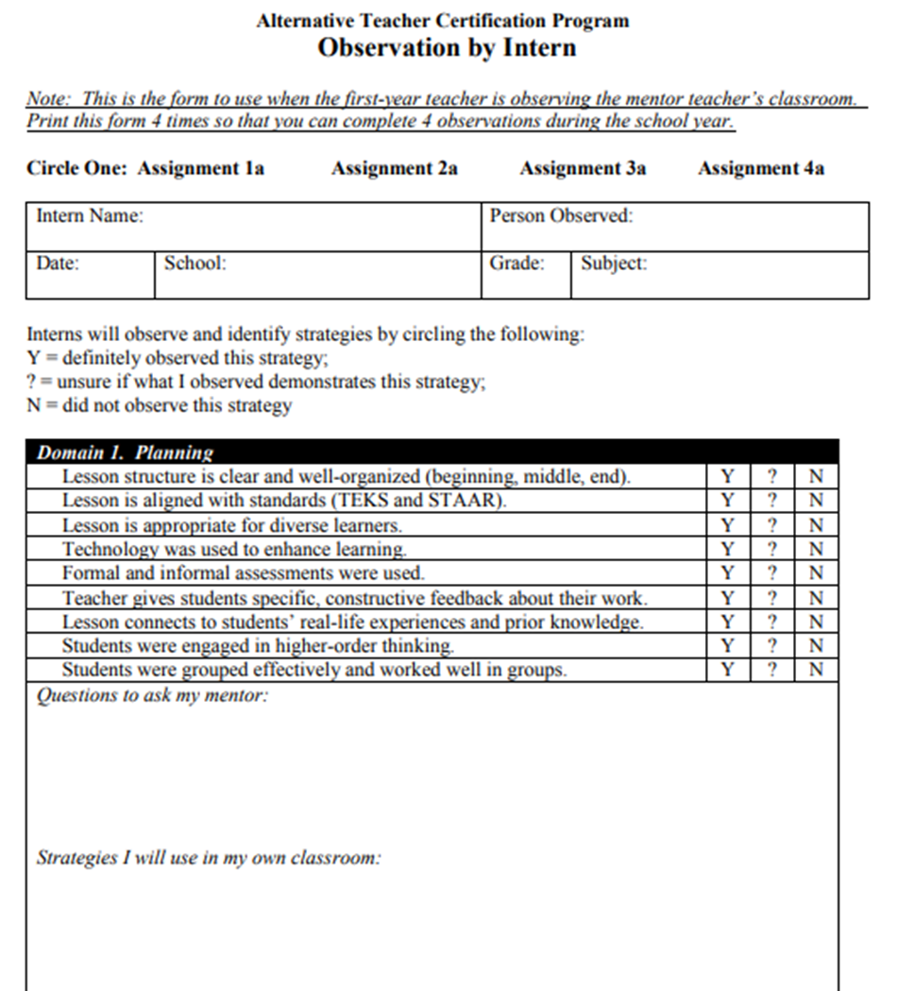
Teacher Intern observing the Mentor Teacher
Observations should last 45 minutes.
Make arrangements for the Teacher Intern to observe you at least twice each semester (Oct, Dec, Feb, April)
Conduct a post-observation conference.
Coach the Teacher Intern and point out
strategies you used. Allow them to ask
questions.
Remind the Teacher Intern to turn in the Observation forms at Internship class.

Slide 20
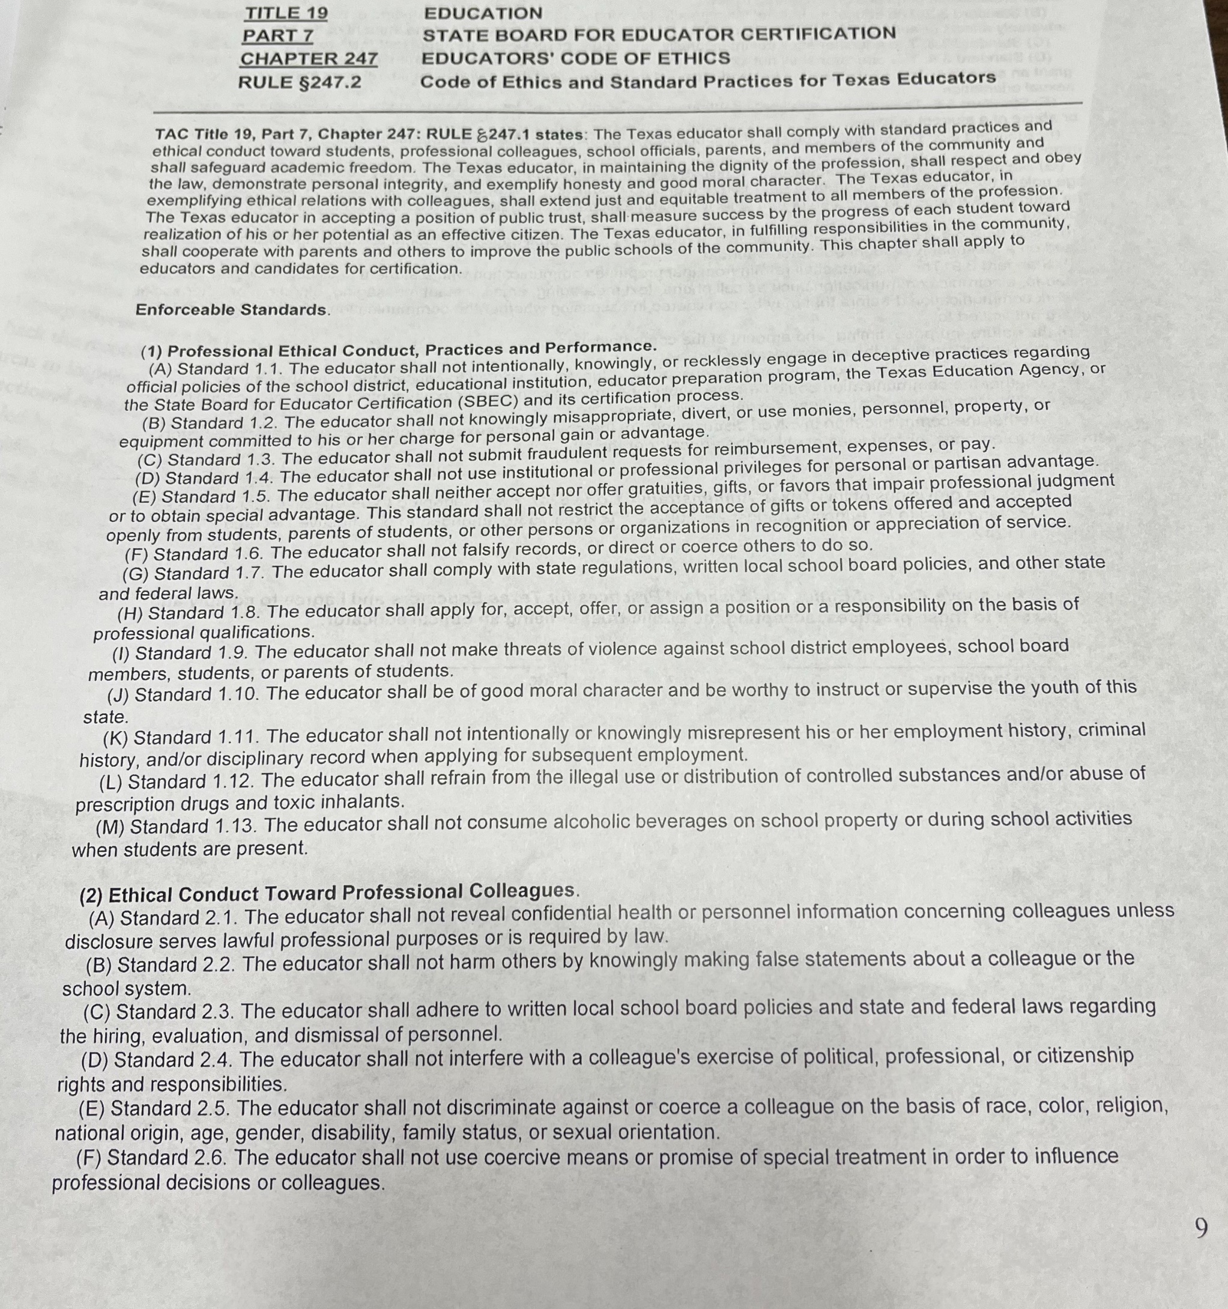
Teacher Code of Ethics
Part of our acknowledgement form that you will complete includes an acknowledgement of the Texas Teacher Code of Ethics. In the packet you receive from your Intern, a copy of this document is included. We ask that you review the Code of Ethics in order to help your Intern throughout this process . You need not sign and return the acknowledgement from your packet to us.

Slide 21

Thank you for being a part of our Professional Network!
This Photo by Unknown Author is licensed under CC BY-SA-NC
This Photo by Unknown Author is licensed under CC BY-NC-ND

Slide 22
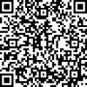
TH
Please scan this QR code and complete your acknowledgement of completion of training.

