Slide 1


The Mentor
Teacher
Alternative Teacher Certification Program
McLennan Community College
Notes:
Welcome to the Mentor Teacher training for the ATC of McLennan Community College. We are so glad you are with us. Please open your mic and tell me your name and who you are mentoring. Part of my job here at MCC is not only to act as a field supervisor for 11 of our intern teachers, but I am also the Mentor Specialist, so part of my job is to supporting you, our Mentors, and help you support our candidates.

Slide 2
Course
Outline
Role of the Mentor Teacher
Qualifications and Responsibilities
What Makes a Good Mentor Teacher?
Working Effectively with an Intern
Critical Tasks Beginning Teachers Need Help With
Notes:
Today we are covering these topics. Anytime you have a question,please either put it in the chat or open your mic and just ask, and I’ll do my best to answer it.

Slide 3

Informal mentoring(buddy system) is not enough.
New educators often do not ask for the help they need.
Experienced teachers do not want to intrude.
Beginning teachers need to observe effective teaching models.
Informal mentoring does not tend to improve teaching over time.
Informal mentoring programs are difficult to support.
There is a need to identify who is obtaining support and the quality and quantity of that support.
Notes:
How does this resonate with you? Do you find these things to be true?

Slide 4

The Role of the Mentor Teacher
The Mentor Teacher provides support to the Teacher Intern on his or her campus on a day-to-day basis, ensuring that the Teacher Intern has the necessary tools and support to successfully navigate campus and curricular expectations through modeling, conferencing and encouraging. This level of support will help the Teacher Intern use their knowledge and skills to effectively carry out the role of a classroom teacher at a successful level and retain them in that role.
Mentor Teachers are a part of the Professional Network in place for the Teacher Intern. In addition to the Mentor Teacher, the Building Principal, and the Field Supervisor make up the team that supports and promotes the personal and professional well-being of early career teachers.
The Alternative Teacher Certification staff is available to support both the Mentor teachers and the Teacher Interns in their collaboration.
This Photo by Unknown Author is licensed under CC BY-SA
First Skill
Second Skill
Third Skill
Conclusion

Slide 5


Qualifications and Responsibilities
Responsibilities
Provide to the Teacher Intern campus-based support and solution-oriented responses.
Meet regularly with the Teacher Intern to assist with teaching practice, planning, trouble-shooting and problem solving.
Observe the Teacher Intern a minimum of 4 times during the school year, completing forms for each and submitting and providing feedback to the Teacher Intern and allow Teacher Intern to observe Mentor Teacher with conferences to follow each.
Qualifications
Certification in the area and at the level of the Intern.
Employed as a teacher on the same campus as the Intern.
3-5 years teaching experience
Demonstrated success in improving student learning, as evidenced by data
A willingness to provide quality instruction and guidance through modeling, conferencing and encouraging the Teacher Intern.
Second Skill
First Skill
Third Skill
Conclusion
Notes:
Your principal will fill out the form in the white envelope that may have been in the packet your Intern should have given you. If you did not receive the packet (large manilla envelope) please let meknow in the chat and I’llget those docs to you.

Slide 6
What Does a Mentor Teacher Provide?
Orientation to the logistics of the school- rules/procedures, resources, classroom management, lesson planning, establishing a positive classroom climate, getting off to a great start
Assistance- Collaborator, Coach, Role Model, Evaluator
Support- Advisor, Resource, Friend ( sometimes they just need a smile and some chocolate!)

Slide 7
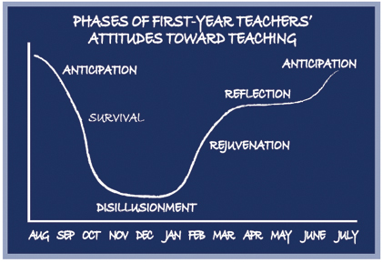
Notes:
Do you find this to be true for all of us? How can we help each other during that low period, particularly those first year teachers?

Slide 8
What Makes a Good Mentor Teacher?
Mentoring is a form of teaching that benefits the Intern and the Mentor. Good Mentor Teachers understand the typical needs and challenges of the beginning teacher and they develop strategies to assist the beginning teacher. Good Mentor Teachers:
Model being a learning pro- share expertise, knowledge and professional skills. Show the Teacher Intern how and where to look for answers and how to use them effectively
Share why and how planning decisions are made.
Demonstrate a positive attitude and enthusiasm for teaching and mentoring
Keep children as learners at the forefront- primary focus. Model how things look through the lens of a child.
Participate in ongoing learning and growth. Learn from the Teacher Intern. Find topics of mutual interest.
Provide frequent constructive feedback to the Teacher Intern, starting with the positives. Frame questions and feedback to allow Intern to reflect and grow. Agree when and how to give feedback and agree that feedback is not criticism. Be explicit about teaching practice, but communicate that the Teacher Intern does not just need to copy the Mentor Teacher. Encourage them to develop their own practice and make their own decisions; but guide them with functional feedback and discussion to aid in developing solid practice.

Slide 9
What Makes a Good Mentor Teacher, continued
Work on one goal at a time. Classroom management is usually first. Decide when, where and how to step in and help when needed. Give acceptance and support.
Regularly meet with and build relationship with Teacher Intern to build trust and a safe and constructive relationship. Knowledge is developed through collaboration. Don’t allow things to build up.
Listen and allow Teacher Intern to come to own conclusions and solutions.
Celebrate successes and growth.
Show your own weaknesses in teaching. Share your stories. Give yourself permission to not know.
Feedback is a two way conversation- both must be willing to accept it.
Tell the truth no matter what. Voice mistakes; be honest and open-minded. Be direct, but not hurtful. Targeted feedback with suggested remedies. Ask questions.

Slide 10

How to Identify Focus Area for Intern Teacher
Observe- when you do your observations, identify a key area that needs refinement (example-classroom procedures at the beginning of class).
Make note of what you are seeing, how it affects student learning outcomes and how it can be improved.
Debrief after the observation what you are seeing, giving good focused feedback.
Model the area of focus for the Intern in the lesson that they observe you teaching, making sure you plan to focus on that area for the Intern.
Meet after their observation of you to follow-up on what they saw and ask them how they could implement that in their classroom.
Check for this on your next observation of them.
Keep the conversation going- helping them to learn what a great classroom looks like and how to get there. You might plan to visit another teacher’s classroom to observe the same focus skill.
This Photo by Unknown Author is licensed under CC BY
Notes:
How does this resonate with you? Why do you think this is important or why not?

Slide 11

Working Effectively with a Teacher Intern
Mentor teachers need to find ways to those initial conversations with the Teacher Intern, starting with those basic issues that all teachers need to think about and know how to do. Share information rather than give advice. Mentor Teachers are automatically wired to do these tasks well. Teacher Interns often don’t know what to ask and need direction.
Frame problems to get to what is relevant for a given situation to make things manageable. Deal with one thing at a time.
Examine the Teacher Intern’s thinking on the problems, then extend their thinking through questioning, conversation and feedback that is specific to get the Teacher Intern to consider thing they had not.
Third Skill
First Skill
Second Skill
Conclusion

Slide 12
Working Effectively with an Intern, continued
Mention what is good, comment on growth and point it out, celebrate it! We all need positive feedback, but it is important to get the Teacher Intern to be aware of the content of the feedback. Sometimes, what the Mentor Teachers sees as positive may be something the Teacher Intern was unaware of. Help the Teacher Intern set realistic, attainable goals for their growth.
Always focus on student-centered learning; encourage the Teacher Intern to see things through the lens of the student’s thinking and using that as a source of feedback on the effectiveness of their teaching. Then, help them connect that student learning to research and theory to help the Teacher Intern develop broader perspectives about their work.
Think aloud for the Teacher Intern, using examples from your own teaching to show the Teacher Intern processes and how you respond to a similar situation. Model for them your “wondering”- the mental work behind visible teaching. Examine and discuss different approaches and work to solve them together. Talk, ask questions, give feedback, analyze, negotiate and clarify.

Slide 13
Critical Tasks Beginning Teachers Need Help With
Classroom Management:
Arranging and setting up a classroom, bulletin boards
How to take attendance, handle emails
Use technology, phone and copier
Planning- format, requirements, software, deadlines
Teaching rules/policy (written and unwritten)
Managing student work/setting up gradebook
Establishing a positive classroom climate- does
campus/district have specific climate or behavior
management system
Supporting good student behavior (rewards)
Planning for and getting a substitute teacher
Getting off to a good start
Planning for Instruction
Available resources
Long-range, unit and daily plans
Cumulative records
Student data
Grouping
Pacing
Parental Involvement/PTA
Reporting to parents-conferences and
how to document those
School and district policies
Conclusion
First Skill
Second Skill
Third Skill
Notes:
This is not an exhaustive list. Please put in the chat or comment on anything that you think is important that isn’t on this list.

Slide 14

Tasks, Continued
Teaching Content
Curriculum guides
Special populations(504/IEP/GT/ESL/Dyslexia)
Testing-STAAR, TELPAS, others
Assessment expectations- diagnostic/
formative/summative
Professional resources
Motivating and engaging learners-centers,
groups work/PBL/use of technology/field
trips/labs/library
Professional Growth
PLC’s
Professional organizations- ATPE, AFT, TSTA
This Photo by Unknown Author is licensed under CC BY-SA-NC

Slide 15
What is EdTPA?
EdTPA is a performance-based, subject-specific assessment and support system that was piloted for the last two years by TEA. The State Board of Education did not approve exclusive use of EdTPA in Texas instead of the PPR exam. EdTPA is a portfolio-based assessment that focuses on planning, instruction and assessment. Teacher candidates prepare a portfolio of materials during their internship. Since it is an optional program at this time, you will receive information and training on your role as a Mentor Teacher of an Intern Teacher in EdTPA should your Intern Teacher choose to participate in EdTPA instead of PPR.

Slide 16
Formal Observations of the Teacher Intern
The first observation should last 45 minutes or a full class period. After that, it will depend upon the focus. If an Intern’s focus area with you is procedures, for example, you might only observe the first 15 minutes to check on that focus skill and give feedback afterwards.
Observe your Teacher Intern teach twice each semester (Sept, Nov, Jan, March).
Conference with the Teacher Intern after each observation to ask reflective questions and provide feedback and a copy of the document. Follow up by then having them observe you in your classroom, with you modeling the identified focus area, with a debrief afterwards.
Send a copy of each form with the Teacher Intern to Internship class as you complete these observations.
Copies of the forms are a part of your packet and will also be in the Intern packet and on our website.

Slide 17
Teacher Intern observing the Mentor Teacher
Observations should last 45 minutes.
Make arrangements for the Teacher Intern to observe you at least twice each semester. These observations follow you observing them. This will allow you to model in your classroom the focus skill you have identified from their teaching that needs refinement.
Following each observation, meet with the Intern to debrief, answer questions and provide guidance for them.
Remind the Intern to turn in all documents of BOTH observations to our office for their file.

Slide 18
Teacher Code of Ethics
Part of our acknowledgement form that you will complete includes an acknowledgement of the Texas Teacher Code of Ethics. In the packet you receive from your Intern, a copy of this document is included. We ask that you review the Code of Ethics in order to help your Intern throughout this process . You need not sign and return the acknowledgement from your packet to us.

Slide 19

Thank you for being a part of our Professional Network!
This Photo by Unknown Author is licensed under CC BY-SA-NC
This Photo by Unknown Author is licensed under CC BY-NC-ND

Slide 20
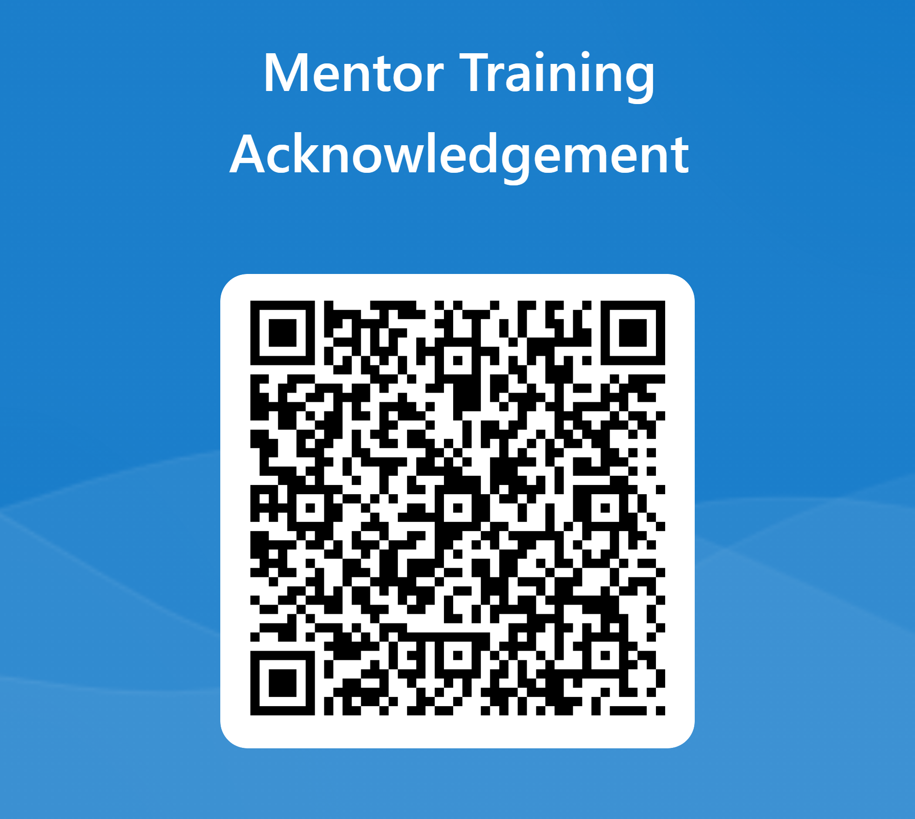
https://forms.office.com/r/qg9R2csuTj
Please scan this QR code and complete your acknowledgement of completion of training.

