Slide 1
Program Review
A Strategy for Success

Slide 2
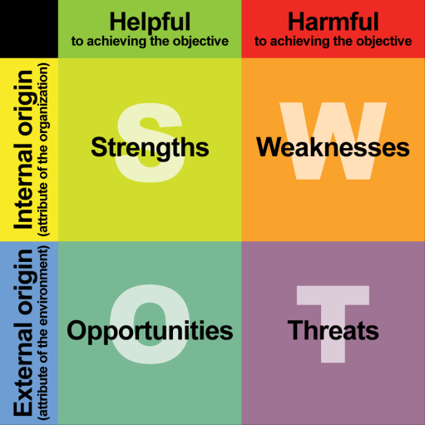
SWOT?
What is it?
What can it do for me?
S.W.O.T. – an acronym that stands for Strengths, Weaknesses, Opportunities, Threats.
It enables a program, department, or unit to assess a changing environment and respond proactively.

Slide 3
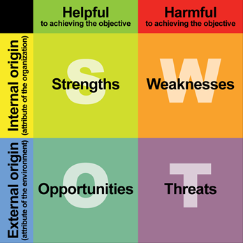
Let’s see where we are: internal
Assess our strengths and weakness – items often internal to our department, area, or program:
Strengths
What do we do well?
What do we do better than anyone else?
What unique resources do we have that others don’t?
What do others see as your strengths?
Weaknesses
What factors that are within your control detract from your ability to obtain or maintain a competitive edge?
What areas need improvement to accomplish your objectives or compete with your strongest competitor?
What do people in your market see as weaknesses?
What factors cause you to lose market share?

Slide 4
Let’s see where we are: external
Assess our opportunities and threats– items often internal to our department, area, or program:
Opportunities
What opportunities exist in your market or the environment that you can benefit from?
Has there been recent market growth or have there been other changes in the market that create an opportunity? Is the opportunity ongoing, or is there just a window for it?
Is the perception of your program positive--why?
Tip: Useful opportunities can come from changes in technology/markets on both a broad and narrow scale; changes in government policy related to your field; changes in social patterns, population profiles, lifestyle changes, etc.; and local events. Also, look at your strengths and ask if these might open up any opportunities and whether by eliminating some of your weaknesses might open up opportunities.
Threats
What obstacles do you face?
What are your competitors doing?
Is changing technology threatening your position?
Do you have unsustainable cost issues?
Are quality standards or specifications changing rapidly?

Slide 5
SWOT tips
Only accept precise, verifiable statements
Keep lists of factors lean and focused—prioritize/rank order them
Make sure action ideas are carried forward throughout the planning, development, and implementation process

Slide 6
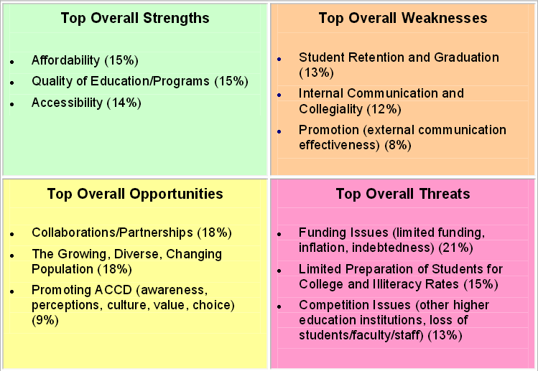
Example — Alamo community college district

Slide 7
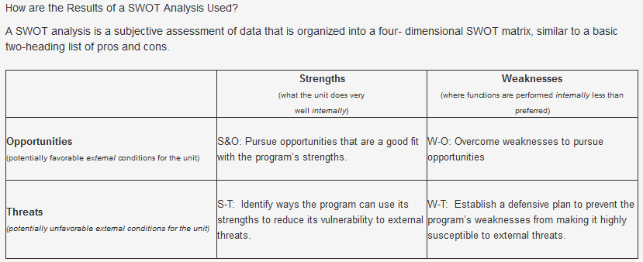
Using your s.w.o.t. for action

