Slide 1
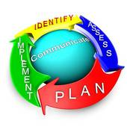
Planning, the basics
Essential Knowledge

Slide 2
Planning?
A process for getting work done—a custom to-do list (no two plans are alike)
A blue print for growth and a road map for development
It helps to objectify (make real) ideas for improvement in both quantitative and qualitative terms

Slide 3
Purpose of your plan
What should it be?
Purpose:
A realistic view of expectations
It can be long range, intermediate range, or short range
It provides the framework within which you operate—it provides structure, but doesn’t guarantee success (however, lack of a sound plan will generally ensure failure)
Helps to manage, focus, and clarify strategies to accomplish goals
Provides a logical framework for pursuing strategies
Offers a means for measuring performance and seeking improvement based on end-of-year results for next planning cycle

Slide 4
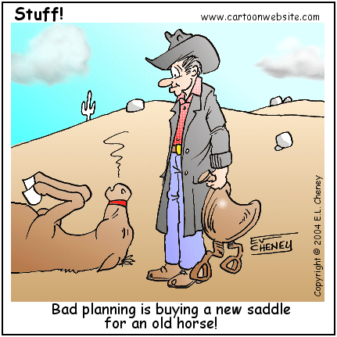
Importance of the planning process
A plan-oriented approach helps one…
avoid mistakes
recognize opportunities
be accountable
stay on budget
stay on task
stay on schedule
be a top performer

Slide 5
Planning essentials
Identify your main goals for the year (as related to the College’s strategic plan and your supervisor’s annual plan)
Normally there will be at least 3 goals
Once you’ve identified your annual goals, develop at least 2 strategies for accomplishing each goal
Identify how you will measure each of these strategies used to accomplish these goals

Slide 6
Unit Level Plan — details
Goals
Strategies
The most useful goals are time specific and are stated in quantitative results-oriented terms (job descriptions are a good example of this)
Goals may be the same from year to year
When writing think about implementation dates and how you will measure
Use verbs like: improve, increase, enhance, achieve, reduce, evaluate, measure, expand, upgrade
Each goal will need two or more strategies
Strategies include specific activities that will lead to accomplishment of the goal
Use verbs like: create, investigate, establish, conduct, develop, analyze, attend, implement, provide

Slide 7
Unit Level Plan — examples
Goals
Strategies
Increase student enrollment in _____
Increase student retention in _____
Upgrade learning/teaching techniques
Develop a marketing plan for _____
Identify and recruit qualified students for _____
Investigate the need for a major in _____

Slide 8
Unit Level Plans — end-of-year results
Goal + Strategy = Results (your expected outcome)
Examples of end-of-year results:
Increase student enrollment by 3% between fall 2011 and fall 2012
Improve student retention by 2% during the 2011-2012 school year
Increase the number of _______certificates by 3%
Improve student satisfaction by 5%

Slide 9
Good Planning requires…
Tracking and recording results
Updating plan
If planning is a road map, you need to consult it more than twice a year—monthly is good
Print out your goals and related strategies and post to office bulletin board
Save documentation that shows accomplishment of your goals as they happen (that is, don’t wait to the end of the year when such documentation can be hard to find)
As the year progresses and things change
Update your annual plan to show changing circumstances and lessons learned

Slide 10
Planning process key steps— A review
Set goals
Establish strategies to accomplish goals
Provide measures for strategies
Collect data/evidence of accomplishments
As strategies are completed, save documentation
Make adjustments to plan, based on changing circumstances
Update plan throughout the year to show changes as needed

