Slide 1
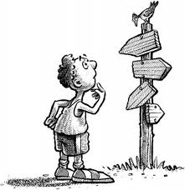
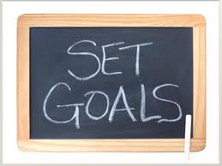
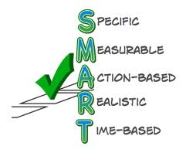
Planning
Signpost to Success
“The world will step aside for the man [or woman] who knows where he [or she] wants to go.”
Anonymous … possibly Henry David Thoreau

Slide 2
Planning is basic
It is about
Excellence in leadership and management of resources
Program offerings
Values, skills and competencies
Academic & administrative processes
Organizational culture
Encourages excellence and confidence by providing
A road map—
Knowledge of what specific changes need to be made
Priorities for work
What needs to be retained and what left behind
Training in new skills

Slide 3
Planning and the road map…
Annual Unit Plan
College’s Strategic Plan
To do list
List your top priorities for the year
With an eye to lessons learned from past year and looking ahead to the next year
Align your goals with
Best practices
Your Vice President
College’s Strategic Plan
A five-year plan with annual and five-year goals
Reviewed annually by the Strategic Planning Committee to ensure its continuing relevancy
Includes:
Mission statement
Vision statement
Core values
Strategic plan—with 7 goals and 38 objectives

Slide 4
Model of planning is changing
Ten years ago—90% planning/10% execution
Today—70% planning/30% execution
Ten years from now—40% planning/60% execution

Slide 5
Planning is streamlined in Compliance Assist
Compliance Assist includes:
SACS Compliance Report
Strategic Plan
Student Learning Outcomes
QEP
Annual Unit Level Plan
Budget Information
Program Review
This combination of planning, budget, and accountability functions in a single software program should enable us to realize the planning standard of 40% planning to 60% execution

Slide 6
Your ULP
General guidelines
The 3-year vision
Goals (points of focus on annual to-do list)—what you are seeking to accomplish & linked to MCC’s strategic plan
2-6 (average is 3)
Strategies (methods of accomplishing your goals)—how will accomplish
Generally it takes 2 strategies per goal
Measures (a specific date, number, or measurable result that will let you know you accomplished what you set out to do)—helps you define the target/finish line
Normally the number of measures are about the same as number of goals (with a single measure being used for multiple strategies)
Most recent year completed
What are lessons learned to improve/revise upcoming year?
Current year
Gather documentation and results throughout the year for inputting end-of-year results
Up-coming year
Based on findings from past and current year, develop a revised plan that will maximize improvement and make a compelling case for the upcoming budget allocations

Slide 7
Words of wisdom?
“The planning process is the setting and your unit’s work is the gemstone.”
Make sure you’ve sufficiently engaged in the planning process to show off your unit to others
Missing key to-do items from your annual plan can result in:
Failure to support and receive annual budget requests
Missing recognition for your unit’s efforts and accomplishments
Diminished respect for your unit both on and off campus
Have an annual planning meeting for your unit and include all unit members—make sure to maximize time for sharing and creative “out of the box thinking”—prior to finalizing your annual plan (preferably each summer)

Slide 8
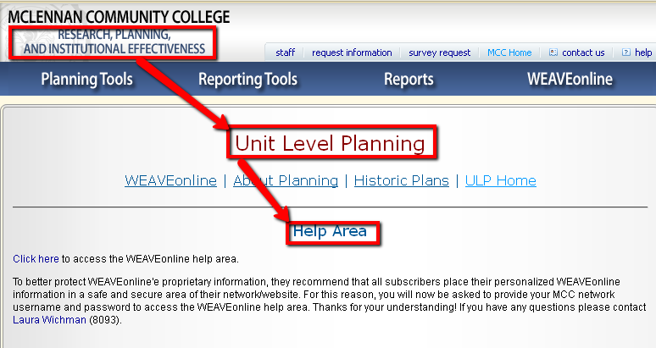
ULP help
Online
Email, Phone, or Face-to-Face
http://mcciep.mclennan.edu/UnitLevel/help.php
Planning Assistance
Tom Proctor
Planning Coordinator
119 LH
McLennan Community College
1400 College Drive
Waco, Texas 76708
tproctor@mclennan.edu
(254) 299-8619
Technical Assistance
Laura Wichman
Database Admin Specialist
McLennan Community College
(254) 299-8093
lwichman@mclennan.edu

