Slide 1

Supporting Student Success:
New Tools and Shared Practices
Brandon D. Hill, Ph.D., Dean of Students
Natalie G. James, M.Ed., AD Success Coaching Services
Analytics Builder implementation in partnership with
Timothy Waldie, Instructional Application Specialist

Slide 2



GOAL:
SUCCESS
REFER
CONTACT
Spring 2025
1,429 Students
finished the term in serious
academic jeopardy
142 of these students were referred for support
Analytics Builder

Slide 3
PROACTIVE
GOAL:
SUCCESS
REFER
CONTACT
+
Analytics Builder

Slide 4
Analytics Builder
Timely Predictive Identification of students who are going to struggle
Absences
Late Assignments
Failed Assignments, tests etc.

Slide 5
Analytics Builder
Week 4:
Timely Predictive Identification of students who are going to struggle
Missed Class A 3 times in a row
Failed Quiz Class B
Paper in Class C has not been turned in

Slide 6
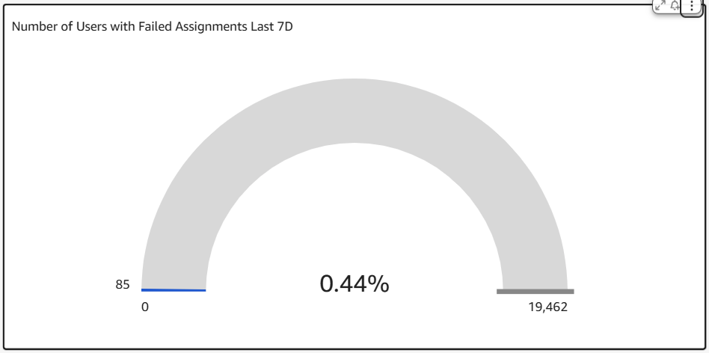

Slide 7


Outreach Report Week 1
DAY
3 |  | 224
5 | 64 | 231
FOCUS: Absences

Slide 8
Key Student Challenges Identified
Student or family health issues
Personal circumstances
Work schedule conflicts
Logistical confusion
Technology issues

Slide 9
Earlier insight
More intentional outreach
Better support for students when it matters most

Slide 11
END OF PRESENTATION
The following slides are in case of questions and will not appear in the BOT published version.

Slide 12
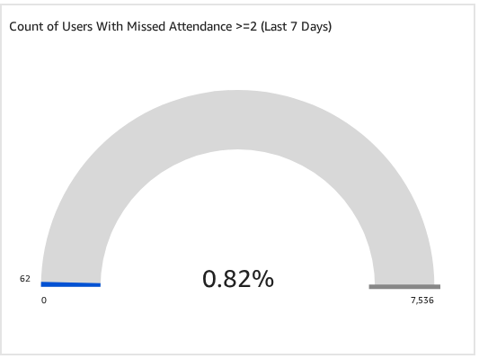

Slide 13
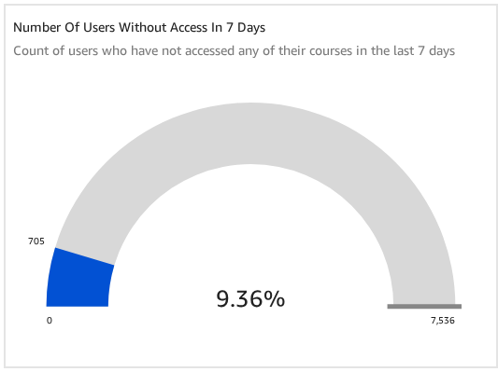

Slide 14

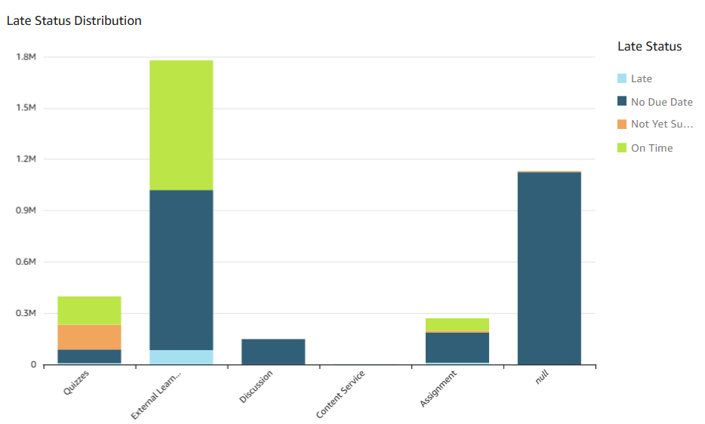

Slide 15
Outreach Report Week 2
Type
Missed | 36
Failed | 50
FOCUS: Assignments
During Week 1

