Slide 1

Lightcast Data Report
March 5, 2026

Slide 2

Overview
Data Informed Decision Making
Environmental Scan
Program Demand Gap Analysis
New Program Opportunities

Slide 3
Data Informed Decision Making
Institutional Program Data
Texas Higher Ed Coord. Board
Texas Workforce Commission
Dept. Labor Statistics
Texas Labor Market
Local Workforce Advisory Boards
Third-Party Reports
Lightcast
Notes:
We are looking at a piece of data, not the entire data story. The data we review today is only a portion of the data available that we will use in determining programming needs.

Slide 4
Environmental Scan

Slide 5
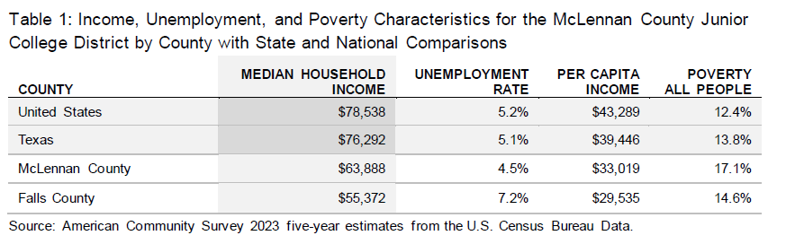
Notes:
McLennan County has a poverty rate 3.3 points higher than the state rate and 4.7 points higher than the national rate.
The data in Table 1 show several of the region’s socioeconomic indicators. Household income, reported as a median annual value, includes the income of all individuals in a household, 15 years and over, whether they are related to the householder or not. Per capita income is calculated as the mean income for every person in the area divided by the aggregate income of the total population.

Slide 6
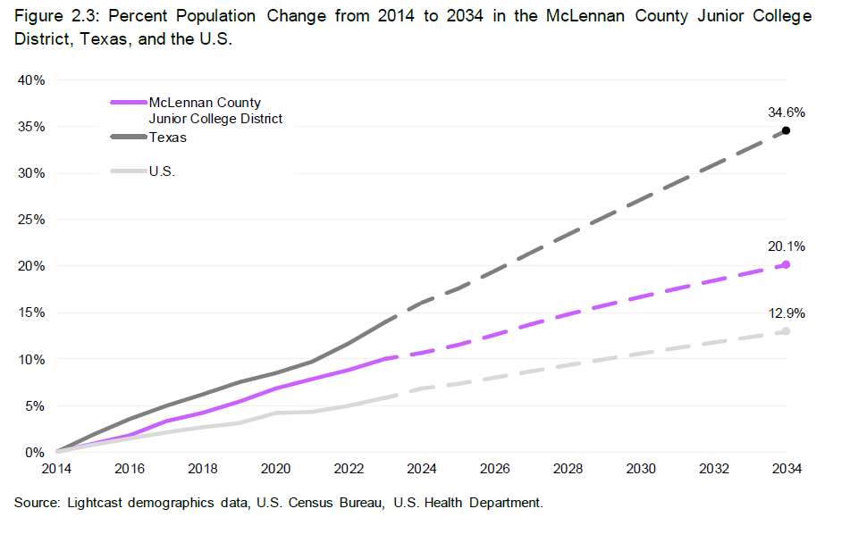
Notes:
In 2014, 260,390 people lived in the McLennan County Junior College District, and 312,760 people are projected to live in the region by 2034 (Figure 2.2). Using 2014 as the base year, this reflects a growth rate of 20.1% (Figure 2.3). Texas’s population is projected to increase by 34.6% over the same 20-year period, and the population in the U.S. is projected to increase by 12.9%.

Slide 7
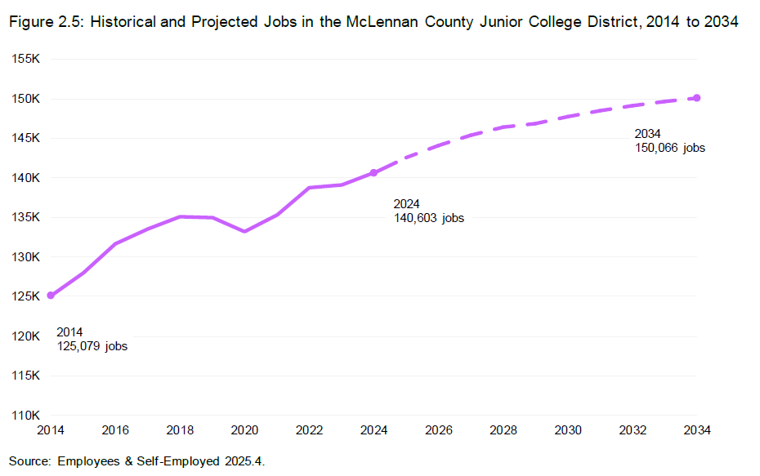
Notes:
As shown in Figure 2.5, the McLennan County Junior College District supported 125,080 jobs in 2014. By 2024, that number increased to 140,600 jobs for an increase of 12.4%. For context, in 2024 Texas supported 16 million jobs, and the U.S. supported 174 million jobs. In addition, the region is projected to add another 9,460 jobs from 2024 to 2034 for a growth of 6.7%.

Slide 8
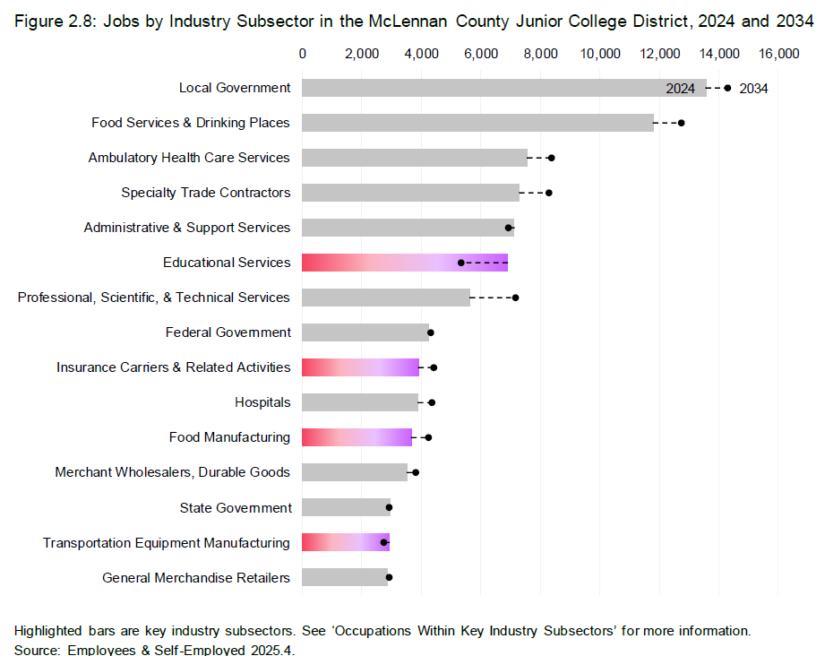
Notes:
Figure 2.8 presents the 15 largest industry subsectors in the McLennan County Junior College District, by their 2024 job counts and also shows the industry subsectors’ projected change over the next decade. The region supported 140,600 jobs in 2024, and by 2034, it is projected to add 9,460 new jobs for a 6.7% job increase. As shown in the figure, Local Government is the largest employer, with 13,570 jobs in 2024, and it is expected to remain the top regional employer. The Food Services & Drinking Places and Ambulatory Health Care Services industry subsectors are the next largest, with 11,790 and 7,570 jobs in 2024, respectively. As for growth, Professional, Scientific, & Technical Services is projected to add the most jobs of the top 15 industry subsectors, with a 10-year increase of 1,530 new jobs for 27.1% job growth. On the other hand, four of the top 15 industry subsectors are expected to contract between 2024 and 2034. The top two contracting industry subsectors are Educational Services and Administrative & Support Services.

Slide 9
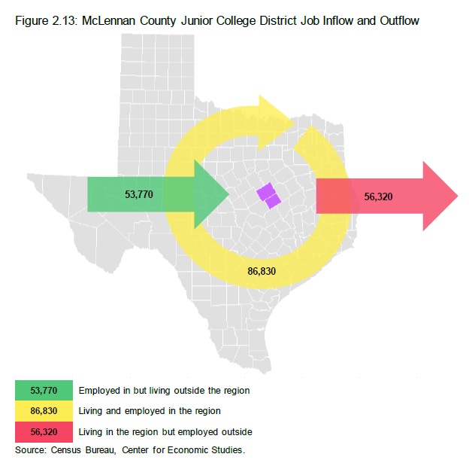
Notes:
Figure 2.13 presents the inflow and outflow of jobs to and from the McLennan County Junior College District. 140,600 jobs in the region, with 86,830 jobs filled by residents and 53,770 jobs filled by people living outside the region. In addition, 56,320 jobs are held by the region’s residents outside the McLennan County Junior College District. In other words, 56,320 residents commute outside the region for work.

Slide 10
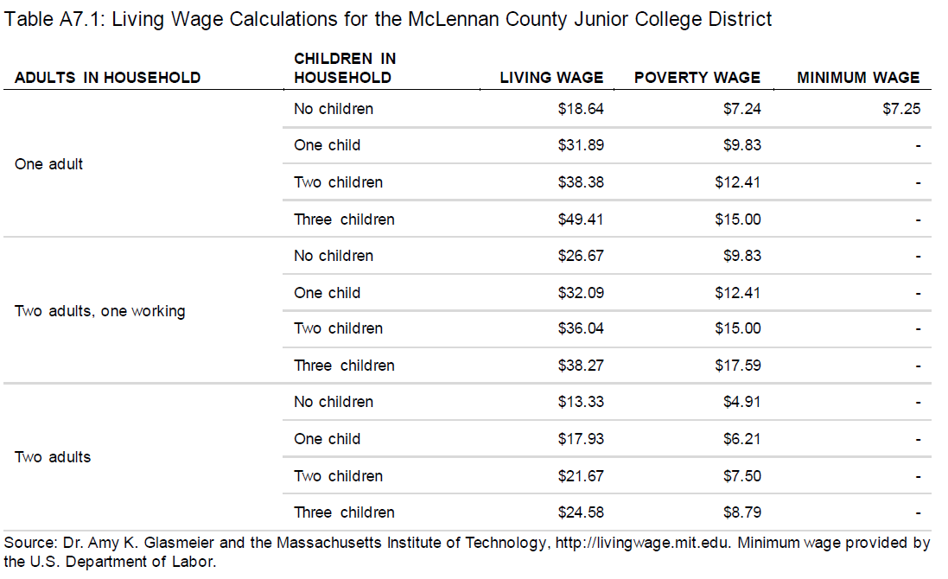
Notes:
THECB Self-Sustaining Wage = $30,000 annually or $14.42 per hour
TWC Self-Sufficient Wage for McLennan County = $31,213 annually or $14.78 per hour

Slide 11
Program Demand
and
Gap Analysis

Slide 12
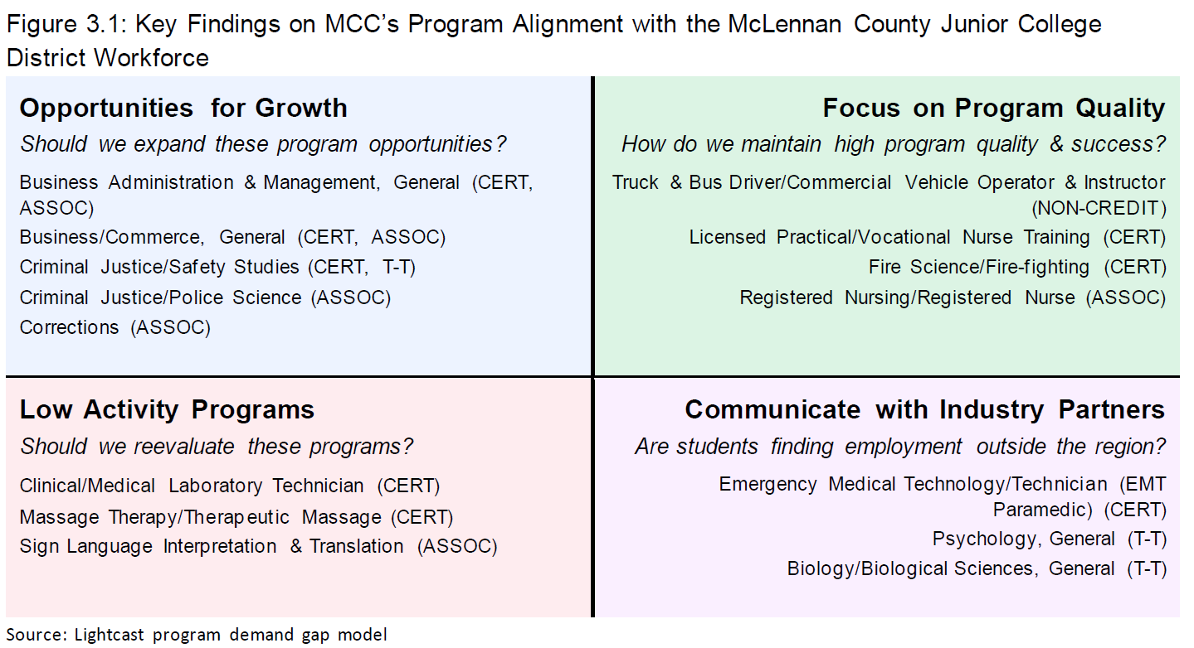

Slide 13
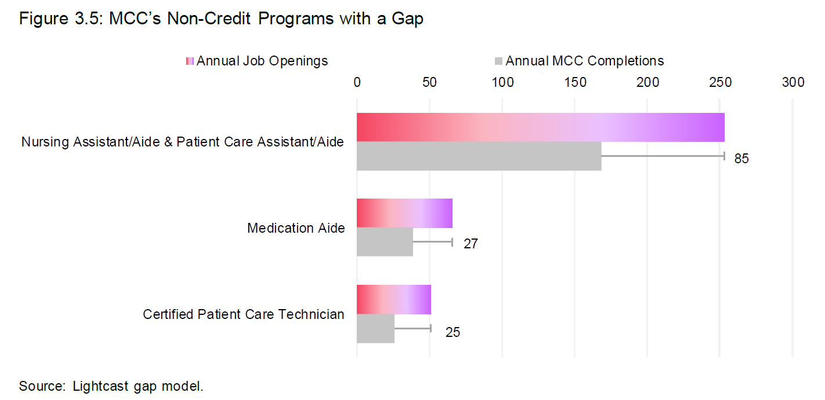
Notes:
Keeping this in mind we see that Nursing Assistant/Aide has a significant gap of 85, while the Medication Aide program has a gap that is not significant. While both of these programs have gaps, neither commands a wage above the living wage in the region ($21.67); in fact, both of these programs have median hourly wages below $15.00. Due to this dichotomy of demand and offered wages it is likely that this gap will remain until wages rise to incentivize students to pursue these opportunities.

Slide 14
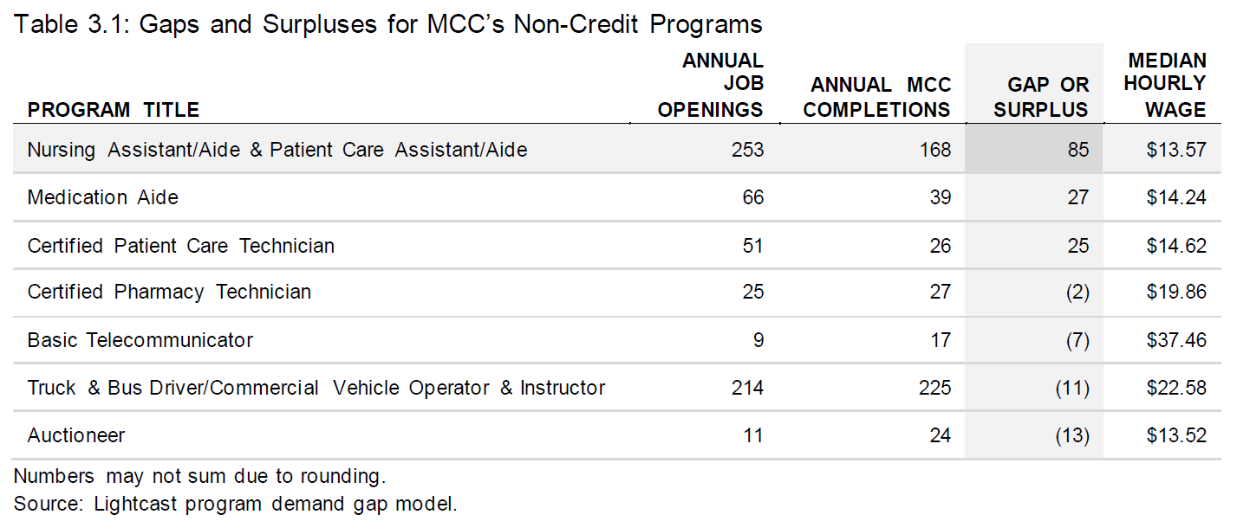

Slide 15
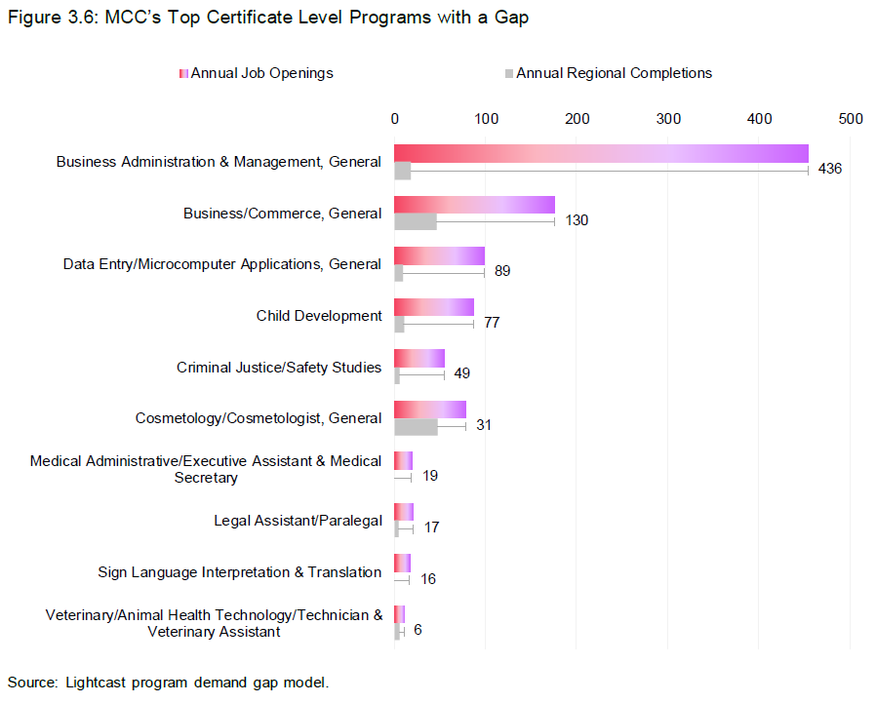
Notes:
The largest certificate level gap, at 436 job openings, is for the Business Administration & Management, General program. On average, the college has 18 annual completions and is the only postsecondary educational institution in the region offering the program at this award level. There are no programs with a significant surplus of program completions above the 50-openings level of significance.

Slide 16
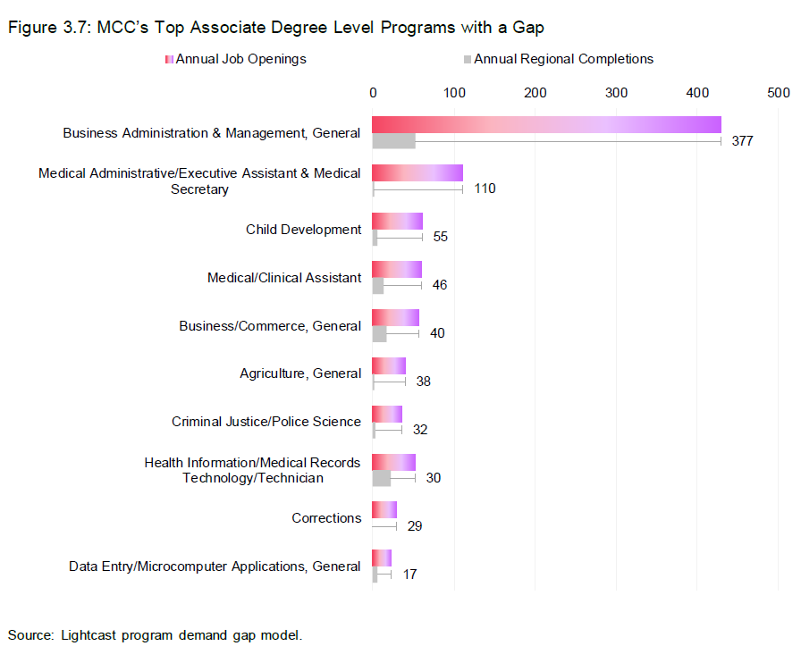
Notes:
As shown in Figure 3.7, three programs have a significant gap above the 50-openings level of significance. The Business Administration & Management, General program has the largest, followed by the Medical Administrative/Executive Assistant & Medical Secretary and Child Development programs. Business Administration & Management, General program has 429 average annual job openings, considering the region’s labor market. On average, the college has 52 annual completions, and, combined with the other postsecondary educational institutions in the region, there are a total of 53 annual completions.

Slide 17
New Program
Opportunities
Notes:
Recommendations are based solely on the gap and whether or not the occupation looks promising (job growth, wages, etc.). These are initial findings and should serve as a starting point for further research. MCC’s administration will still need to undergo steps before deciding whether these programs would be a good fit for the college and the region. This future work could include surveying local employers, analyzing skills and similar programs offered elsewhere, calculating program specific economic impacts, and looking at capacity and capital requirements for building these programs.

Slide 18
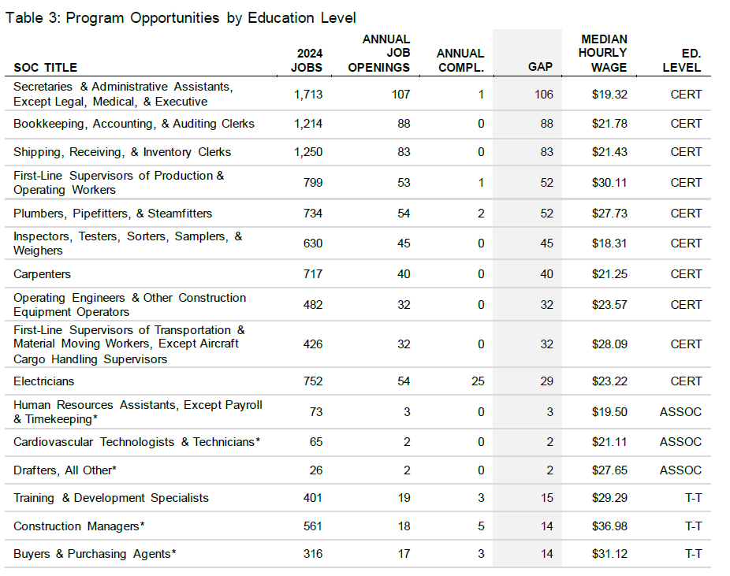

Slide 19
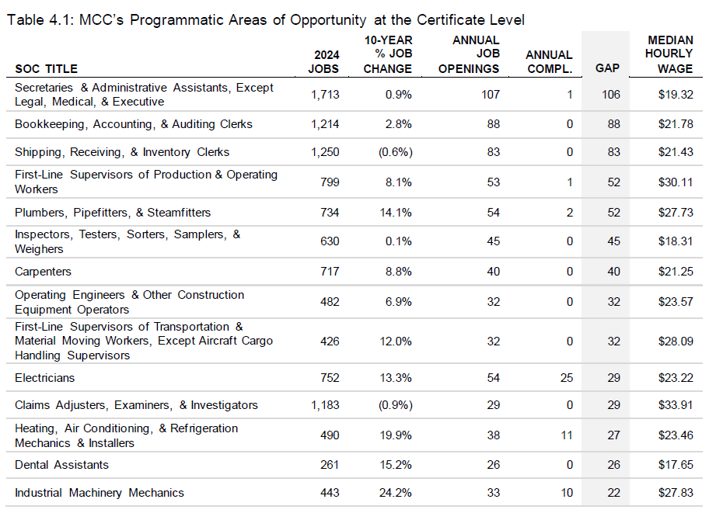

Slide 20
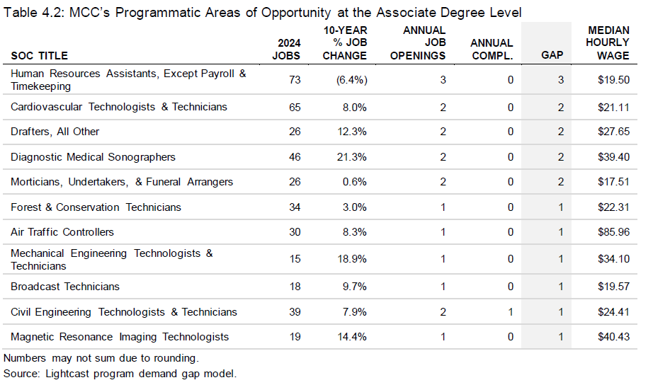

Slide 21
Questions

