Slide 1

TASB
Policy Site Review
March 5, 2026

Slide 2
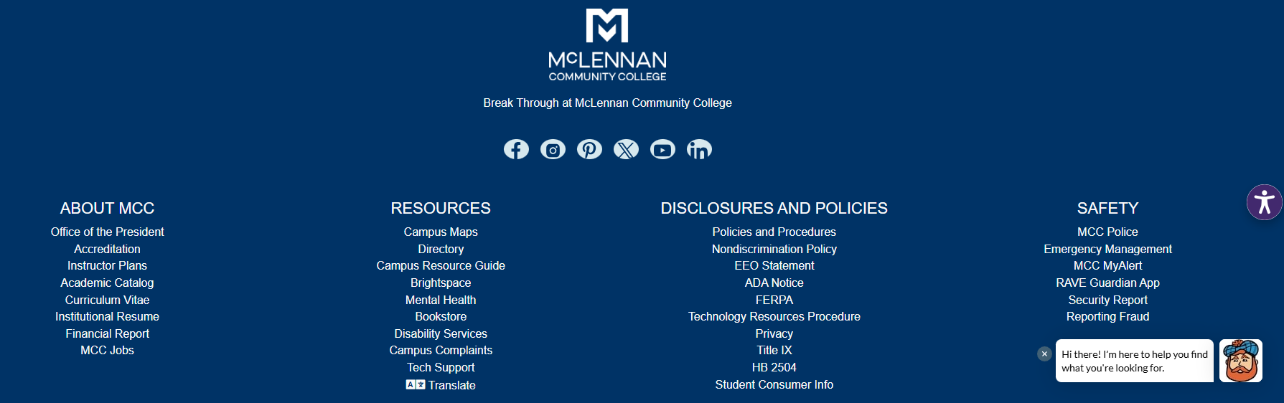

Navigating TASB

Slide 3
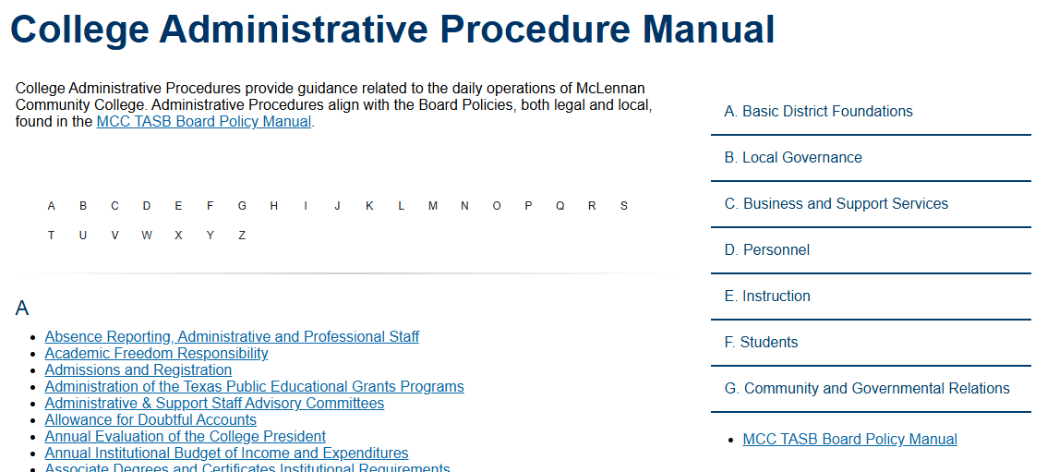
Navigating TASB

Slide 4
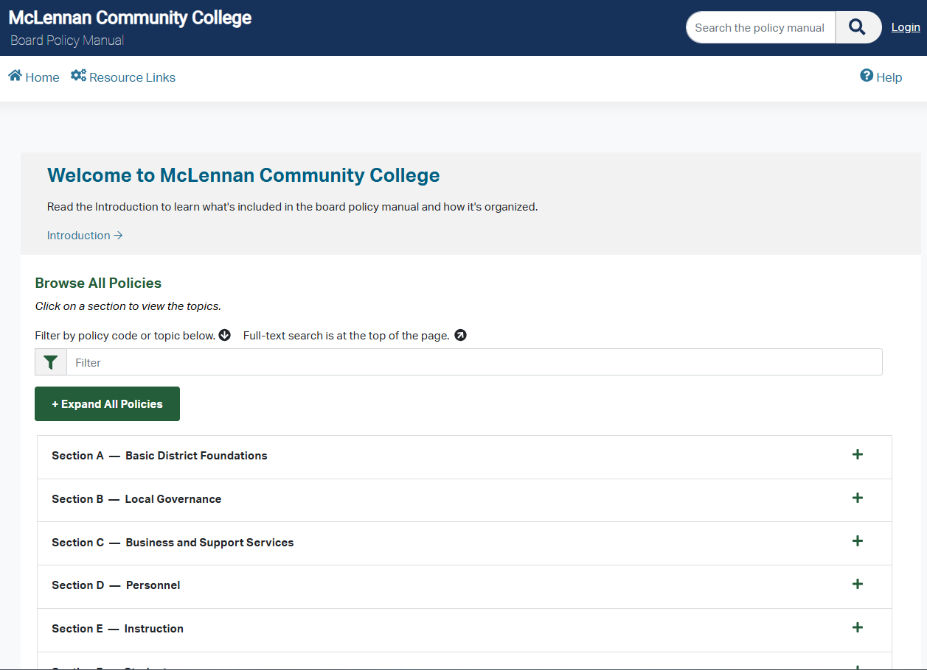
Keyword Search
Code or Topic Only

Slide 5
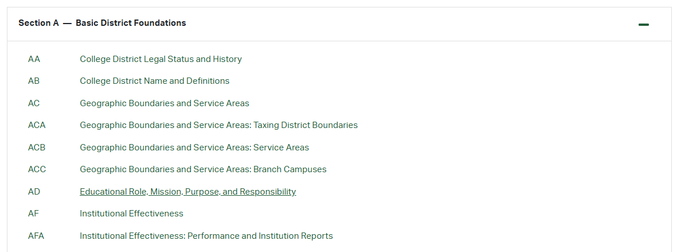

Slide 6
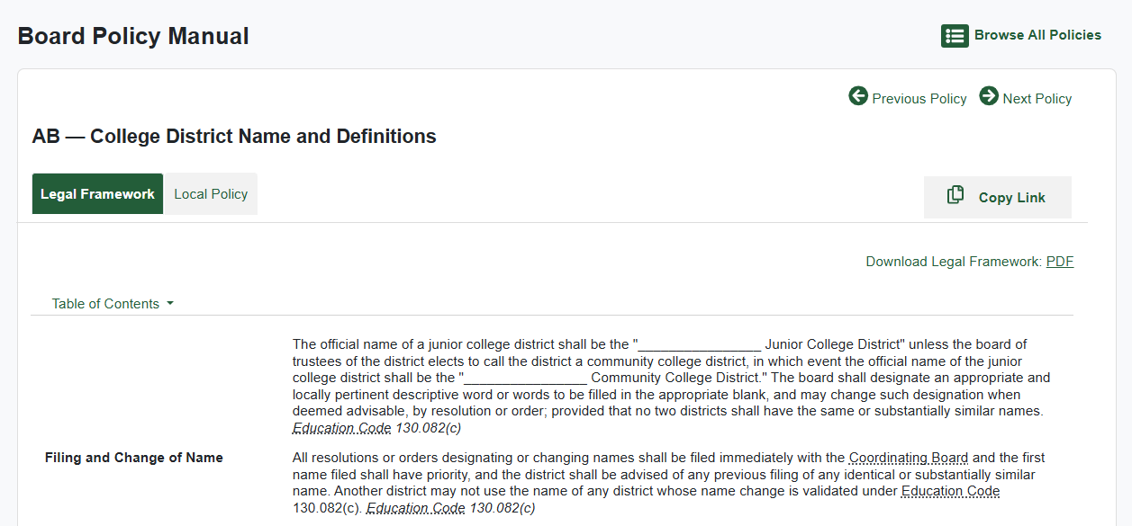

Slide 8
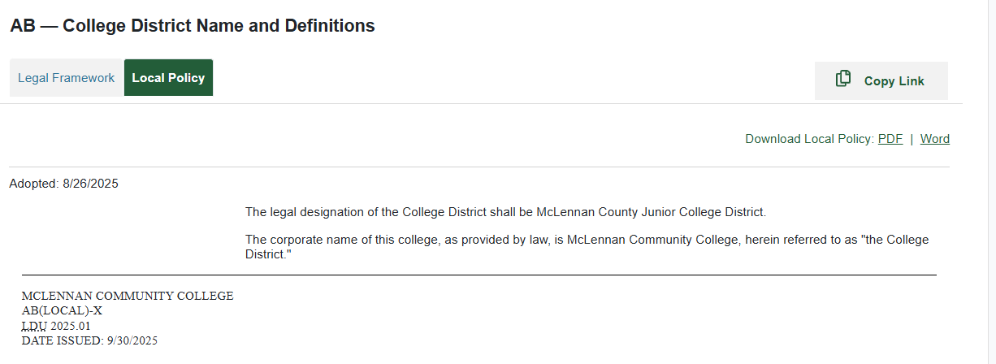

Slide 9


Legal Policy
Local Policy
Not editable by the College
Legal framework documents track the language of:
The U.S. and Texas Constitutions;
Federal and state statutes, including the Texas Education Code;
Attorney general opinions;
The Texas Administrative Code, including commissioner's and Texas Higher Education Coordinating Board rules; and
Case law and other sources of authority defining the legal context for local college district governance and management.
Editable by the College
Provisions that the board has determined are appropriate for the college district and that have been formally adopted by the board.
TASB-created local policy versions reflect language common to many college districts. Local policies have the code and (LOCAL) label in the lower left corner of the policy.
A letter or letter/number combination other than "-X" identifies the version, for example BD(LOCAL)-AJC.
An "-X" indicates a unique local policy containing text developed by the college district, for example BD(LOCAL)-X.

Slide 10
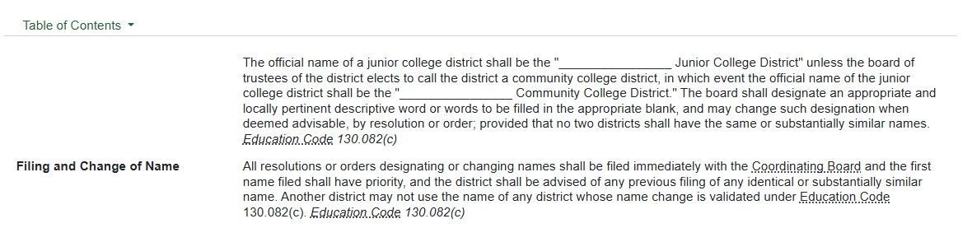
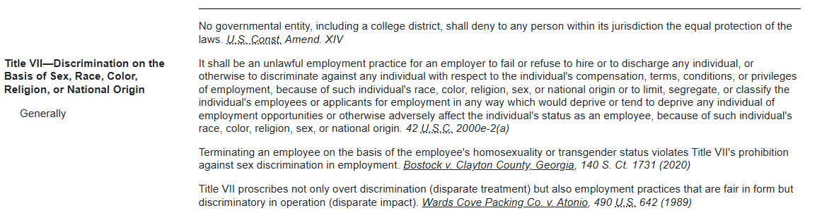

Slide 11
TASB
Policy Update 50
Second Reading

Slide 12
TASB 50 Update Overview
Revisions to legal frameworks incorporate clarification of existing materials and new materials arising from the 89th Regular Legislative Session and second special session, as well as amendments to state rules
Notes:
Breakout of Changes:
Deletion of Policies: 1
Addition New of Policies: 5
Edits to Existing Policies: 22
Major bills addressed in update:
SB 37 – Board Governance, Curriculum Changes/Review, Faculty Senate/Council
SB 2972 – Expressive Activities on College Campuses

Slide 13
Changes From
First Reading

Slide 14
Section C – Business & Support Services
Construction Facilities (CM Local) Edits
Recommended revisions address SB 1173, which increases the contract value threshold at which a community college is required to utilize a statutory competitive procurement method for Construction Contracts from $50,000 or above to $75,000 or above.
Updating threshold from $50,000 to $100,000 $75,000

Slide 15
Section D – Personnel
Employee Standards of Conduct(DH Local) Edits
Recommended revisions address HB 46, which prohibits a college from restricting the storage of low-THC cannabis authorized by state law.
Addresses the distribution and consumption of alcohol at events and facilities as approved by the President

Slide 16
Senate Bill 37
Related Updates
Notes:
SB 37 addresses issues Relating to the governance of public institutions of higher education, including review of curriculum and certain degree and certificate programs, a faculty council or senate, training for members of the governing board, and the establishment, powers, and duties of the Texas Higher Education Coordinating Board Office of the Ombudsman.

Slide 17
Section B – Local Governance
Administrative Organization: Councils and Faculty Senates(BGC Local) Edits
Recommended revisions address SB 37, which establishes the requirements for a Faculty Senate, including requirements related to Membership, Officers, Compensation, Governing Documents, Faculty Senate Meetings, Communications, as well as the requirement that policies and procedures remain in Harmony with Law.
At Removal, recommended language incorporates the requirement from the bill that a member may be removed on recommendation of the provost. The title for the employee who serves in the role as provost reflects the information submitted by the college.
Additional revisions have been made to align the policy with applicable law.

Slide 18
Section D – Personnel
Employment Practices (DC Local) Edits
Recommended revisions address SB 37, which requires the board to approve hiring decisions for certain positions and allows the board to overturn hiring decisions for certain positions. The titles for the employees who serve in the specified positions reflect the information submitted by the college. Language related to dismissal of noncontractual employees has been moved to policy DM to consolidate language related to at-will termination.

Slide 19
Section E – Instruction
Instructional Programs and Courses: Academic Courses (EFAA Local) Addition of Policy
This new recommended local policy clarifies the process for the development and adoption of a Core Curriculum by the college.
It also addresses the SB 37 requirement that the board conduct a comprehensive review of the college’s general education curriculum, providing that the review must occur every five years, with more frequent reviews at the board’s discretion.
It also establishes a process for the submission of an annual update on general education curriculum changes to the board and reflects the board’s choice to reserve the right to overturn decisions regarding changes to the curriculum.
Curriculum Design: Degrees and Certificates (EFB Local) Edits
Recommended revisions incorporate SB 37, requiring the college’s chief executive officer to develop procedures addressing a Low-Enrollment Certificate Program Review.

Slide 20
Section F – Students
Admissions (FB Local) Edits
Recommended revisions address SB 37, clarifying that the board must develop admission procedures in collaboration with the college’s chief executive officer.
The recommended revisions address SB 365, permitting the college to disregard course credits and grades earned by an applicant for admission 5-10 years prior to the start of the semester if chosen by the applicant, at Academic Fresh Start. Existing law requires a college to disregard credits earned 10 years prior to the start of the semester for an applicant under the Academic Fresh Start program. The number of years prior to admission at which credits will be disregarded reflects information submitted by the college.

Slide 21
Senate Bill 2972
Related Updates
Notes:
SB 2972: Relating to expressive activities at public institutions of higher education.

Slide 22
Section D – Personnel
Employee Rights and Privileges: Employee Expression and Use of College Facilities (DGC Local) Edits
Recommended revisions throughout this policy incorporate SB 2972, which addresses the regulation of expressive activities on college campuses.
A definition of Expressive Activities has been added.
At Prohibited Speech and Conduct, existing content from Limitations on Content, Approval, and Common Outdoor Areas has been consolidated and updated to reflect language from the bill prohibiting certain expressive activities on campus.
Also, from SB 2972, language has been added at Time, Place, and Manner Restrictions prohibiting the distribution of materials in a manner that is materially and substantially disruptive to college operations. Language has been added to clarify when Identification must be provided. Employees and employee organizations distributing materials or using college facilities must provide identification to a college representative.
Recommended revisions provide that the Distribution of Literature by faculty and other instructional personnel as part of instruction or other classroom activities is not governed by that section.

Slide 23
Section F – Students
Student Rights and Privileges: Student Expression and Use of College Facilities (FC Local) Edits
Recommended revisions throughout this policy incorporate SB 2972, which addresses the regulation of expressive activities on college campuses.
A definition of Expressive Activities has been added.
At Prohibited Speech and Conduct, existing content from Limitations on Content, Approval, and Common Outdoor Areas has been consolidated and updated to reflect language from the bill prohibiting certain expressive activities on campus.
Also, from SB 2972, language has been added at Time, Place, and Manner Restrictions prohibiting the distribution of materials in a manner that is materially and substantially disruptive to college operations. Language has been added to clarify when Identification must be provided.
Students and student organizations distributing materials or using college facilities must provide identification to a college representative.

Slide 24
Section G – Community & Governmental Relations
Community Expression and Use of College Facilities (GD Local) Edits
Recommended revisions throughout this policy incorporate SB 2972, which addresses the regulation of expressive activities on college campuses.
A definition of Expressive Activities has been added.
At Prohibited Speech and Conduct, existing content from Limitations on Content, Approval, and Common Outdoor Areas has been consolidated and updated to reflect language from the bill prohibiting certain expressive activities on campus.
Also, from SB 2972, language has been added at Time, Place, and Manner Restrictions prohibiting the distribution of materials in a manner that is materially and substantially disruptive to college operations. Language has been added to clarify when Identification must be provided.
Community members and organizations distributing materials or using college facilities must provide identification to a college representative.
Language related to Designated Public Forums has been added to require the board to designate common outdoor areas where community members may engage in permissible expressive activities and publish those areas on the college’s website and in other publications.

Slide 25
Grievance/Complaint
Updates

Slide 26
Section D – Personnel
Personnel-Management Relations: Employee Grievances (DGBA Local) Edits
Language has been reorganized to clarify the structure of grievance processes.
Recommended revisions require the college to provide Notice to Employees on the college's website.
At Formal Process, language has been added to clarify that certain complaints must begin at the board level.
Provisions have been added to provide clarity about what the Record includes, to allow a college to Remand a complaint for an incomplete record, and to allow an employee to make an Audio Recording of a hearing under this policy.
Notes:
The certain complaint updates are that complaints against the President start with the Board.

Slide 27
Section F – Students
Student Rights and Responsibilities: Student Complaints (FLD Local) Edits
Language has been reorganized to clarify the structure of grievance processes.
Recommended revisions require the college to provide Notice to Students on the college's website to ensure appropriate due process.
At Formal Process, language has been added to clarify that certain complaints must begin at the board level.
Provisions have been added to provide clarity about what the Record includes, to allow a college to Remand a complaint for an incomplete record, and to allow a student to make an Audio Recording of a hearing under this policy.
A cross reference has been updated to incorporate the reorganization of policies related to security personnel.
Notes:
The certain complaint updates are that complaints against the President start with the Board.

Slide 28
Section G – Community & Governmental Relations
Public Complaints and Hearings (GB Local) Edits
Language has been reorganized to clarify the structure of grievance processes.
At Formal Process, language has been added to clarify that certain complaints must begin at the board level.
Provisions have been added to provide clarity about what the Record includes, to allow a college to Remand a complaint for an incomplete record, and to allow an individual to make an Audio Recording of a hearing under this policy.
A cross reference has been updated to incorporate the reorganization of policies related to security personnel.
Notes:
The certain complaint updates are that complaints against the President start with the Board.

Slide 29
Misc. General Updates

Slide 30
Section B – Local Governance
College District Governance (BA Local) Removal
College District Governance: Board Legal Status (BAA Local) Addition
Removal of BA(Local) and language from policy BA has been moved to BAA(Local) to accommodate the reorganization of policies related to college district governance
Board Members: Authority (BBE Local) Edits
Recommended revisions to this policy address HB 4310, which establishes a procedure for board members to access records maintained by the college while preserving the Confidentiality of those records.
Board Meetings (BD Local) Edits
Recommended revisions to this policy incorporate HB 1522, which updates the meeting notice requirements under the Open Meetings Act to require that notice of a meeting be posted three business days before the scheduled date of a meeting, at Notice to Members.

Slide 31
Section C – Business & Support Services
Accounting Inventories (CDB Local) Edits
Recommended revisions address the Budget Requirements and Annual Financial Reporting Requirements for Texas Public Community Colleges, Fiscal Year 2025, which was recently released by the Coordinating Board. The document updates the definition of capital assets to recommend, rather than require as in prior years, a minimum capitalization threshold of $5,000. The revisions permit a community college to choose the threshold at which assets are capitalized.
Updating threshold from $5,000 to $10,000
Facilities Planning (CL Local) Addition of Policy
This new policy addresses SB 8 from the second special session, which requires a community college to designate certain private spaces by sex consistent with the bill’s provisions.

Slide 32
Section C – Business & Support Services
Construction Facilities (CM Local) Edits
Recommended revisions address SB 1173, which increases the contract value threshold at which a community college is required to utilize a statutory competitive procurement method for Construction Contracts from $50,000 or above to $100,000 or above.
Updating threshold from $50,000 to $100,000
Technology Resources: Artificial Intelligence (CRB Local) Addition of Policy
This new recommended local policy includes information related to AI Use by Employees and Students, including the parameters for use; compliance with privacy and data security law, policies, and regulations; and prohibitions on use of AI tools to harm, bully, or harass others.
Information Security (CS Local) Edits
Recommended revisions to this policy incorporate HB 150, which requires a college to notify affected persons of cybersecurity incidents, formerly referred to as security incidents.

Slide 33
Section D – Personnel
Employees Standards of Conduct: Child Abuse and Neglect Reporting (DHB Local) Edits
Recommended revisions incorporate SB 571, which requires the Reporting of instances of child abuse or neglect to a law enforcement agency within 24 hours and amends the definition of law enforcement agency.
Assignment, Work Load, and Schedules: Telework (DJA Local) Addition of Policy
This new recommended local policy addresses SB 2615. It permits employees to telework only under certain specified circumstances.
Termination of Employment (DM Local) Edits
Language related to dismissal of noncontractual employees has been moved to this policy to consolidate language related to termination of At-Will Employees.

Slide 34
Section E – Instruction
Academic Achievement: Grading and Credit (EGA Local) Edits
A cross reference has been added to policy code FB to incorporate provisions related to the Academic Fresh Start program.

Slide 35
Section F – Students
Registration and Attendance (FC Local) Edits
Recommended revisions to this policy address administrative procedures related to registration.
Student Rights and Responsibilities: Student Conduct (FLB Local) Edits
At Behavior Targeting Others, a cross reference has been added to policy code FM to incorporate the
definition of antisemitism required to be used in discipline for Student Code of Conduct violations, as provided by SB 326.
Student Conduct: Alcohol and Drug Use (FLBE Local) Edits
Recommended revisions address HB 46, which prohibits a college from restricting the storage of low-THC cannabis authorized by state law.

Slide 36
Questions

