Slide 1

Trellis Student Financial
Wellness Survey
March 31, 2026

Slide 2

Overview
Trellis Research Group
Trellis Company (Trellis) is a nonprofit organization that supports students, families, institutions, and communities through research, outreach, student loan administration, and philanthropy programs.
Student Financial Wellness Survey (SFWS)
The SFWS is a self-reported, online survey that seeks to document the financial well-being and student success indicators of post-secondary students across the nation.
Notes:
Conducted in fall 2025
Open for 3 weeks
Trellis offered incentives for completion

Slide 3



Overview
Students Surveyed
6,322
Student Responses
509
Response Rate 8.1%
Notes:
Excluded dual credit students
Completion rate: 83%
A total of 153 institutions participated in the survey—103 public two-year institutions, one private two-year institution, 39 public four-year institutions, and ten private nonprofit four-year institutions.

Slide 4
Financial Security

Slide 5
Understanding Our Students
66% respondents work
24% area parent, primary caregiver, or legal guardian to any children
22% have two or more jobs
43% work 40+ hours
per week
57% are independent
Notes:
While concerns about the return on investment of higher education have been growing in recent years, it is still widely valued as a pathway to career success.

Slide 6

72% experienced financial difficulties or challenges while in college.
60% worry about being able to pay their current monthly expenses.
65% would have trouble getting $500 in cash or credit in order to meet an unexpected need within the next month.
Notes:
Among those students who said they had experienced those challenges, 49 percent said they had difficulty concentrating on their schoolwork because of their financial situation
72% compared to 67% of all 2-year respondents
65% compared to 58% of all 2-year respondents

Slide 7
Since January 1, 2025, approximately how
many times did you run out of money?
453
Students
Notes:
100 of 453 never ran out of money
7% higher than all other 2-year schools on eight or more times
68% indicated they borrowed money from family and/or friends since January 1, 2025

Slide 8
64% know how they will pay for college next semester.

Slide 9
Methods to pay for college:
58%
Pell Grant
26%
Loans
42%
Current Income
28%
Scholarships
34%
Savings

Slide 10
92% to pay for basic necessities
13% paid for college
51% used a credit card in the past year
61% of those with a credit card reported paying their bill on time.
35% stated they fully pay off their balance each month
Notes:
92% used a credit card in the past year said they had used it to pay for basic necessities, such as food, transportation, or housing.

Slide 11


Perceptions Educational Value
76% of respondents believe that the cost of college is a good investment for their financial future.
84% believe a college degree will provide them with a higher quality of life.
Notes:
While concerns about the return on investment of higher education have been growing in recent years, it is still widely valued as a pathway to career success.

Slide 12
Basic
Needs Security

Slide 13


262 food and/or housing insecure
142 food AND housing insecure
43 food insecure AND housing insecure AND homeless

Slide 14
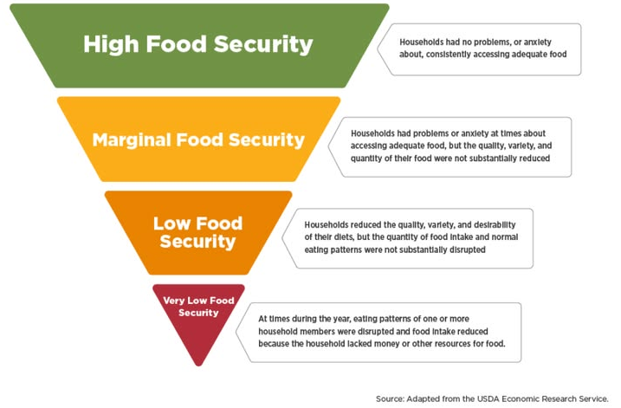
229
86
112

Slide 15

201 bought food that didn’t last and I didn’t have money to get more.
196 couldn’t afford to eat balanced meals.
171 cut the size of their meal or skipped meals because there wasn’t enough food
122 were hungry but didn’t eat because there wasn’t enough food
Notes:
Skipped meals:
19% did fewer than 3 days
65% three or more days
22% visited on campus or off campus food pantry/bank
81% on campus
48% off campus

Slide 16
10% temporarily
stayed with a relative, friend, or couch surfed while I looked for housing
202 (47%)
housing insecure
5% Slept in a vehicle,
such as a car or truck, van, RV, or camper
56 (27%)
homeless
2% didn't know where I would sleep at night

Slide 17
23% not paid the full
amount for utilities
26% moved one or more times in the last 12 months
13% been unable to
pay or underpaid rent or mortgage
8% had trouble finding an
affordable place to live near campus
11% moved in with
other people, even for a little while, because of financial problems

Slide 18
Of those who moved 3+ times
74% could not afford rent
25% needed to be closer to school
65% needed to be closer to work
36% housing was unsafe

Slide 19
Questions

