Slide 1
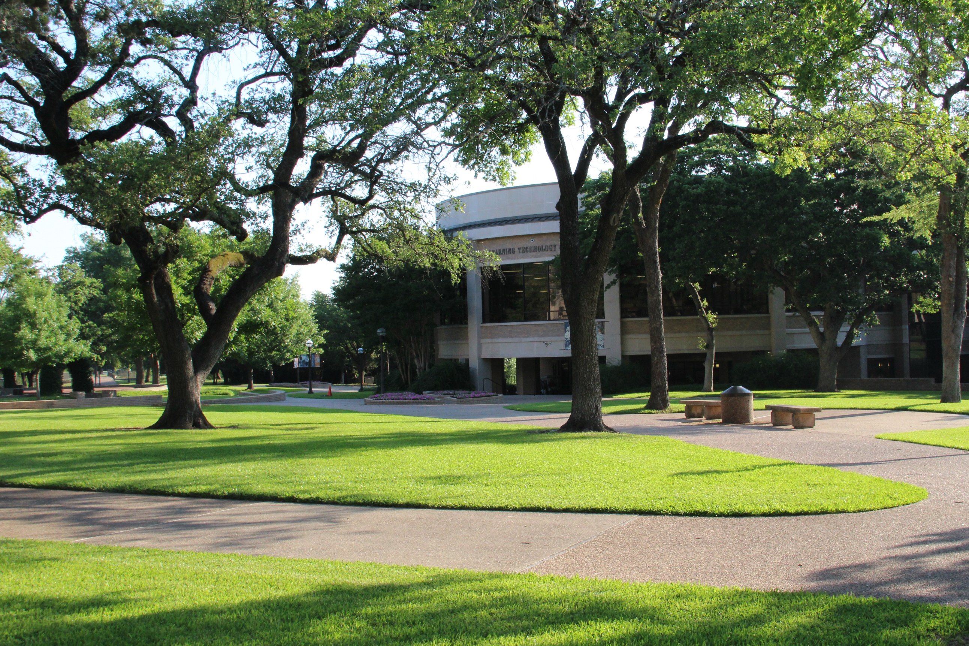
Student Success
Data Review
Laura Wichman
February 2022

Slide 2

Enrollment Update

Slide 3

Comparison of Enrollment
 | Fall 2019 | Fall 2020 | Fall 2021 | Percent Change 19 vs. 21 | Percent Change 20 vs. 21
Regular Students | 8,705 | 7,742 | 7,337 | -15.7% | -5.2%
Flexible Entry | 0 | 0 | 0 | 0.0% | 0.0%
Total Enrollment | 8,705 | 7,742 | 7,337 | -15.7% | -5.2%
Total Contact Hours | 1,417,972 | 1,230,872 | 1,216,784 | -14.2% | -1.1%

Slide 4
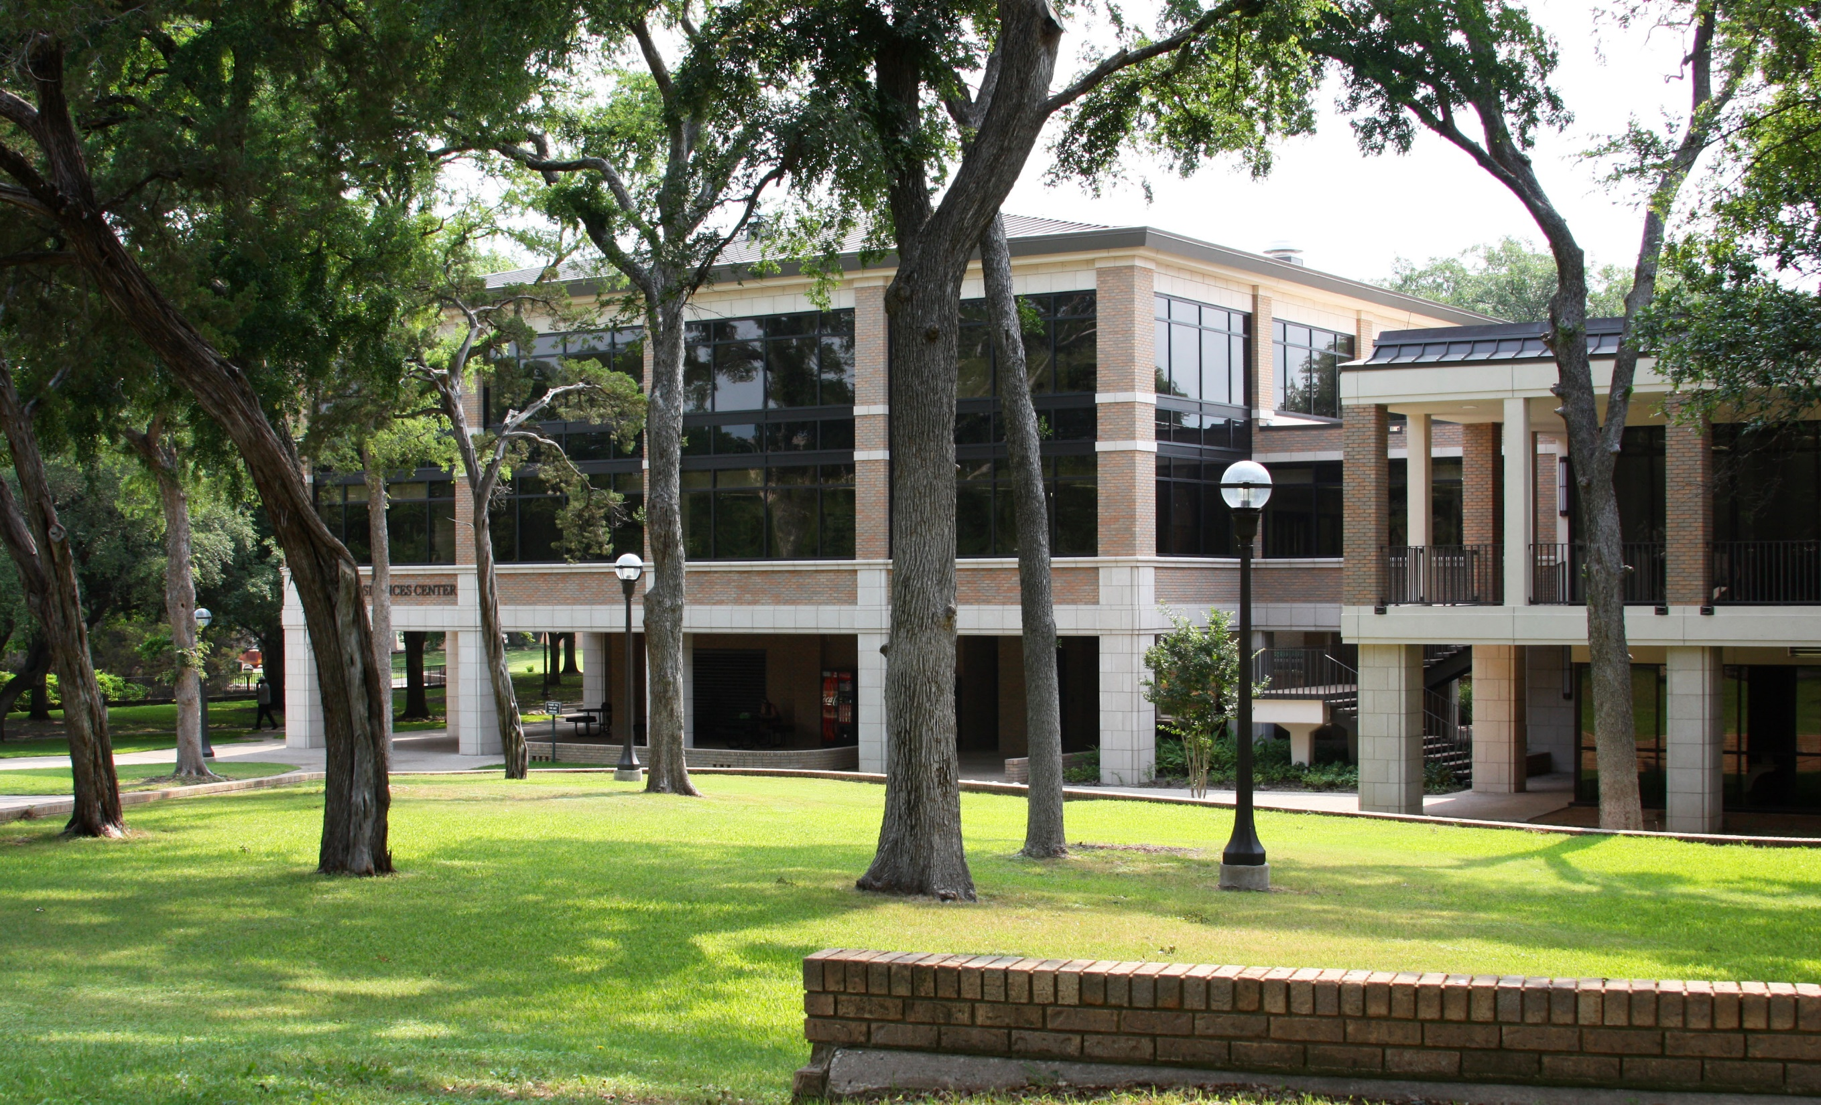
Fall 2021 Facts
7,337 Fall 2021 Enrollment
77% of our students are from McLennan County
68% are female
13% are members of the African American ethnic group
34% are members of the Hispanic ethnic group
74% of our students are enrolled in academic majors designed to transfer to a four-year college
23% dual credit enrollment
The top three Pathways of Study:
  Liberal Arts
  High School Pathways
  Business & Industry
Notes:
McLennan County: 51% Female, 45% minority – 15% African-American and 27% Hispanic
Transfer: Fall 2020 was height of Transfer enrollment at 76%, fall 2018 was 74%
Dual Credit: Fall 2020 was height of DC enrollment at 26%, fall 2017 was last time we were 22%

Slide 5

Retention and Graduation Data

Slide 6
First Time in College First Year
Student Retention
Fall 2010 Retention
Notes:
The Red line at 58% represents the Fall 2010 retention rate prior to financial aid changes in fall 2011.
Fall 2015 mandatory advising began
Fall 2016 TSI cut scores changed
Fall 2020 COVID-19

Slide 7
First Fall to Second Fall Retention – by Gender
Notes:
NOTE: national trend that more male students are working instead of going to school.
Of the Fall 2018 national cohort, 53.7% retained at the same institution in comparison to 52.2% at MCC. 62.1% persisted in college nationally, compared to 58.6% at MCC.

Slide 8
First Fall to Second Fall Retention – by Ethnicity

Slide 9
First Fall to Second Fall Retention – by Male & Ethnicity

Slide 10
First Fall to Second Fall Retention – by Female & Ethnicity

Slide 11
3 Year Graduation Rates
Notes:
Note: FTIC numbers do not include any dual credit students; it is post-HS graduates only.
Fall 2011: Financial Aid changes went into place
Fall 2012: we started graduating students without graduation application
Fall 2015: Mandatory adivising
--This includes Certificates, Associate degrees
COVID falls into the Fall 2018 three-year rate

Slide 12
Graduation & Transfer Rates by Gender and Ethnicity

Slide 13
Graduation & Transfer Rates by Gender and Ethnicity

Slide 14


