Slide 1
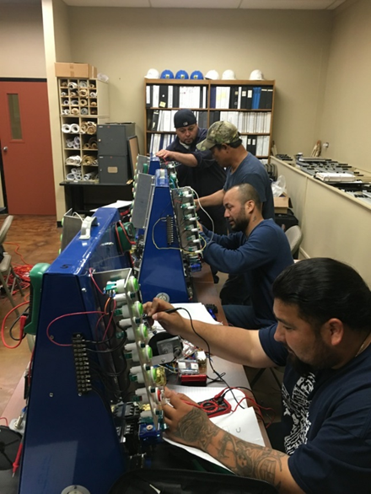
Workforce and Industry Engagement Update
Dr. Frank Graves
Stephanie Maultsby

Slide 2

Workforce Strategies
Build comprehensive workforce pathways in developing a skilled workforce
Build on workforce credit certificates and associates
Integrate non-credit credentials and awards
Provide multiple entry and exit points
Connect BSAS & BAAS opportunities through our University Center partners
Engage students where they are:
Connect with adult learners
Offer GED options through AEL
Use stackable credentials
Connect all pathways with industry partners

Slide 3







Skills Development Fund Partners & Awards
Texas Workforce Commission Grants provide upskilling of our local workforce!
Customized training opportunities for local businesses
COVID – 19 Skills Development Fund
Traditional Skills Development Fund
$14.3 million in grants awarded to MCC since inception
$667,183 in 2020-2021
Industries served include Healthcare, Manufacturing, and Logistics

Slide 4












2020-2021 Corporate Partners

Slide 5
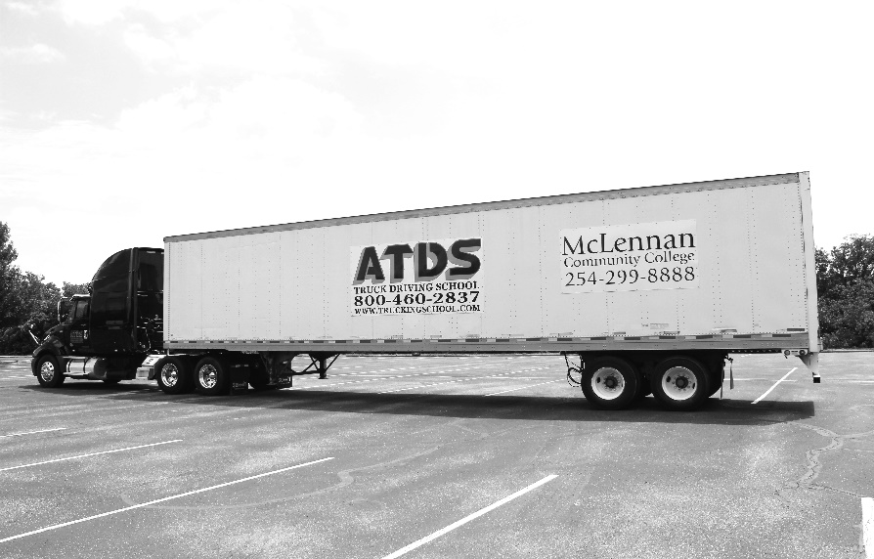



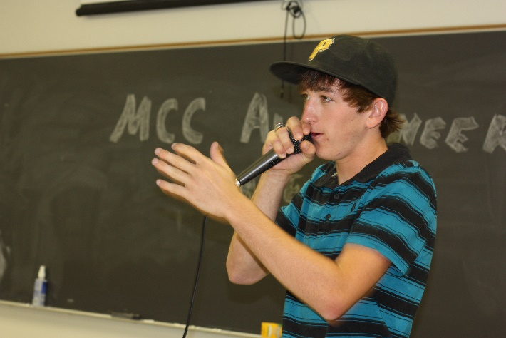









Public Enrollment and Skills for Small Business
Public Enrollment and Skills for Small Business
$58,673 in SSB Grants 2020-2021
392 students
82,320 contact hours
58 sections
$221,650 in revenue
68 students
5,139 contact hours
Notes:
Certified Production Technician
Certified Logistics Associate
Certified Logistics Technician
Truck Driving School
Auctioneering
SHRM
Industrial Training
Ed2Go

Slide 6



2020-2021 Community Health
Healthcare certifications for the Public and School Districts
On-site training and administration based on district needs
Certified Nurse Aide, EKG, and Medication Aide
Online options
Healthcare related Professional Development
Medication Aide re-certification
Testing Center for Certified Nurse Aide
American Heart Association Training Center
695 students
38,826 contact hours

Slide 7
Medical Laboratory Technician
Licensed Vocational Nurse
PATIENT CARE TECHNICIAN
Certified Medication Aid
Certified Nurse Aid
Hospital Track
Gerontology Track
Notes:
218 contact hours
CNA, EKG and Phlebotomy

Slide 8
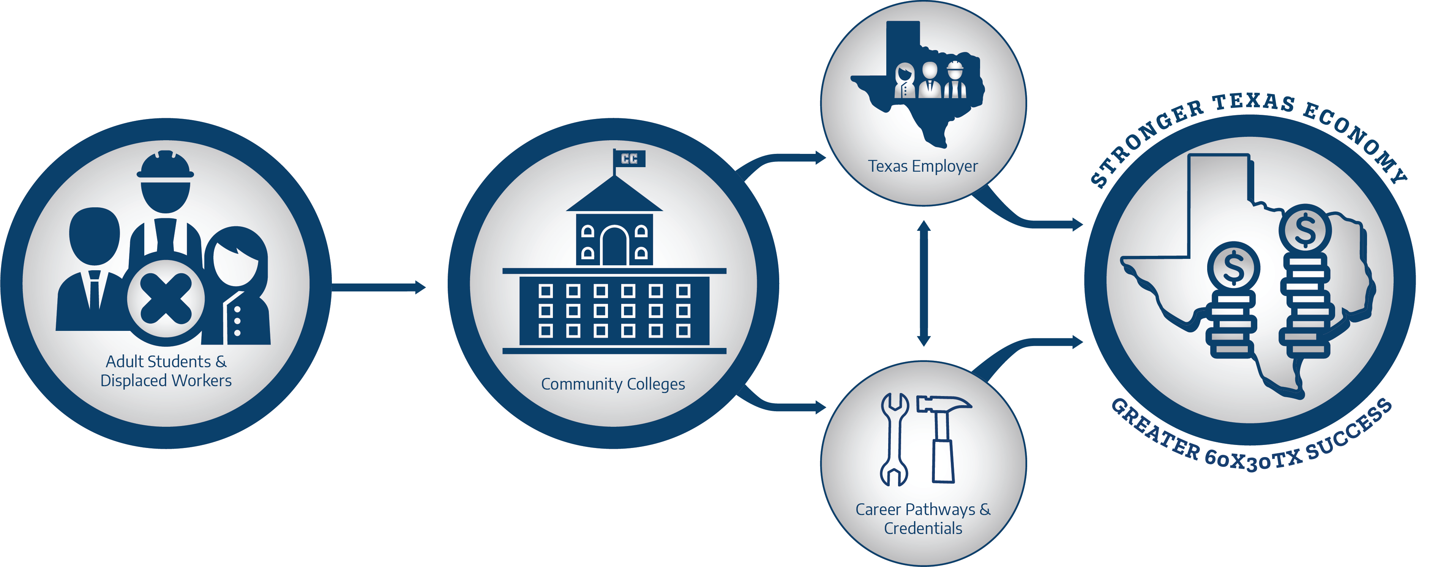
Texas Reskilling Upskilling through Education (TRUE)
Texas Association of Community Colleges initiative
TRUE focuses on Stackable Credentials.

Slide 9
Texas Reskilling Upskilling through Education (TRUE) - Pathways Update
Microsoft Office Specialist (MOS) Certification
Certified Production Technician
Certified Logistic Technician
Patient Care Technician
Amazon Web Services

Slide 10
Pathway to Success From Continuing Education/Adult Education
CE/AEL Courses
Microsoft Office Certifications
Occupational Skills Awards
Document Design
Certificates
Office Technology Specialist
Introduction to Keyboarding
Associate Degrees
Bachelor Degrees
Office Software Technician
Keyboarding & Business Document Formatting
Records Management
Office Technology
Administrative Office Management
Medical Office Management
Transfer to a 4-year institution

Slide 11
Reskilling and Upskill Grant Awards - THECB
Texas Reskilling Support Fund Grant Program – Texas Higher Education Coordinating Board - $412,000 Awarded
Displaced Texas workers who need to reskill or upskill to get back into the workforce & Texas students who have previously stopped out of higher education institutions without completing a postsecondary credential.
Funded 28 students in the amount of $73,959.14
Marketing Budget to promote the program
Accelerating Credentials of Purpose and Value Grant Program- $90,500
Enhance or create 10 existing short-term credentials utilizing the EHR software
Provide free access for 250 students access to the curriculum
Marketing Budget
Curriculum Development

Slide 12

Workforce Initiatives
Upskill Waco
Medical Office Certificate ( Waco Family Medicine)
Certified Production Technician training (Magnolia)
Customer Services/Hospitality (Magnolia)
Hospitality (Hilton Hotel)

Slide 13
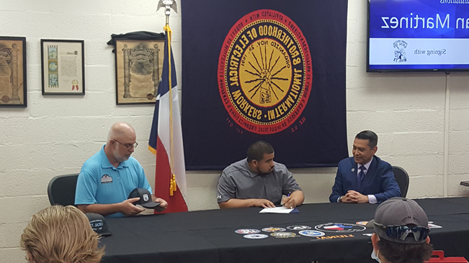
Industry Engagement Activities
Workforce Advisory Committees
Carl D. Perkins - Comprehensive Local Needs Assessment and Industry Surveys.
Internship sites.
Apprenticeships.
On-campus job posting databases to connect with students.
On-campus recruiting, interview, and visits.
Corporate Training, training facilities, and computer labs.
Employee Reimbursement Programs for existing employees (FedEx)
Site Visit (AbbVie)

Slide 14
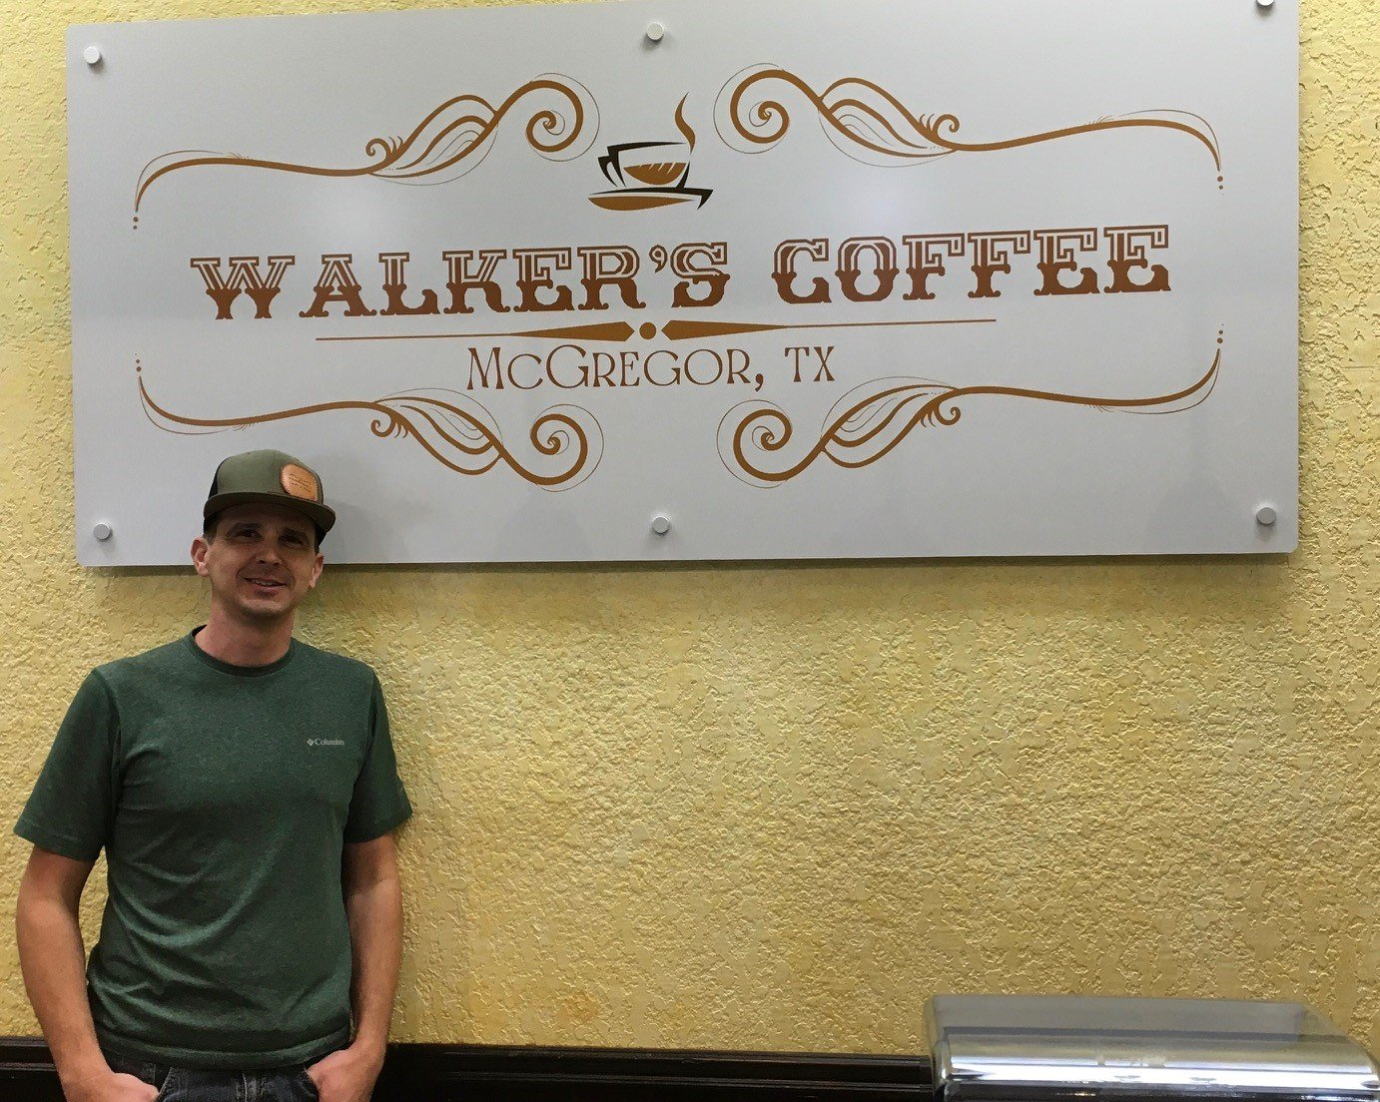
SBDC Workforce Economic Development
567 Clients with 1060 Counseling Sessions and 2,010 hours
Waco Chamber of Commerce, Baylor Research and Innovation Collaborative (BRIC), Copperas Cove EDC, Temple Chamber of Commerce, Cen-Tex African American Chamber and Cen-Tex Hispanic Chamber
Economic Impact
SBA Loan | $12,055,245
Non-SBA Loan | $ 3,951,365
Personal Injection | $ 1,468,800
Total Capital Investment | $17,475,410
Jobs Created | 178
Business Start-Ups | 42
21 Training Events | 535 Participants

Slide 15

Questions?

