Slide 1

McLennan Community College Police
Planning and Training for Campus Safety

Slide 2
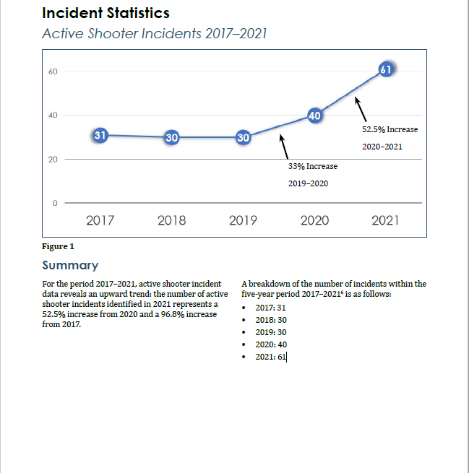
Active Shooter Incidents

Slide 3
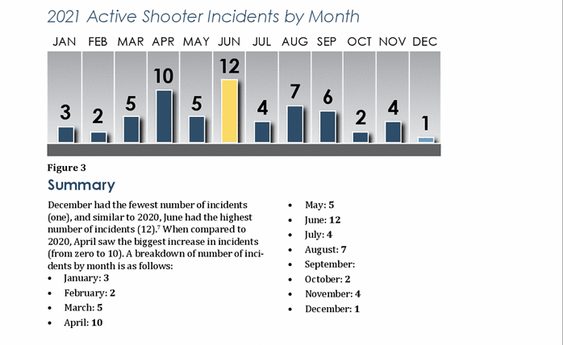
Active Shooter Incidents by Month

Slide 4
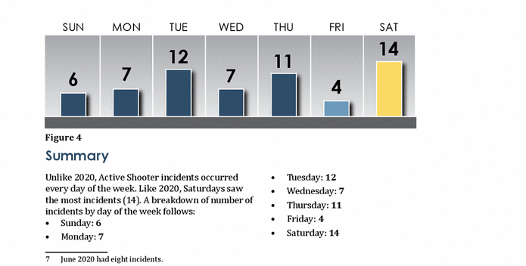
Active Shooter Incidents by Day of Week

Slide 5
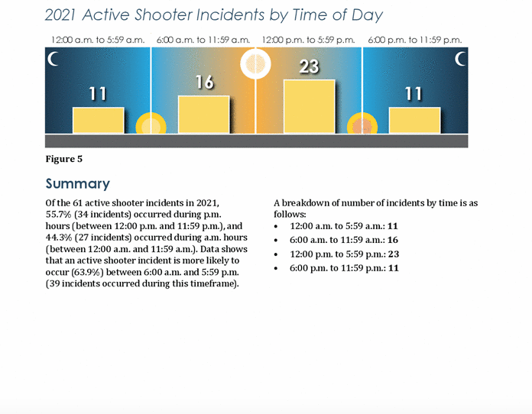
Active Shooter Incidents by Time of Day

Slide 6
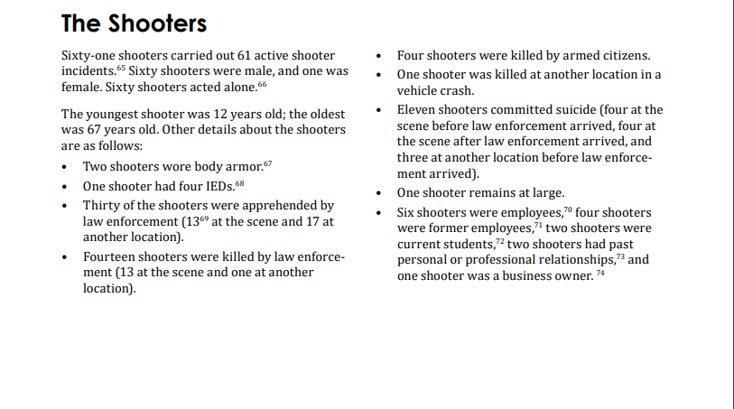
The Shooters

Slide 7
What have we done?

Slide 8
Safety Features
2018 Over 400 hundred classroom door locks were replaced with locks with deadbolts. Able to lock down Electronic locks (exterior) remotely
2018 Officers issued Radios on Waco System
2019 Grant – Officers issued Active Shooter Kit Level IV Plates
Officers being proactive

Slide 9
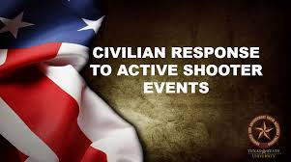
Safety Features
2019 Employee On Boarding began with Campus Safety as a session.
2019 Spring Break – All Police and Security Officers trained on Alerrt Active Shooter at MCC.
More cameras added approx. 350 cameras as of current.
Professional Development classes being offered for Active Shooter…Upcoming CRASE

Slide 10
Safety Features
2022 Active Shooter Training at MCC- 2 Classes
2022 5 Members of the MCC Police Department participated at Baylor University in a full scale active shooter exercise. 12 different agencies participated.
Officers have been trained in CPR, Stop the Bleed
Rave Guardian
Evertel

Slide 11
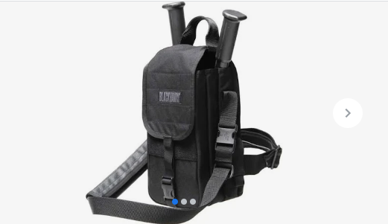
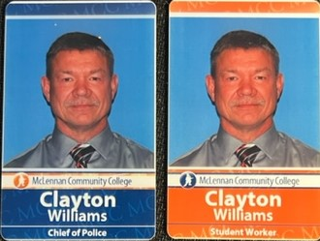
Safety Features
All MCC Patrol Units have breaching kits.
Call Boxes
ID Access Cards
Threat assessments of buildings

Slide 12
Rock Valley College Active Shooter Video
https://www.youtube.com/watch?v=ppIrzuYIvDk

