Slide 1


Board of Trustees EOP Briefing

Slide 2
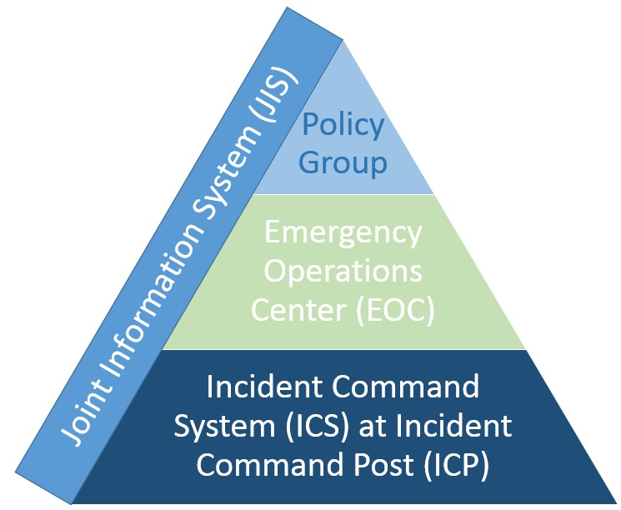
National Incident Management System (NIMS) Overview
Four Areas of Responsibility
Outreach and communication with the media, students, staff and public to keep them informed about the incident.
Policy guidance and senior level decision making.
Incident support, conducted at the Emergency Operations Center, through operational and strategic coordination, resource acquisition and information gathering, analysis, and sharing.
Tactical activities to apply resources on scene, through use of the Incident Command System.

Slide 3
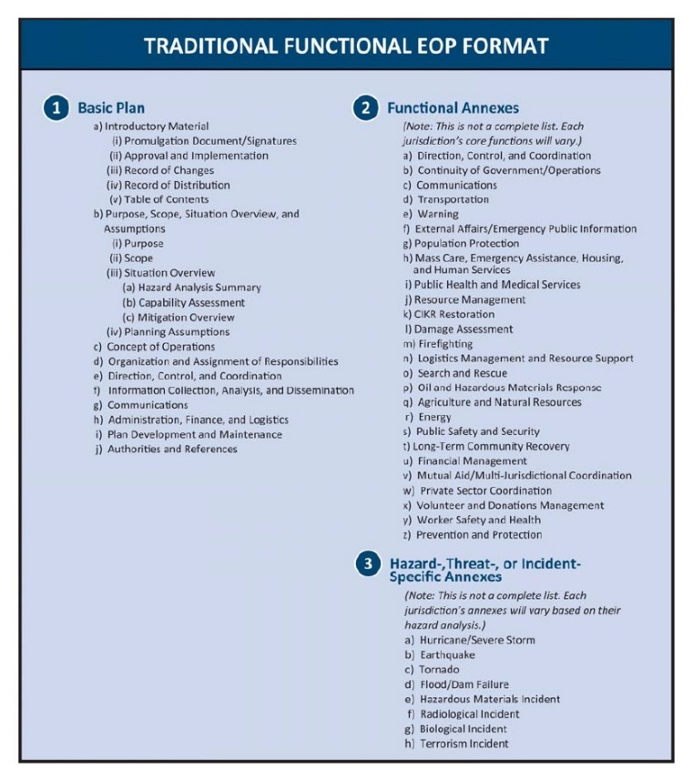
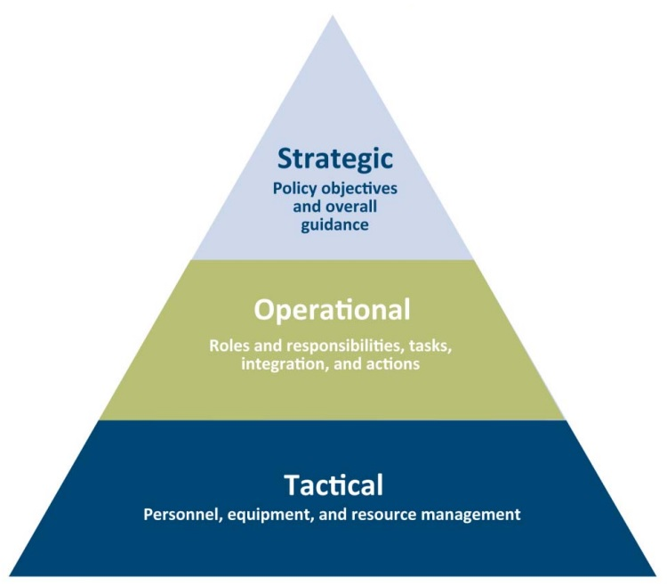
Plan Structure
Basic Plan
Functional Annexes
Job Guides

Slide 4
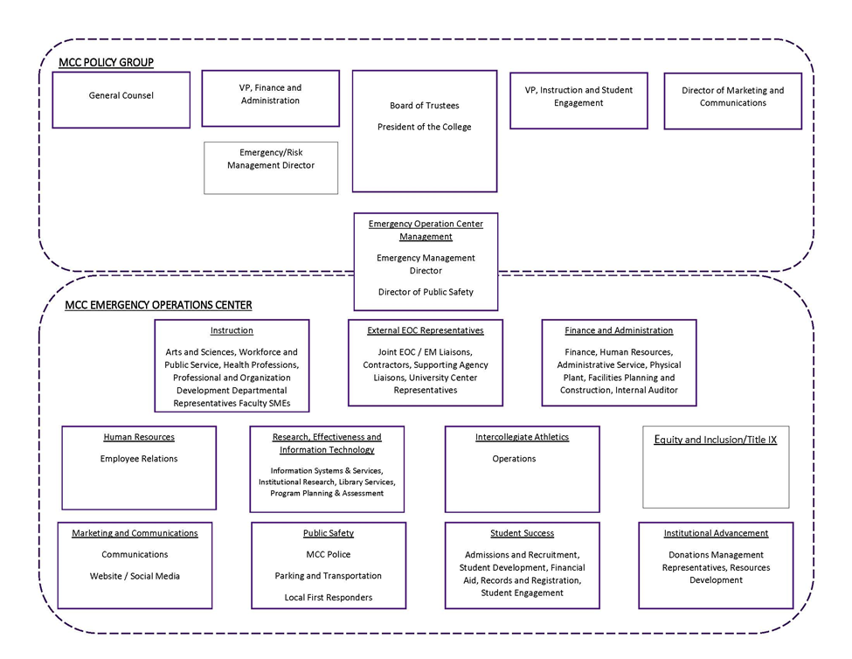
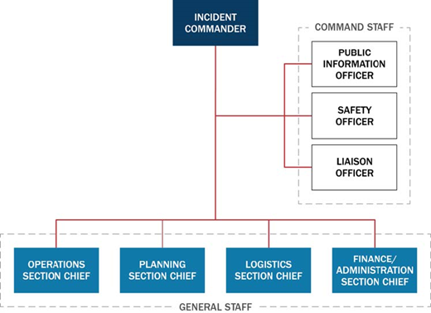

Slide 5
Emergency Functions/Annexes
Annexes are applicable to any emergency, activated as necessary
Direction, Control, & Coordination
Recovery/Continuity of Operations
Communications
Evacuation
Law Enforcement
Emergency Public Information
Legal (contracted service)
Health and Medical
Hazard Materials Response
Warning
Active Attack/Shooter
Each of these functions will have an annex within the Emergency Management Plan.
Many divisions and/or departments will have multiple emergency responsibilities, while some will may not be assigned a lead or support role for any function.
Those which have not been assigned a specific role will still be expected to support emergency response as directed by organizational leadership.

Slide 6
Active Attack/Shooter Annex Elements
Incident Response Considerations
Task Assignments
Employees
Report the incident: call campus police 8911 or 911
Evacuate if possible: Run
Shelter if necessary: Hide
Take action, if you must: Fight
Respond Appropriately When Law Enforcement Arrives

Slide 7
Active Attack/Shooter Annex Elements
Incident Response Considerations
The EMC, Management and Campus Police:
Control Access and Account for Personnel
Assist Emergency Responders
Manage the Perimeter
Identifying Secondary Impacts

Slide 8
Active Attack/Shooter Annex Elements
Incident Recovery Considerations
Incident Recovery Considerations
Address Victims and Families
Establish a family hotline
Assist with victim identification
Gather information related to victim identities, extent of injuries, and what hospitals are being utilized
Notify the family members
Use personnel who are specifically trained for this responsibility
Provide and if needed procure counselors for employees and students
Develop an action plan to handle concerns about returning to work for employees, and campus for students

Slide 9
Active Attack/Shooter Annex Elements
Incident Recovery Considerations
Communicate Internally (See Communications Annex)
Develop instructions for management to give to employees
Develop a plan for communicating the information
Communicate Externally ( see Emergency Public Information Annex)
Identify the designated official for responding to media inquiries
Determine what information and details campus personnel will provide to the media that will ease community concerns without inciting panic or hindering the investigation
Continue Business Operations ( see Business Continuity Plan)
Implement business recovery/continuity plans
Make re-entry decisions after site/building is released by law enforcement
Provide safety and security debriefings
Take actions to ensure employees feel safe
Determine how the campus will continue operating with limited class rooms or with certain areas of the campus designated a crime scene

Slide 10
Committees
Building Preparedness Coordinators
Safety/Security Committee
Notes:
If you see safety hazards please report them to me.

Slide 11
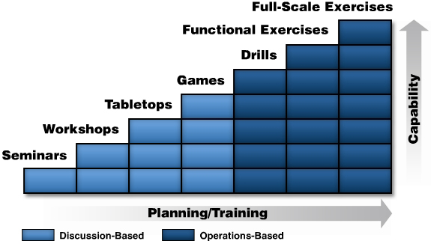
Path Forward
Improve warning capabilities
MyAlert, Informacast
Training and Exercise Plan (TEP) derived from the Basic Plan, Safety and Security Audit and THRIA
TEP Workshop(s) to develop goals for each year (Building Preparedness Coordinators)
New Employee-New Student Orientation
Annual Safety and Security Audits

Slide 12
QUESTIONS and COMMENTS

