Slide 1
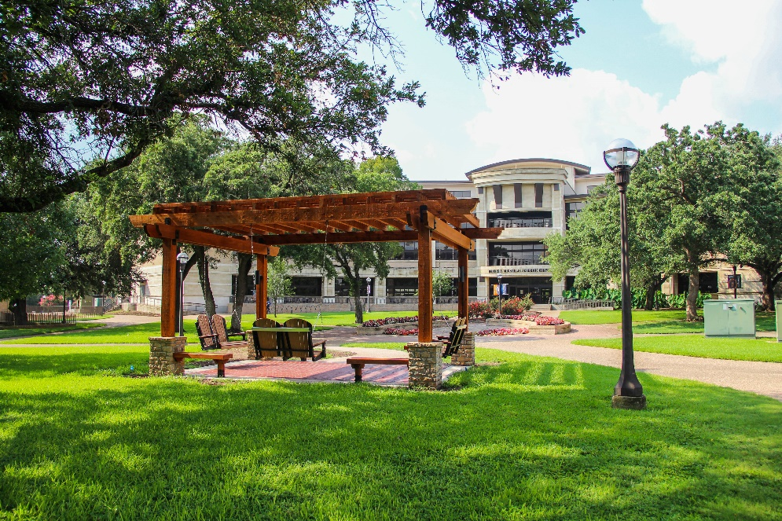
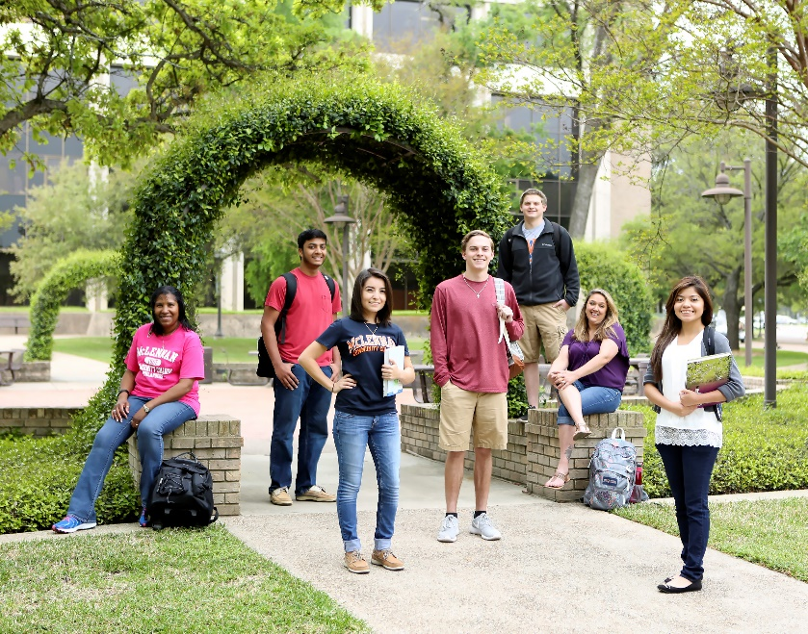

2022-25 Institutional
Objectives
July 8, 2022

Slide 2
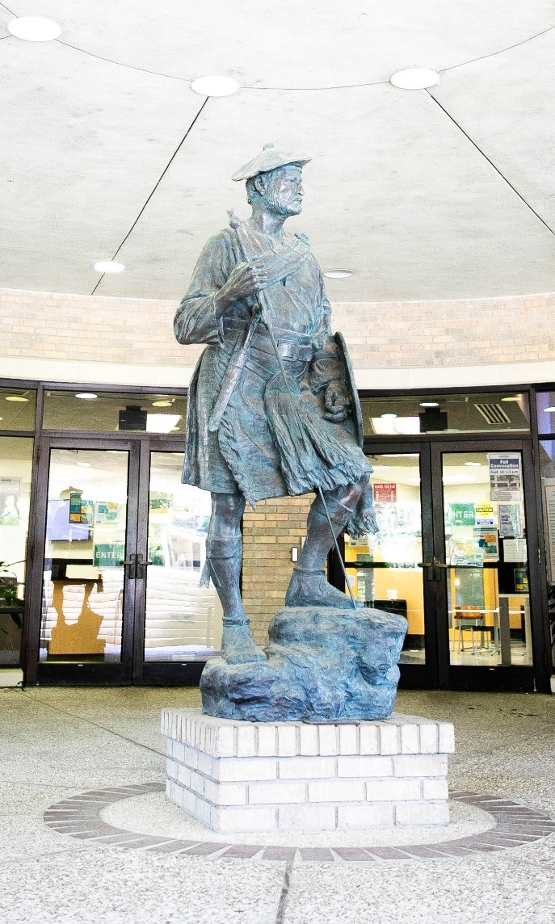

2022 – 2025 Strategic Planning Task Force
Chair: Dr. Laura Wichman
Co-Chair: Tom Proctor
Dr. Londa Carriveau
Dr. Shelley Blackwood
Karen Clark
Dr. Claudette Jackson
Natalie James
Mario Leal
Becky Parker
Brenda Price
John Searight
Notes:
The Strategic Planning Task Force is a short-term group called by the Leadership Team (the President and Vice Presidents) to assist in the development of a new strategic plan for McLennan Community College. The committee will manage the process of writing and revising the strategic plan to guide the College for the next three years. This will include soliciting multiple inputs from the Leadership Team, the Board, faculty, staff, students, and community members and producing revised drafts as needed. The committee will also review the College’s mission, values, goals, and performance indicators, as well as any other related items. The end product of the Task Force is a draft of three-year strategic plan presented to the Leadership Team and Board of Trustees for final approval before the July 2022 Board meeting.

Slide 3
Goal I. Help all students succeed at the highest level possible.
a. Improve student mastery of general and workforce education state learning outcomes.
b. Increase fall-to-spring and fall-to-fall retention across all demographic groups.
c. Increase the percentage of students successfully completing courses, credentials, certificates, associate degrees, transferring to four-year institutions, and/or job placement across all demographic groups.
d. Increase the percentage of student participation in curricular and co-curricular activities.
Notes:
a. Percentage of students rated Proficient or Distinguished on each core learning outcome
b. Percentage of FTIC students returning for 2nd and 3rd terms.
c. Percentage of courses completed successfully (A, B, or C); percentage of dropped courses.
Percentages of student graduating with credentials, certificates or associate degrees
Two- and Three-year FTIC graduation + transfer rate
Percentage of students who are employed after graduating
d. Percentages of students participating in curricular and co-curricular activities

Slide 4
Goal I. Help all students succeed at the highest level possible.
e. Build pathways for students in Adult Education and Literacy programs to college credentials, certificates and degrees
f. Expand access to college services for students in our Adult Education and Literacy and non-credit programs
g. Develop wrap around services to provide for our students’ basic needs in completing their academic goals at the college.
Notes:
e. Create pathway for AEL students to college credentials, certificates and degrees
f. Measure college services available to AEL and non-credit students and the usage of services by those students
g. Develop wrap around services to provide

Slide 5
Goal II. Take care of our people
a. Provide a positive and engaging environment where employees are involved, enthusiastic, and committed across the organization.
b. Improve student awareness and utilization of academic and support resources both on campus and in the community.
c. Create a welcoming environment on campus for students and the community.
d. Provide an affordable education for our students.
e. Pay market salaries for all employees.
f. Provide employees with relevant personal and professional development opportunities
Notes:
a. Great Colleges to Work For Survey
Professional Development course/certificate tracking
b. Student Satisfaction Survey question on awareness and utilization
Track student usage of services
c. Student Satisfaction Survey question
Continuing Education Course evaluation
Track events on campus for students and community members
d. Tuition & fees rate, total cost of attendance.
e. Pay within 10% of median market salaries across all employee classes

Slide 6
Goal III. Impact the community
a. Strengthen dual credit partnerships for increased student success
b. Increase collaboration between our ISD partners and the college to best support our students
c. Increase collaboration with our University Center partners
i. Expand degree offerings
ii. Implement dual enrollment opportunities with our two university partners

Slide 7
Goal III. Impact the community
d. Expand business outreach and partnerships to meet industry demand for skilled workers.
e. Increase MCC's student and employee volunteerism and community service in our service area
f. Promote the college’s contributions to the community through the arts, athletics, community partnerships, and enrichment activities to improve the quality of life in our service area.

Slide 8
Goal IV. Provide resources to fund success
a. Increase student enrollment in all categories and demographics.
b. Increase the scholarship endowments, grant writing, and fund-raising at the MCC Foundation in support of college priorities.
c. Improve administrative efficiency.

Slide 9
Goal IV. Provide resources to fund success
d. Build on program review process to identify efficiencies, growth opportunities and changes in support of the college priorities and the community needs.
e. Utilize & leverage the power of employees as community ambassadors.
f. Identify external funding opportunities that support initiatives that benefit the College and the community.

Slide 10
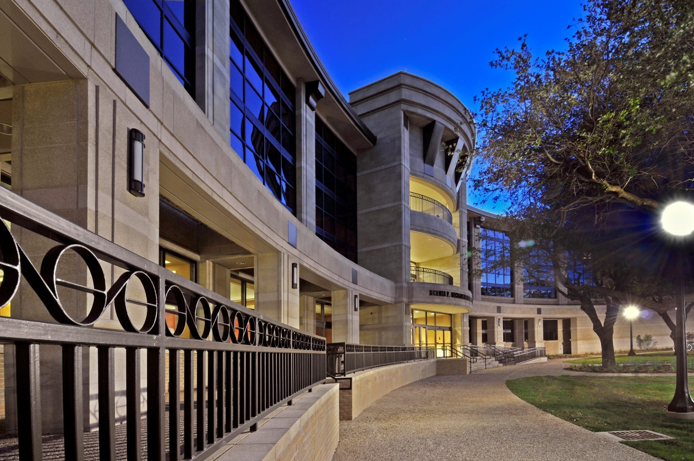
Questions?

