Slide 1



2022-23
Annual Priorities
July 8, 2022

Slide 2

What are Annual Priorities

Slide 3
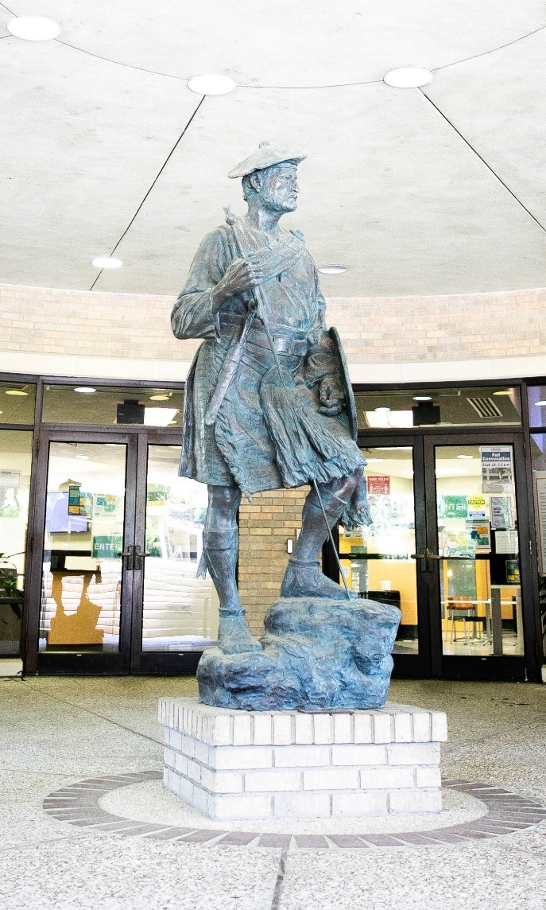
2022-2023 Annual Priorities
Develop wrap around services to provide for our students’ basic needs in completing their academic goals at the college. (Goal I. G)
Improve student awareness and utilization of academic and support resources both on campus and in the community. (Goal II. B)
Strengthen dual credit partnerships for increased student success. (Goal III. A)
Increase student enrollment in all categories and demographics through the Strategic Enrollment Plan and committees. (Goal IV. A)

Slide 4

Questions?

