Slide 1
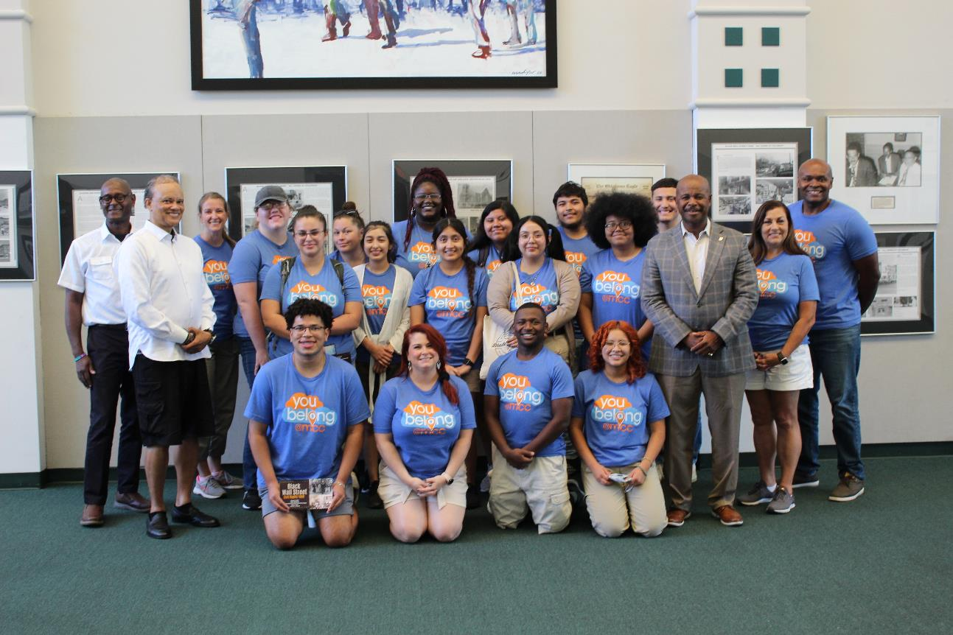
Trio Student Support Services (SSS): a journey through history
2
+

Slide 2
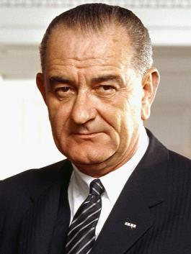
Quick TRIO History
Established through the Higher Education Act of 1965
Upward Bound (1964)*
Talent Search (1965)
Student Support Services (1968)*
Educational Opportunity Centers (1972)*
Veterans Upward Bound (1972)
Training Grants (1976)
McNair Post-Baccalaureate Achievement (1986)
Upward Bound Math and Science (1990)
*McLennan Community College currents hosts these three programs
Lyndon Baines Johnson 36th US President
Notes:
TRIO is not an acronym – named with the creation of the first 3 programs

Slide 3

Purpose of All TRIO Programs
To provide services and resources to individuals from traditionally underrepresented populations to help them progress through the academic pipeline from middle school to post-baccalaureate programs.

Slide 4



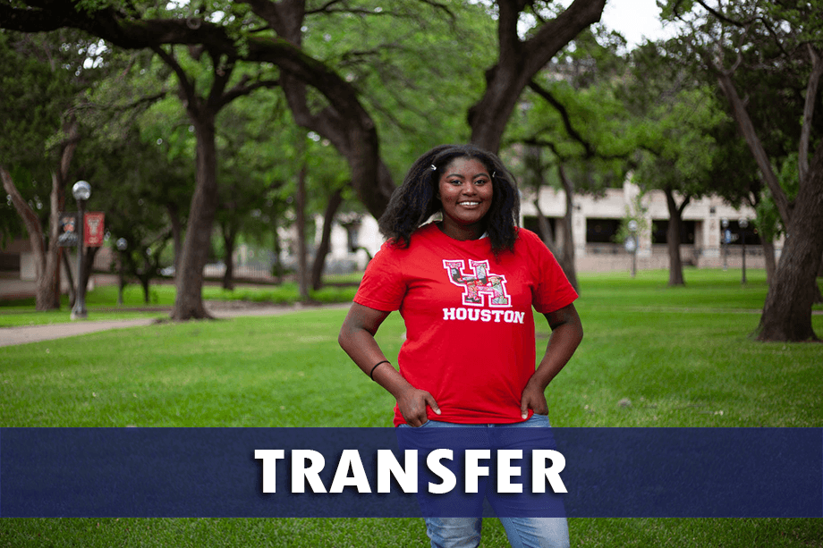
TRIO SSS @ MCC Objectives
Notes:
Laura

Slide 5
Qualifications for SSS
Services/REsources
First generation college student
Neither parent has a bachelor’s degree
Low-Income according to federal guidelines
150% of the federal poverty guideline
Documented disability
All participants must be US Citizens or Permanent Residents
Academic advising & success coaching
Tutoring
Computer lab with free printing
University tours
Career readiness & financial literacy
Scholarship assistance
Cultural enrichment

Slide 6
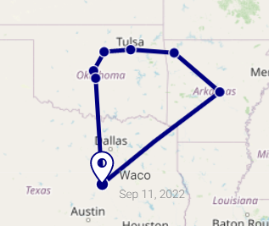
Overview of Summer Travel trip
Visited Little Rock & Fayetteville, Arkansas; Tulsa, Stillwater, Oklahoma City, & Norman, Oklahoma
August 1-5, 2022
14 TRIO SSS students, 4 staff
Trip funded by TRIO SSS using unspent funds from 2020-21 fiscal year

Slide 7
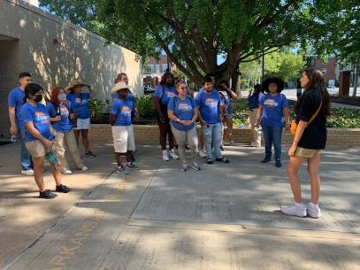
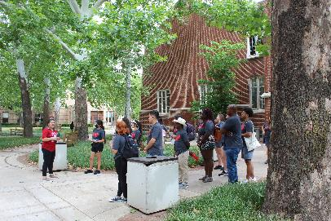
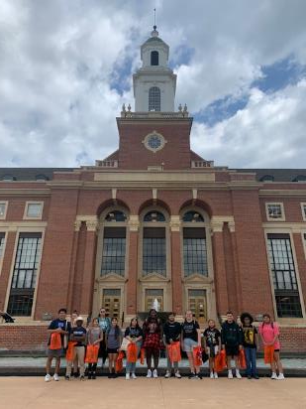
Universities visited
University of Arkansas
Oklahoma State University
University of Oklahoma

Slide 8
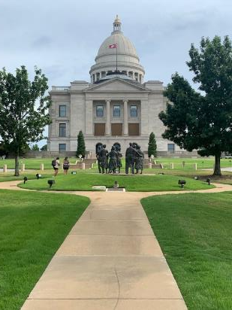
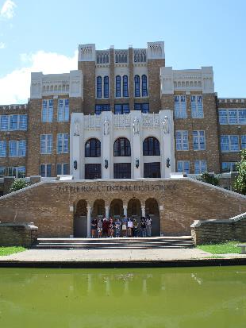
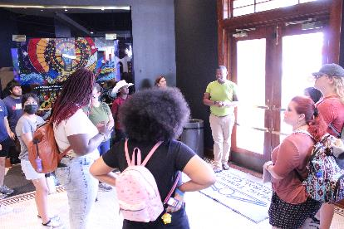
Arkansas Historic Sites visited
Arkansas State Capitol
Mosaic Templars
Central High School

Slide 9
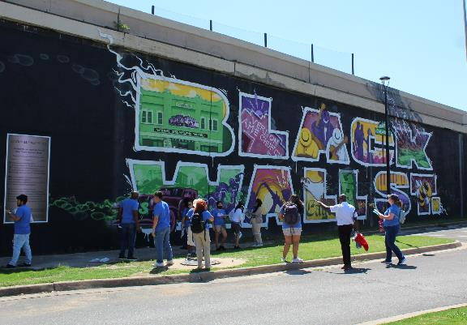
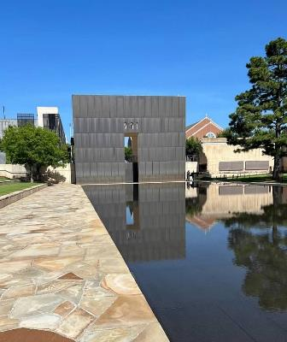
Oklahoma Historic Sites visited
Greenwood District (a.k.a. Black Wall Street)
Oklahoma City National Memorial & Museum

Slide 10
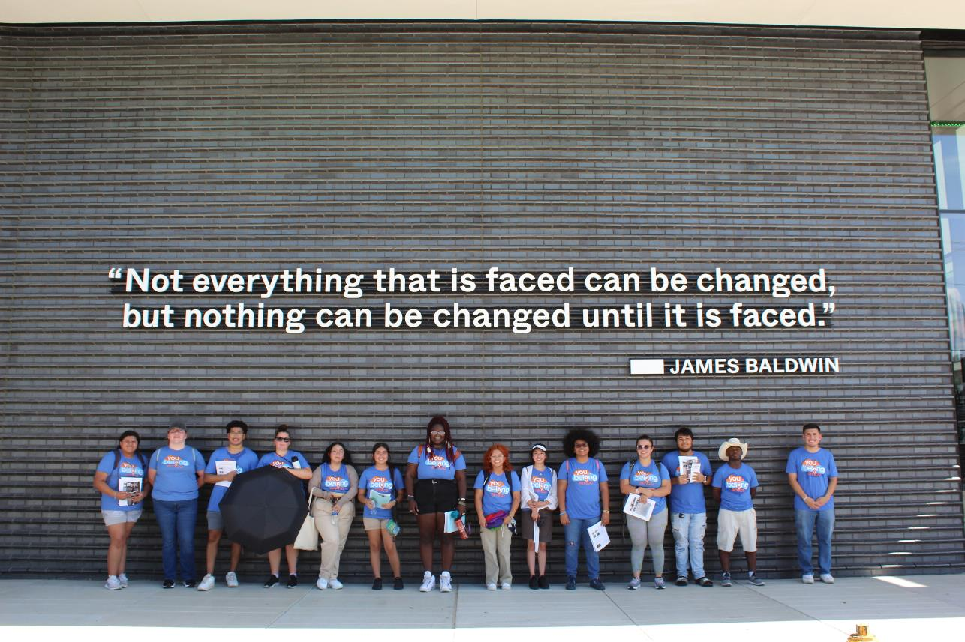
Greenwood District
2
+
Notes:
Share about recruitment…

Slide 11
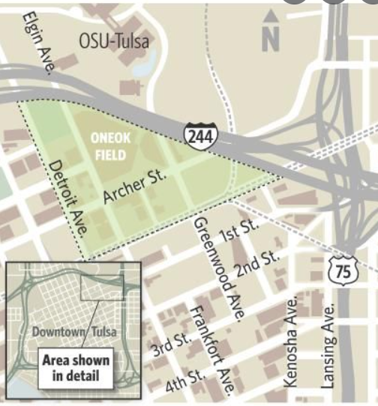
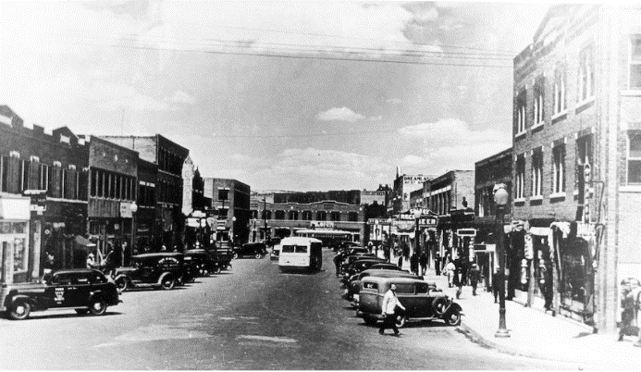
What was The greenwood district?
Notes:
What was life in Greenwood like before 1921?

Slide 12
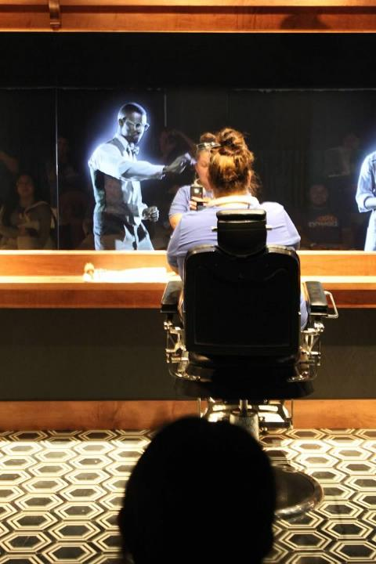
Life in Greenwood
Custom built homes
Black owned businesses
Hotels, nightclubs, restaurants
Barbershops & clothing stores
Grocery stores
Churches
Owned cars & some owned airplanes
Notes:
What was life in Greenwood like before 1921?

Slide 13
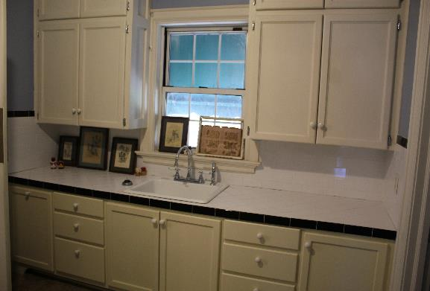
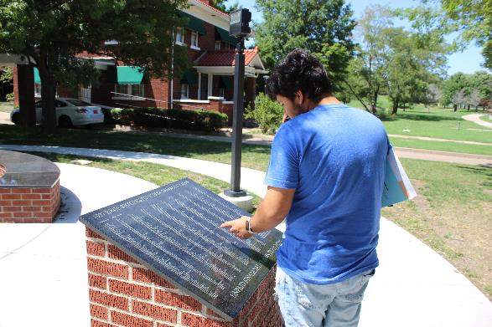
Life in greenwood
Notes:
What was life in Greenwood like before 1921?

Slide 14
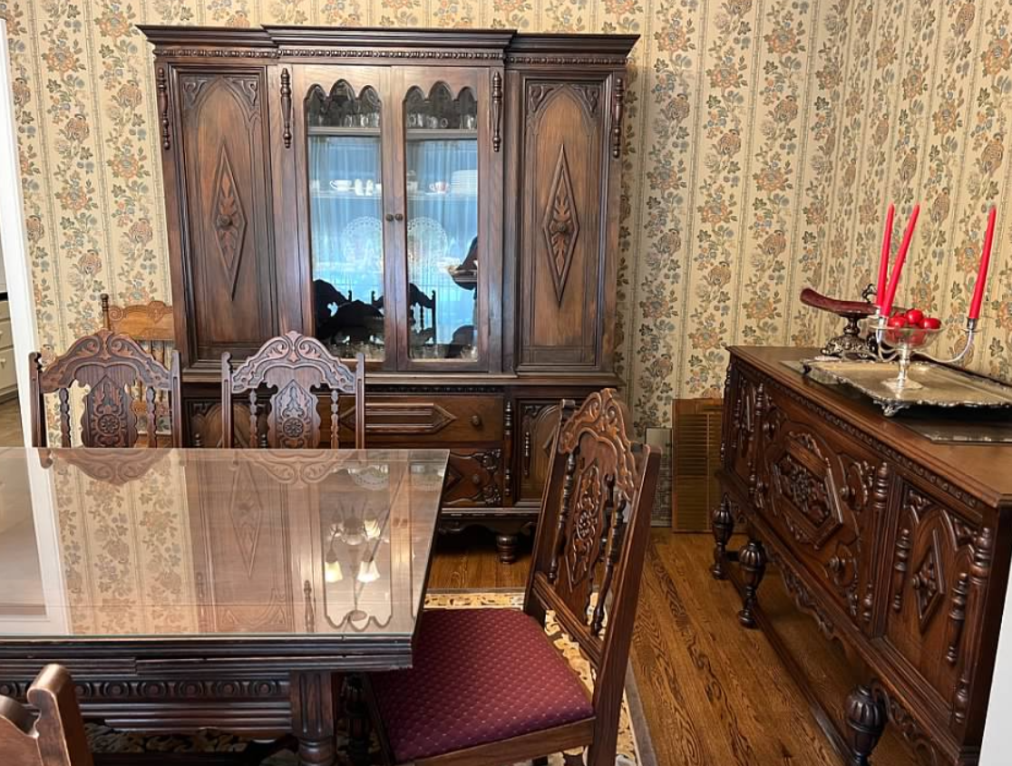
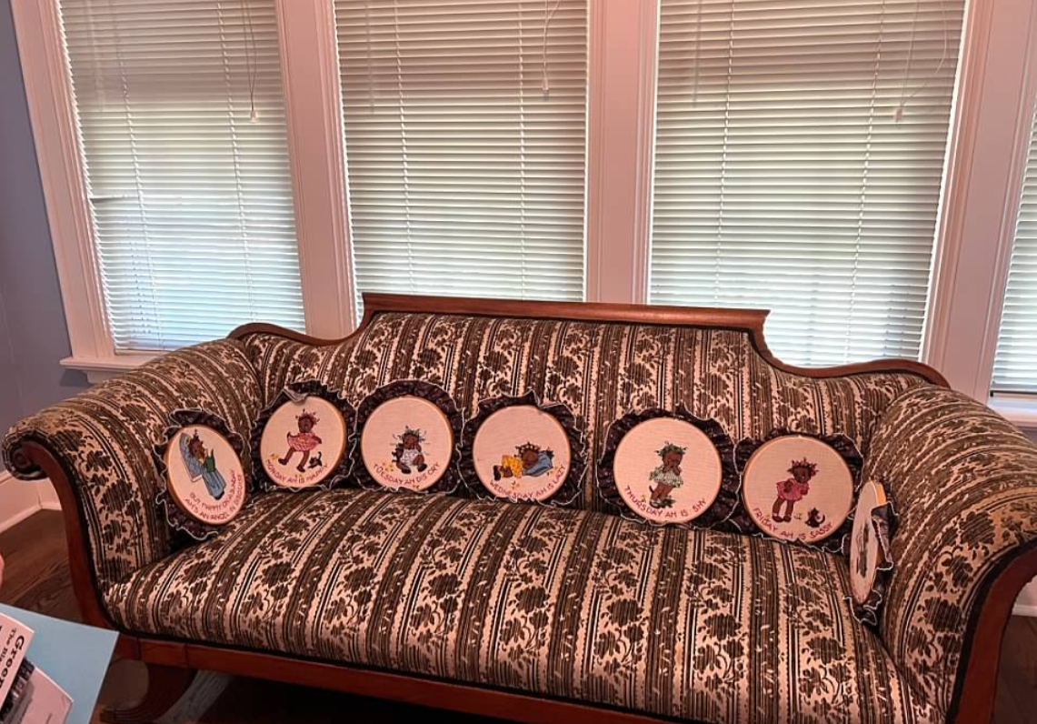
Life in greenwood
Notes:
What was life in Greenwood like before 1921?

Slide 15
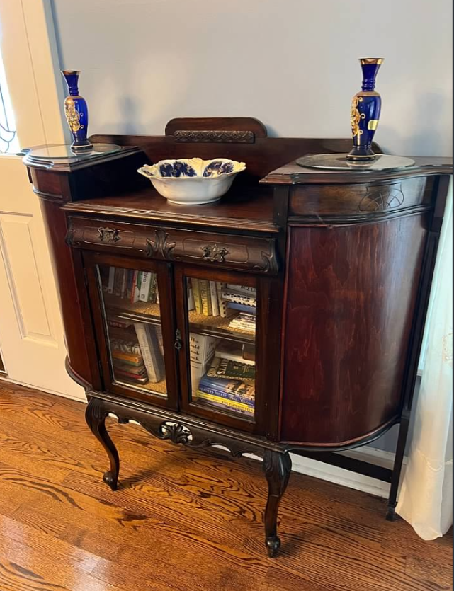
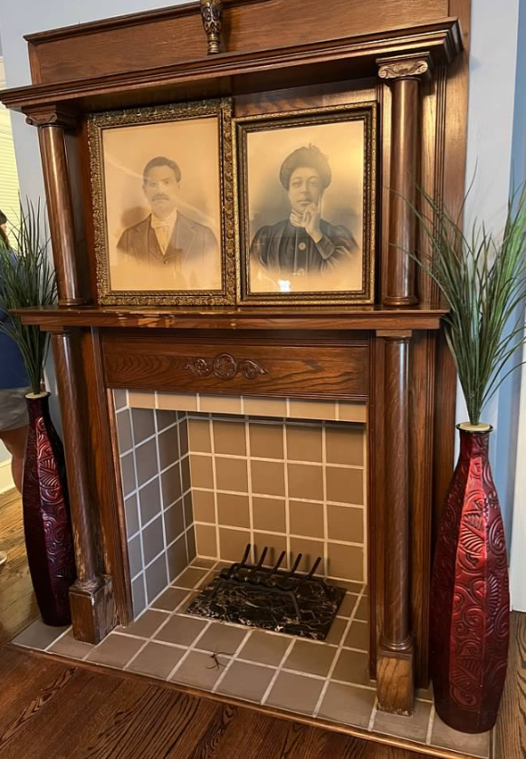
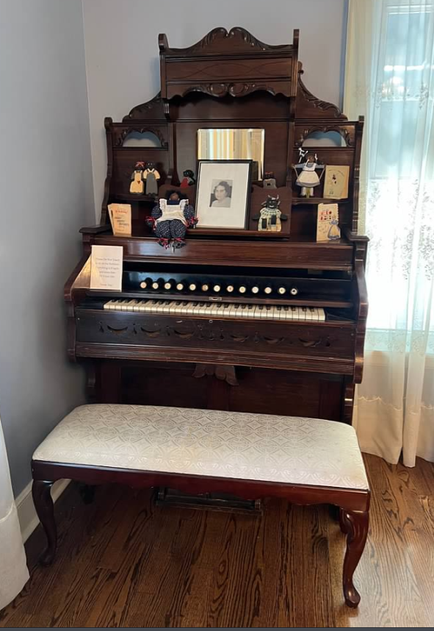
Life in greenwood
Notes:
What was life in Greenwood like before 1921?

Slide 16
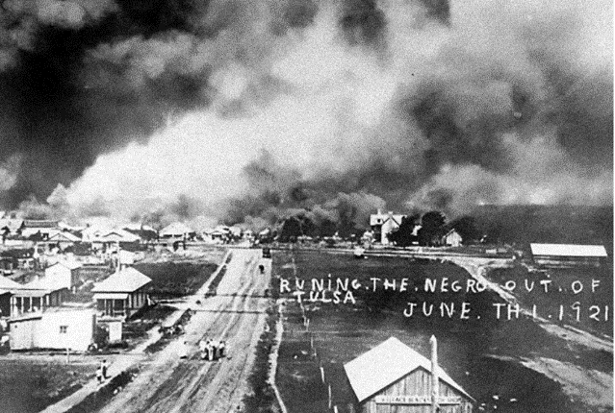
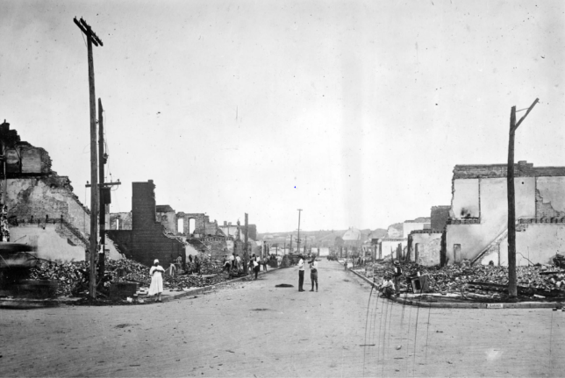
The Tulsa race riot – May 31-June 1, 1921
Notes:
What sparked the riot?

Slide 17
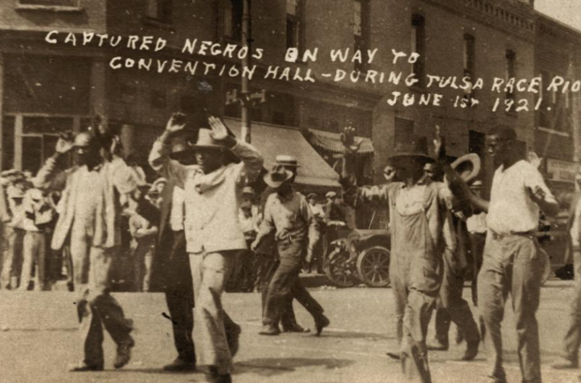
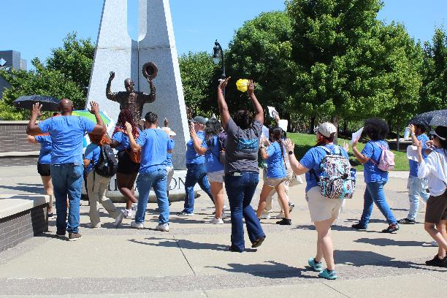
The Tulsa race riot – Humiliation

Slide 18
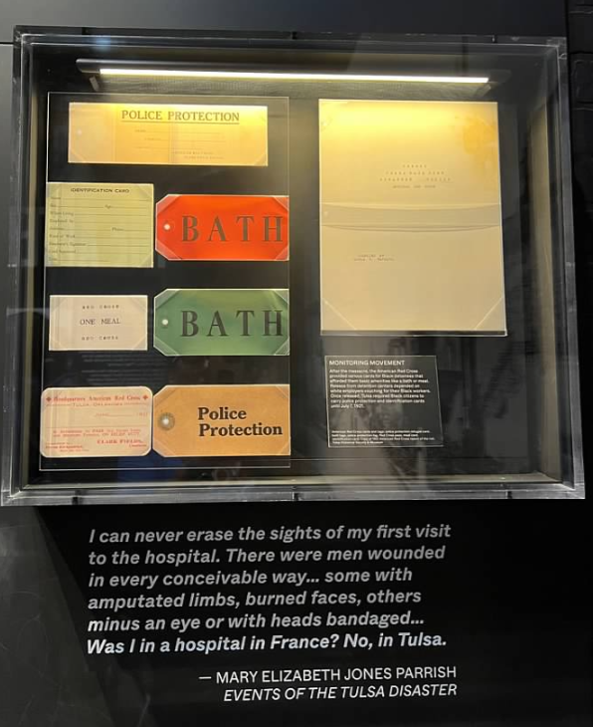
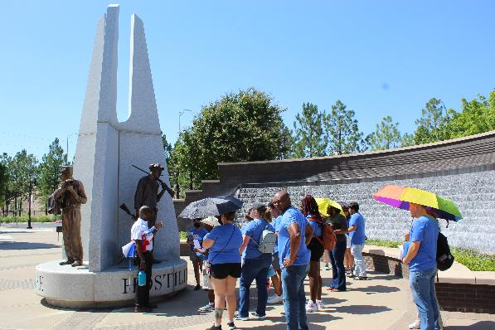
The Tulsa race riot - hostility

Slide 19
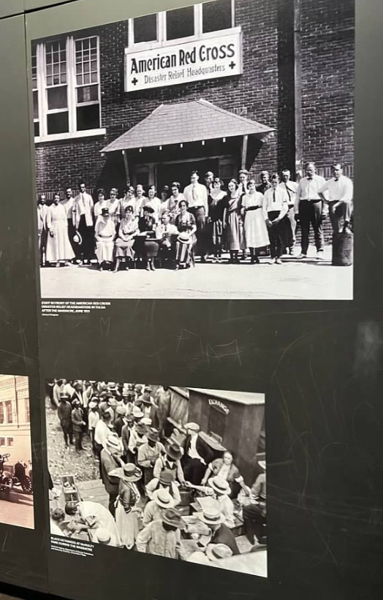
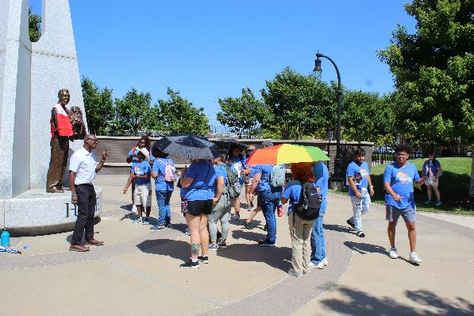
The Tulsa race riot - hope

Slide 20
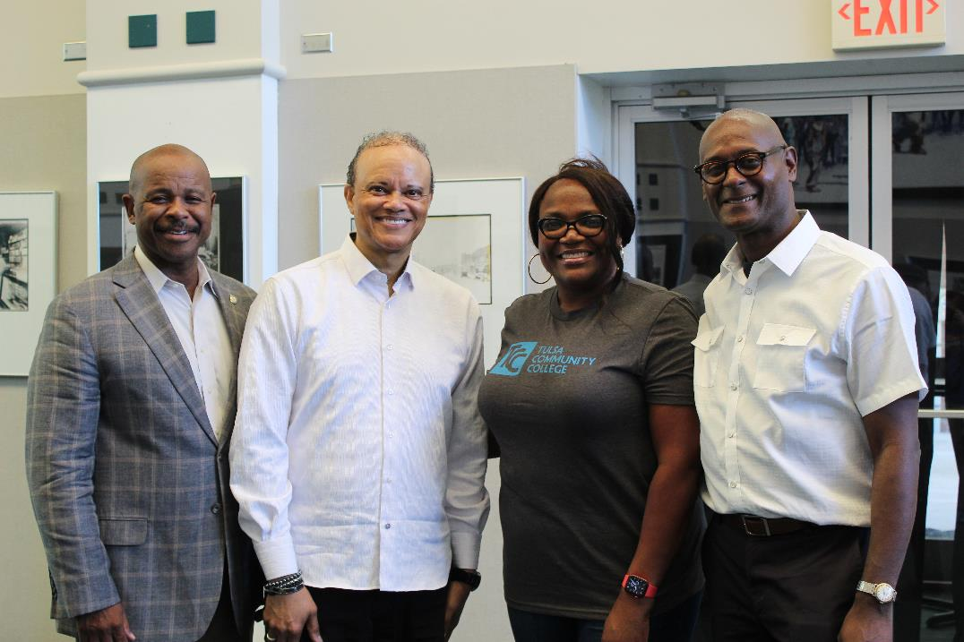
Tulsa Today – remembering Greenwood
Kevin Matthews, Senator
Hannibal Johnson, Author
Ramona Curtis, Director of Workforce Development, TCC
Dewayne Dickens, Director of DEI, TCC

Slide 21
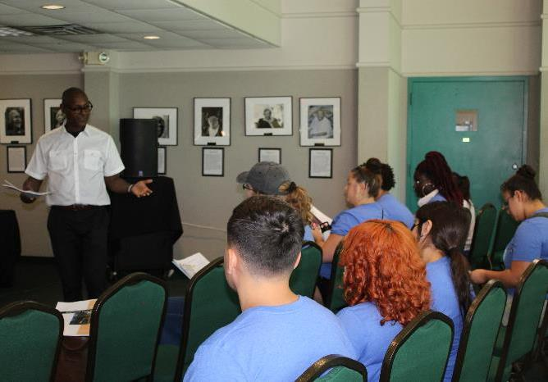
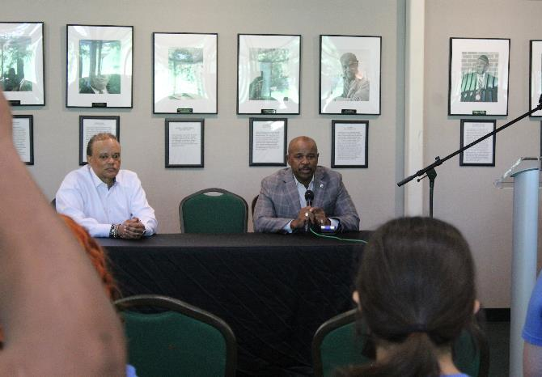
Tulsa Today – remembering Greenwood

Slide 22
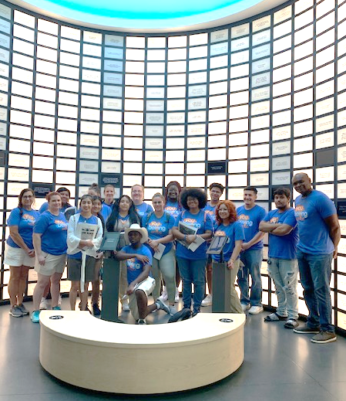
Biggest Takeaway
“Start where you are, use what you have, do what you can.”
- Arthur Ashe

