Slide 1
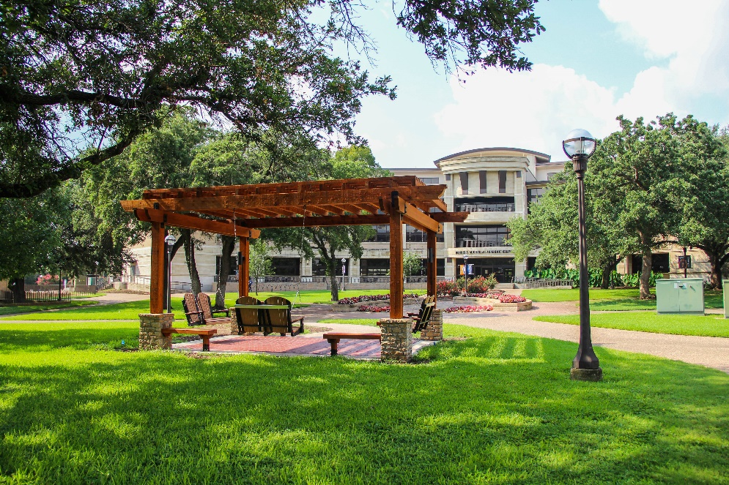
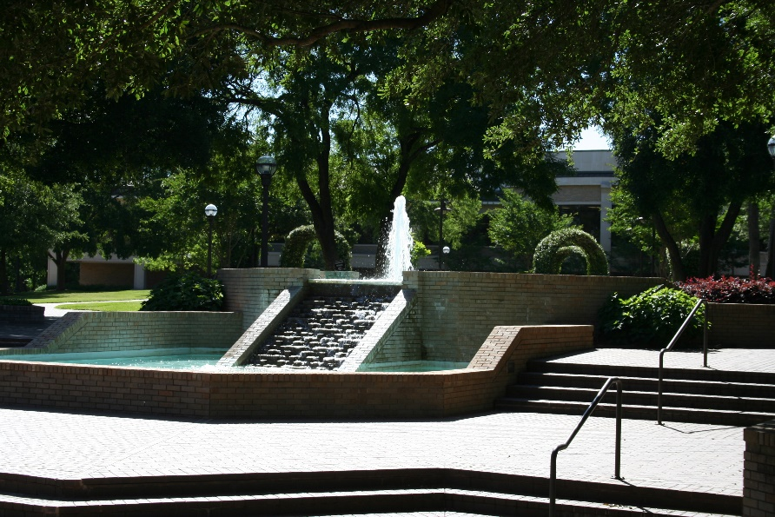

Board
Self-Evaluation
September 27, 2022
Notes:
A place for honest reflection/sharing and visioning. You get out what you put into a process like this.

Slide 2
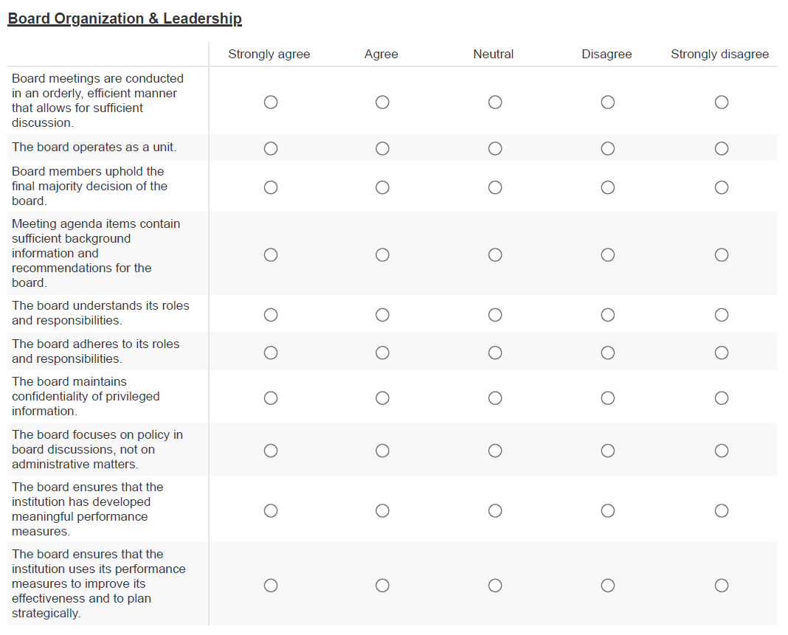

Slide 3
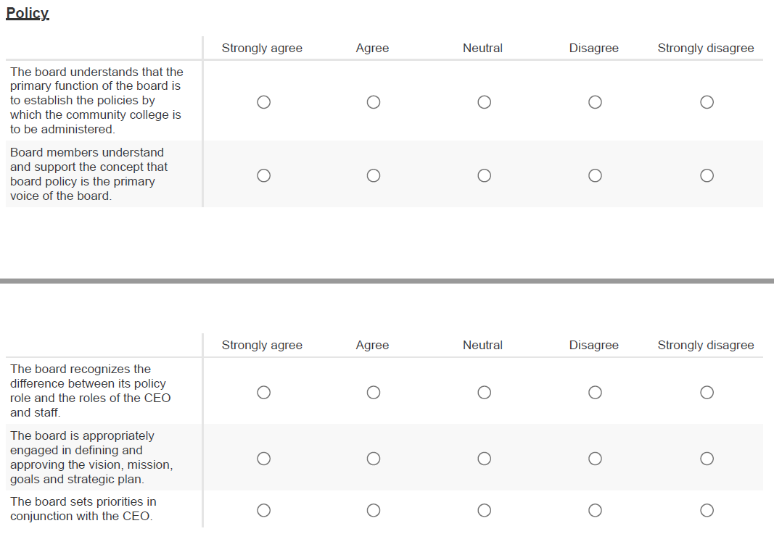

Slide 4
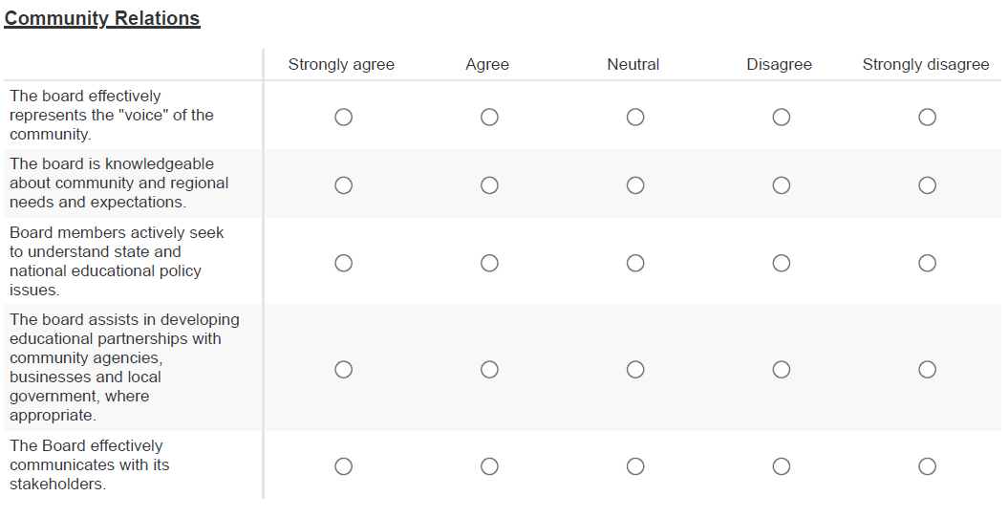

Slide 5
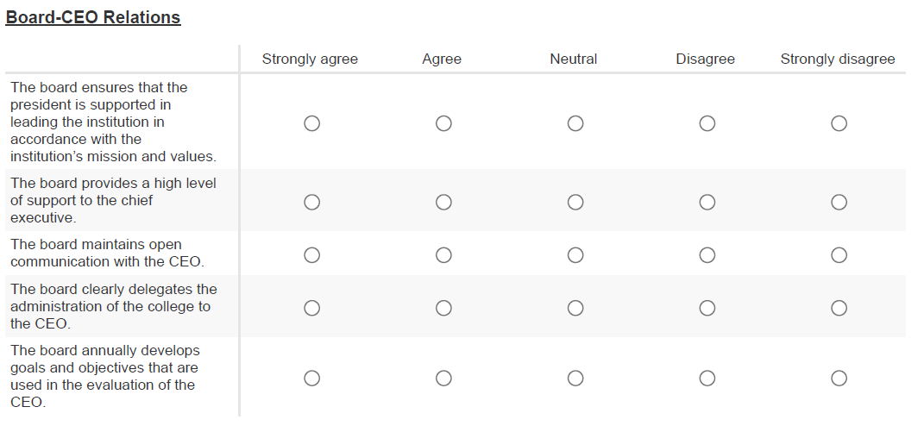

Slide 6
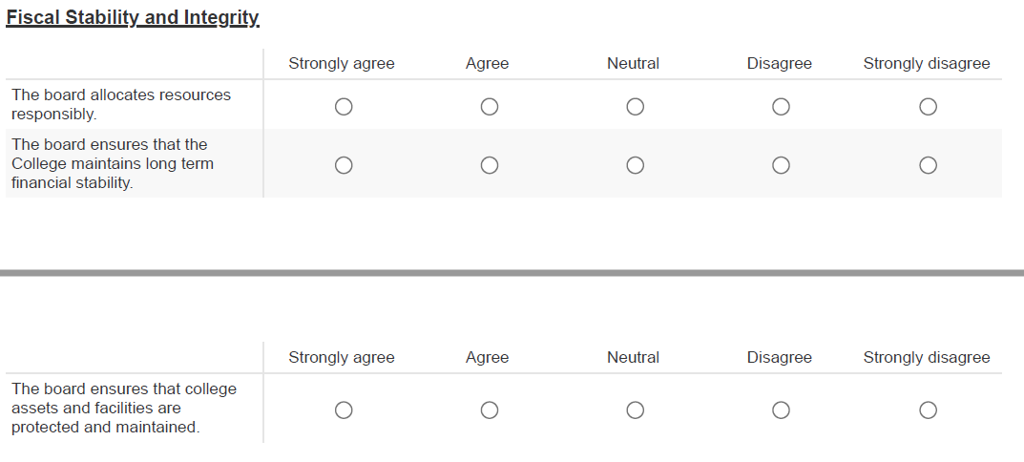

Slide 7
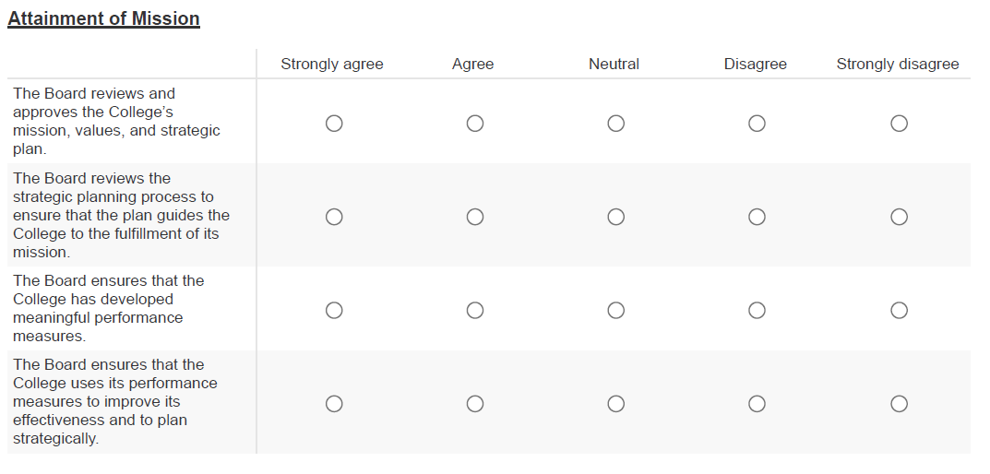

Slide 8
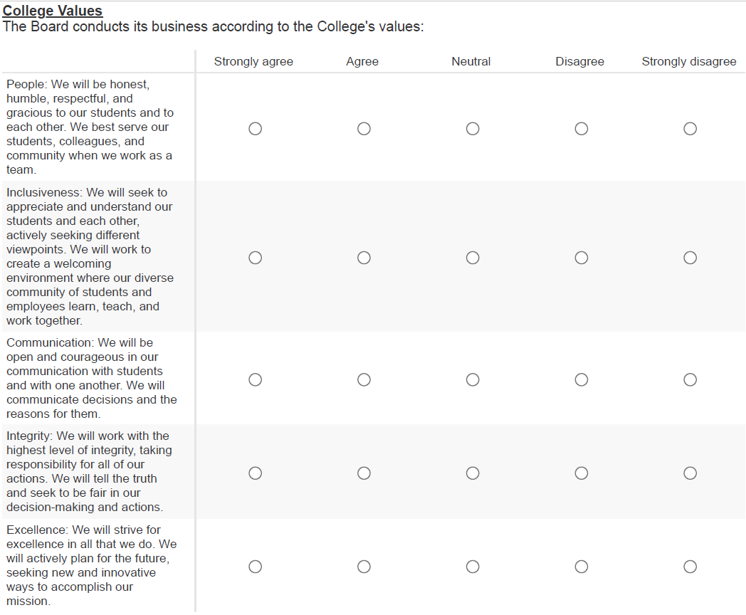

Slide 9
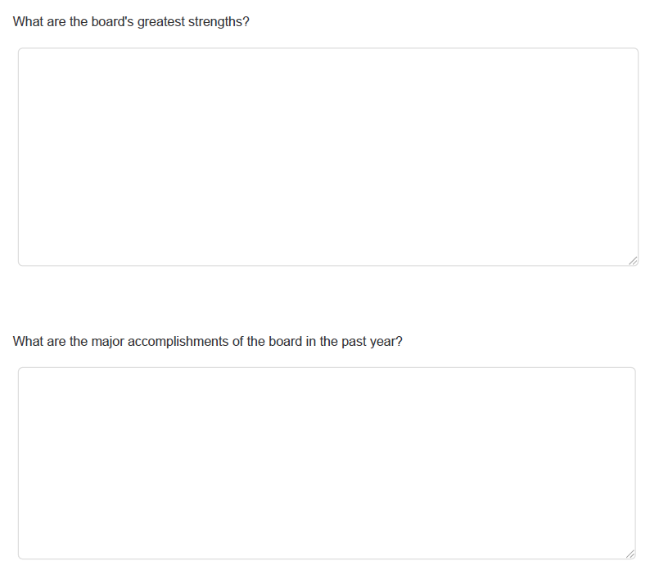

Slide 10
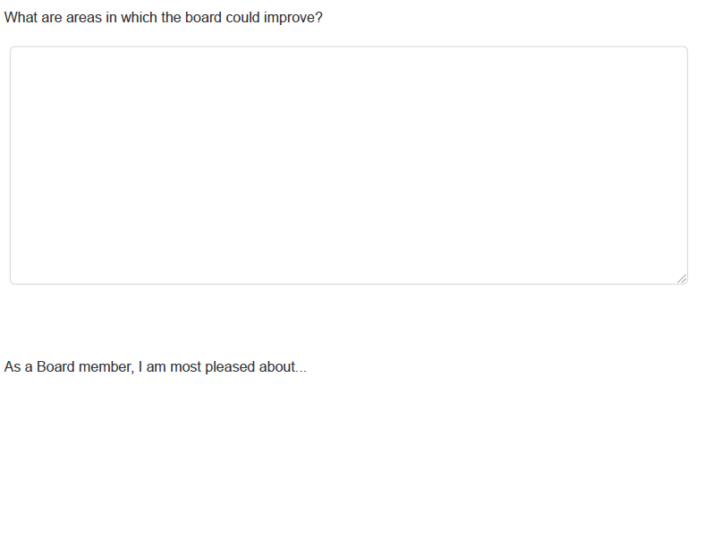

Slide 11
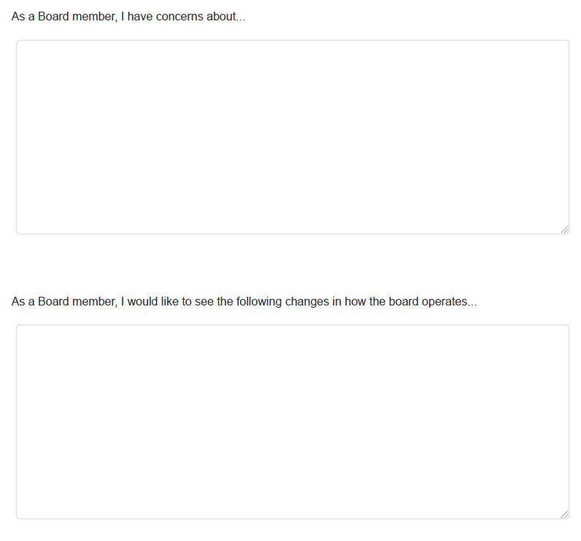

Slide 12
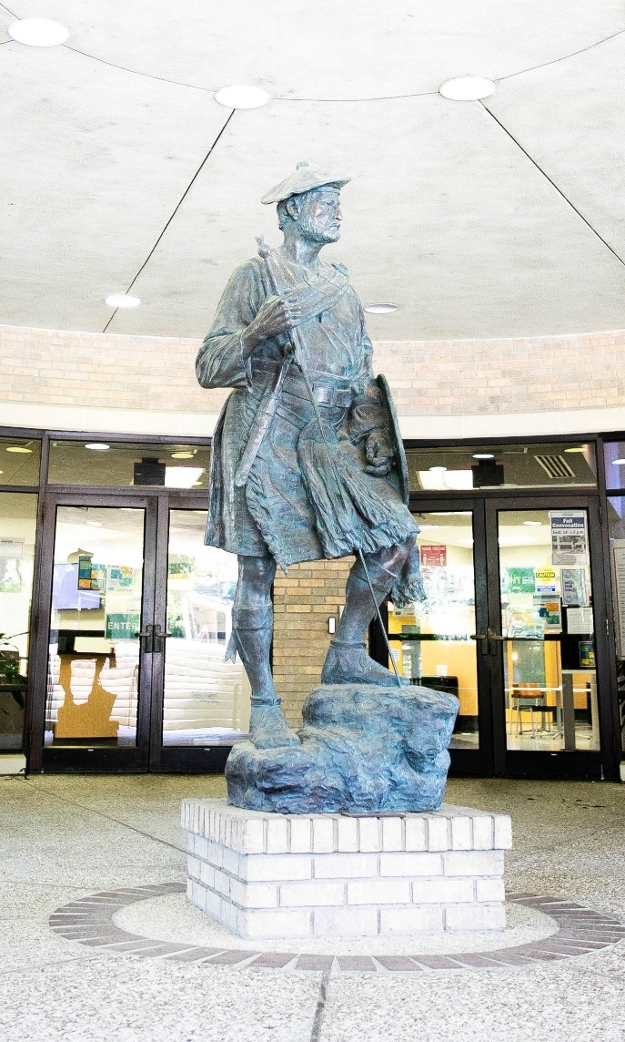

Board’s Self-Evaluation Schedule
September 27, 2022 Board’s Self-Evaluation approved
September 30, 2022 Evaluation opens & links sent to Board members
October 14, 2022 Evaluation closes
October 15-19, 2022 Results analyzed
October 20, 2022 Results sent to Board of Trustees
October 25, 2022 Results discussed by Board

Slide 13
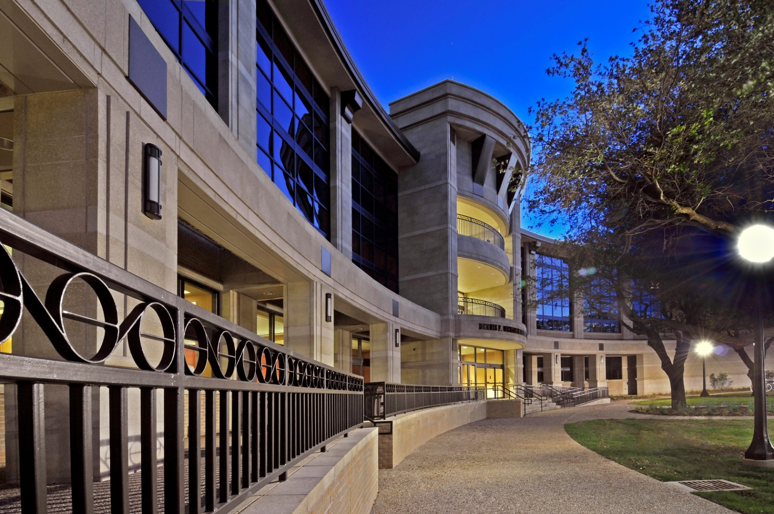
Questions?

