Slide 1
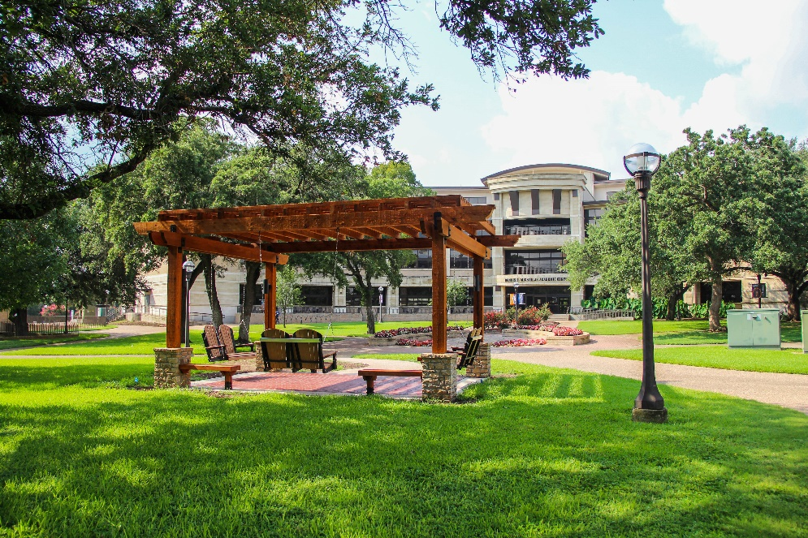
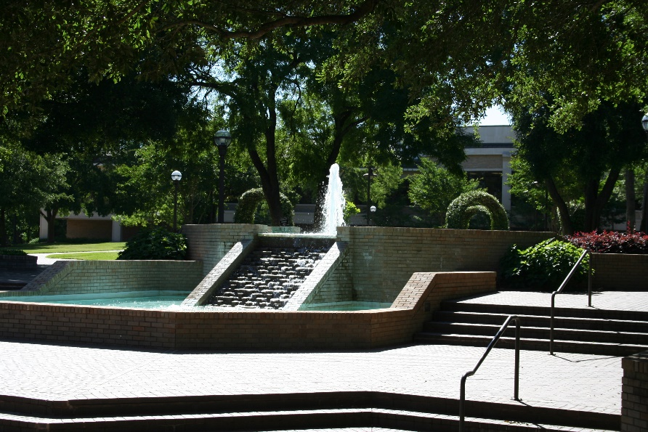

Great Colleges
to Work For 2022
September 27, 2022
Notes:
A place for honest reflection/sharing and visioning. You get out what you put into a process like this.

Slide 2
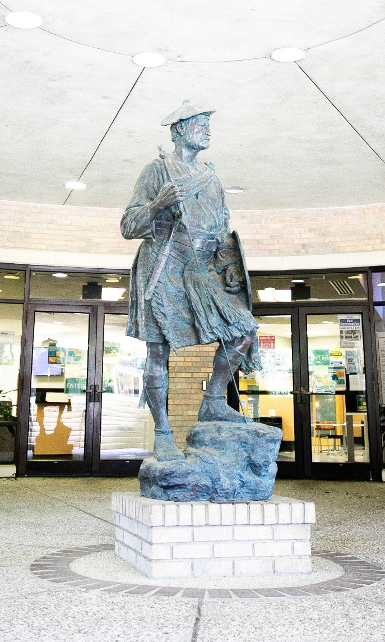

Survey Overview
Surveyed 658 employees, 47% (308) participated.
Administrators: 83%
Professional Staff: 63%
Support Staff: 40%
Faculty: 55%
Adjuncts: 11%
Notes:
Administered by ModernThink, LCC
Free to all accredited institutions in the United States with 500 or more students enrolled
2022 Survey Nationwide:
212 institutions participated
130 four-year colleges and 82 two-year colleges
Over 111,000 surveys given
44% response rate nation wide

Slide 3
Recognized in Texas – 2-Year Institutions
Collin College
Lone Star College System*
McLennan Community College*
Northeast Texas Community College
Panola College*
*Honor Roll Status for size
Notes:
Four-Year Institutions
Abilene Christian University*
Angelo State University*
Baylor University*
Lubbock Christian University
Parker University*
Texas Tech University*
Texas Tech University Health Sciences Cetner*
University of the Incarnate Word*

Slide 4

2022 Honor Roll
Job Satisfaction & Support
Professional Development
Mission & Pride
Faculty & Staff Well-being
Faculty Experience (Faculty only)
Shared Governance (Faculty only)

Slide 5
Great College's to Work For Trends by Job Category
Institutional Characteristics | MCC 2022 Overall | Administration | Faculty | Adjunct Faculty | Exempt Professional Staff | Non-exempt Staff
Collaboration | 70 | 78 | 76 | 69 | 67 | 62
Communication | 68 | 74 | 71 | 71 | 68 | 58
Confidence in Senior Leadership | 74 | 78 | 79 | 83 | 72 | 66
Diversity, Inclusion & Belonging | 82 | 87 | 87 | 85 | 78 | 76
Faculty & Staff Well-being | 83 | 89 | 86 | 90 | 82 | 78
Job Satisfaction & Support | 82 | 89 | 86 | 86 | 77 | 78
Mission & Pride | 89 | 92 | 92 | 89 | 87 | 84
Performance Management | 61 | 65 | 67 | 55 | 54 | 60
Professional Development | 79 | 91 | 85 | 68 | 73 | 76
Supervisor/Department Chair Effectiveness | 81 | 86 | 83 | 80 | 82 | 71
Faculty Experience | 78 | - | 78 | 87 | - | -
Overall Survey Average | 78 | 83 | 82 | 79 | 75 | 72
 | Poor | Warrants Attention | Fair to Mediocre | Good | Very Good | Excellent
Legend | 0%-44% | 45%-54% | 55%-64% | 65%-74% | 75%-89% | 90%-100%

Slide 6
Actions & Moving Forward
Presented the results to the President, Vice President, President’s Council
President’s Council Retreat Friday, September 30th to address areas of concern
Continue listening to employees and addressing areas of concern around campus

Slide 7
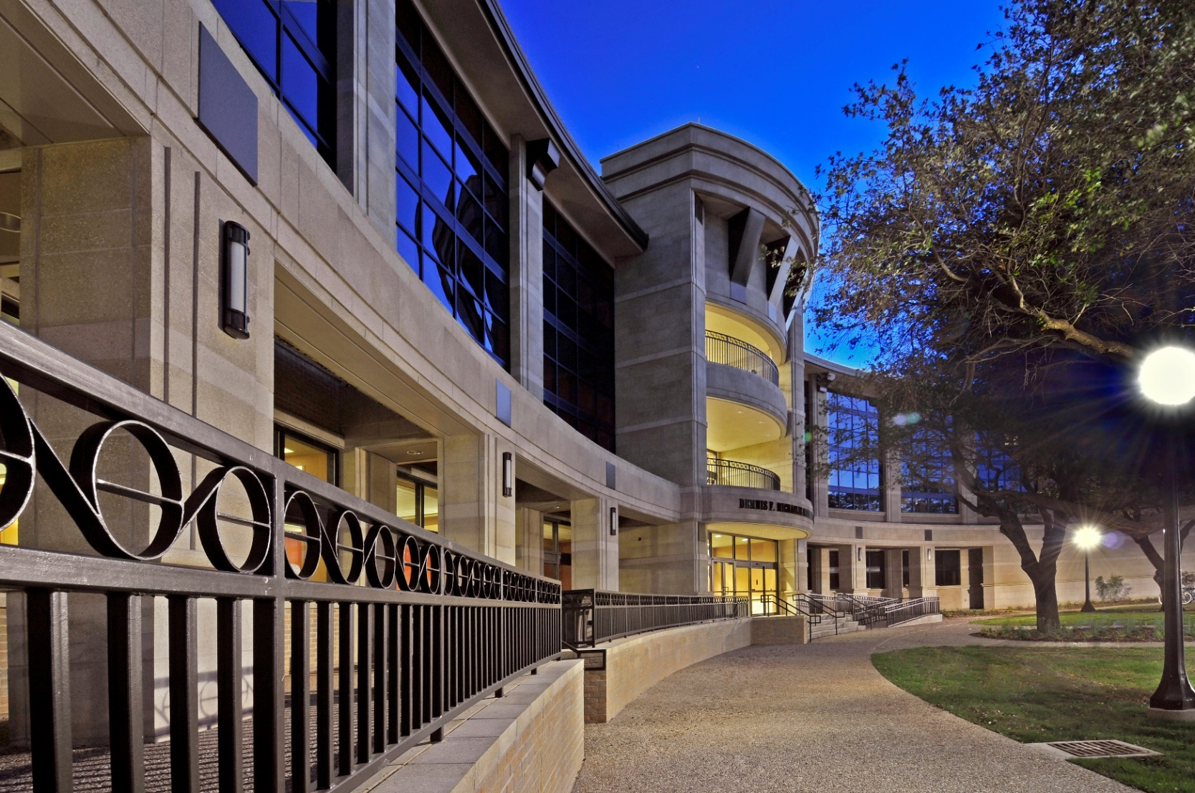
Questions?

