Slide 1
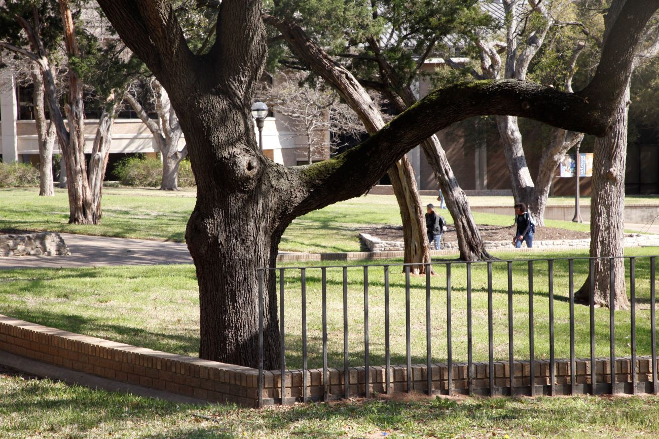

Strengthening Partnerships
Board to Board Conversations
September 29, 2022

Slide 2






Thank you to our partners for being present tonight!
Our partnerships strengthen our institutions and our community. MCC would like to ensure we keep them healthy and strong.
Dual credit has been a key component of our partnership efforts and so will be reviewed before discussing new opportunities.
2022

Slide 3
Dual Enrollment National Perspective
2022
Dual enrollment students are more likely than others to graduate from high school, enroll in college, and complete college degrees.
As students across the country grapple with the twin effects of the COVID-19 pandemic and an economic recession, higher education can seem out of reach—and the cost and time savings offered through dual enrollment are more important than ever. This is especially the case for students from historically underrepresented racial and ethnic groups and low-income backgrounds. (Dual Credit Playbook: Aspen and CCRC)
Notes:
The Dual Enrollment PlayBook: A Guide to Equitable Acceleration for Students
The Aspen Institute: College Excellence Program
The Aspen Institute: Education & Society Program
CCRC (Community College Research Center: Teachers College, Columbia University
Five Principles to Advance Equity in High-Quality Dual Enrollment
Set a shared vision and goals that prioritize equity
Expand equitable access
Provide advising and supports that ensure equitable student outcomes
Provide high-quality instruction that builds students’ competence and confidence
Organize teams and develop relationships to maximize potential

Slide 4
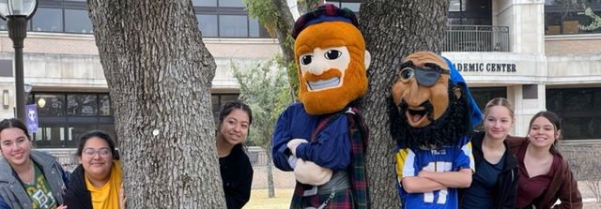

Dual Credit in Texas
Trends
26.6% of total students in community college are dual credit.
Cost to students varies from $0 to full cost of tuition and fees.

Slide 5
Community Colleges - FALL 2021
26.6%
23.3%

Slide 6
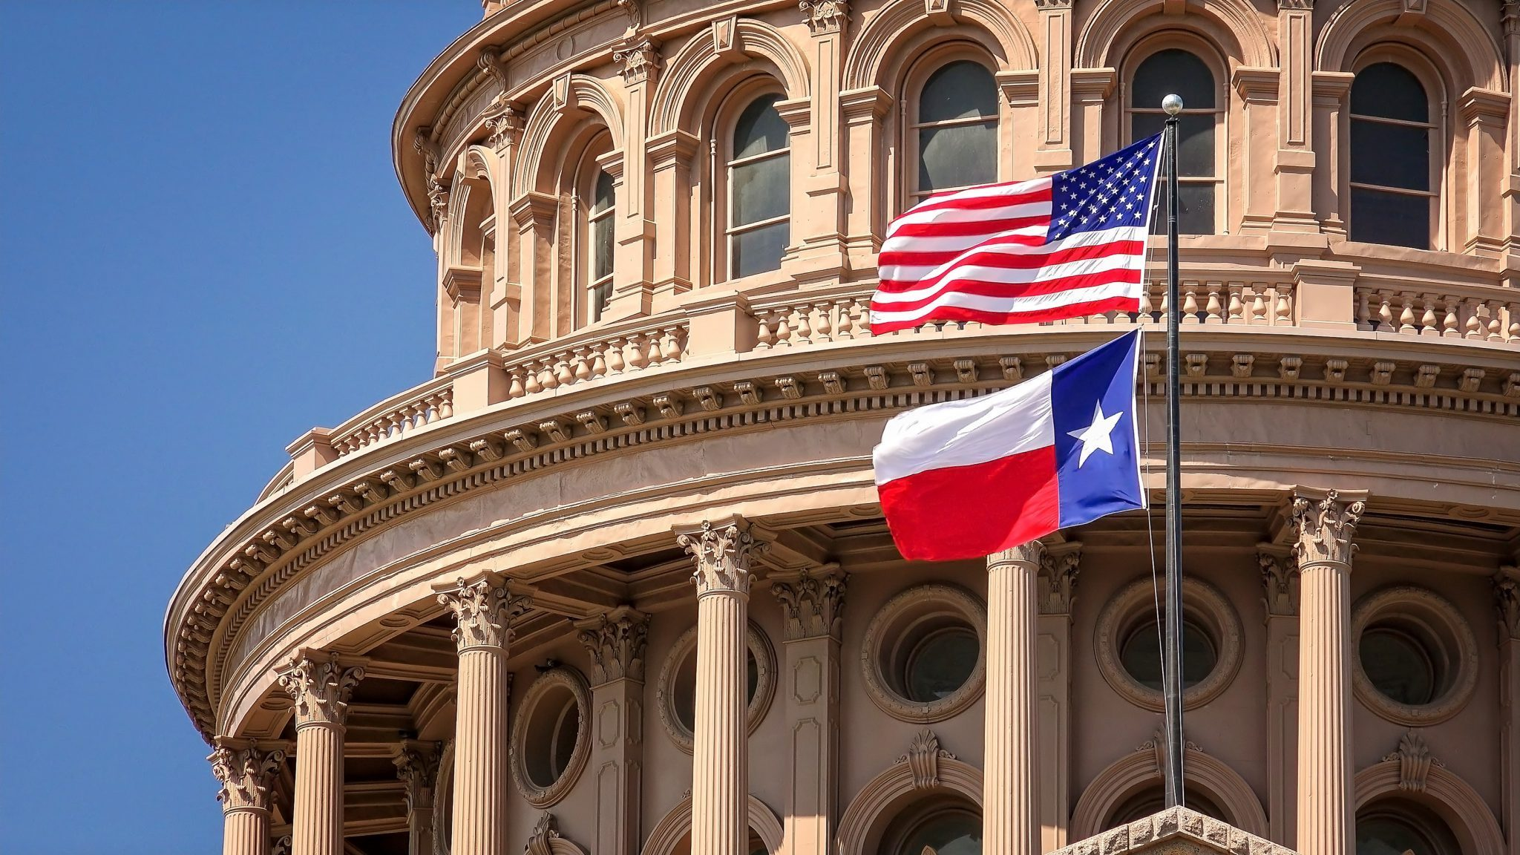
88th TEXAS
LEGISLATURE
Update
Community College Finance Commission
State Funding for Outcomes
Affordability for Students
Investments in College Capacity

Slide 7
DRAFT Recommendations
State Funding for Outcomes—No Enrollment-Based Metrics
Credentials of value
High-demand fields
Transfer to four-year universities
State-funded guaranteed yield for colleges with low taxable valuations
Affordability for Students
Increase Texas Educational Opportunity Grants for low-income students
Provide financial aid for economically disadvantaged dual credit students
Expand partnerships among colleges and private employers for work-based opportunities
Investments in College Capacity
Provide seed grants for programs in high-demand fields
Support and facilitate shared services
Help colleges provide high quality non-credit credentials programs that are convertible stackable

Slide 8
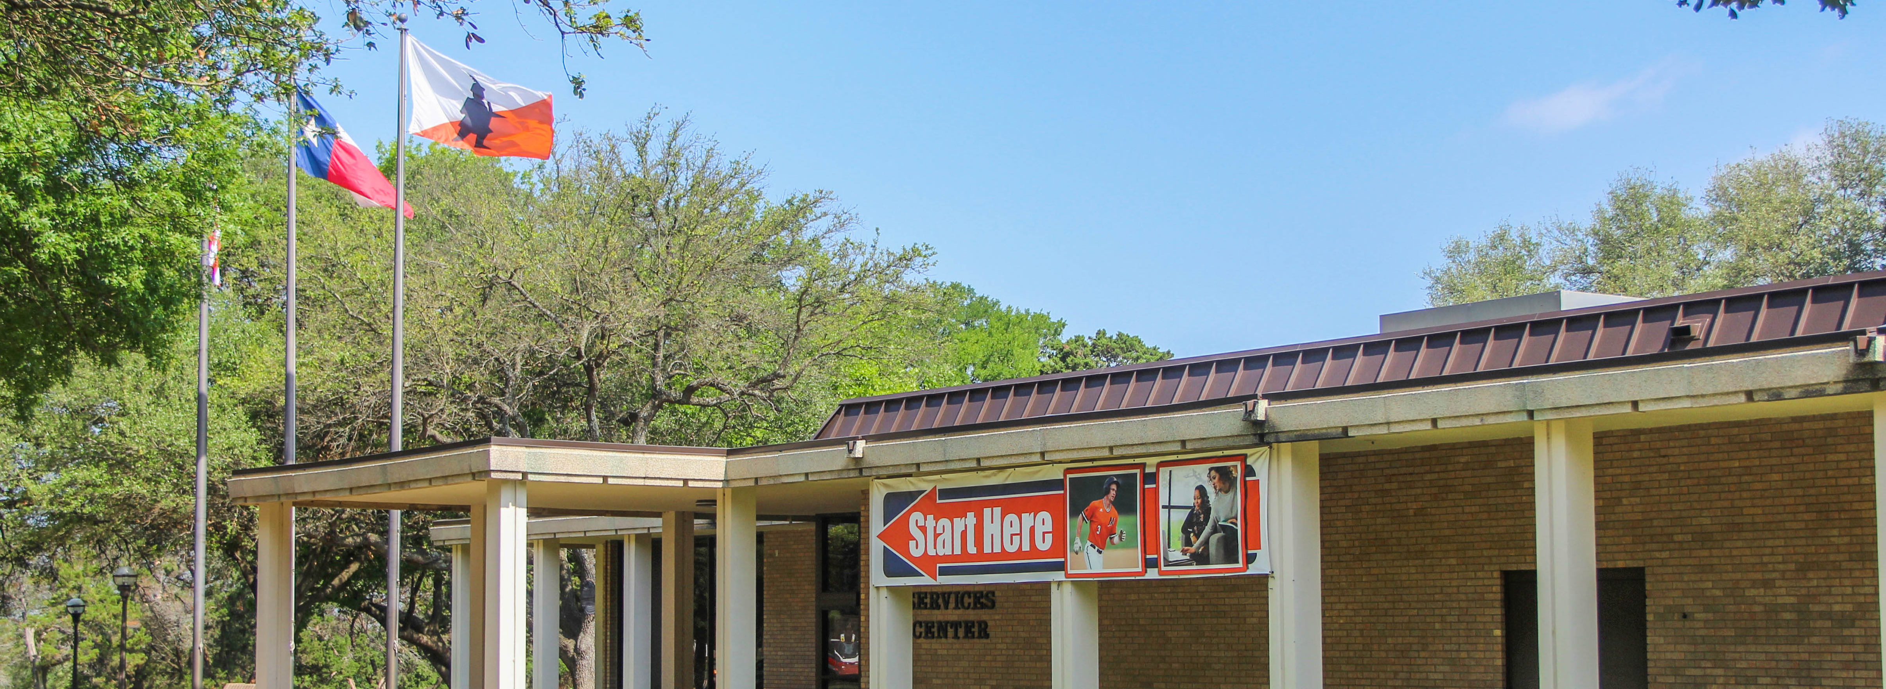
Dual Credit at McLENNAN
2022

Slide 9
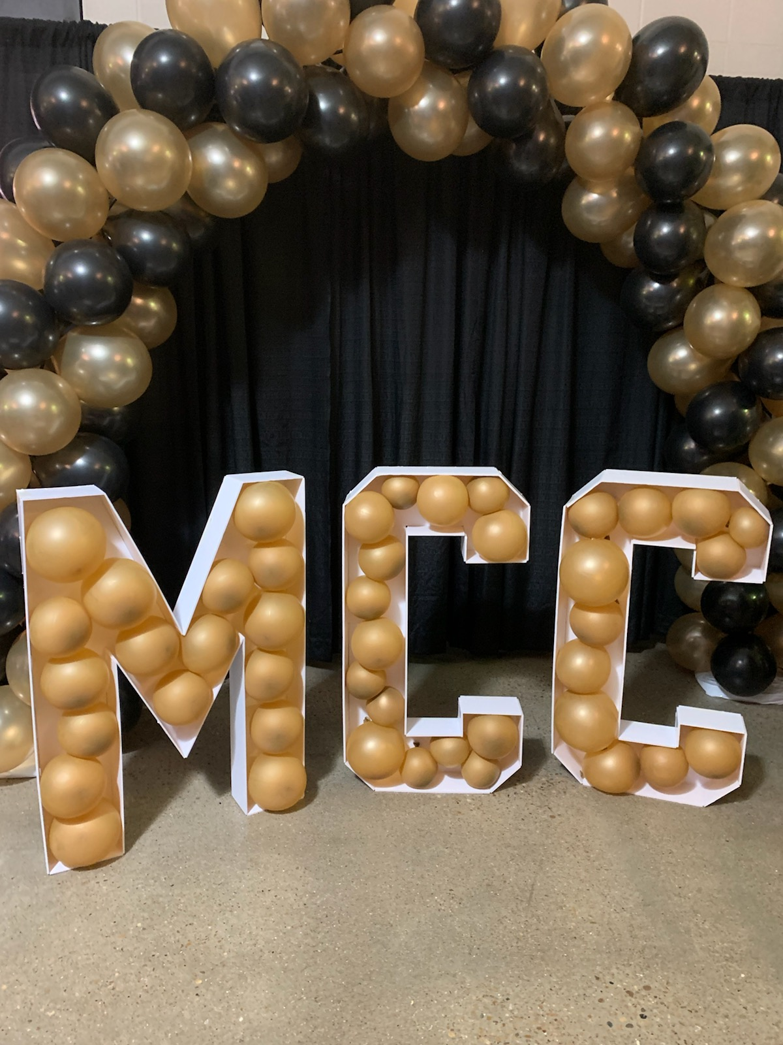




Dual Credit Overview
2022
29 High Schools
1,737 Students
83.5% Success Rate A, B, or C
Free Tuition, Low Income Students
Reduced Tuition, $77/SCH All Other Students
Fall 2021

Slide 10

Dual Credit Enrollment
2022
Fall Semesters 2016-2022
Recent Trends
Dual credit enrollment:
Peaked in Fall 2018 and Fall 2019.
Saw a reduction as a result of COVID.
Has leveled and seen a small increase.

Slide 11
Dual Credit Tuition Exemption & Tuition Reduction
Tuition Reduction

Slide 12
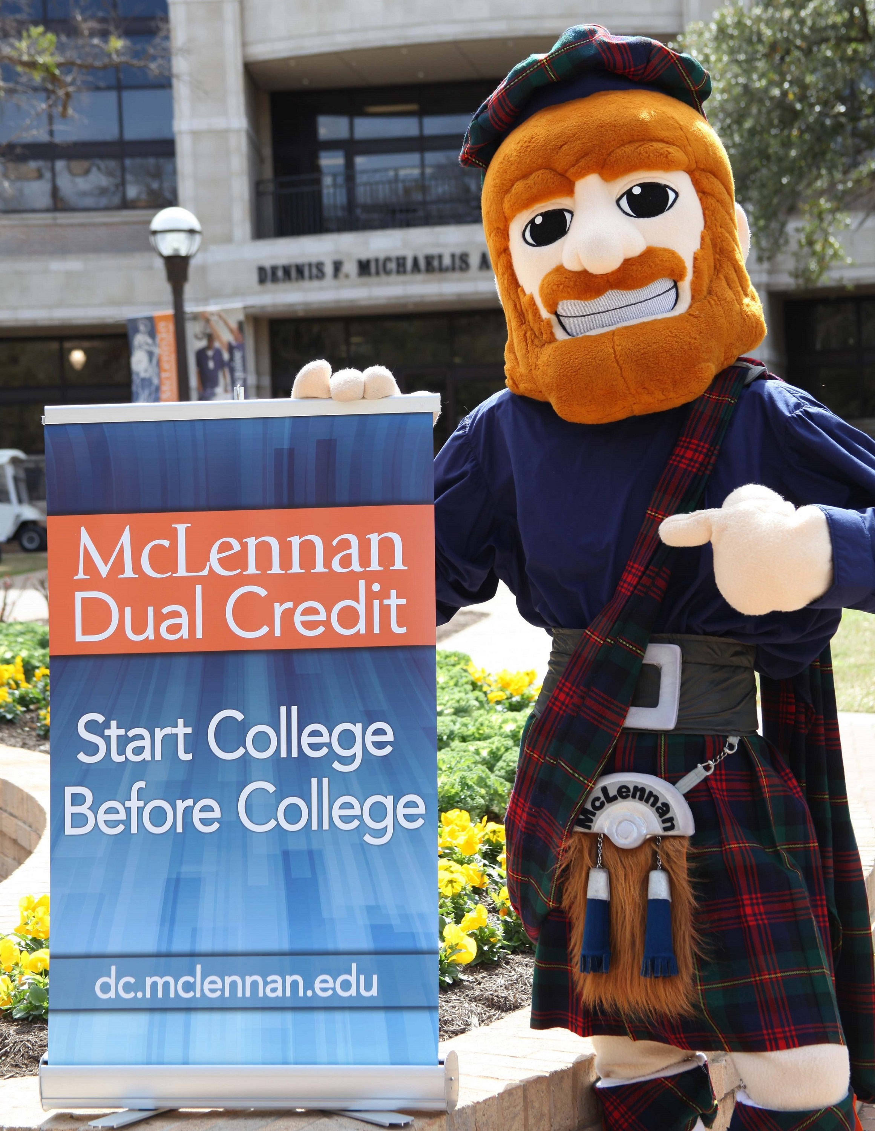
District Data
2022
China Spring
Lorena
Robinson
West

Slide 14
Tuition Exemption
Percent of Enrolled
Dual Credit Students
Fall Semester 2020

Slide 15
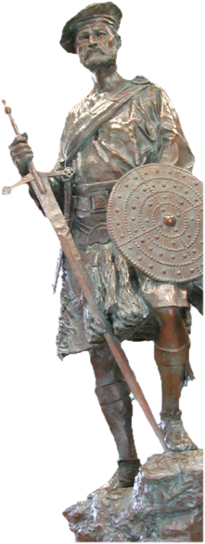
Progress
2022
Dual Credit and More

Slide 16

Dual Credit Advances
2022
Reduction of textbook cost
Increased student support
Degree plans aligned to high school semesters
Students attending class on the MCC campus

Slide 17


Educational Partnerships
2022
Dual Credit + University Center
Waco Campuses
Emphasize full Waco experience – Dual Credit to Degree
Raise awareness of affordable local options for place-bound students
Improve advising and transition assistance for students on local pathways

Slide 18


Distinctives
2022
Support Systems
Facilitators, technology, services
Education Degrees
Through Tarleton State and Texas Tech
Marketing Seamless Pathways
Awareness of Dual Credit and University Center connection
Dual Credit -- University Center
Increasing number of seamless pathways

Slide 19
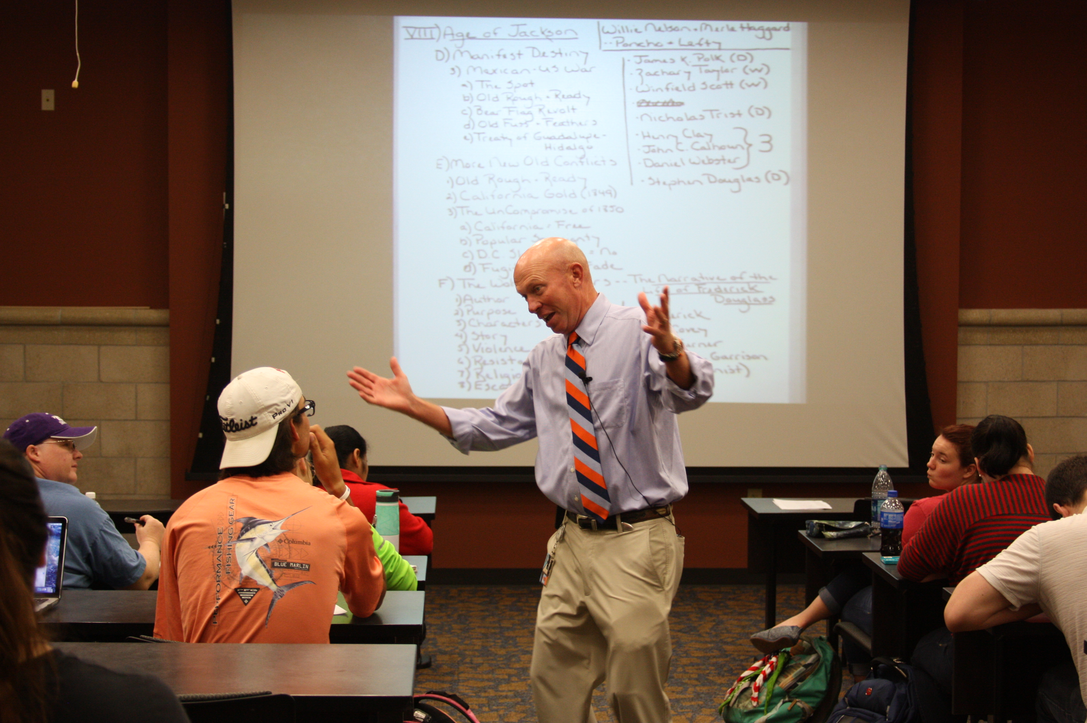
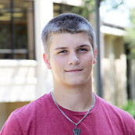
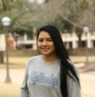
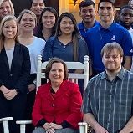
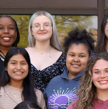

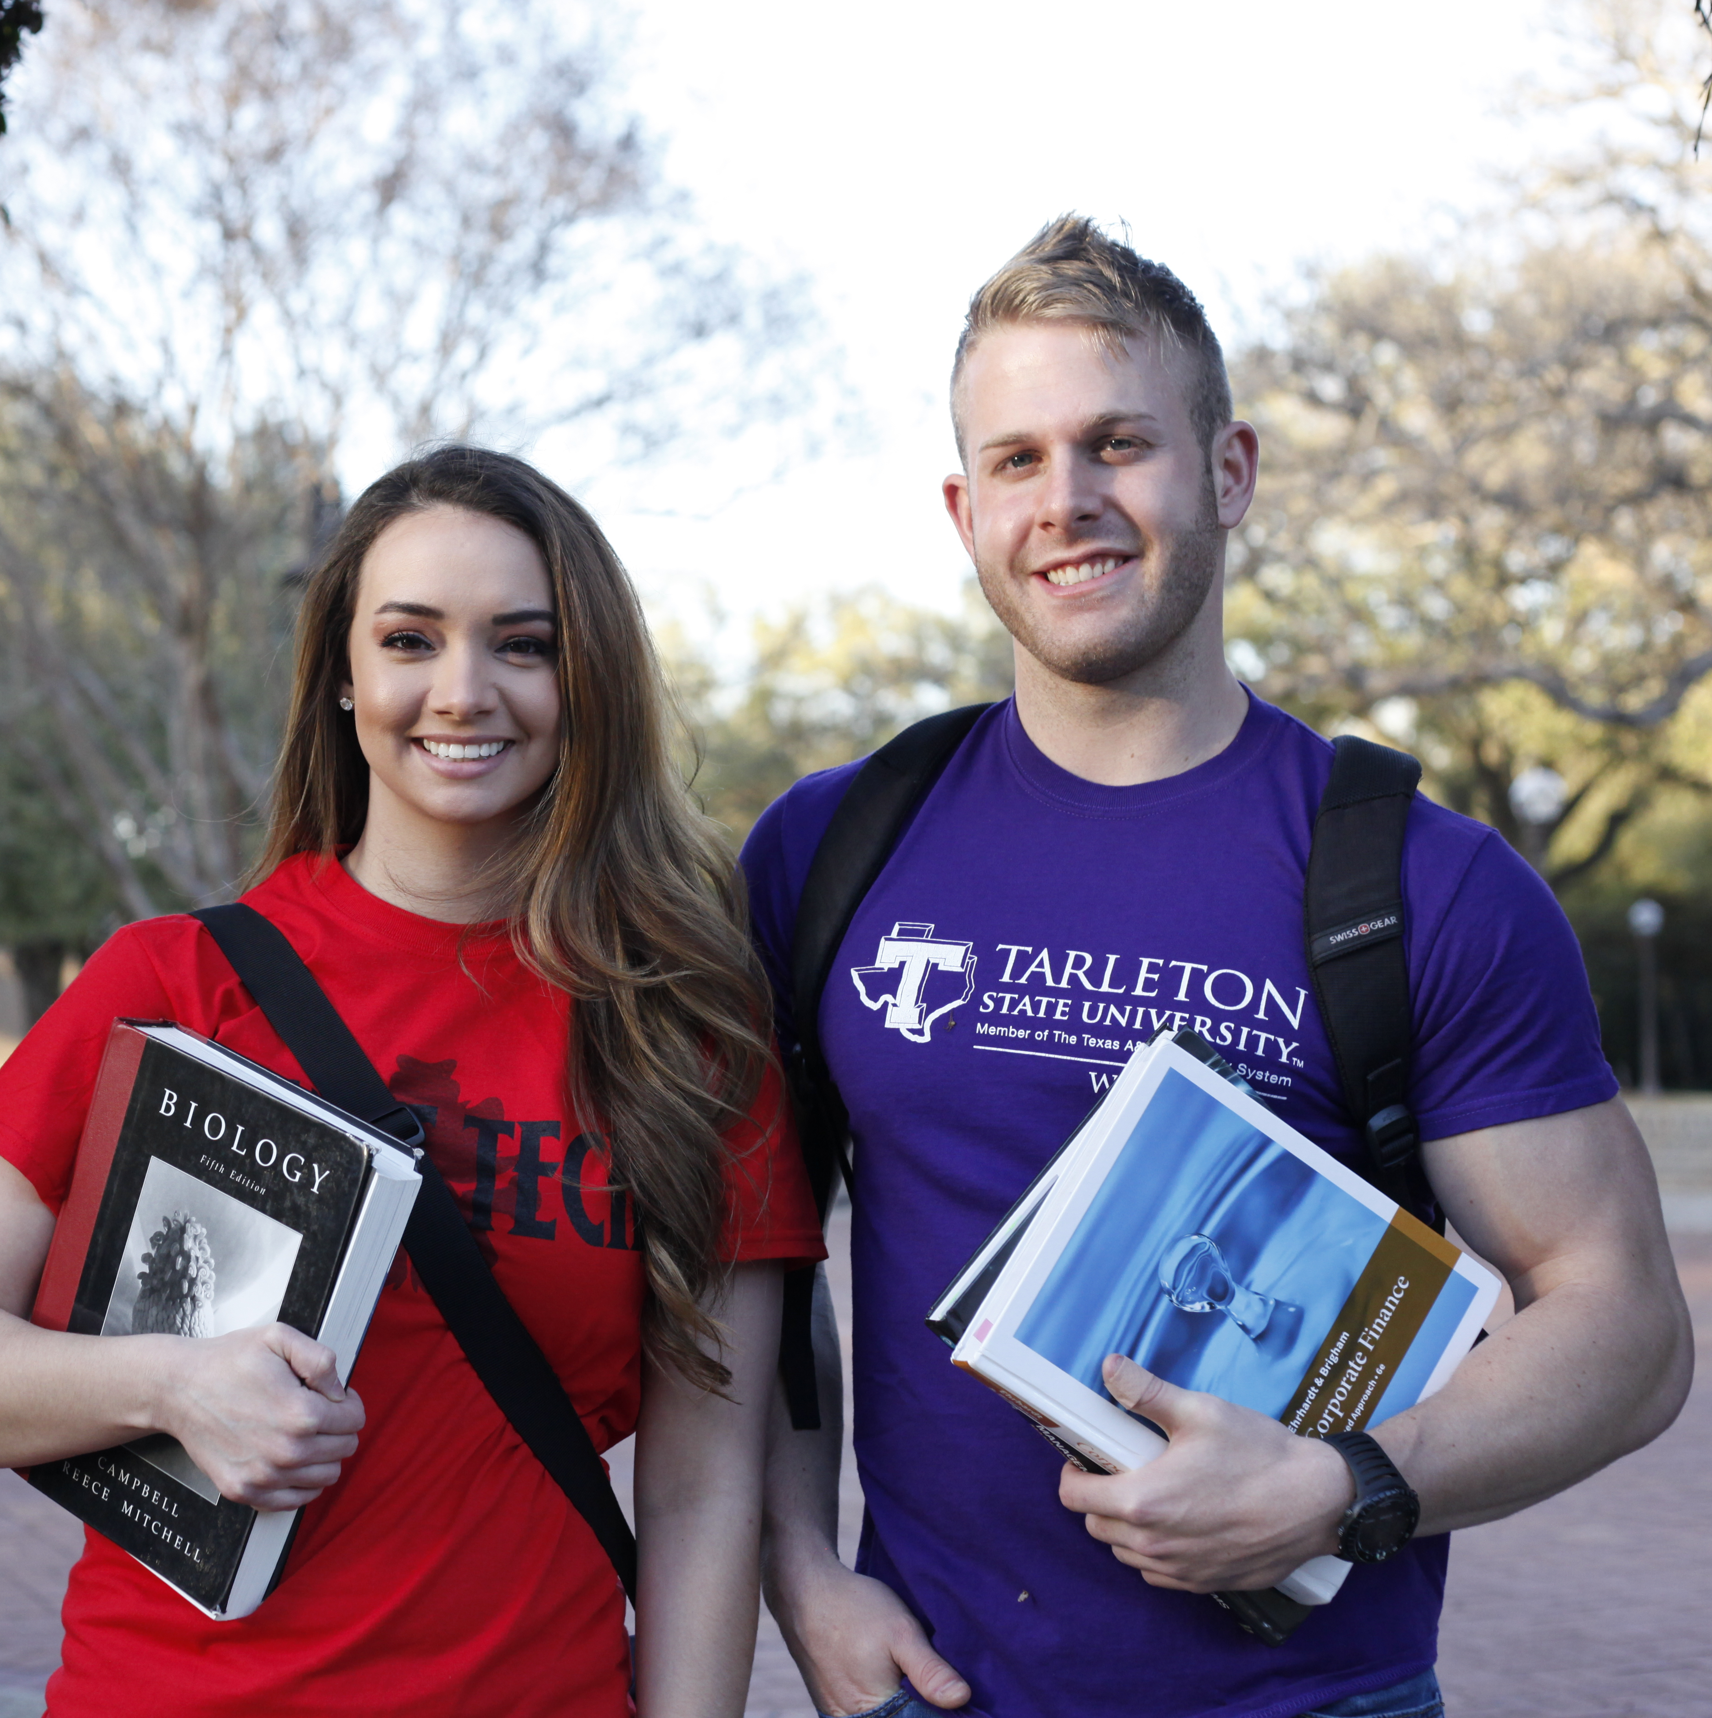
Scholarships= Excellence & Debt Relief
2022
McLennan Scholar
McLennan Rising Star
Presidential Scholars
Top 10%, 100% tuition
Top 11-20%, 50% tuition
Tuition, books, mentorship, travel
First Generation Scholars
Honors College
University Partner Awards
Scholarship funds, mentorship
Tuition, books, mentorship, research
Many awards applicable in Waco

Slide 20
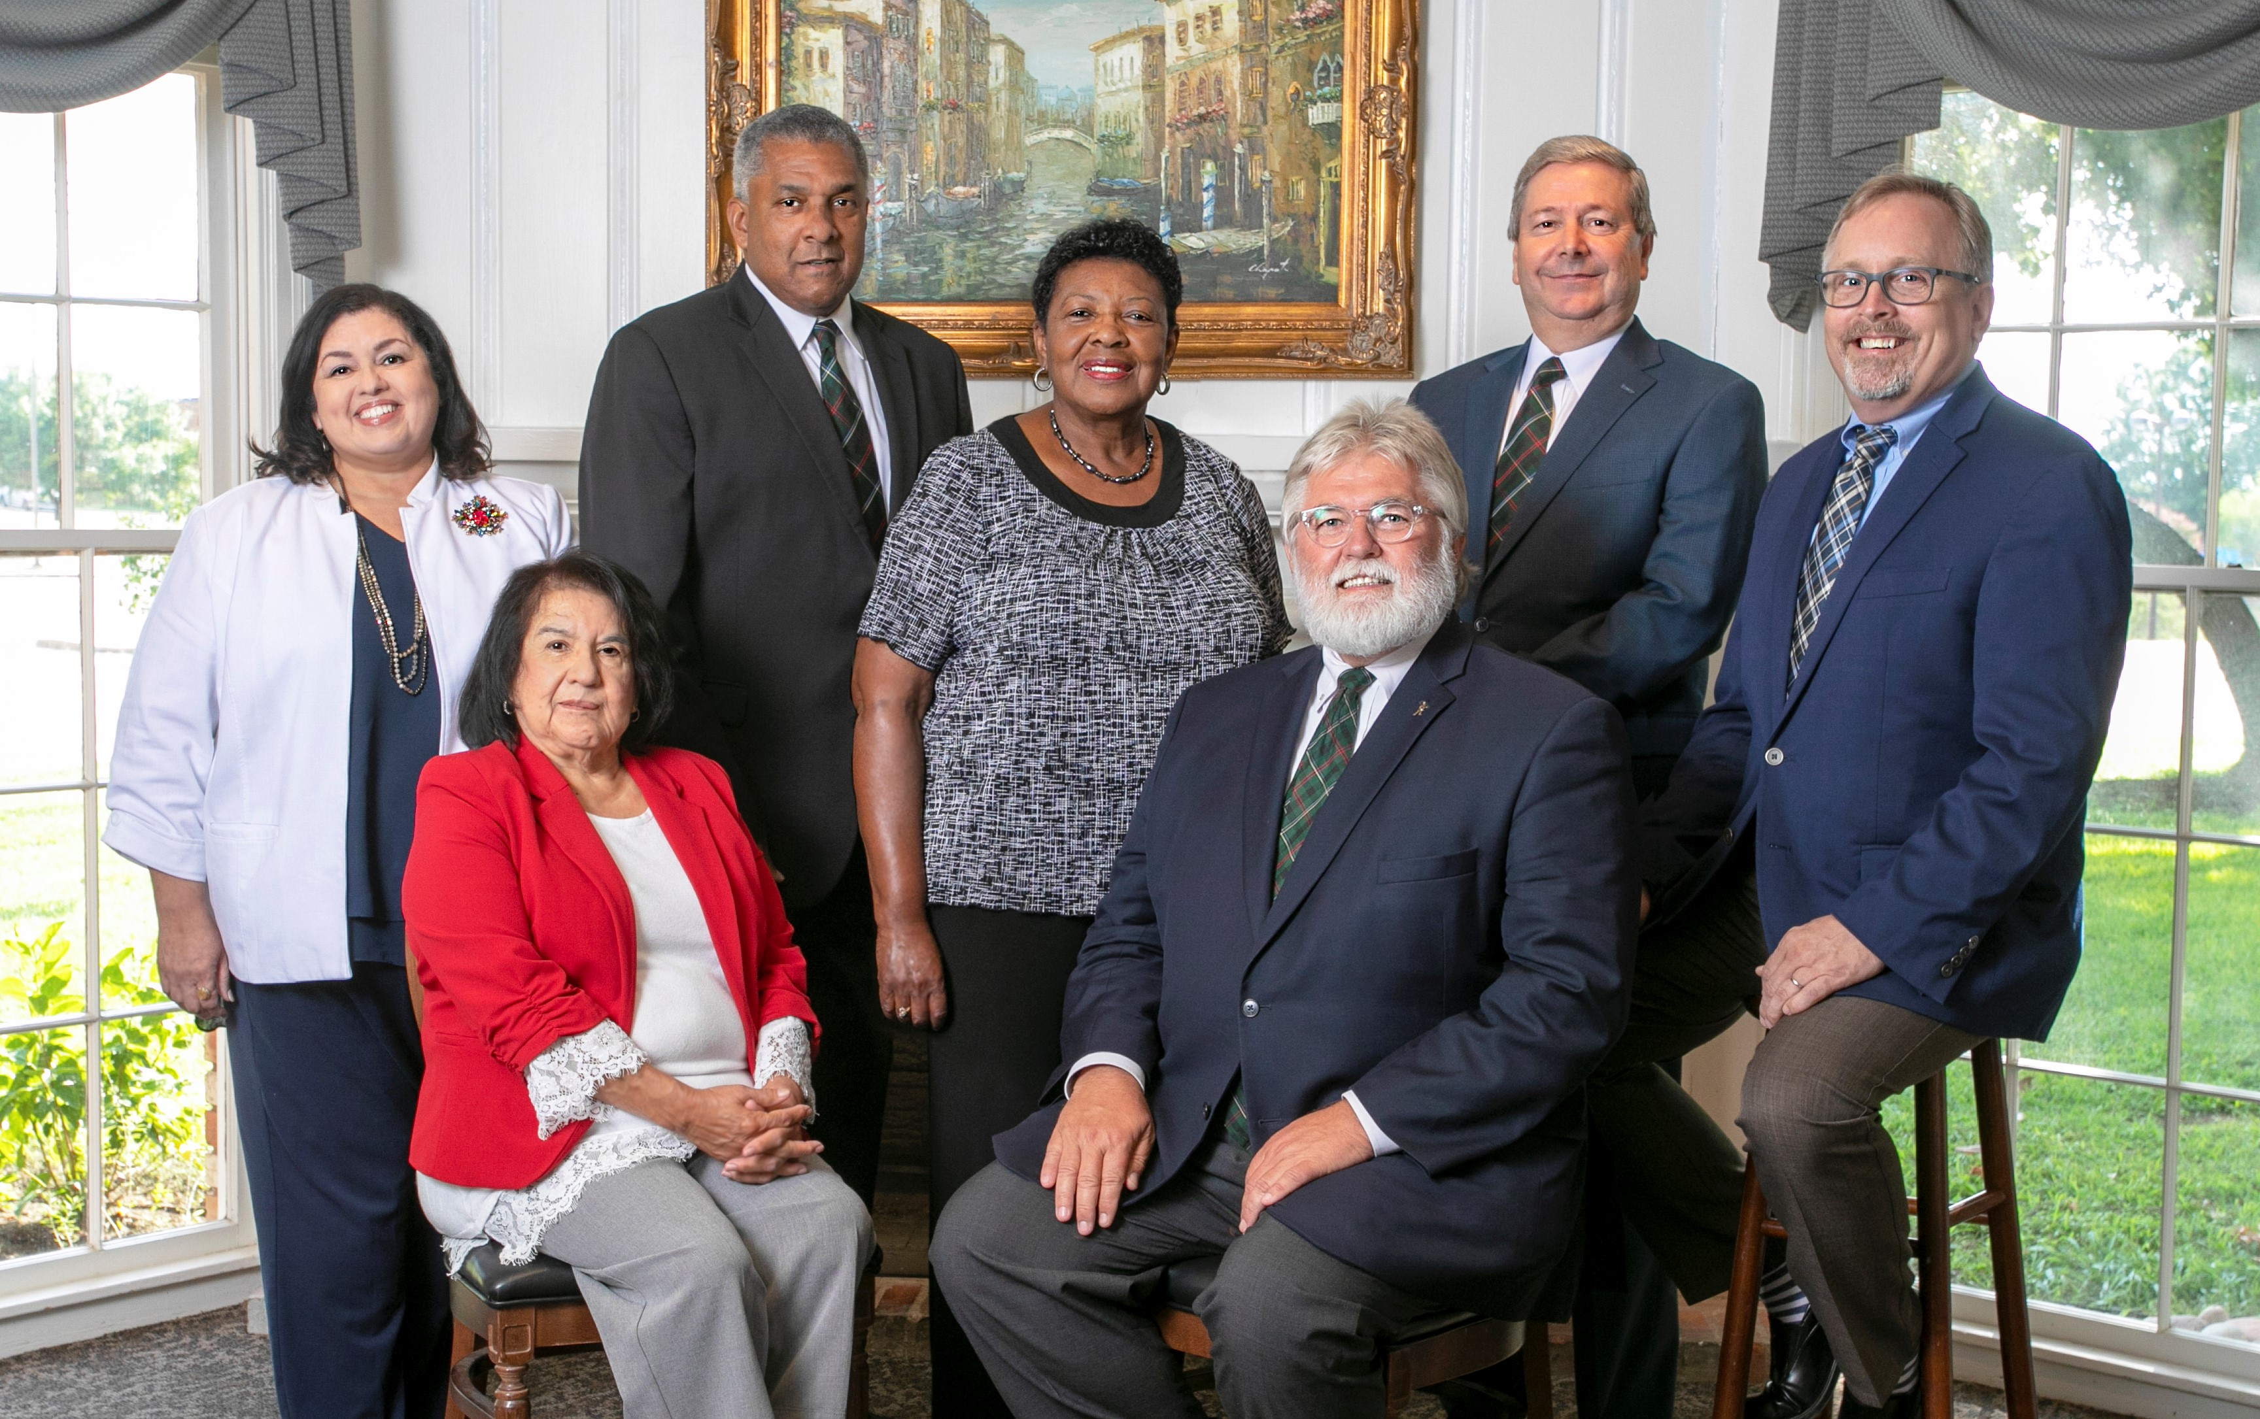
DISCUSSION
Pictured, from left: Dr. Elizabeth Palacios, Pauline Chavez (seated), Earl Stinnett, Sr., Geneva Watley, K. Paul Holt (seated), Ricky Turman, Doug McDurham

Slide 21
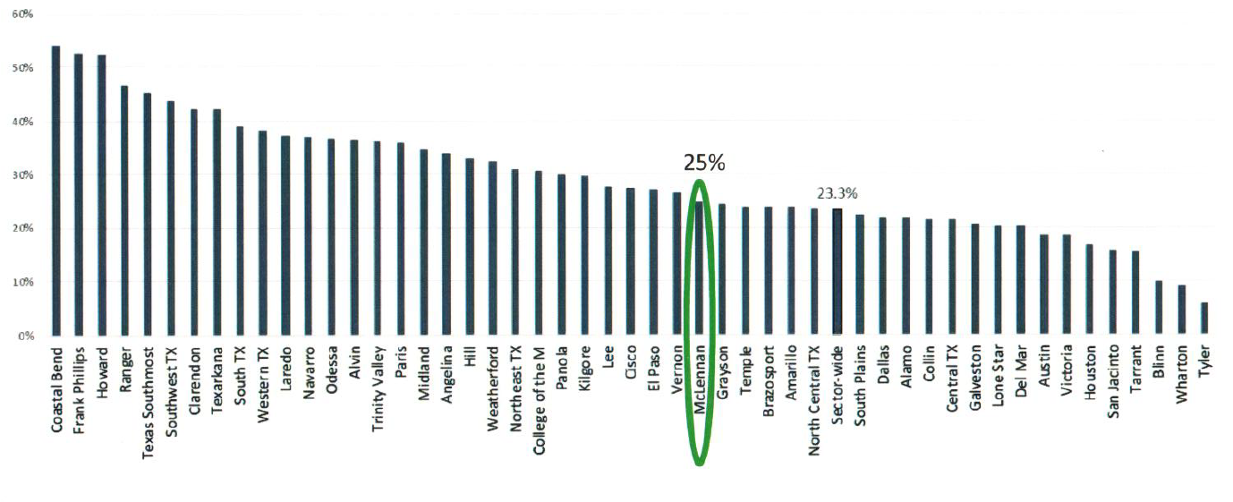

Community Colleges - FALL 2018

Slide 22
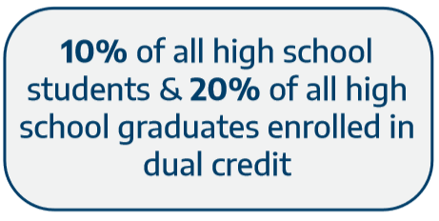
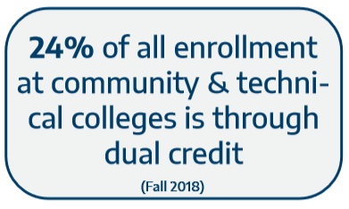
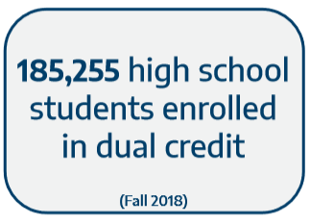
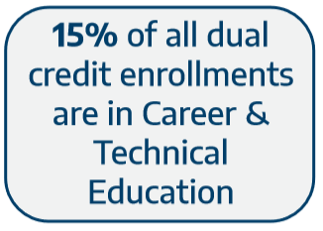
Quick Facts Dual Credit in Texas

Slide 23
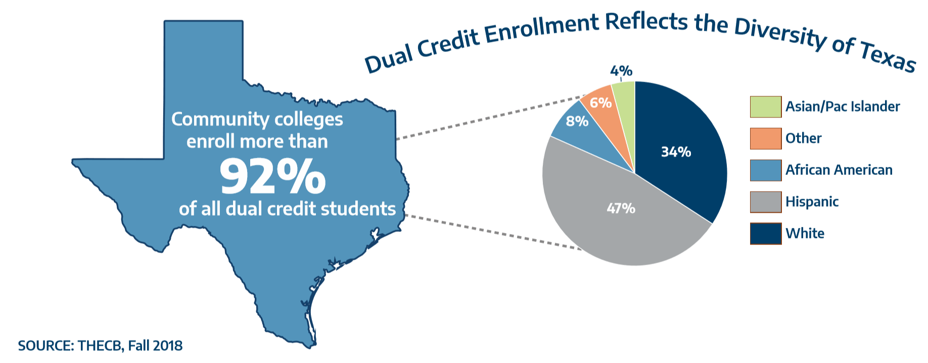

Slide 24
