Slide 1

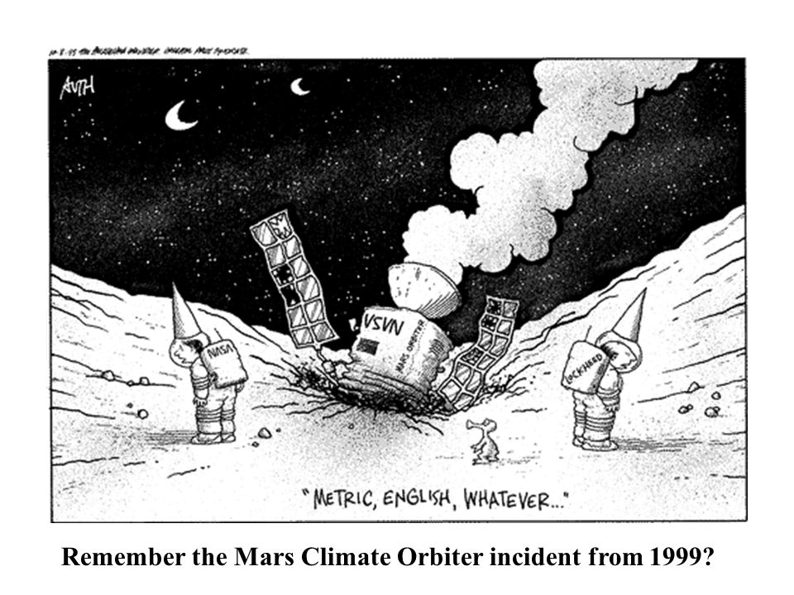
Avoid Disasters:
Learn Unit Conversions!
Laura Wright
Associate Professor, Engineering
McLennan Community College
Source: https://slideplayer.com/slide/5829764/19/images/37/Remember+the+Mars+Climate+Orbiter+incident+from+1999.jpg

Slide 2
Base Quantities
Common Unit Systems
Length
Mass
Time
Most all other quantities are combinations of these three!
SI Unit System
US Customary Units

Slide 3

Unit System | Length | Mass | Time
SI Units | Meters (m) | Kilograms (kg) | Seconds (s)
US Customary Units | Feet (ft) | Slugs | Seconds (s)
Pounds
(lb)
Actually a force! Not a mass
SI Units commonly called “MKS” units
US Customary commonly called “FPS” units

Slide 4
Common Conversion Factors
Length: Customary to SI
1 mi = 1609.34 m
1 in = 2.54 cm
Time: Customary & SI
1 hour = 60 minutes
1 minute = 60 seconds

Slide 5
Example: Convert 9.85 mph to m/s
Identify which units need to be converted:
miles to meters
hours to seconds
2. List conversion factors:
1 mi = 1609.34 m
1 hr = 60 min
1 min = 60s
3. Set up problem and solve:
9.85 mi
1609.34 m
1 hr
1 min
x
x
x
=
4.40 m/s
1 hr
1 mi
60 min
60 s

Slide 6
But for real, Professor Wright… Why do I have to know this?
Unit conversion errors have the potential to cost millions of dollars and/or lives

Slide 7
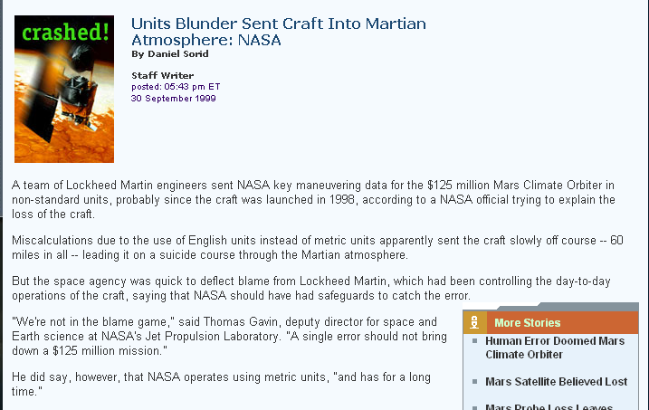

Slide 8
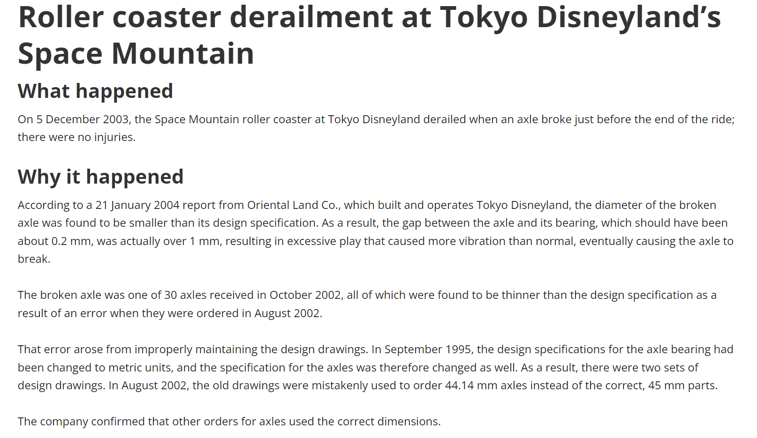

Slide 9
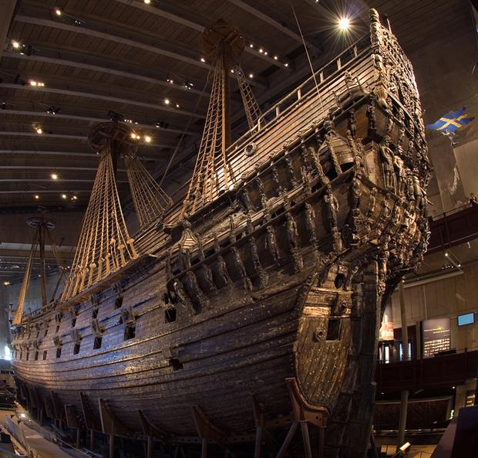
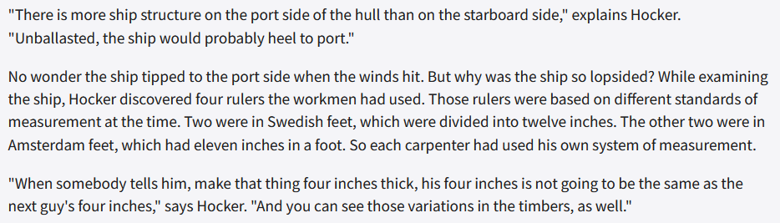
New Clues Emerge in Centuries-Old Swedish Shipwreck

Slide 10
Thank you for your time!
Questions?

