Slide 1
Texas Commission on
Community College Finance:
Final Recommendations

Slide 2




Texas community colleges enroll 43% of all postsecondary students in the state.
Our colleges:
43%
Award
92%
Provide a pathway for transfer.
93%
Enroll
70%
of all dual credit enrollments in the state
of all career and technical education degrees & certificates
of all FY2019 bachelor’s degree graduates had some transfer credits from a two-year college

Slide 3
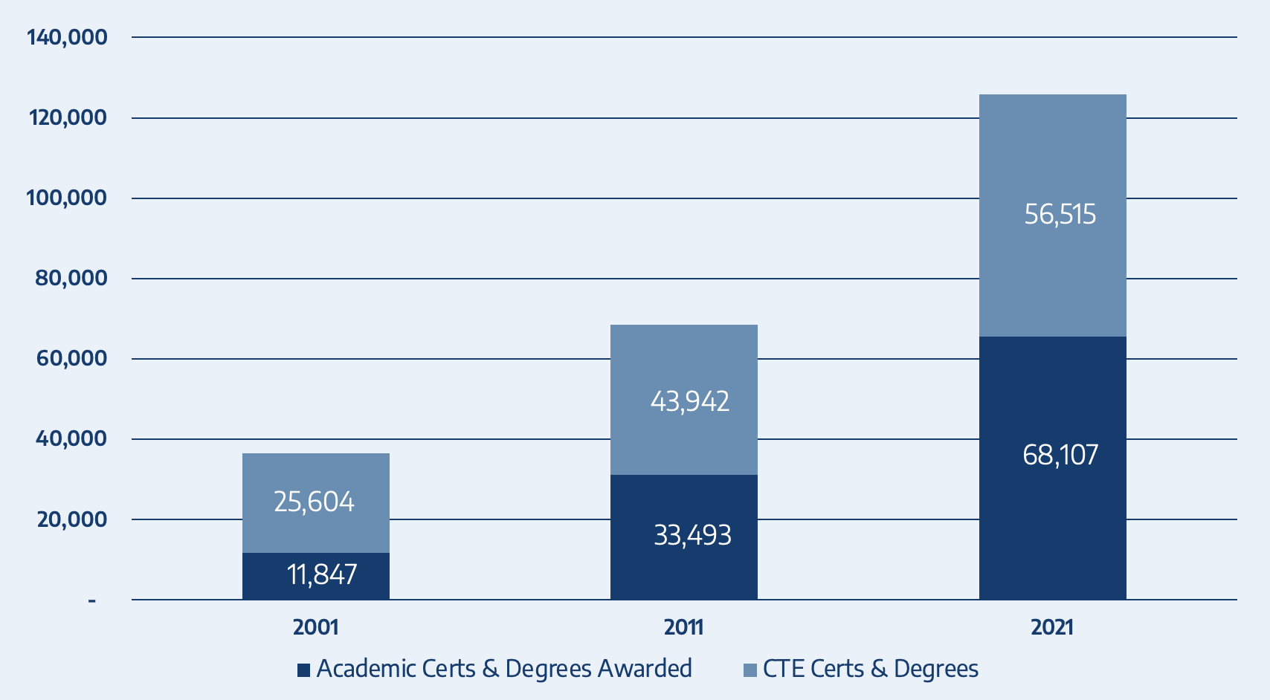
Texas community colleges help meet workforce needs
Total Certificates and Degrees Awarded by Community Colleges

Slide 4









Texas community colleges are currently
funded through 3 main sources of revenue
State Appropriations
Local Property Taxes
Tuition & Fees
tacc.org

Slide 5
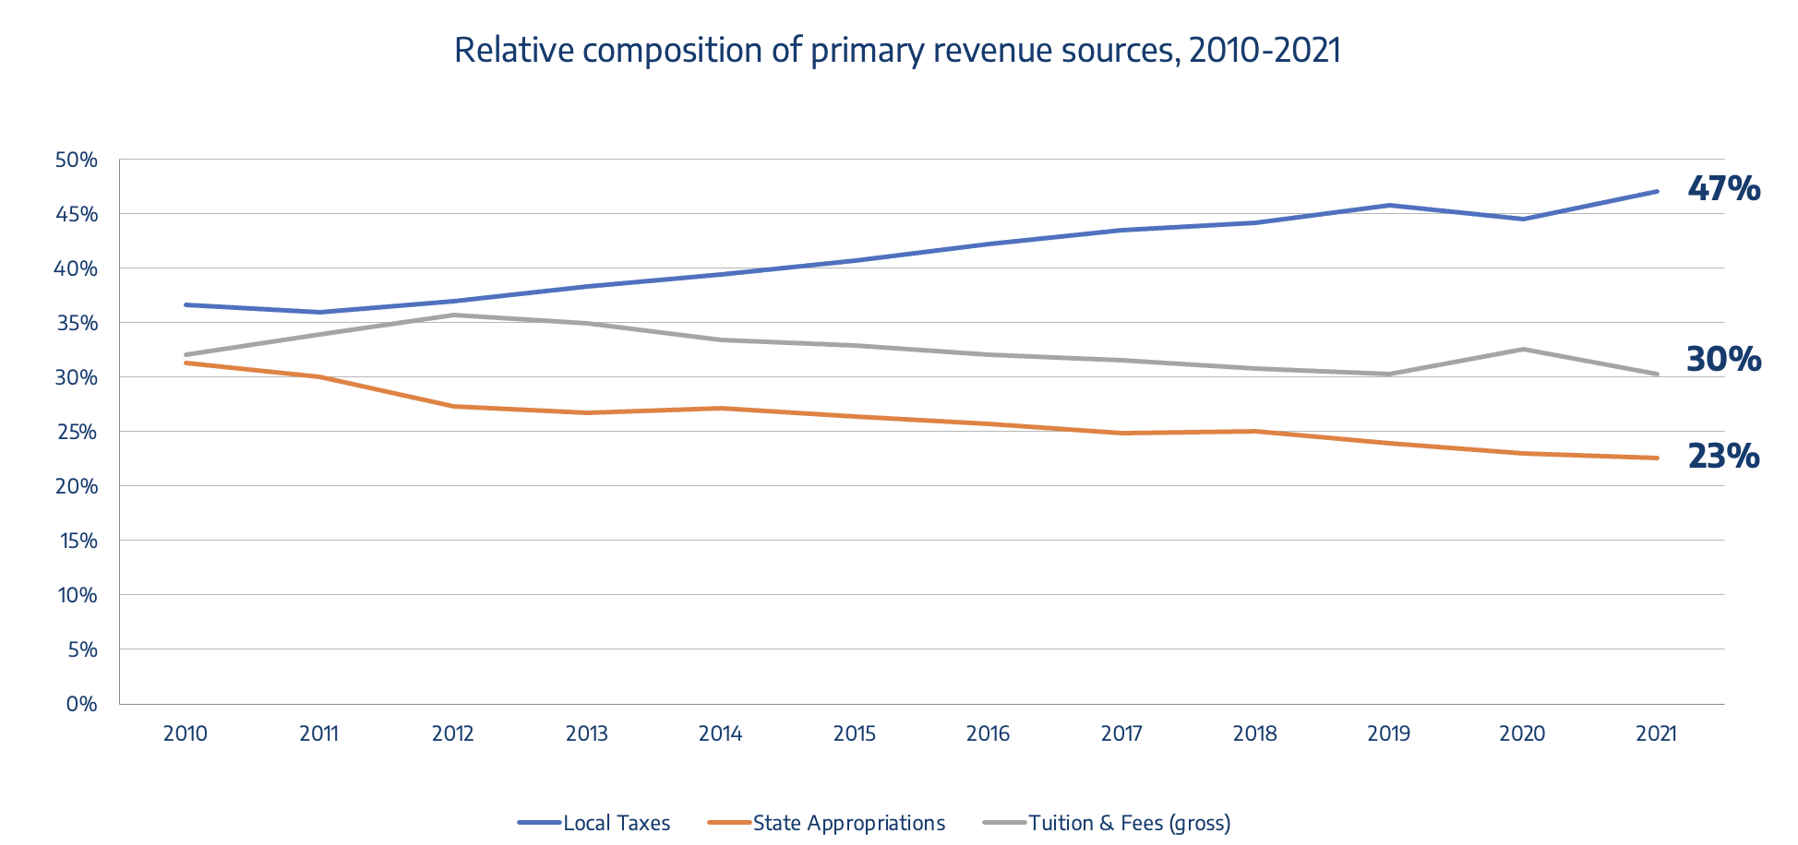
Funding streams have significantly changed
tacc.org

Slide 6
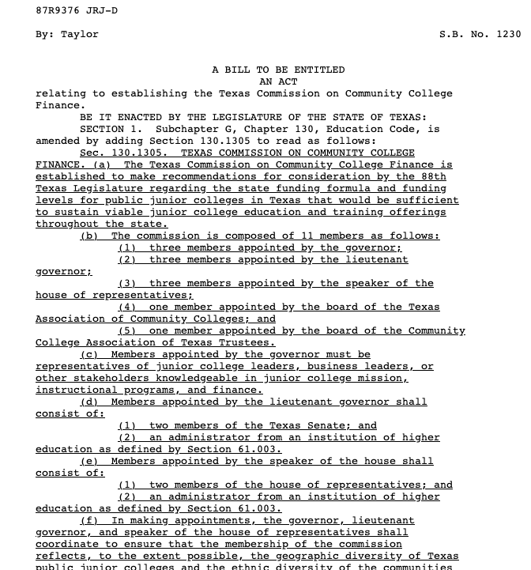
87 (R) – SB 1230
Relating to establishing the
Texas Commission on Community College Finance
Passage: May 7, 2021
Commission goal:
The commission shall make recommendations for consideration by the 88th Texas Legislature for establishing a state funding formula and funding levels sufficient for sustaining viable community college education and training offerings throughout the state.
tacc.org

Slide 7
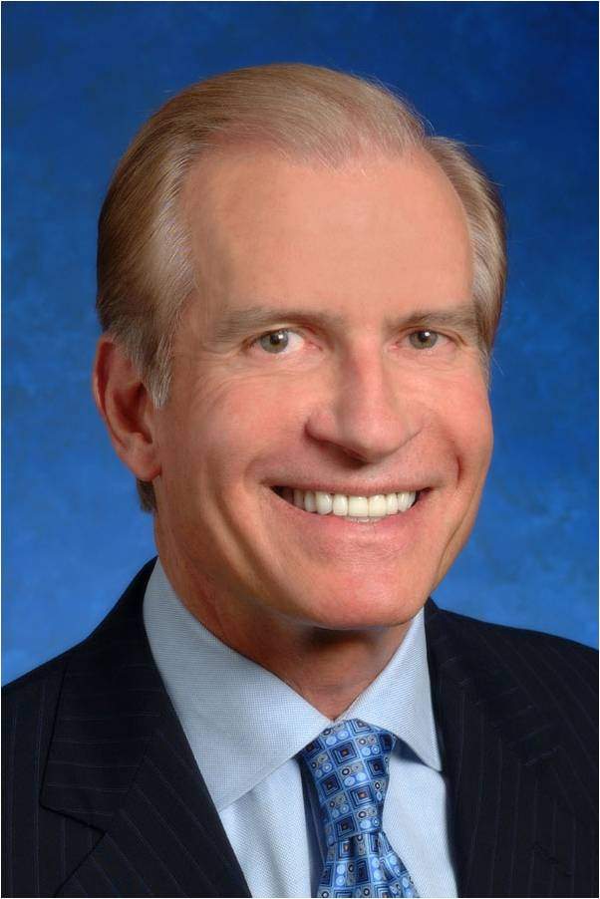
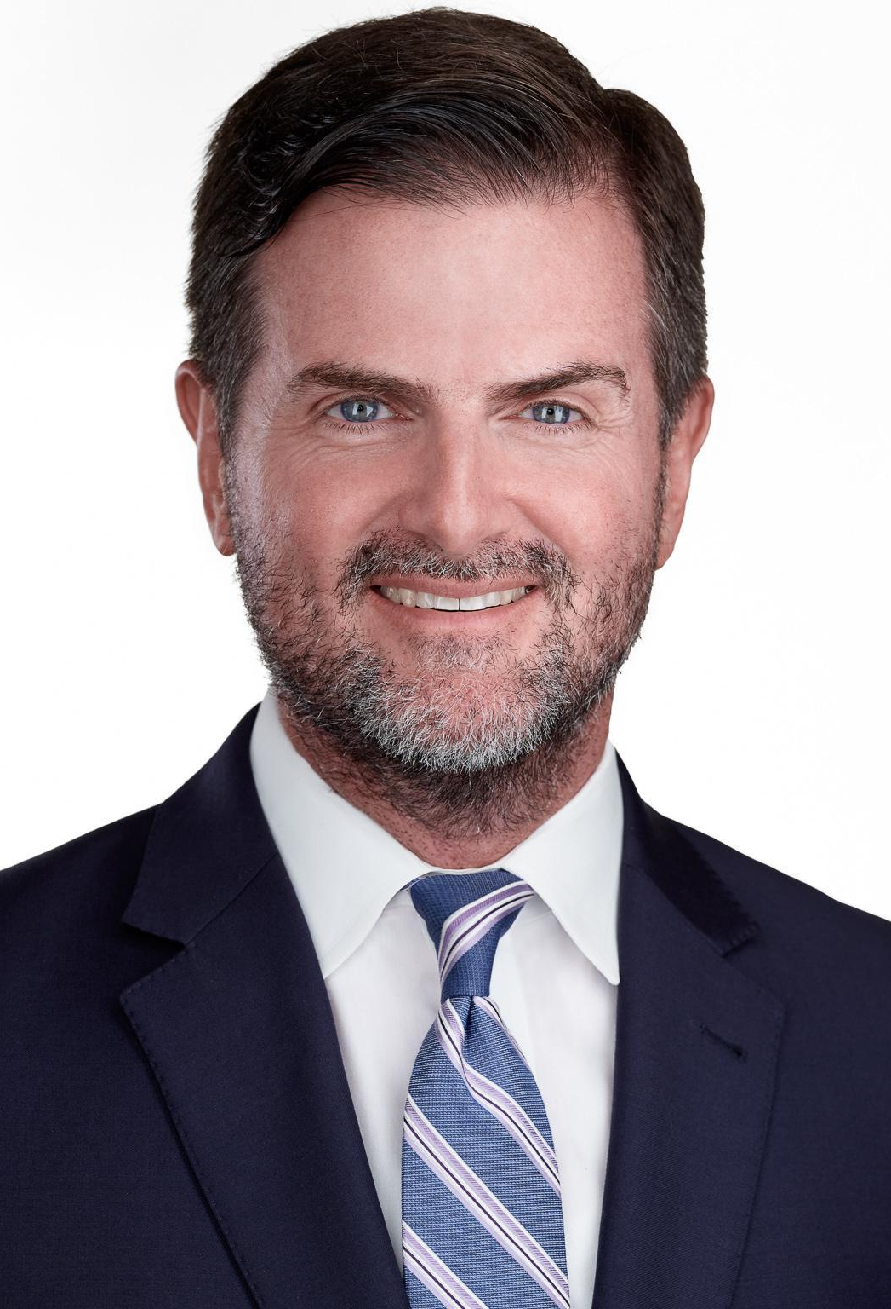
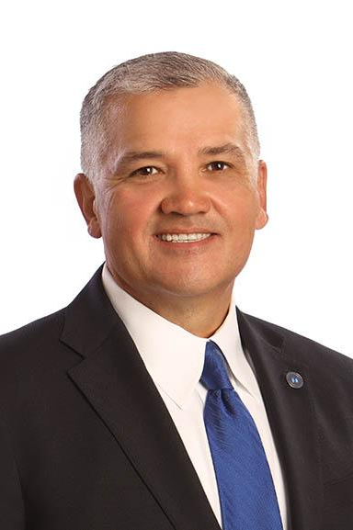
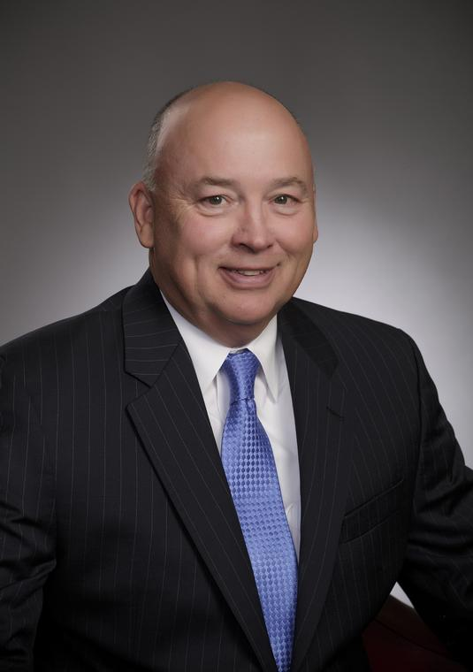
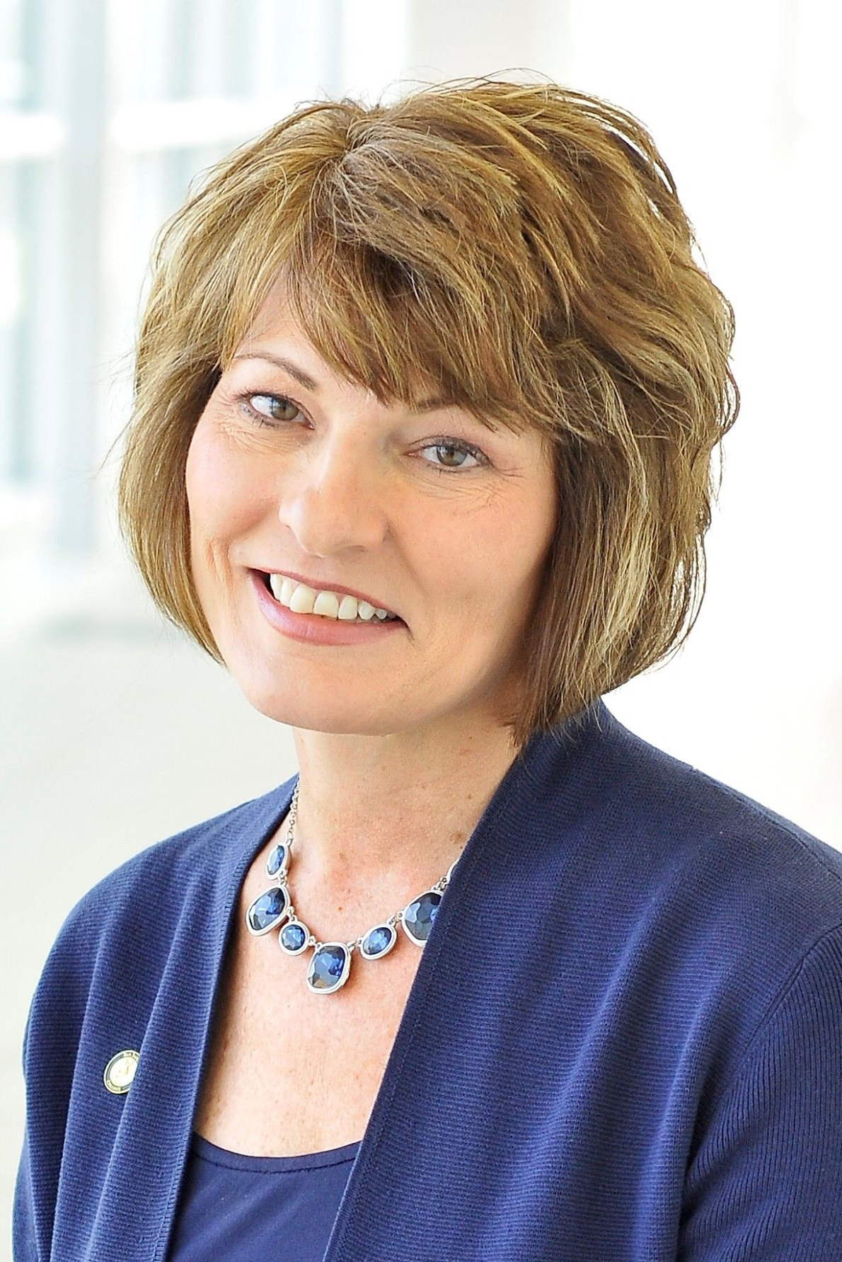


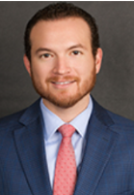
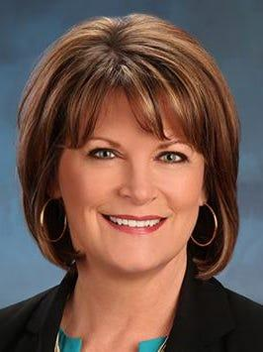
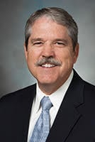
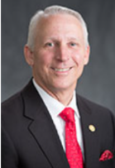
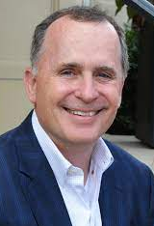
Commission Appointees
Chairman
Woody Hunt
Senior Chairman of the Board of Hunt Companies
Brandon Creighton
Texas State Senate
Dr. Mark Escamilla
President,
Del Mar College
Dr. Steve Head
Chancellor,
Lone Star College
Dr. Brenda Hellyer
Chancellor,
San Jacinto College
Brian Jones
Director, Professional Learning at Odessa College
Dr. Brenda Kays
President, Kilgore College
Oscar Longoria
Texas House of
Representatives
Carol Scott
Chair, Del Mar College Board of Regents
Larry Taylor
Texas State Senate
Gary VanDeaver
Texas House of
Representatives
Todd Williams
CEO, The Commit Partnership

Slide 8
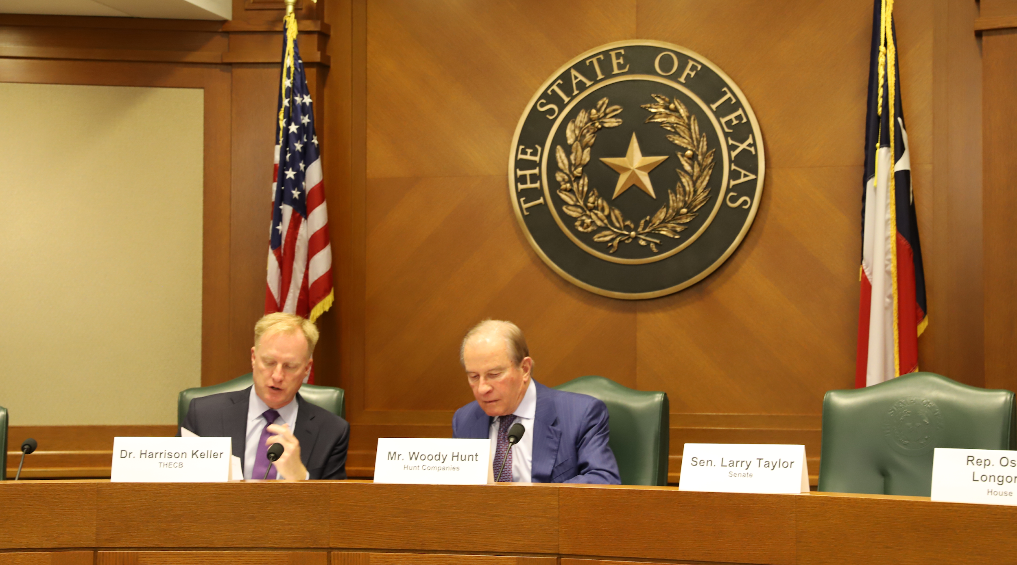
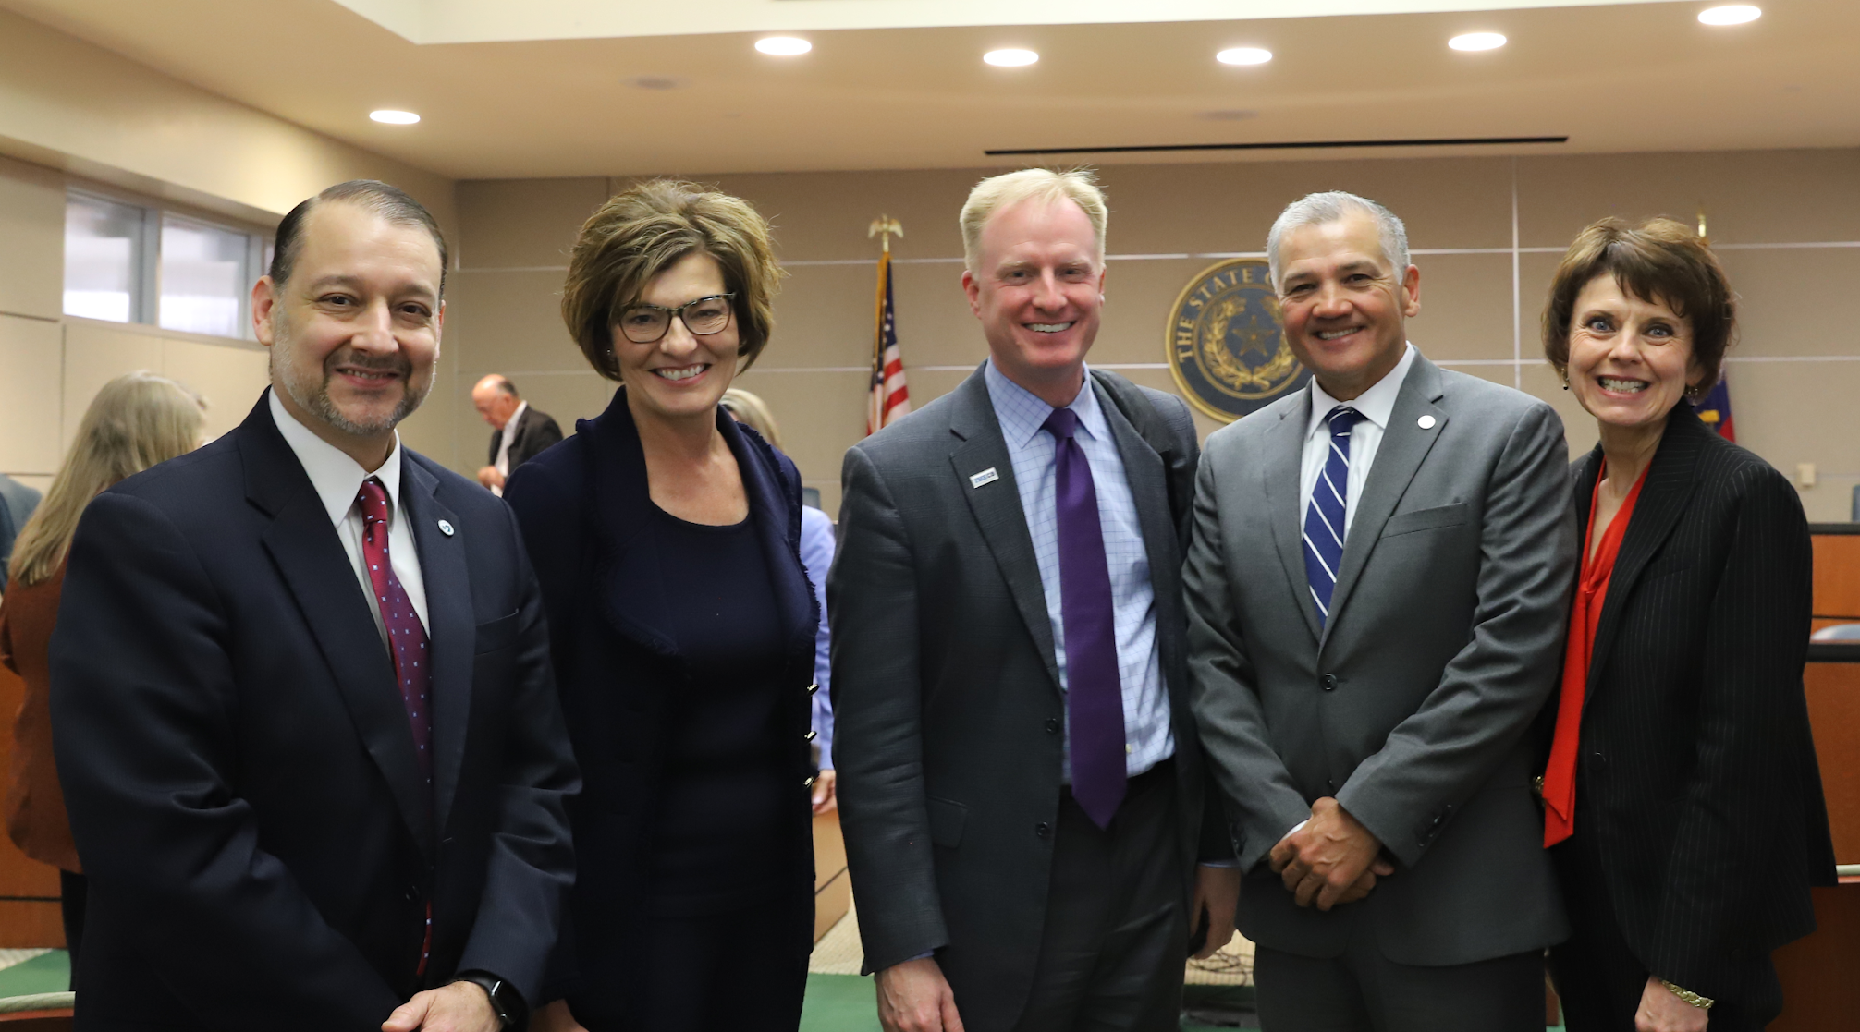
TXCCCF Meeting Cadence
Inaugural meeting – November 15, 2021
The full Commission met a total 6 times
Commission broke into three workgroups to further explore topics:
College Operations
Student Supports
Workforce Policy
Final report timeline:
September 12, 2022 – Commission issued first draft of report
October 18, 2022 – Commission presented updated draft and unanimously approved the recommendations
November 1, 2022 – Final report submitted to Texas Legislature
Texas Legislative Session starts January 10, 2023
tacc.org

Slide 9






Static Formula
Dynamic Formula
+
+
vs.
vs.
This is a historic opportunity to transition from a funding model that is static and merely redivides the same pie,
to one that provides colleges with predictable funding based on outcomes.

Slide 10






Key Changes from September Draft
The addition of dual credit courses that apply toward academic or workforce education program requirements as a metric to the outcomes-based formula in Recommendation 1.1.
Temporary hold harmless language to ensure that no college receives less state funding under the new outcomes-based formula than what is provided under the current formula.
A recommendation to provide discretionary authority to the Texas Commissioner of Higher Education to address "unintended consequences" of the new funding formula.
A change in terminology from “uniform” to “maximum” dual credit tuition rate in Recommendation 2.2.
tacc.org

Slide 11
TXCCCF Final Recommendations
1. State Funding for Outcomes
$430M
Recommendation 1.1: Develop a modern community college finance model that distributes the majority of state funding based on measurable outcomes aligned with regional and state workforce needs and state goals for Building a Talent Strong Texas.
This new outcomes-based formula should be dynamic, with adjustments through an annual settle-up process. Funding levels should be based on individual colleges’ current outcomes with specified fixed dollar amounts for:
Credentials of value, including degrees, certificates, and other credentials from credit and non-credit programs that equip Texas students for continued learning and greater earnings in the state economy;
Credentials of value awarded in high-demand fields;
Students who transfer to four-year universities; and
Students who complete a sequence of dual credit courses that apply towards academic and workforce program requirements.
Recommendation 1.2: Ensure community colleges across Texas can access foundational levels of funding for instruction and operations through a state-funded guaranteed yield for colleges with low taxable valuations.
tacc.org

Slide 12
TXCCCF Final Recommendations
2. Affordability for Students
$170M
Recommendation 2.1: Increase funding for Texas Educational Opportunity Grants (TEOG) and link state performance measures for eligible students served through TEOG at two-year institutions and TEXAS Grants at universities to establish a state goal of supporting at least 70 percent of qualified low-income college students in pursuing postsecondary credentials of value at public two- and four-year institutions. The TEOG program should also be restructured to provide colleges greater flexibility in meeting the needs of non-traditional students pursuing a wide variety of credentials of value, including non-credit and short-term programs.
Recommendation 2.2: Provide financial aid through colleges to cover tuition and required fees in dual credit courses for economically disadvantaged students. This new targeted financial aid for dual credit should be administered by THECB, with support from the Texas Education Agency (TEA), for dual credit courses that apply towards academic or workforce education program requirements. It should also incorporate a maximum tuition rate for dual credit courses set annually by THECB to help ensure equitable access for high school students across the state to dual credit courses.
tacc.org

Slide 13
TXCCCF Final Recommendations
2. Affordability for Students
Recommendation 2.3: Expand partnerships among colleges and private employers for paid work-based learning opportunities, including work-study, apprenticeships, and internships related to students’ programs of study, utilizing the work-based learning strategic framework developed by the Governor’s Tri-Agency Workforce Initiative. Work-based learning is a proven strategy to provide financial support while giving students opportunities to apply and develop skills through real work experiences in industry settings. The state should leverage existing federal funding and provide targeted state support for programs developed in partnership with employers and offered through colleges to expand paid work-based learning.
tacc.org

Slide 14
TXCCCF Final Recommendations
3. Investments in College Capacity
$50M
Recommendation 3.1: Provide one-time seed grants for programs in high-demand fields to support community colleges in rapidly standing up or expanding programs to meet regional and state workforce needs. These grants would be administered through THECB in consultation with the Texas Workforce Commission. Drawing on insights from initial implementation of the Texas Reskilling and Upskilling through Education (TRUE) program, the state should give priority to short-term workforce programs developed in partnership with employers.
Recommendation 3.2: Support and facilitate shared services and stronger inter-institutional partnerships. THECB should facilitate shared services to enable individual colleges to improve operational efficiency and expand the range of academic and workforce programs they offer. These shared services might include support for inter-institutional partnerships, master service agreements, and state technology infrastructure, along with related feasibility studies. For example, institutions across the state should be able to leverage other institutions’ online courses so students can stack courses, credits, and credentials to earn degrees, certificates, and short-term workforce credentials that smaller colleges would be unable to offer on their own.
tacc.org

Slide 15
TXCCCF Final Recommendations
3. Investments in College Capacity
Recommendation 3.3: Update state policies, and build upon the recent work by individual colleges, to help community colleges across the state provide high-quality non-credit credential programs that are convertible and stackable with credit-bearing programs. A state crosswalk of non-credit to credit courses and programs will improve transferability of workforce education courses across institutions and throughout students’ pathways, from high school dual credit programs through pathways for adult learners to support ongoing reskilling, upskilling, and career advancement. This state crosswalk could also facilitate and improve the mobility of credit awarded for students’ prior work experience. Projects already underway through the Governor’s Tri-agency Workforce Initiative to clarify and streamline career pathways should be considered in these specifications of stackable credentials.
tacc.org

Slide 16

Minimum Additional State Investment Needed
TOTAL
Formula
Financial Aid
College Capacity
$430M
$170M
$50M
$650M
tacc.org

Slide 17
Thank you
For further information, please contact:
Ray Martinez III, J.D.
ray.martinez@tacc.org
(512) 653-3331 (Mobile)
Texas Association of Community Colleges https://tacc.org/

