Slide 1
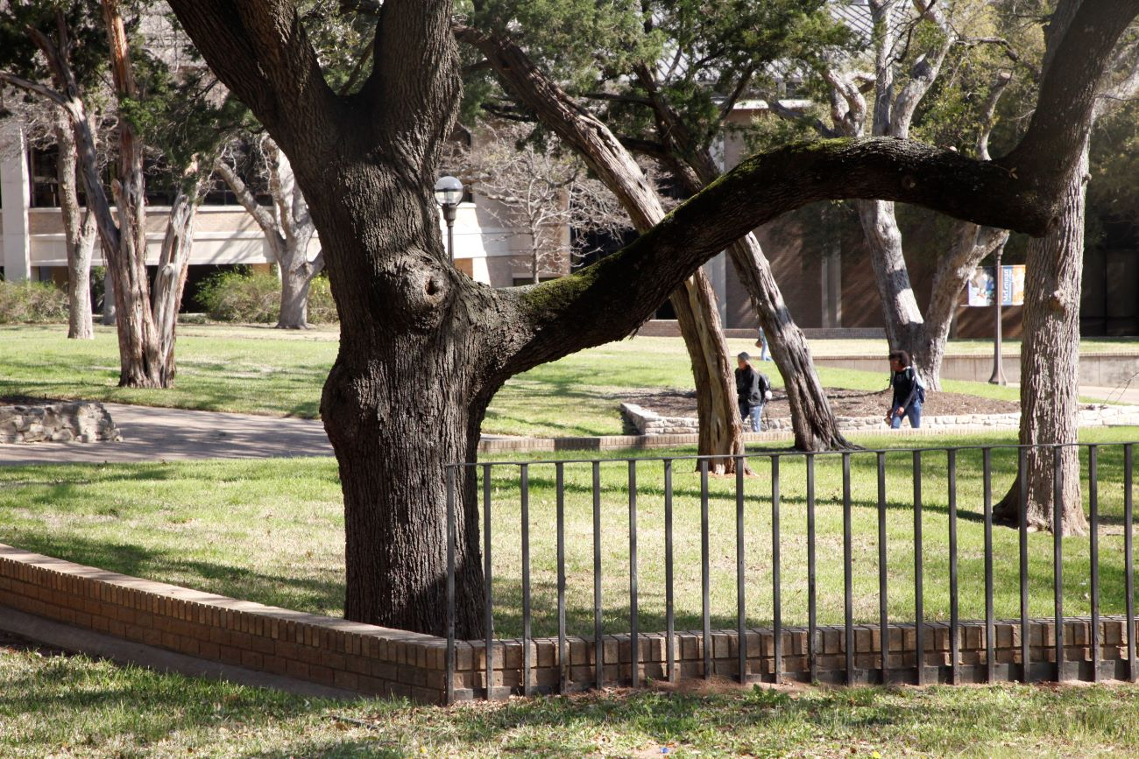

Legislative Update January 2023
Texas Association of Community College
Community College Association of Texas Trustees

Slide 2

88th TEXAS
LEGISLATURE
2023 Legislative Priorities
Finance Reform
Texas Education Opportunity Grants
Cybersecurity & IT Modernization
Clinical Nursing Sites
Texas Transfer Framework
Notes:
88th Texas Legislature 2023 Legislative Priorities Community College Finance Reform Support legislation developed from the final recommendations of the Texas Commission on Community College Finance. The new proposed model ties funding directly to measurable outcomes such as transfer rates, credentials of value, credentials in high-demand fields, and dual credit. Most notably, it moves away from a funding model that is static to one that is dynamic and provides colleges with predictable funding based on their own success. The recommendations also include additional funds for colleges to support low-income or academically unprepared students, and adult learners. Texas Education Opportunity Grants (TEOG) Texas Education Opportunity Grants are the state’s primary method for providing financial aid to community college students. However, colleges are required to provide matching funds to draw down this aid. TACC seeks to provide the same flexibility allowed for four-year universities to match the financial aid program for their students. Specifically, by allowing Pell Grants to count for that match with TEOG the way they do with TEXAS Grants. The Texas Association of Community Colleges (TACC) and the Community College Association of Texas Trustees (CCATT) support the following legislative priorities. Cybersecurity & IT Modernization During the 87th Texas Legislature, HB 4018 was passed establishing a Joint Operations Committee (JOC) of the legislature to oversee state funding for IT modernization projects across state agencies and institutions of higher education. Community colleges submitted reports on their modernization strategies and timelines in the fall of 2022. TACC will advocate to utilize one-time funding to the extent it’s made available, to meet those needs for community colleges should funding be provided to other state agencies or institutions of higher education. Clinical Nursing Sites There is statewide demand for growing our nursing workforce. The Board of Nursing and has noted the lack of clinical nursing hours as a key constraint on the state’s nursing pipeline. TACC will seek to address the nursing shortage and ensure that availability for clinical nursing sites is prioritized for students from Texas community colleges through statutory authority via the Texas Higher Education Coordinating Board (THECB). Texas Transfer Framework For the past three years the Texas Higher Education Coordinating Board (THECB) has developed and implemented the new Texas Transfer Framework, to improve transferability and portability of credit hours between two-year and fouryear institutions, and revise the current Fields of Study curricula. However, the THECB lacks statutory authority to enforce articulated Fields of Study disciplines. TACC will advocate for additional statutory authority for the THECB to better implement Texas Transfer Framework.

Slide 3
88th TEXAS
LEGISLATURE
Update
Community College Finance Commission
State Funding for Outcomes
Affordability for Students
Investments in College Capacity

Slide 4

Changes in Funding Model
2023
Dynamic model primarily based upon student outcomes
Allows for future growth as outcomes are achieved:
Degrees,
Certificates,
Credentials from credit and non-credit programs
Credentials of value in high-demand fields,
Completion of dual credit courses toward an academic or workforce program,
Transfer to four-year universities
Investment of additional $650m in next biennium
Notes:
Wash DC – Ashley Cruseturner, Jeremy Lehman, Andrew Clayton, Government and History, Presidential Scholars
Trips in May 2023
Roatan, Honduras – Stephanie Randel, Biology
Rome, Italy – April Andreas and Laura Wright, Engineering
Southwest (Texas, New Mexico, Colorado, Utah, Arizona) – Elaine Fagner, Geology/Environmental Sciences
Barcelona, Monserrat in Spain; Paris and Beauvais, France- Bonnie Sneed, Choir
London, Paris and Munich - Mandy Morrison, Becky Parker, Kelly Parker, and Karen Crump , Music, Theater, Business and Hospitality
Brno and Czech Republic – Amy Antoninka and Jessica Zbeida, Presidential and Honors College Scholars
1.1M included for their Health Professions Simulation Lab Yes sir. $1.1M included for their Health Professions Simulation Lab

Slide 5
Other Notable Aspects of Recommendations
2023
Baseline operational support for colleges with low taxable valuations
Guaranteed yield for struggling colleges with property taxes and tuition/fees
Incentives for workforce education
Seed grant funding for capacity building of new programs or expansion
Student characteristics
More funding for economically and academically disadvantaged students and adult learners
Increased access to financial aid
Increased funding from 28% to 70% of students qualifying for TEOG (Texas Educational Opportunity Grant
Dual credit financial aid
Provision of state support for dual credit tuition and fees for students qualifying for free or reduced lunch program
Notes:
What are other notable aspects of the final recommendations?
● Baseline operational support for colleges with low taxable valuations: a guaranteed yield for colleges
that struggle with needed revenue to support core operations through property tax collections and
tuition/fee revenues.
● Incentives for workforce education: seed grant funding for capacity building of new or expansion of
existing programs to meet regional and state workforce needs.
● Student characteristics matter: more funding for students who need additional resources to succeed,
such as economically and academically disadvantaged students, as well as adult learners.
● Increased access to financial aid: Texas Educational Opportunity Grant Program (TEOG), the state’s need-
based, financial aid program for community college students, currently provides enough funding for only
28% of eligible students. The recommendations increase the funding level to support at least 70% of
students who qualify for TEOG. The recommendations also include greater flexibility for using TEOG, such
as allowing their use for a wide variety of credentials of value, non-credit and short-term training programs,
and for non-traditional students.
● Dual credit financial aid: the recommendations also provide state support for dual credit tuition and fees
for students who qualify for free or reduced lunch programs.

Slide 6
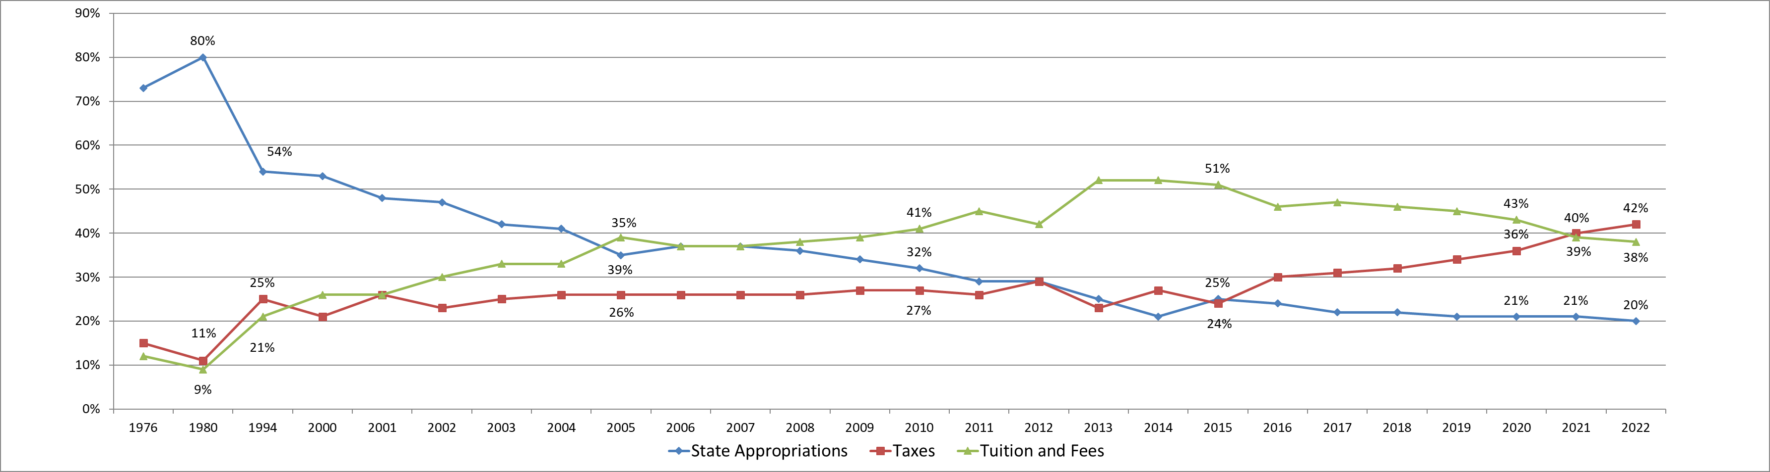
McLennan Community College
Revenue by Source

