Slide 1
Year-1 Update
Presented by Dr. Amber Bracken

Slide 2
RE-CAP
What is a QEP?
LEAP (2012-16)
Title V Grant (2020-25)
PASS (2022-27)
Notes:
T5: (1)

Slide 3
PASS PLAN
GOAL 1: Provide FTIC students with peer-led academic support
Objective 1a: Standardize training and evaluation of tutors, LF mentors, and SILs
Objective 1b: Integrate and promote peer-led academic support programs campus-wide
GOAL 2: Bolster peer social support for FTIC students
Objective 2a: Foster relationships among students and mentors in LF sections
Objective 2b: Integrate and promote peer social support programs

Slide 4
ASSESSING PROGRESS
OBJECTIVES MET IN YEAR 1
Standardize training of peer leaders
Develop peer leadership curriculum
Expand numbers of peer leaders & peer leader-supported classes

Slide 5
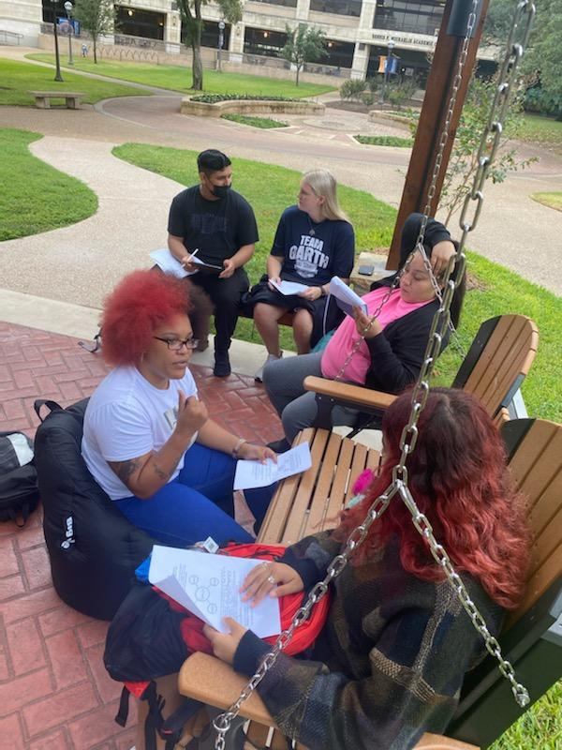
SI GROWTH BY SEMESTER
SEMESTER | FALL 2021 | SPRING 2022 | FALL 2022
SI Leaders | 9 | 8 | 14
Course Offerings | 8 | 11 | 17
Course Sections | 14 | 14 | 43
Unique Users | 115 | 200 | 421
Contact Hours | 470 | 1,000 | 1,704

Slide 6
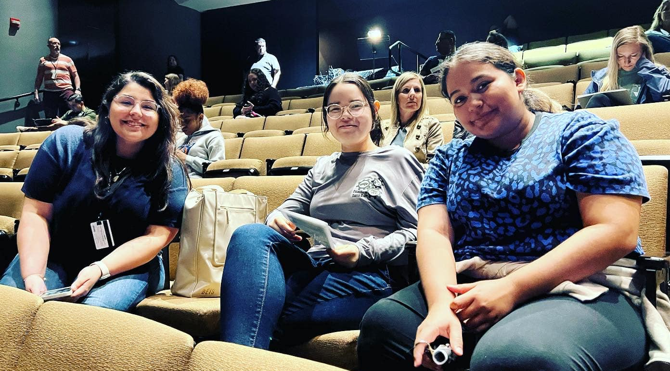
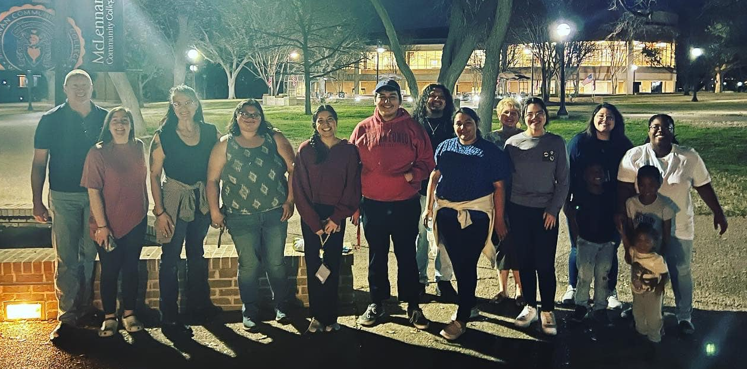
Peer Mentorship Growth by Year
YEAR | ONE | TWO
Peer Mentors | 5 | 10
Classes Served | 9 | 11

Slide 7
CHALLENGES IDENTIFIED IN YEAR 1
Requiring attendance/participation
Mid-year loss of peer leaders
Need for permanent, designated meeting areas
Awareness & participation
Data analysis/controlling for variables

Slide 8
YEAR 2 PLANS & RECOMMENDATIONS
Increase Awareness & Participation
Assess & Plan for Improvements in Year 3
Conference presentations
PASS website
Advertise to students & solicit faculty & staff recommendations
Focus groups
PD sessions
Implement & evaluate standardized trainings
Implement & evaluate peer leadership curriculum
Assess impact of peer leadership on student sense of belonging
Continue increasing numbers of student & faculty participating in the program

Slide 9

QUESTIONS

Slide 10
FEEDBACK FROM SACSCOC
STRENGTHS
Research-based & well supported
Builds upon LEAP
Supports Strategic Plan & core values
Adequate human & financial capital
Admins are committed
CONCERNS
Goals too similar to Title V
Assessment plan needed refining
More evidence of broad support needed, particularly among students & community
Heavy dependence upon students / Need for clear training & support

Slide 11
ADDRESSING CONCERNS
Goals
Revised to narrow focus & reduce overlap with Title V
Assessment Plan
Assess at course level, measure sense of belonging, & utilize qualitative assessments
Evidence of Support
Surveyed FTIC students & Workforce/CTE Advisory Councils
Training & Support
Developed standardized trainings, clear guidelines, and strengths-based curriculum

Slide 12
ASSESSING PROGRESS
SACSCOC OBJECTIVES MET IN YEAR 1:
Submit the QEP (September 2021)
Complete the on-site review of the QEP (November 2021)
Make revisions to proposed Quality Enhancement Plan (Spring 2022)
Receive approval of the QEP (Summer 2022)

