Slide 1
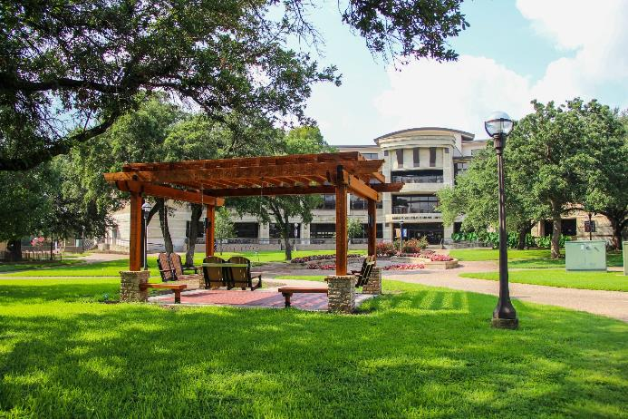

Student Retention & Graduation Update
March 2023

Slide 2
First Time in College First Year
Student Retention
Source: MCC Institutional Research Retention Files
Notes:
Remember FTIC students are those who have graduated high school, so these figures to not include dual credit students.
These rates will be different than prior presentations; we are using the Federal definition for retention rates.
Cohort – (Grads + Transfers)

Slide 3
First Time in College First Year
Student Retention
Source: MCC Institutional Research Retention Files
Notes:
These rates will be different than prior presentations; we are now using the Federal definition for retention rates.
Cohort – (Grads + Transfers)

Slide 4
First Time in College First Year
Student Retention
Source: MCC Institutional Research Retention Files

Slide 5
First Time in College
Three Year Graduation Rates
*FTIC Cohort data calculated by Census Data
Source: MCC Institutional Research Retention Files
Notes:
Average completion of a 2 year degree is now 3.5 years
When looking at this data it is important to note COVID is seen in data for Fall 2017 – Fall 2019 cohorts
Fall 2017 it was their last year/semester
Fall 2018 – they were half way through
Fall 2019 – they were one year into college

Slide 6


