Slide 1
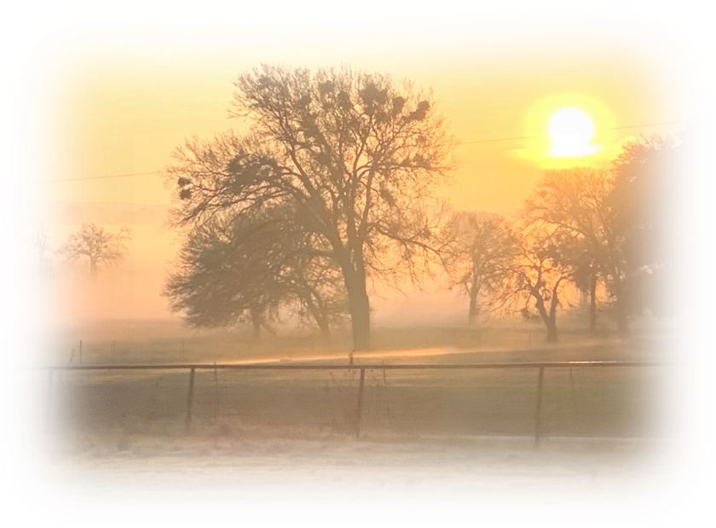
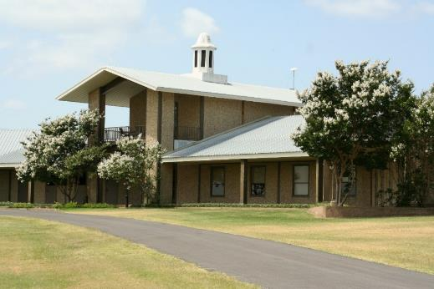
Review
4/25/2023

Slide 2
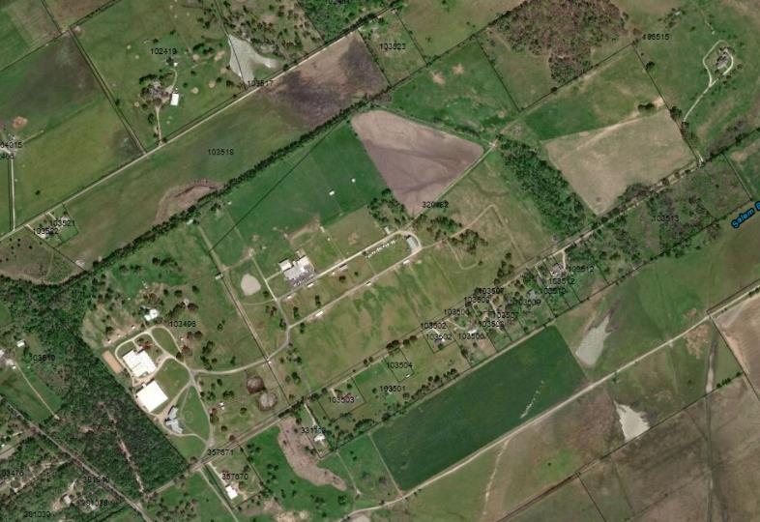
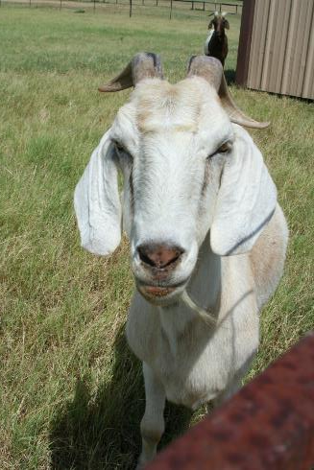
Financial Aspects – History
April 12, 2002 – Purchased 147.77 Acres for $750,000 (lower section)
July 30, 2003 – Purchased 49.39 Acres for $1,250,000 (upper section)

Slide 3
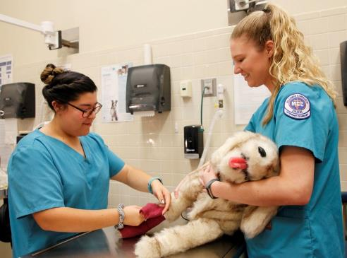
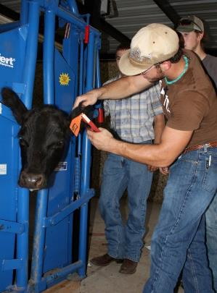
Strengths
Serves as a unique educational crossroad between local rural and urban communities
  Offers training opportunities for Vet Tech, Science, and Agriculture
  Vet Tech 1 of 15 fully AVMA-CVTEA accredited programs in Texas
  Vet Tech Lab 1 of 2 American Animal Hospital Association Accredited (AHAA) rated facilities in Central Texas
  Supports rural and urban community partnerships
  Located near Waco and MCC campus
Provides a forum for continuing education & community programs
  Horseback riding clinics and lesson (CHA)
  Horse shows and events
  Agricultural training
  K-9 courses, Kids College, Saddle Club, Equestrian Camp, Gardening, Hunter Safety, Agriculture (provides opportunities for inner-city youth)

Slide 4
Strengths
Hosts community special events:
  Joint Use: Indoor lab facilities for Ag and Vet Tech
  McLennan County 4-H Equine Program
  Co-Hosting Extraco/MCC Agriculture Invitational
Generates revenue through:
  Horse Boarding (44 horses currently) (EFM Certified)
  CE Programming, Horse Shows and Events
  Apartment and house rentals
Serves as evacuation site for area horses and livestock in case of emergency

Slide 5

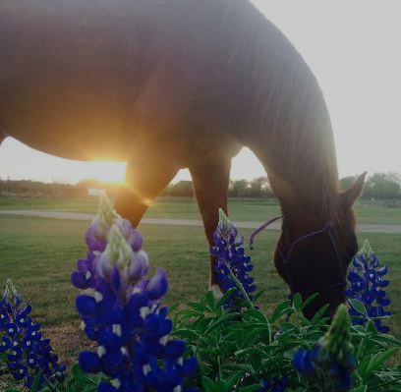
Our partnership with MCC allows the McLennan County Extension Office to offer high quality, relevant information to various populations across our region.
We have a unique partnership with MCC that allows us to have an enormous educational impact on youth, agriculture and health/nutrition education programs.
Dr. Shane McLellan
County Extension Agent - Ag, McLennan County
Notes:
2 other quotes coming for this slide

Slide 6
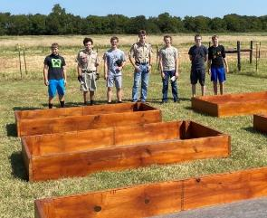
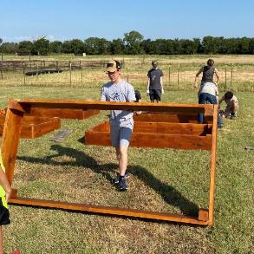
Ongoing Initiatives
Execute 5-year strategic plan:
  Expanding opportunities for community veterinarians and vet techs through use of our wet labs
  Offering hands-on experience for sciences classes
  Expanding community partnerships
    Waco mounted law enforcement officer training
    Master Gardeners and Master Composters
    County Extension Office
    University Center Partner Ag research programs
  Expanding CE course/program offerings
    Agricultural skill training center
    Equine Management Certification
    Community gardening
    Ecological testing ground (vertical Farming)
  Working with Central Texas dressage “L” programs
  Expanding the Equestrian Team
Continuing to grow Kids College offerings
Notes:
The Vet Tech hospital could serve as an evacuation facility for areas affected by disasters. There is FEMA funding available to help with this. We would need a generator for the hospital side.
Collaboration with ESEC programs to provide animal emergency care coursework.
Develop community garden, small farming plots. These could supplement Paulann’s pantry with fresh produce.
Space for native plant nursery.
Courses in organic gardening, backyard chickens, sustainable and environmentally friendly gardening, backyard farming.
Level 1 equine course
Possibility for competitive teams—equestrian, rodeo.
Opportunity to revitalize the agriculture program. Our students who transfer from MCC to TAMU have been very successful and recruiters are seeking them for their programs. Agronomy, Range Land Ecology Management, are two programs needing transfer students.

Slide 7
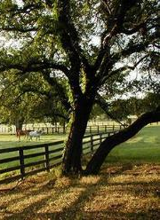
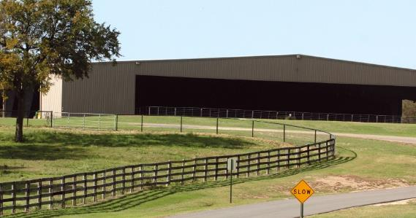
Challenges
Lack of visibility in the community
Ongoing facility maintenance costs
Long-term facility maintenance
Vet Tech program costs
Cost of upgrades
Cost of expansion to add facilities

Slide 8
Data – Vet Tech
Student Data | Fall 2022 | Fall 2021 | Fall 2020 | Fall 2019 | Fall 2018 | Fall 2017 | Fall 2016 | Fall 2015 | Fall 2014
Headcount | 23 | 39 | 29 | 31 | 38 | 46 | 45 | 40 | 47
Average Class Size | 9 | 12 | 9 | 11 | 13 | 14 | 9 | 11 | 12
 | 22-23 | 21-22 | 20-21 | 19-20 | 18-19 | 17-18 | 16-17 | 15-16 | 14-15
Majors | 27 | 40 | 38 | 54 | 44 | 64 | 73 | 117 | 143
Graduates |  | 23 | 12 | 23 | 17 | 27 | 20 | 21 | 24
Placement Rates |  | 86% | 100% | 93% | 93% | 83% | 100% | 96% | 93%
Faculty Data | Fall 2022 | Fall 2021 | Fall 2020 | Fall 2019 | Fall 2018 | Fall 2017 | Fall 2016 | Fall 2015 | Fall 2014
Full-Time Faculty | 3 | 3 | 3 | 3 | 3 | 3 | 3 | 3 | 3
Part-Time Faculty | 1 | 1 | 1 | 1 | 1 | 1 | 1 | 1 | 1

Slide 9
Financial Review – Vet Tech

Slide 10
Financial Review – Continuing Education

Slide 11
Financial Review – Agriculture

Slide 12
Financial Review – Operations

Slide 13
Complete Ranch - Financial Review
*Total Capital Improvements since 2002 - $682,714

Slide 14
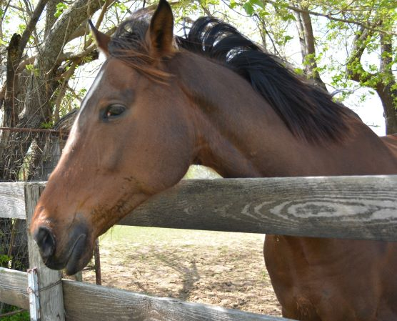

Facilities Challenges
Deferred Maintenance:
Tractor replacement ($41,000)
Fence replacement and maintenance ($20,000)
Stallion Barn roof replacement ($150,000)
Ranch house repairs – plumbing & water drainage issues around the house ($20,000)
Road repairs ($95,000)
Front gate and controls – update ($75,000)
Stallion Barn - upstairs renovation ($250,000)
Stallion Barn - ADA compliance ($100,000)
Arena office - ADA compliant ($150,000)
*Items marked with “ ” are the most critical.

Slide 15
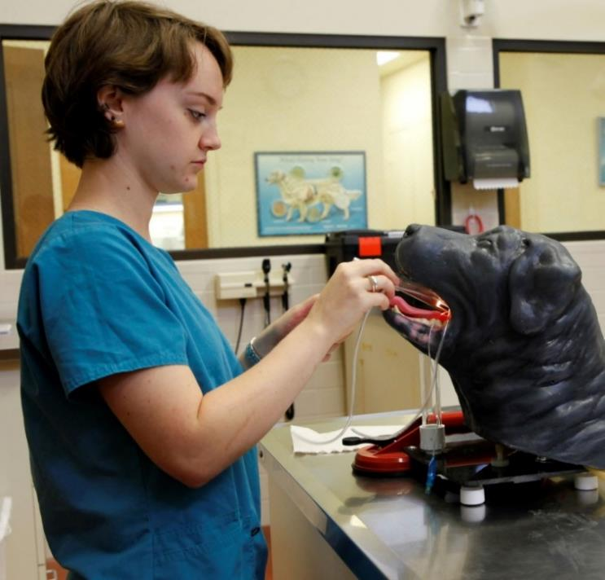
Facilities Challenges
Other Needs: (To grow)
Extend the arena ($100,000)
Additional items in 5 year plan
Potential for additional classrooms and facilities in the longer term
  Expansion of Vet Tech facility ($1,000,000)
  New Building (Stallion Barn) ($3,750,000)
  Sewer lift station ($5,000,000)

Slide 16
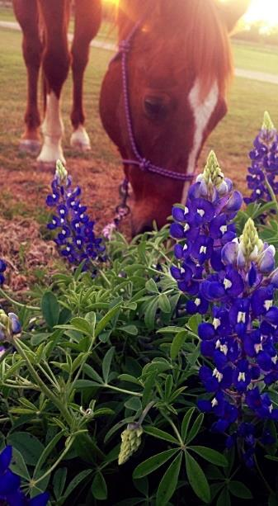
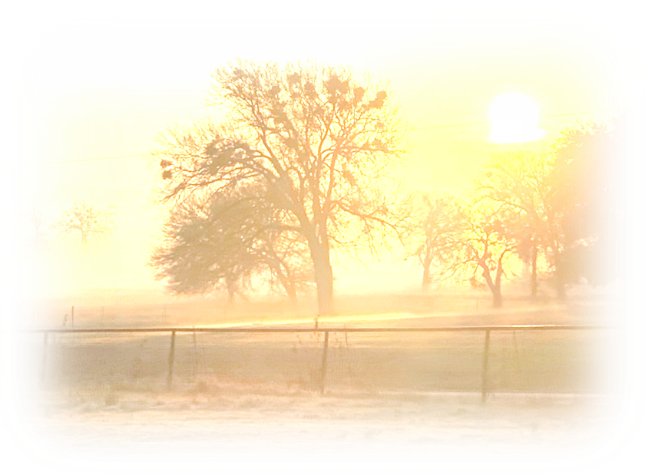
Potential Actions Moving Forward
Retain the Ranch
  Act on the opportunities to expand the Ranch’s value
  Actions Steps:
    Expand awareness in the community of the Ranch’s benefits
    Expand classroom experience (Science and Ag)
    Build on and expand on our community partnerships at the Ranch to include University Center partners
    Increase the number of horse boarding and the associated fees
    Expand the Show Arena to meet Dressage Standards
    Add staff to support an increase in existing and new programs
    Refurbish and expand the Vet Tech and/or Stallion Barn facilities to accommodate additional classrooms, conferences, and boarding as needed
    Explore optional uses for the land – example: solar farm
Notes:
Vet Tech is not a CE option. Vet Assistant might be., but we are unsure about eligibility for certification. Our current graduates have a pathway to become certified with additional hands on experience (through TVMA).

Slide 17
Potential Actions Moving Forward
Sell and Vacate the Ranch (Estimated market price = $4-5 million)
  Action Steps:
    Create communication plan to engage community partners on the changes
    Relocate or teach out Vet Tech program (at least 18 months for teach out and advise SACSCOC of closing facility)
    Work to relocate horse boarders
    Transition College animals
    Cancel planned horse riding and arena events
    Relocate/cancel Kids College Ranch options
    Develop plan to meet community partners ongoing needs where feasible (facility use on other parts of campus)
Notes:
Vet Tech is not a CE option. Vet Assistant might be., but we are unsure about eligibility for certification. Our current graduates have a pathway to become certified with additional hands on experience (through TVMA).

Slide 18
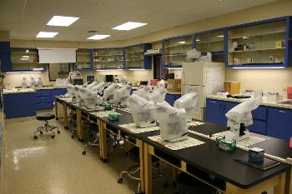
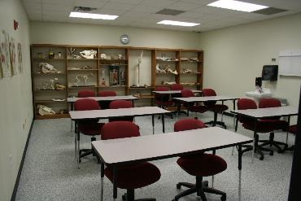
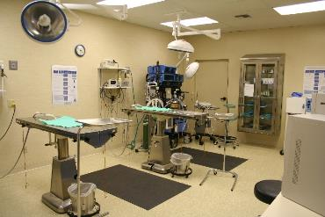
Option to Relocate Vet Tech to Campus
Current Vet Tech Building (15,320 sq/ft)
Move to the main campus
  Building using some shared spaces (13,610 sq/ft)
    Steel frame with brick ($6.6 million)
    Metal frame with brick ($6.3 million)
  Building using some shared spaces (13,610 sq/ft)
    Steel frame with stucco ($5.4 million)
    Metal frame with stucco ($4.7 million)

Slide 19
Potential Actions Moving Forward
Sell the Ranch and Partner with a Buyer
  Action Steps:
    Develop a partnership with a 3rd Party
    Retain and operate some aspects of the current ranch programs and lease from a buyer (e.g., Vet Tech)
    Relocate or eliminate some aspects of the current ranch programs
Notes:
Vet Tech is not a CE option. Vet Assistant might be., but we are unsure about eligibility for certification. Our current graduates have a pathway to become certified with additional hands on experience (through TVMA).

Slide 20
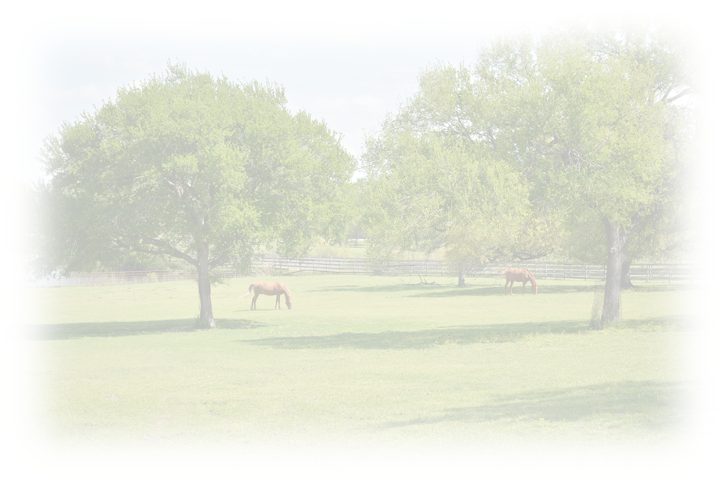
Questions & Discussion

