Slide 1


Spring 2023
Student Course Completions
May 23, 2023

Slide 2



Spring 2023
6,443
Students
18,567
Grades
1,140
Sections
Source: MCC Grade Distribution Reports

Slide 3
Success Rate by Mode
84%
70%
78%
Face to Face
Internet
Blended
Source: MCC Grade Distribution Reports
Notes:
F2F = 3381 students – 84% / 10% / 6 %
Internet = 4,556 students -- 70% / 17% / 12%
Blended = 801 students -- 78% / 12% / 10%

Slide 4
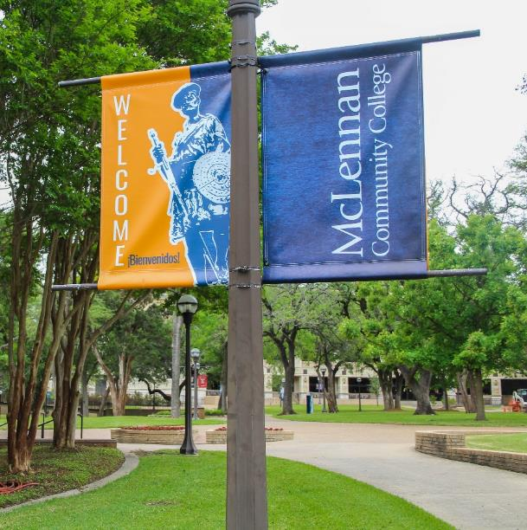
Success Rate by Mode by Gender
Source: MCC Grade Distribution Reports

Slide 5
Success Rate by Mode by Ethnic Group
Source: MCC Grade Distribution Reports

Slide 6
5-Year Comparison
Spring 2019
Spring 2023
Source: MCC Grade Distribution Reports
Notes:
While we still have areas of improvement as a campus, since spring 2019 the overall spring success rate has increased 2%, while face to face has increased 6%, internet increased 5%, and blended decreased 2%.

Slide 7
5-Year Comparison Success Rate by Mode by Gender
Source: MCC Grade Distribution Reports

Slide 8
5-Year Comparison Success Rate by Mode by Ethnic Group
Source: MCC Grade Distribution Reports

Slide 9

Questions?

