Slide 1
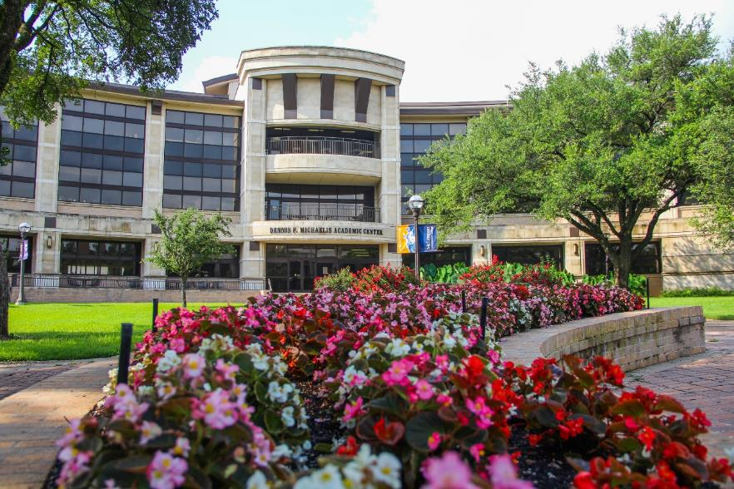

Annual Priorities
Update
May 23, 2023

Slide 2
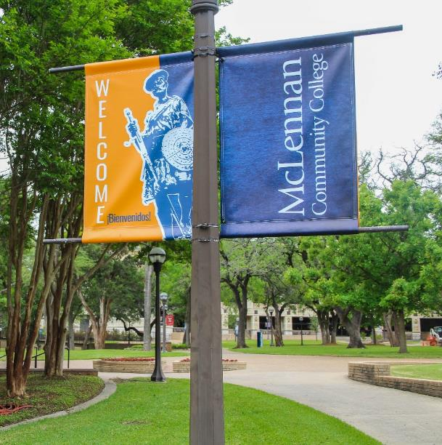

2022-23 Annual Priorities
Develop wrap-around services to provide for our students’ basic needs in completing their academic goals at the college. (Goal I. G)
Improve student awareness and utilization of academic and support resources both on campus and in the community. (Goal II. B)
Strengthen dual credit partnerships for increased student success. (Goal III. A)
Increase student enrollment in all categories and demographics through the Strategic Enrollment Plan and committees. (Goal IV. A)

Slide 3
Institutional Achievements
Summer 2023 and Fall 2023 enrollment is up
Continued success of Workforce Program pass rates
94% Pass Rate of Required Testing
National Accrediting Agency for Clinical Laboratory Sciences 10-Year accreditation – one of eight in the state
Grant funding – 28 grants totaling over $19 million
14 grants totaling $6.5 million awarded this AY
Fundraising at the Foundation -- $3.3 million – Awarded over $650,000
Established the Business Partners Employee Educational Assistance Partnerships
Notes:
Cameron House Project – donor support and TIF funds
Responding to the SACSCOC recommendations and completing Monitoring Report
Foundation was awarded the 2023 Candid Platinum Transparency
Receiving designation by Diverse Issues in Higher Education as one of the 2023 Most Promising Places to Work in Community Colleges and the recognition as a Great Colleges to Work For.

Slide 4
Institutional Challenges
Inflation and increased costs
Responding to market conditions and fairly compensating our employees
Providing appropriate support services (food pantry, free tutoring, success coaches, counseling services, scholarships, transportation, etc.) for students; responding to mental health and struggles of students as well as employees.
Keeping an innovative eye on the future and planning; Addressing the value of community college education in growingly skeptical world
New THECB State Funding Model
Responding to the SACSCOC recommendations
Final stages of Cameron House Project fundraising

Slide 5
Develop wrap-around services to provide for our students’ basic needs in completing their academic goals at the college. (Goal I. G)
Instructional Design and Innovation - Offered laptops and other technology for students to rent so they can complete course work even if they don't own a computer.
Adult Education & Literacy – Helped students get college ready, having classes that hopefully students will pass developmental classes, understand study and time management, help students already be familiar with campus services when they start college classes.
Perkins Grant- Improved and strengthened procedures to ensure that SEP students receive increased levels of transportation, childcare, and textbook support that is proportional to their actual need to help them complete workforce certificates and degrees at the college.
Student Ambassador – Met with success coaches to help better understand the challenges students face and to provide input regarding what I believe would be helpful for student to complete their courses.
Source: Annual Priorities Survey
Notes:
Fall 22 Hotspots: 37 MCC, 22 DC
Fall 22 Laptops: 36 MCC, 21 DC
Spring 23 Hotspots: 20 MCC, 11 DC
Spring 23 Laptops: 28 MCC, 15 DC

Slide 6
Improve student awareness and utilization of academic and support resources both on campus and in the community. (Goal II. B)
Diversity, Equity, & Inclusion - When meeting with students to address accommodations needs, conduct issues, or Title IX referrals, additional challenges the student is facing are sometimes shared. We refer students to Campus Resources Education Web to assist with food, housing, or other basic security needs.
Library - The marrying of AST, the reference librarians, and the information desk has made us all more aware of the services that each branch provides and in turn helps us communicate to the students the resources available from each department.
Social and Behavioral Sciences Division - Instructors post announcements regarding our resources on Brightspace for better student awareness. I encouraged my faculty members to acquaint themselves with the academic and support services offered.
Source: Annual Priorities Survey

Slide 7
Strengthen dual credit partnerships for increased student success. (Goal III. A)
RSVP - Works daily to develop relationships and partnerships through volunteer mentoring programs in area schools.
Continuing Education - Community Health -- Email all the surrounding High Schools quarterly to let them know our offerings and what certifications we can provide to their students to help them achieve their pathways.
Library Services - I began an intensive outreach campaign to visit as many of our dual credit partner schools as possible to provide a Learning Commons Orientation. In Fall 2022, I gave in-person orientations to 11 out of 29 schools (38%) and reached hundreds of students - more than has ever been done before. This Spring, I am working on a virtual version of the orientation (collaborating with IDI) to disseminate to schools who are unable to schedule an in-person orientation. Between the virtual and in-person orientations, we hope to reach 100% of our dual credit students in Fall 2023.
Source: Annual Priorities Survey

Slide 8
Increase student enrollment in all categories and demographics through the Strategic Enrollment Plan and committees. (Goal IV. A)
Adult Education & Literacy - We ask all AEL students who enter our program what their career paths are and work goals. We check with the students every 6 months to see where they are on their career and academic goals.
Paramedicine - Our EMS program piloted an earn as you learn EMT course with American Medical Response (AMR). AMR hired the non-certified employees and allowed us to train them.
Financial Aid - After a recommendation from the Strategic Enrollment Management Finance Subcommittee, the Financial Aid Census date was moved from the 4th class day to the 12th class day beginning with the Fall, 2023 semester.
Source: Annual Priorities Survey
Notes:
FA - This date change, along with a change in transmittal rules, allows for only tuition, fees and books to be transmitted to student accounts up until the 12th class day. On the 12th class day all excess financial aid funds are then transmitted to students accounts, Previously, students were receiving their financial aid disbursements before the 12th class day, which caused them to owe a large portion of those funds back to the college if they totally withdrew. With this change, students now receive their financial aid disbursement based on the number of hours they are enrolled in on the 12th class day.

Slide 9
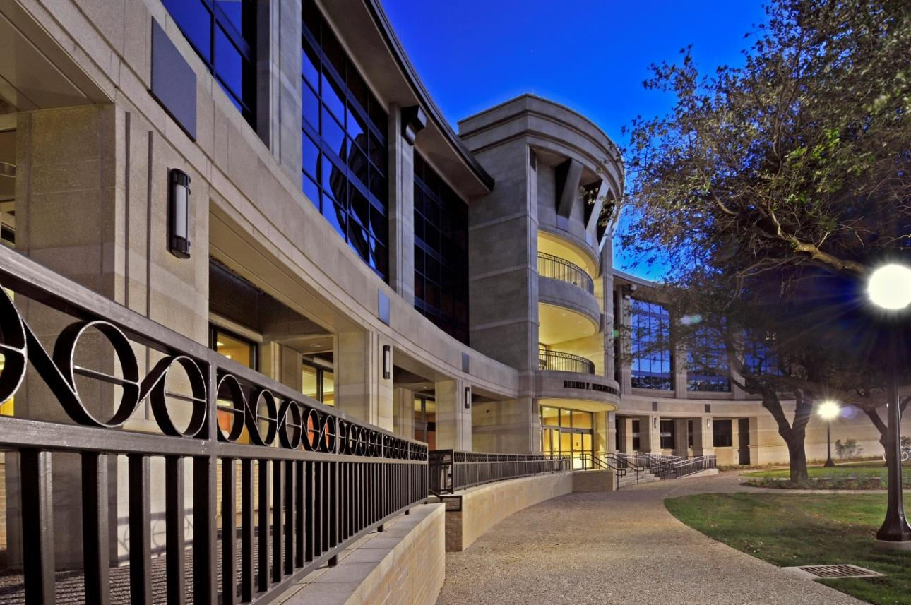
Questions?

