Slide 1
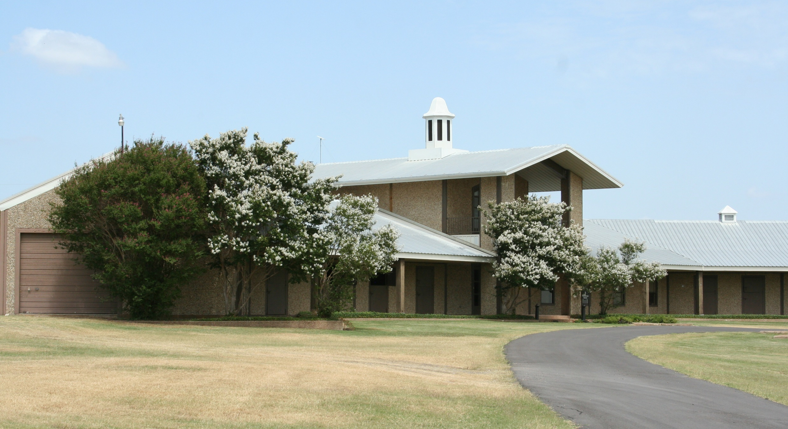
July 11, 2023

Slide 2
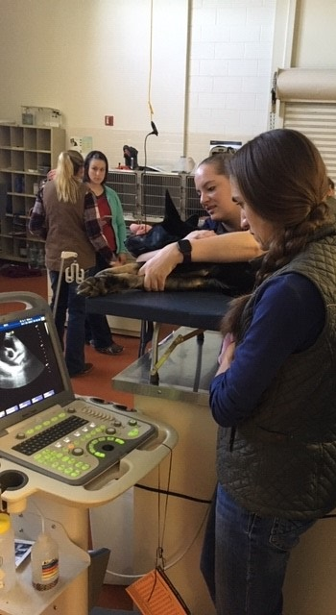
Why we are doing this?
  Normal review of programs
  Interest by the Board in the financials of the Ranch
What have we done so far?
  Presented facts – 10/29/2019, 4/5/2022,1/24/2023, and 4/25/2023
  Preparation of a 4-year instructional plan
  Research options
Plan for tonight
  Hear feedback
  Review financials
  Present the instructional plan
  Review optional actions
  Allow the Board to discuss and decide the future

Slide 3
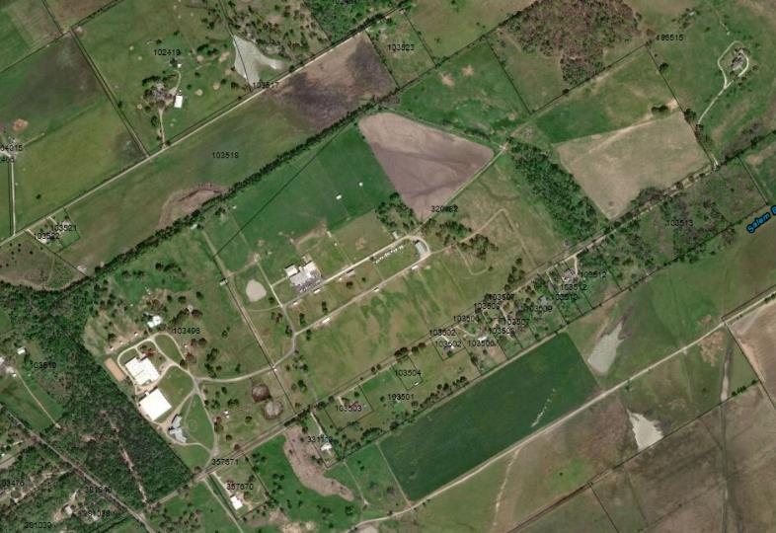
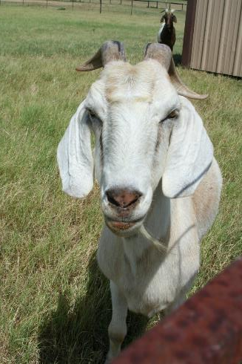
History of the Purchase
April 12, 2002 – Purchased 147.77 Acres for $750,000 (lower section)
July 30, 2003 – Purchased 49.39 Acres for $1,250,000 (upper section)

Slide 4
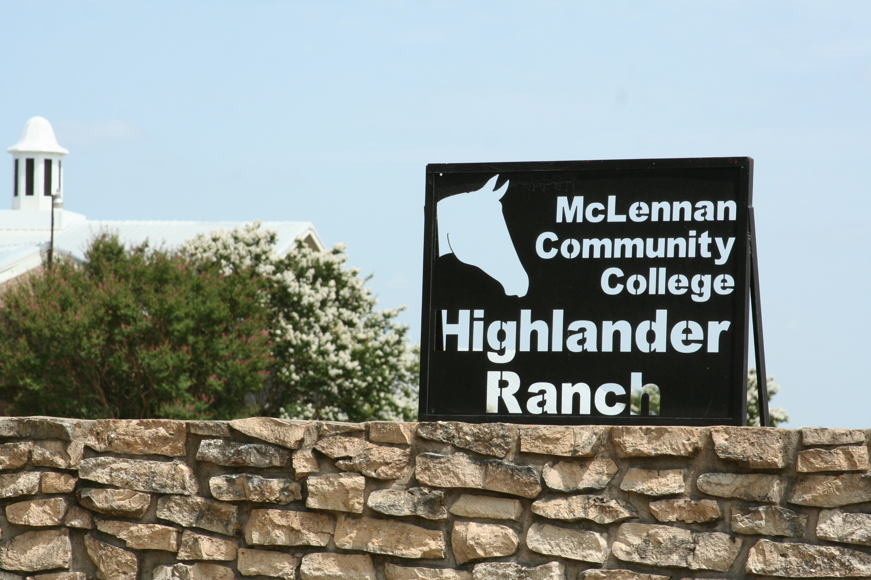
PUBLIC COMMENTS

Slide 5
Financial Review – Vet Tech

Slide 6
Data – Vet Tech
Student Data | Fall 2022 | Fall 2021 | Fall 2020 | Fall 2019 | Fall 2018 | Fall 2017 | Fall 2016 | Fall 2015 | Fall 2014
Headcount | 23 | 39 | 29 | 31 | 38 | 46 | 45 | 40 | 47
Average Class Size | 9 | 12 | 9 | 11 | 13 | 14 | 9 | 11 | 12
 | 22-23 | 21-22 | 20-21 | 19-20 | 18-19 | 17-18 | 16-17 | 15-16 | 14-15
Majors | 27 | 40 | 38 | 54 | 44 | 64 | 73 | 117 | 143
Graduates | 14 | 23 | 12 | 23 | 17 | 27 | 20 | 21 | 24
Placement Rates | - | - | 86% | 100% | 93% | 93% | 83% | 100% | 96%
Faculty Data | Fall 2022 | Fall 2021 | Fall 2020 | Fall 2019 | Fall 2018 | Fall 2017 | Fall 2016 | Fall 2015 | Fall 2014
Full-Time Faculty | 2 | 3 | 3 | 3 | 3 | 3 | 3 | 3 | 3
Part-Time Faculty | 1 | 1 | 1 | 1 | 1 | 1 | 1 | 1 | 1

Slide 7
Financial Review – Agriculture

Slide 8
Data – Agriculture
Student Data | Fall 2022 | Fall 2021 | Fall 2020 | Fall 2019 | Fall 2018 | Fall 2017 | Fall 2016 | Fall 2015 | Fall 2014
Headcount | 17 | 29 | 29 | 33 | 35 | 46 | 38 | 20 | 27
Average Class Size | 10 | 15 | 17 | 8 | 13 | 17 | 15 | 13 | 10
 | 22-23 | 21-22 | 20-21 | 19-20 | 18-19 | 17-18 | 16-17 | 15-16 | 14-15
Majors | 37 | 46 | 35 | 46 | 27 | 38 | 64 | 66 | 61
Graduates | 2 | 2 | 0 | 2 | 1 | 3 | 0 | 1 | 2
Faculty Data | Fall 2022 | Fall 2021 | Fall 2020 | Fall 2019 | Fall 2018 | Fall 2017 | Fall 2016 | Fall 2015 | Fall 2014
Full-Time Faculty | 1 | 0 | 0 | 2 | 2 | 2 | 1 | 0 | 1
Part-Time Faculty | 1 | 2 | 2 | 1 | 1 | 1 | 1 | 2 | 1

Slide 9
Financial Review – Continuing Education

Slide 10
Financial Review – Operations

Slide 11
Complete Ranch - Financial Review
*Total Capital Improvements since 2002 - $682,714

Slide 12

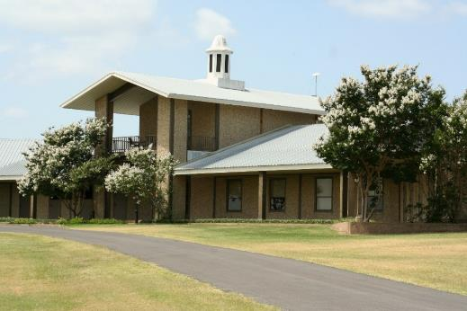
Instructional Four-Year Strategic Plan for the Ranch
Notes:
Partnerships with agricultural science programs at area high schools with Ranch as their remote campus
Explore new pathways with existing university partners
Explore new partnerships in agriculture and food science with other universities

Slide 13
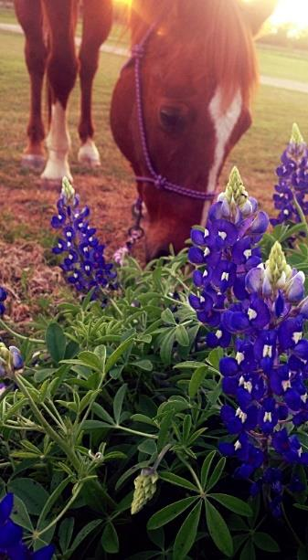
Strengths and Opportunities
Ranch offers the College and the Community:
    The perfect “base” for hands-on learning for a variety of programs
    Established relationships with the community
    Successful, established programs with dedicated staff
    Established relationships with local and regional leaders in agriculture and veterinary technology
    Cross-institution collaboration is already established and functioning
Absence of significant agriculture-based programming for community and credit courses at Temple, Hill, and Navarro Colleges
Waco is home to large, national food manufacturers that need training and workers
New state funding model incentivizes workforce and community programs, collaboration with peer institutions, and expansion of pathways with universities and business/industry
Notes:
Partnerships with agricultural science programs at area high schools with Ranch as their remote campus
Explore new pathways with existing university partners
Explore new partnerships in agriculture and food science with other universities

Slide 14
Weaknesses and Challenges
Ongoing maintenance requirement and deferred maintenance items need attention
Veterinary Technology program expense driven by required standards for accreditation and animal welfare
Limited direct, targeted marketing for Ranch offerings
Expanding and adding programs requires updates and new structures and take time to establish
Retention of current boarders and development of new equine programs and partnerships are challenging
Competition from other educational institutions
Ranch property is very attractive to individuals and private investors

Slide 15
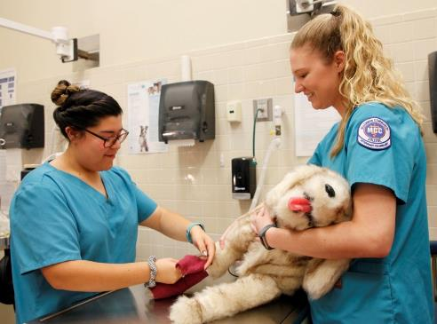
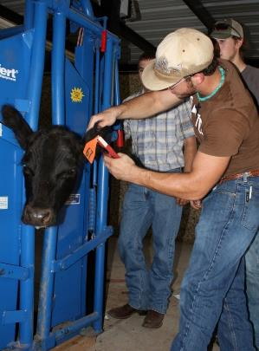
Phase I – 2023-24
Form a Ranch Advisory
    Local and regional leaders in agriculture and food science as well as education and industry partners
    Identify local workforce training needs
Re-introduce popular sustainable agriculture course to Ranch through continuing education
Increase Ranch usage by existing academic/workforce programs (i.e., Biology and Environmental Sciences)
Increase marketing of Vet Tech, Vet Assistant, Agriculture, and the Ranch to the Community
Review expenses and contracts in Vet Tech Program for savings

Slide 16
Phase I – 2023-24 (Continued)
Apply for USDA NIFA Workforce Training Grant (Dec 2023) to meet workforce training need
Increase Ranch staffing (two part-time barn attendants and one full-time riding specialist) to support:
Expand horse riding lessons to meet community demand
Expand boarding capacity with 10 new stalls and an additional pasture
  Estimated initial outlay of $110,794.

Slide 17
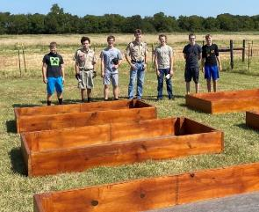
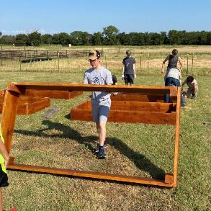
Phase II – 2024-25
Begin transition of sustainable agriculture from non-credit training to credit training.
Add continuing education training in equine management and natural resource (water and soil conservation) management.
Move Vet Tech to a hybrid/online model
Explore alternative usage of open acreage with Texas AgriLife, state, and federal agriculture programs such as establishing natural habitats and conservation plots with possible research opportunities.
Open a pet wellness clinic for faculty, staff, and students
Expand boarding capacity with 5 new stalls
Estimated initial outlay of $6,127.

Slide 18
Phase III – 2025-2027
Continue to expand educational credential offerings in natural resource management and equine management
Work with local agricultural and food science businesses to meet workforce training needs
Partner with universities to use Ranch as a teaching site for upper-level courses
Continue to seek grants to support new programs
Develop an equine cross-country course, dressage arena, and concession area to host more shows and clinics
Estimated initial outlay of $15,500

Slide 19
Financial Analysis – Proposed Changes
 | Projected | Projected | Projected | Projected
Revenue | 2024 | 2025 | 2026 | 2027
Additional related camps, clinics, and lessons related to additional staff | $ 45,212 | $ 47,473 | $ 49,846 | $ 52,339
10 stalls in stallion barn | $ 72,000 | $ 72,000 | $ 72,000 | $ 72,000
4 horse pasture (Epp's pasture) | $ 15,600 | $ 15,600 | $ 15,600 | $ 15,600
additional riding lessons | $ 28,800 | $ 28,800 | $ 28,800 | $ 28,800
Sustainable agriculture | $ 2,970 | $ 5,940 | $ 5,940 | $ 8,910
New workforce training | $ - | $ - | $ 14,640 | $ 14,640
Pet Wellness Clinic | $ - | $ 1,300 | $ 1,300 | $ 1,300
Total | $ 164,582 | $ 171,113 | $ 188,126 | $ 193,589
Expenses
Riding Specialist | $ 50,000 | $ 51,000 | $ 52,020 | $ 53,060
10 stalls in stallion barn* | $ 72,675 | $ 46,050 | $ 46,050 | $ 46,050
4 horse pasture (Epp's pasture)* | $ 15,917 | $ 10,917 | $ 10,917 | $ 10,917
additional horses* | $ 10,449 | $ 5,449 | $ 5,449 | $ 5,449
Sustainable agriculture | $ 99 | $ 99 | $ 198 | $ 396
New workforce training | $ - | $ 1,000 | $ 8,052 | $ 8,052
Vet Tech/Ranch Marketing | $ 200 | $ 200 | $ 200 | $ 200
Pet Wellness Clinic |  | $ 1,300 | $ 1,300 | $ 1,300
Total | $ 149,340 | $ 116,015 | $ 124,186 | $ 125,424
Net | $ 15,242 | $ 55,098 | $ 63,941 | $ 68,165
*includes the cost of the part-time barn attendants

Slide 20
Financial Analysis – Overall
 | As of 6/15/23 |  | Projected | Projected | Projected | Projected
 | 2022 | 2023 | 2024 | 2025 | 2026 | 2027
Revenue
Existing Continuing Education | $ 221,527 | $ 202,961 | $ 255,731 | $ 322,221 | $ 405,998 | $ 11,558
Existing Operations | $ 159,387 | $ 127,215 | $ 160,291 | $ 201,967 | $ 254,478 | $ 320,642
Existing Vet Tech | $ 230,754 | $ 187,448 | $ 229,436 | $ 280,830 | $ 343,736 | $ 420,733
Existing Agriculture | $ 42,480 | $ 39,747 | $ 50,081 | $ 63,102 | $ 79,509 | $ 100,181
Additional related camps, clinics, and lessons related to additional staff | $ - | $ - | $ 45,212 | $ 47,473 | $ 49,846 | $ 52,339
10 stalls in stallion barn | $ - | $ - | $ 72,000 | $ 72,000 | $ 72,000 | $ 72,000
4 horse pasture (Epp's pasture) | $ - | $ - | $ 15,600 | $ 15,600 | $ 15,600 | $ 15,600
additional riding lessons | $ - |  | $ 28,800 | $ 28,800 | $ 28,800 | $ 28,800
Sustainable agriculture | $ - | $ - | $ 2,970 | $ 5,940 | $ 5,940 | $ 8,910
New workforce training | $ - | $ - | $ - | $ - | $ 14,640 | $ 14,640
Pet Wellness Clinic | $ - | $ - | $ - | $ 1,300 | $ 1,300 | $ 1,300
Total | $ 654,148 | $ 557,371 | $ 860,121 | $ 1,039,232 | $ 1,271,847 | $ 1,546,703

Slide 21
Financial Analysis - Overall
 | As of 6/15/23 |  | Projected | Projected | Projected | Projected
 | 2022 | 2023 | 2024 | 2025 | 2026 | 2027
Expenses
Existing Continuing Education | $ 260,092 | $ 182,528 | $ 229,985 | $ 289,781 | $ 365,125 | $ 460,057
Existing Operations | $ 282,199 | $ 253,759 | $ 319,736 | $ 402,868 | $ 507,613 | $ 639,593
Existing Vet Tech | $ 345,091 | $ 308,366 | $ 388,541 | $ 489,562 | $ 616,848 | $ 777,228
Existing Agriculture | $ 21,408 | $ 21,994 | $ 27,712 | $ 34,918 | $ 43,996 | $ 55,435
Insurance | $ 12,834 | $ 14,117 | $ 15,529 | $ 17,082 | $ 18,790 | $ 20,669
Riding Specialist | $ - | $ - | $ 50,000 | $ 51,000 | $ 52,020 | $ 53,060
10 stalls in stallion barn* | $ - | $ - | $ 72,675 | $ 46,050 | $ 46,050 | $ 46,050
4 horse pasture (Epp's pasture)* | $ - | $ - | $ 15,917 | $ 10,917 | $ 10,917 | $ 10,917
Additional horses* | $ - | $ - | $ 10,449 | $ 5,449 | $ 5,449 | $ 5,449
Sustainable agriculture | $ - | $ - | $ 99 | $ 99 | $ 198 | $ 396
New workforce training | $ - | $ - | $ - | $ 1,000 | $ 8,052 | $ 8,052
Vet Tech/Ranch Marketing | $ - | $ - | $ 200 | $ 200 | $ 200 | $ 200
Pet Wellness Clinic |  |  |  | $ 1,300 | $ 1,300 | $ 1,300
Total | $ 921,624 | $ 780,764 | $ 1,130,844 | $ 1,348,925 | $ 1,675,258 | $ 2,077,106
Net | $ (267,476) | $ (223,393) | $ (270,723) | $ (309,693) | $ (403,410) | $ (530,404)

Slide 22
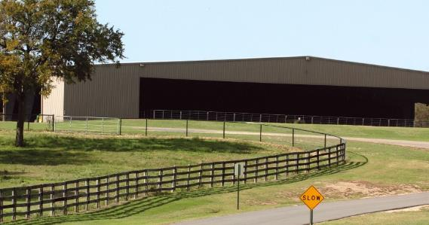
Plan Summary
Current and New Ranch based programs fulfill the mission of MCC and work towards meeting goals
Ranch offers potential to help MCC meet the local and regional workforce and training needs
Ranch supports community needs
Proposed changes cover their own expenses, but do not eliminate the overall loss

Slide 23
Capital Investments

Slide 24
Options
Retain the Ranch
  Continue current operations with some investments to increase use
Retain the Ranch
  Implement the Instructional Plan with additional investments
Accept Proposals to Sell the Ranch
  Estimated market price = $4-5 million
Accept 3rd Party Partnership Proposals
  Retain and operate some aspects of the current ranch programs
  Relocate or eliminate some aspects of the current ranch programs

Slide 25
Board Discussion, Consideration, and Take Appropriate Action on Future of Highlander Ranch

