Slide 1
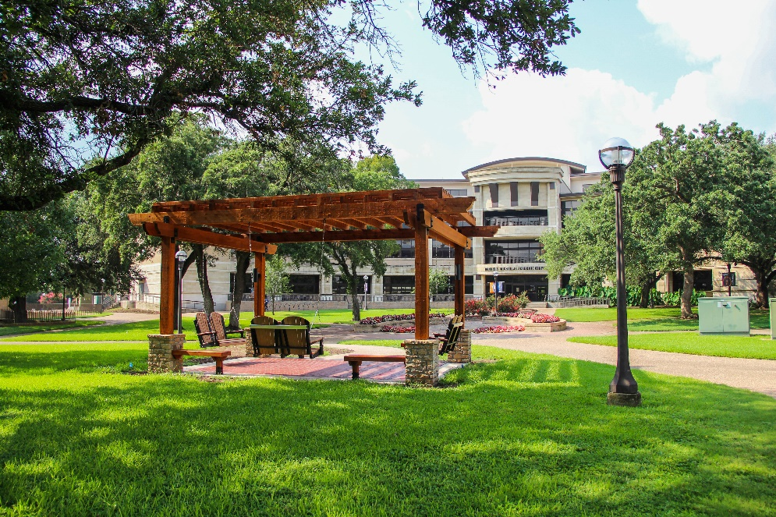
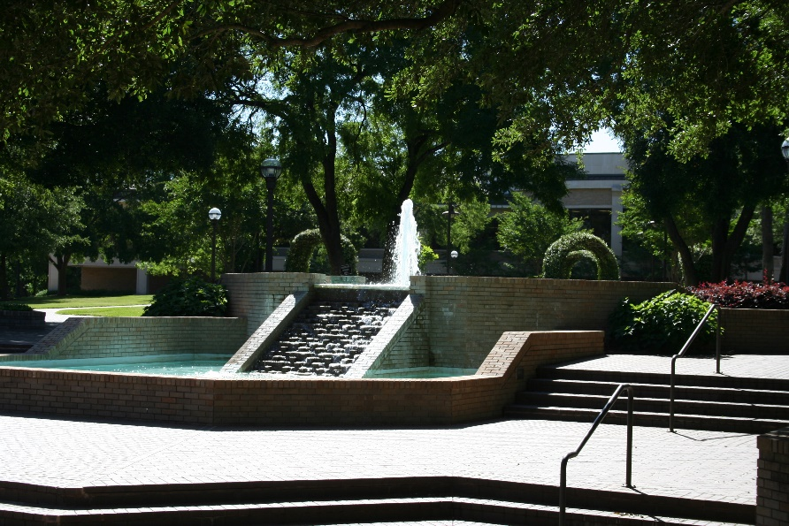

Community Survey
September 26, 2023
Notes:
A place for honest reflection/sharing and visioning. You get out what you put into a process like this.

Slide 2
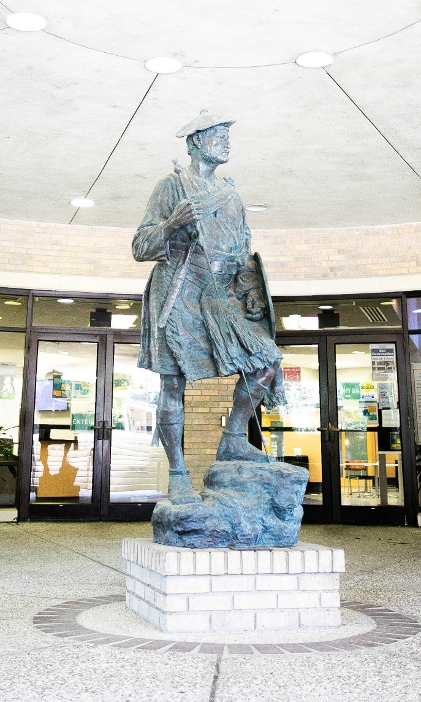

Survey Overview
July – August 2023
Sent to past students, MCC employees, Advisory Councils, Chambers around McLennan County, posted to social media
Purpose:
  identify community perceptions toward MCC as an institution.
  assess the educational needs of the community that can be addressed by MCC.
  gain feedback from those who could be future students of MCC or those who influence the decisions of future students.
  gather information to assist the College in their decision making.
  update and support other research efforts.
Notes:
Summer 2021 - 1,630 participants – 658 more!

Slide 3
Survey Overview
2,288 participants
  McLennan County – 78%
  Falls County – 11%
  Outside McLennan or Falls County – 10%
Employment Status
  54% - Full Time
  11% - Part Time
  12% - Full & Part Time
  11% - Unemployed
  13% - Unknown
Notes:
Summer 2021 - 1,630 participants – 658 more!

Slide 4
Are you a supervisor or business owner?
23% responded Yes
What skills do you expect new graduates to have when they begin with your company?
  Communication
  Customer service/People skills
  Basic computer skills
  Soft skills

Slide 5
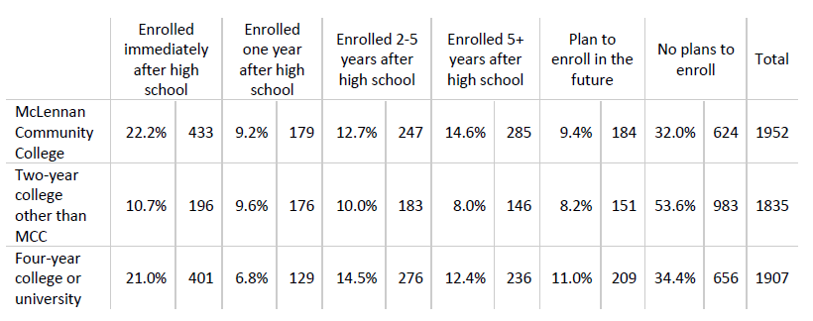
Please choose the best answer for your enrollment status in each type of school

Slide 6
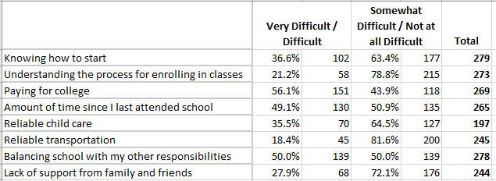
Please rate how difficult each factor makes it for you to attend college.
Notes:
Responses for those who previously selected ‘Some college, no degree or certificate and not currently enrolled in school.’

Slide 7
What programs, degrees, or career training should MCC consider adding?
More Technology
Data analytics
Trades – HVAC, Welding, etc.
Dental hygiene

Slide 8
One thing we do well…
Online education
Facilities
Care for students
Affordability
Quality faculty/staff
Quality instruction
Meets workforce/community needs
Transfer options and/or University Center

Slide 9
One thing we do well…
Being a very welcoming place for students to receive an affordable and valuable education
I have the most exposure to MCC's continuing ed classes. They are very affordable and diverse, and I've always had a good experience.
Provide a stepping stone for students who plan to go on to a four-year college.
Make students feel like they are important and the way they make you feel like you can take on the world.

Slide 10
One thing to improve…
Communication (available services and resources, marketing and advertising)
Online offerings
Scholarships
Parking
Cost

Slide 11
One thing to improve…
Expand healthcare programs to accept more students. Nursing specifically is suffering and not enough local students to staff our facilities in our area.
One thing I would improve about MCC would be their expansion of student support organizations like TRIO/SSS and advocate for students who may not be your “traditional” student.
Keeping the cost down will be a key factor to continued access

Slide 12
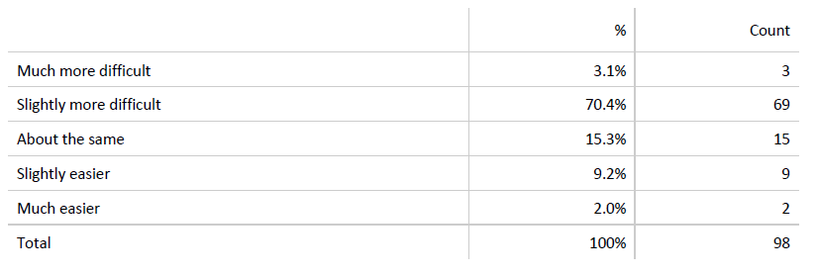
In comparison to high school, how difficult do you expect college to be?
For those who selected ‘Current high school student’ or ‘recent high school graduate’

Slide 13
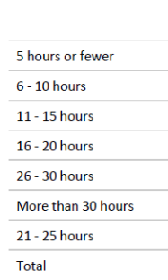
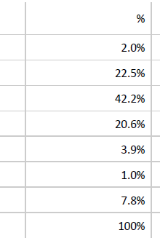
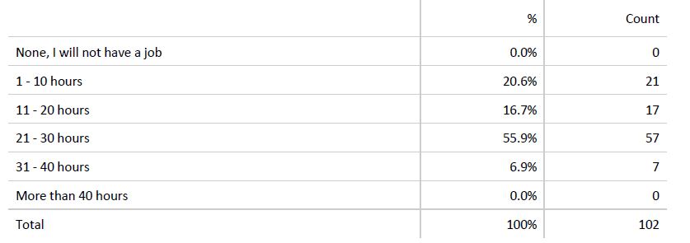
How many hours a week do you expect to spend outside of class on activities, such as studying, writing, reading, lab work, homework, etc.?
How many hours a week do you expect to work for a job outside of school?
For those who selected ‘Current high school student’ or ‘recent high school graduate’
Notes:
102 responded to each

Slide 14
If someone new to the community asked you to describe MCC, what would you say?
It is a good school and prepares students for entering the workforce or transferring to another school
A great option for continuing education and career education.
Small town feel with big town education quality.
MCC is an affordable and great way to kickstart your college career
Economic engine - MCC develops talent and skills for the local workforce. Many graduates go on to jobs at area companies, fueling prosperity in Waco.
MCC has a beautiful, award winning campus. It's not what most community colleges look like. Classes are small and affordable. You can even get a degree from Tarleton or Tech from the Waco campus.

Slide 15
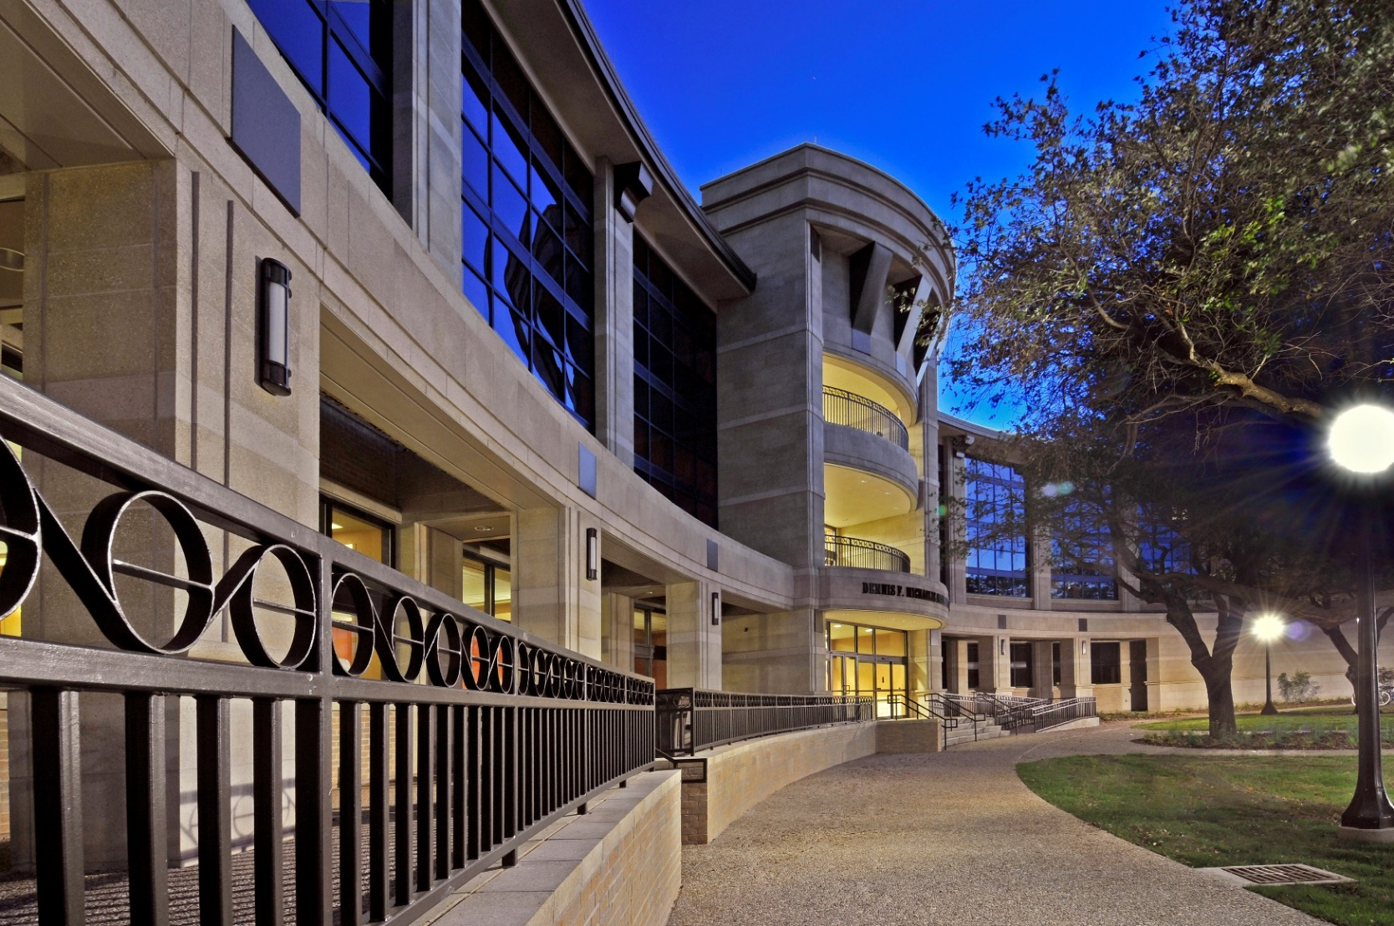
Questions?

