Slide 1
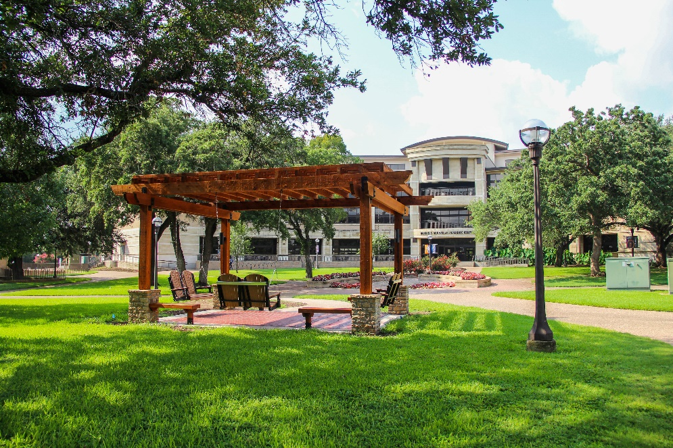
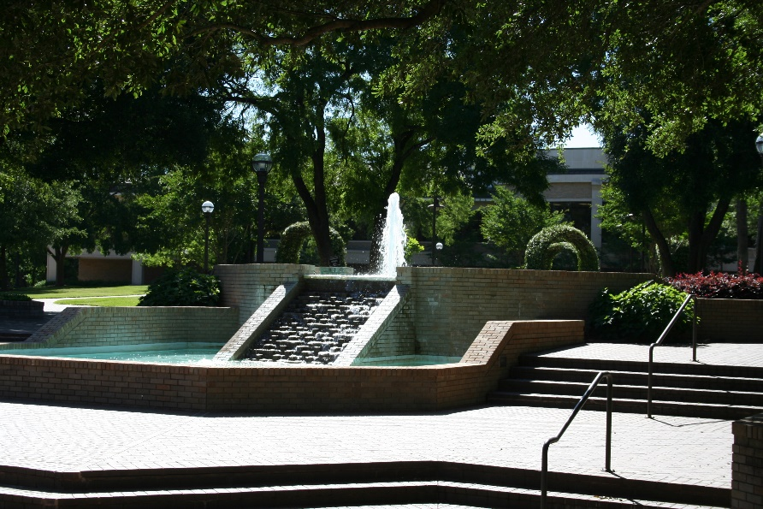

Great Colleges
to Work For 2023
September 26, 2023
Notes:
A place for honest reflection/sharing and visioning. You get out what you put into a process like this.

Slide 2
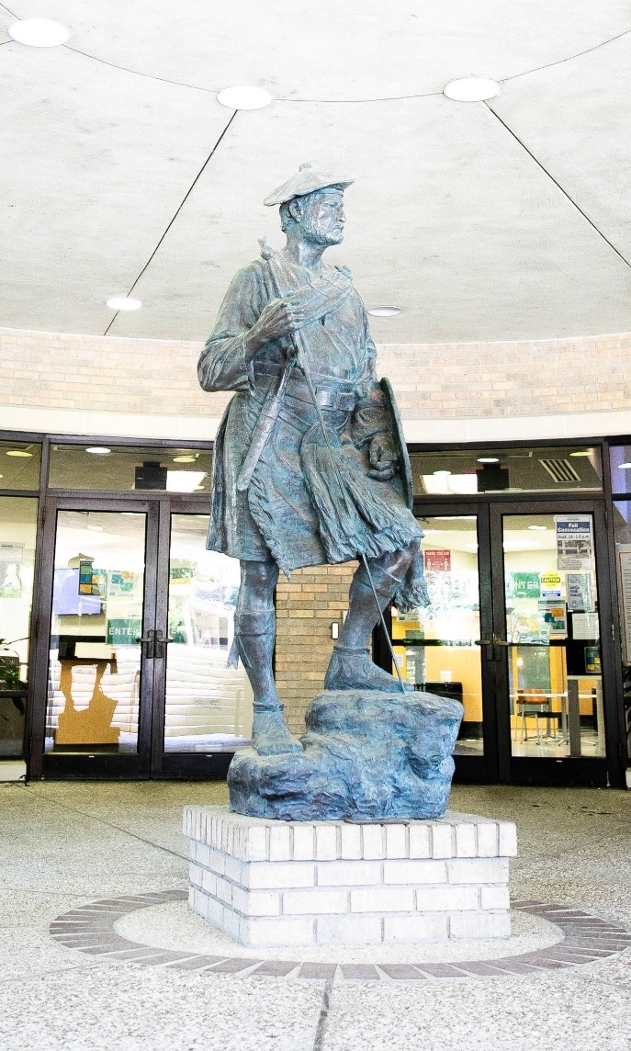

Survey Overview
Surveyed 688 employees, 50% (344) participated.
Administrators: 93%
Professional Staff: 73%
Support Staff: 51%
Faculty: 54%
Adjuncts: 6%
Notes:
Administered by ModernThink, LCC
194 colleges participated – 121 4-year and 73 2-year
Over 103,000 employees participated

Slide 3
Recognized in Texas – 2-Year Institutions
Coastal Bend College
Collin College*
Lone Star College System
McLennan Community College*
Panola College*
*Honor Roll Status for size
Notes:
Four-Year Institutions
Abilene Christian University*
Angelo State University*
Baylor University*
Parker University*
Texas Tech University*
University of the Incarnate Word*

Slide 4

2023 Honor Roll
Job Satisfaction & Support
Professional Development
Mission & Pride
Faculty & Staff Well-being
Faculty Experience (Faculty Only)
Compensation & Benefits
Supervisor/Department Chair Effectiveness
Confidence in Senior Leadership
Diversity, Inclusion & Belonging
Notes:
-9 of the 10 categories
-Recognized last year
--Shared Governance (faculty only) dropped from the list

Slide 5





Our Recognition Over the Years
Notes:
-9 of the 10 categories
-Recognized last year
--Shared Governance (faculty only) dropped from the list

Slide 6
Great College's to Work For Trends by Job Category
Institutional Characteristics |  | MCC 2023 Overall | Administration | Faculty | Professional Staff | Support Staff
Collaboration |  | 73 | 78 | 77 | 74 | 64
Communication |  | 72 | 78 | 74 | 73 | 68
Confidence in Senior Leadership |  | 76 | 79 | 77 | 79 | 68
Diversity, Inclusion & Belonging |  | 85 | 92 | 87 | 83 | 80
Faculty & Staff Well-being |  | 86 | 90 | 88 | 85 | 82
Job Satisfaction & Support |  | 85 | 91 | 97 | 85 | 79
Mission & Pride |  | 90 | 95 | 91 | 91 | 84
Performance Management |  | 64 | 62 | 66 | 65 | 59
Professional Development |  | 80 | 84 | 83 | 78 | 77
Supervisor/Department Chair Effectiveness |  | 83 | 85 | 85 | 85 | 75
Faculty Experience |  | 76 | - | 76 | - | -
Overall Survey Average |  | 78 | 83 | 82 | 75 | 72
 | Poor | Warrants Attention | Fair to Mediocre | Good | Very Good | Excellent
Legend | 0%-44% | 45%-54% | 55%-64% | 65%-74% | 75%-89% | 90%-100%

Slide 7
Actions & Moving Forward
Presented the results to the President, Vice President, President’s Leadership
Continue listening to employees and addressing areas of concern around campus

Slide 8
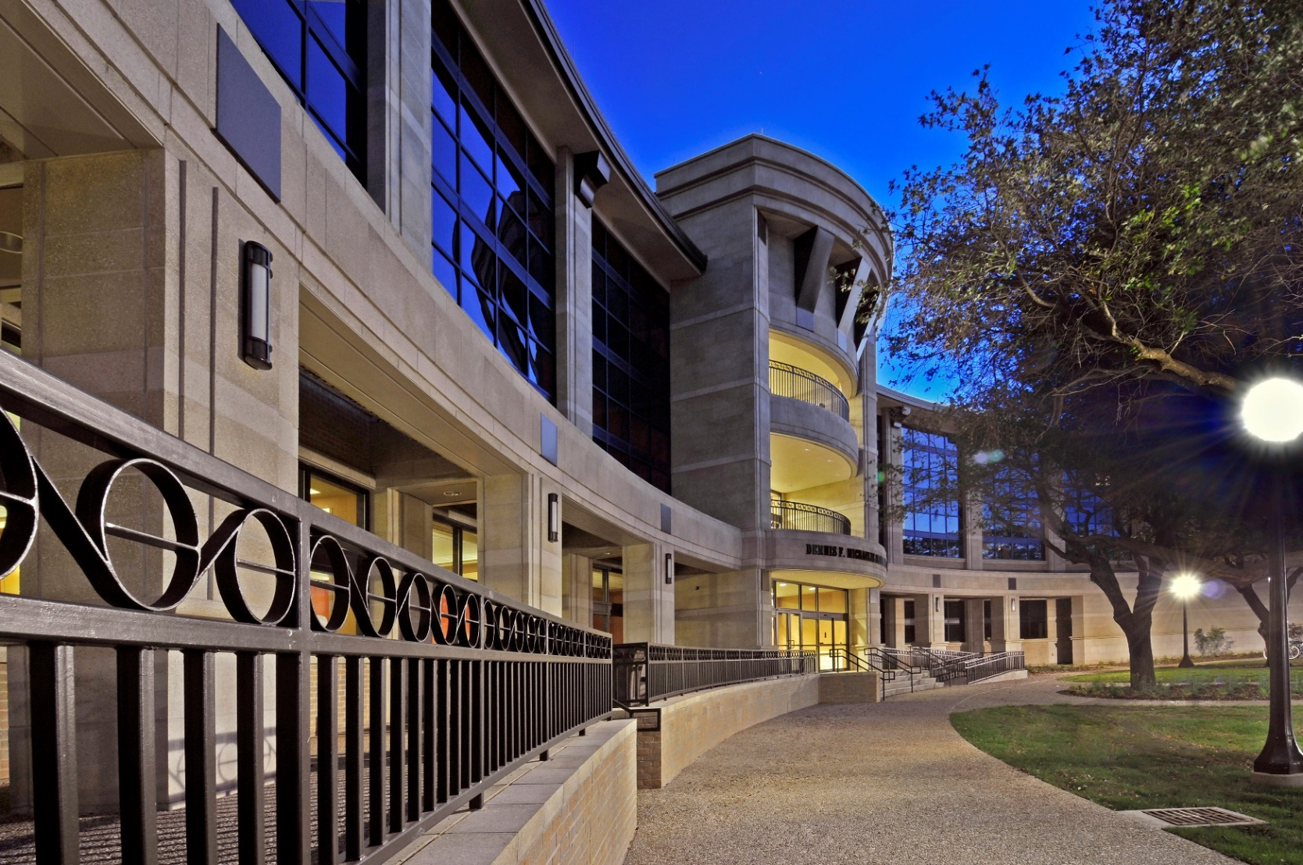
Questions?

