Slide 1

Equality or Equity?
Dr. Kayla Willis

Slide 2

Oh no!
You’ve suddenly attained an ailment.
But don’t worry. The doctor is here to help!
Look at the strip of paper at your table. This is your ailment. Let’s see how the doctor fixes it.

Slide 3


Slide 4
So What’s the Difference?
EQUALITY
EQUITY
Everyone gets the exact same.
Everyone gets what they need to be successful.
Like how everyone got a Band-Aid for their ailment.

Slide 5
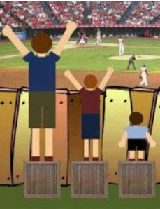
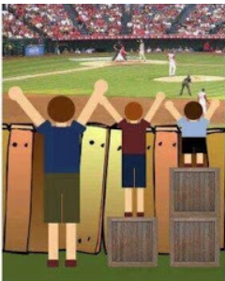
Equality
Equity
vs.

Slide 6
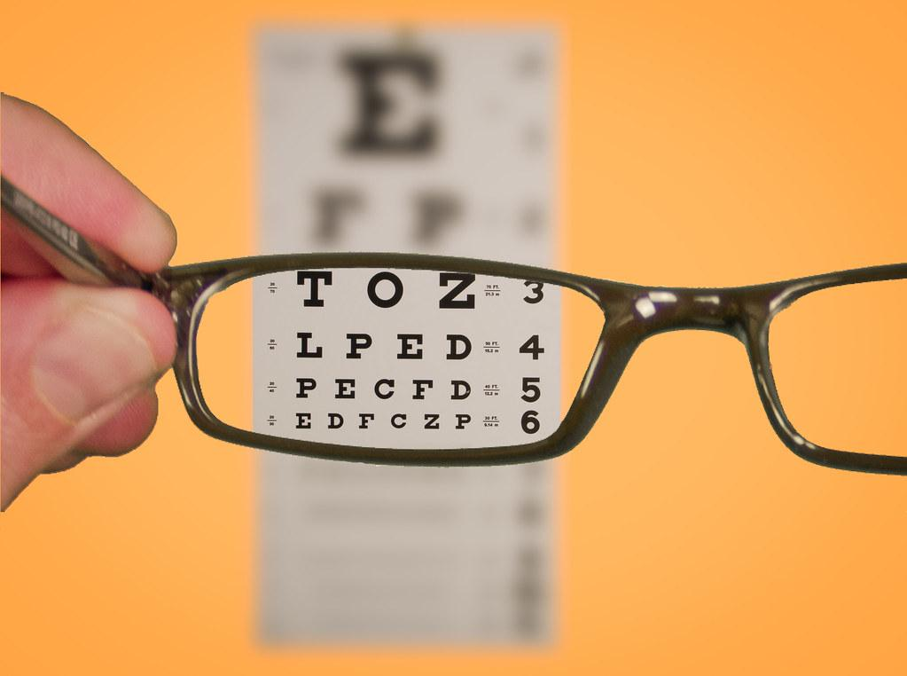
Think of glasses…
When we give students what they need to be successful, is that fair to everyone else?!?

Slide 7
Think about your own experiences as a student….
What are some things you need to succeed?

Slide 8
In the Classroom…
this can look like…
Allowing the use of screen readers and text-to-speech technology.
Allowing testing in a small group or one-on-one.
Giving students access to fidget toys/supplies.
Providing resources and materials for those who don’t have it..
Giving extra time to take tests or complete assignments.
Targeted small group instruction.
Find more info here.

Slide 9

“Meeting each child where they are currently functioning is never unfair to other students.”
Lisa Friedman
Friedman, L. (2013). Fair isn’t equal. Removing the Stumbling Block [Blog]. https://jewishspecialneeds.blogspot.com/2013/07/fair-isnt-equal.html

Slide 10
When we develop equitable classrooms, we focus on the needs of each individual student, which allows them to reach their individual potential!

Slide 11
Reflections to Ponder…
Why is equity important in a classroom/ education?
How can I promote equity in my classroom and/or community?
Would I rather live in a world that is equal or equitable?
Is there a way to promote equity and equality at the same time?

Slide 12
Additional Resources
Equality, Equity, and Justice
Fair Isn’t Equal
Equity and Equality Lesson
8 Powerful Ways to Promote Equity in the Classroom
Advancing Equity in the Classroom
An Overview of Equity in Education
A Practical Guide to Equity in Education

Slide 13


THANKS!
Do you have any questions?
Dr. Kayla Willis
kmwillis@mclennan.edu

