Slide 1

Instruction & Student Engagement Program Review Summary 2022-23
September 2023 Board Presentation

Slide 2
Annual Planning Cycle
Student Learning Outcomes
Unit Level Plan
Budget
Program Review

Slide 3
Progress Evaluation Criteria
For Instructional Programs:
Success of students
Budget Impact
Strategic importance to the college and/or the community
High Demand Field/Targeted Occupation
Notes:
Success of graduates (retention, SLO accomplishment, graduation, transfer, placement, wages, job growth, job market, etc.)
Budget Impact (profit/loss)
Strategic importance to the college and/or the community (job market expectations, capacity growth, etc.)

Slide 4

High Demand
Fields
Computer and Information Sciences and Support Services
Engineering
Engineering/Engineering-Related Technologies/Technicians
Mathematics and Statistics
Physical Sciences
Agricultural Business Management
Agricultural Mechanization
Environmental/Natural Resources Management and Policy
Bilingual, Multilingual, and Multicultural Education
Teacher Education and Professional Development, Specific Levels and Methods
Teaching English or French as a Second or Foreign Language
Human Development, Family Studies, and Related Services
Non-Professional Legal Studies
Legal Support Services
Biological and Physical Sciences
Nuclear and Industrial Radiologic Technologies/Technicians
Physical Science Technologies/Technicians2
Fire Protection
Building/Construction Finishing, Management, and Inspection
Electrical/Electronics Maintenance and Repair Technologies/Technicians
Notes:
LAURA

Slide 5
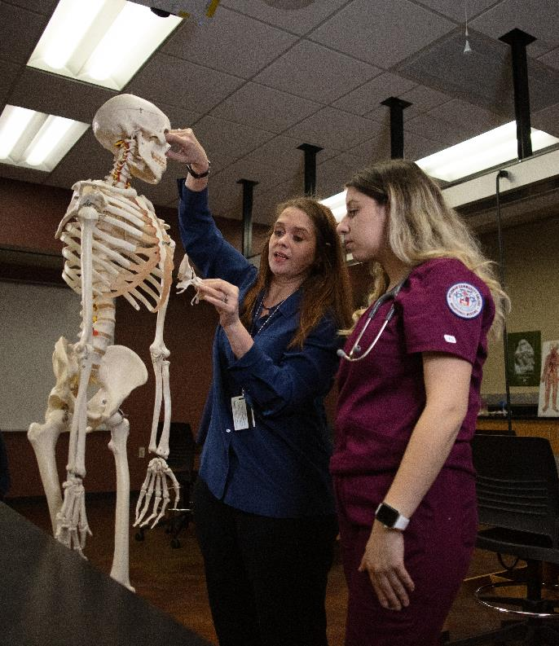
High Demand
Fields
Heating, Air Conditioning, Ventilation and Refrigeration Maintenance Technology/Technician
Heavy/Industrial Equipment Maintenance Technologies/Technicians2
Vehicle Maintenance and Repair Technologies
Energy Systems Maintenance and Repair Technologies/Technicians
Ground Transportation
Communication Disorders Sciences and Services
Dental Support Services and Allied Professions
Health and Medical Administrative Services
Allied Health and Medical Assisting Services
Allied Health Diagnostic, Intervention, and Treatment Professions
Clinical/Medical Laboratory Science/Research and Allied Professions
Ophthalmic and Optometric Support Services and Allied Professions
Rehabilitation and Therapeutic Professions
Health Aides/Attendants/Orderlies
Medical Illustration and Informatics
Dietetics and Clinical Nutrition Services
Health Professions Education, Ethics, and Humanities
Alternative and Complementary Medicine and Medical Systems
Alternative and Complementary Medical Support Services
Registered Nursing, Nursing Administration, Nursing Research and Clinical Nursing
Practical Nursing, Vocational Nursing and Nursing Assistants
Accounting and Related Services
Notes:
LAURA

Slide 6
Program | Student Success | Budget Impact | Strategic Importance |  | Notes | Status
History |  |  |  |  | -Return of Demand for Core | Meeting Demand
Psychology |  |  |  |  | -Return of Demand for Core | Meeting Demand
Sociology & Anthropology |  |  |  |  | -Growing -Combined the two departments during SACSCOC | Meeting Demand
Government |  |  |  |  | -Return of Demand for Core | Meeting Demand
Geography |  |  |  |  | -Small program/GIS possible -Combined with Environmental Science during SACSCOC | Meeting Demand
English |  |  |  |  | -Return of Demand for Core | Meeting Demand
INRW |  |  |  |  | -Restructure and retraining to meet co-requisite mandate | Adapting
Speech & Communication |  |  |  |  | -Numbers down/did not replace vacant faculty position | Meeting Demand
Languages |  |  |  |  | -Combined departments | Meeting Demand
Arts |  |  |  |  | -Building back cohorts | Meeting Demand
Theater |  |  |  |  | -Building back cohorts | Expand
Music |  |  |  |  | -Building back cohorts | Explore Music Ed degree

Slide 7
Program | Student Success | Budget Impact | Strategic Importance | High Demand Field | Targeted Occupation | Notes | Status
Engineering |  |  |  | X | X | -Rebuilding cohort | Expand
Office Tech |  |  |  | X Med Office | X Med Office | -Integrate General Management -Explore Growth Opportunities -Rebranding the program | Under Evaluation
Computer Info. Systems |  |  |  | X | X | -New cyber center -2 cyber transfer pathways -Filling empty faculty positions -Pursue transfer/job options | Growing Demand
Radiologic Tech |  |  |  | X | X | -Expand credential opportunities | Meeting Demand
Respiratory Care |  |  |  | X | X | -New simulation equipment | Growing Demand
Interpreter Training |  |  |  |  |  | -New faculty rebuilding program -Consider restructure options | Under Evaluation
Cosmetology |  |  |  |  |  | -Expanding Esthetician program -Growing Massage Therapy - Adding Barber track (fall 2024) | Growing Demand
Surgical Tech |  |  |  | X |  | -New AAS degree | Growing Demand

Slide 8
Program Profit/Loss Numbers
Program | 2019-20 | 2020-21 | 2021-22
History | $1,302,570 | $1,028,112 | $857,137
Psychology | $737,772 | $583,264 | $435,564
Sociology & Anthropology | $225,233 | $208,727 | $182,164
Government | $915,783 | $749,768 | $612,220
Geography | $5,000 | $24,837 | $15,703
English | $1,529,813 | $991,562 | $993,274
INRW | $345,037 | $278,813 | $316,077
Speech & Communication | $373,955 | $384,401 | $244,640
Languages | $344,741 | $239,808 | $219,686
Arts | $407,525 | $345,789 | $279,670
Theater* | -$228,727 | -$171,365 | -$152,644
Music* | -$93,325 | -$92,974 | -$28,543
*Does not include income from MCC Productions or related Foundation events

Slide 9
Program Profit/Loss Numbers
Program | 2019-20 | 2020-21 | 2021-22 | Required General Education
Engineering | $17,000 | -$9,681 | -$7,079 | 40-45 SCH
Office Tech | $67,093 | $62,036 | $66,146 | 9-12 SCH
Computer Info. Systems | $797,531 | $897,088 | $1,008,627 | 12-15 SCH
Radiologic Tech | $126,081 | $58,083 | $45,417 | 22 SCH
Respiratory Care | -$218,965 | -$319,533 | -$230,893 | 21 SCH
Interpreter Training | -$11,504 | -$26,692 | -$59,080 | 15 SCH
Cosmetology* | $139,787 | $64,448 | $135,176
Surgical Tech | -$78,268 | -$93,862 | -$128,621 | 24 SCH
*Does not include income or expenses from MCC Salon

Slide 10
Program | Status | Strengths/Opportunities | Challenges | Notes
RSVP |  | -Well respected program -Many opportunities | -Limited funding | Explore ways to increase funding
Advising & Career Services |  | -Get on the Bus -Transfer Wednesdays -Career Fairs -Holistic advising model -Multiple advising methods | -Staffing | Extending hours
Library Services |  | -Expanded services -Improved Electronic resources -Good faculty relations -Embedded Librarian | -Meeting changing needs of students & employees -Communicating Library resources to campus | Continue integration of Learning Commons
Professional Development |  | -Foundation Financial Support -Interest from employees -Diversity in program options - 4 years on Great Colleges to Work For survey | -Keeping up with ever changing needs of faculty and staff | -Continue to refresh courses/topics -Expand certification options
CE Programs Ranch |  | -Strong community support -Diverse program offerings -Diversity in show disciplines | -Resources (Facilities, Horses, and staffing) | -Expand number of stalls -Expand on program offerings

Slide 11
Programs Under Review
Office Technology
Status: Moved online and updated curriculum, Not on high demand lists
Action: Moving to Business Specialization
Medical Lab Technology
Status: Modified curriculum but program still low on enrollment, Strong demand locally and statewide
Action: Challenge Local Health Professions to Support the Program
Occupational Therapy Assistant
Status: Modified curriculum but program still low on enrollment, Strong demand locally and statewide
Action: Continue on watch, expand on recruiting efforts
Veterinary Technician
Status: Modified curriculum but program still low on enrollment
Action: Improve recruiting efforts, add blended/online options, collaboration with other colleges and programs
Interpreter Training
Status: New faculty, need to rebuild program, low enrollment
Action: Consider realigning under Languages

Slide 12
Program Opportunities:
Educational Hub
Business Management
Agri-Business
Logistics Management
Long-term Health – multiuse facilities, activities director certification
Emergency Management
Cybersecurity
Health and Human Services
Patient Care Technician
Pharmacy Technologist
Public Health
Explore Dental Assistant partnership
Environmental Sustainability
Ongoing Initiatives:
Micro-credentials
Texas Reskilling & Upskilling through Education (TRUE)
Apprenticeships in Child Development Center
Skills verified
Increase vocational options in high school pathways
Fire Academy/EMT
Cyber Security
Notes:
Computer maintenance and dental assistant program

Slide 13
Workforce
ExpressPath to your Future
Short term Credentials & Certificates
TRUE
Design and field workforce credentials & certificates
Community groups engaged in local workforce
Adult Education & Literacy
GED & Workforce support
Developing a Skilled Workforce
Upskilling (Prosper Waco)
Funding & skill training
Skills Development
for student training
Apprenticeships
Dual Credit
Workforce pathways

Slide 14

Questions?

