Slide 1

Workforce Update

Slide 2

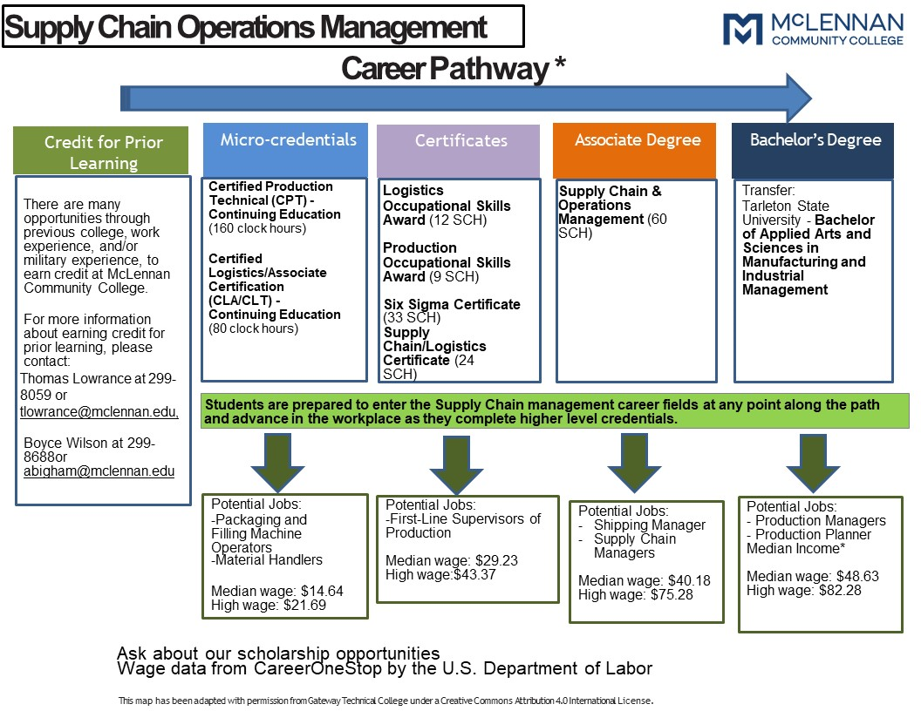
Credential Mapping
Credential Types
  Badges
  Micro-Credentials
  Institutional Credentials that Lead to Licensure for Certification (ICLC)
  Level 1 and Level 2 Certifications
  Associate Degrees
Credential Characteristics
  Stackable credentials
  Portable
  Aligned with Industry needs

Slide 3


Google Certificates Program with Jobs for the Future
Project Management (Launched)
Data Analytics
Advanced Data Analysis
Digital Marketing and eCommerce
https://www.mclennan.edu/business-division/google.html

Slide 4
Texas Higher Education Coordinating Board Micro-credential Network (MCL)
Development of a Strategic Plan to launch micro-credential
Implementation of the Google Certification Project Management
Networking with other community colleges
Credential Coach and working session
Funding for Credential Development ($30,000)
Promotional video: https://www.youtube.com/watch?v=dr8sdBipyQY

Slide 5

Texas Higher Education Coordinating Board Micro-credential Network (MCL)
TRUE Initiative 2022-2023 (Completed)
Launched Patient Care Technician (PCT) Program
Hybrid teaching model for the Certified Production Technician
Equipment – Medical equipment, Skill Boss Simulation Trainers
Funding students to participate in the Patient Care Technician
Mobile Lab and Computers
Advertising
TRUE Grant 2023-2024 (Proposal due October 30th )
Supply Chain Operations Management (Lean Six Sigma Certifications)
Pharmacy Technician Program
Equipment – (Vehicle to support off-site education)
Outreach and advertising

Slide 6

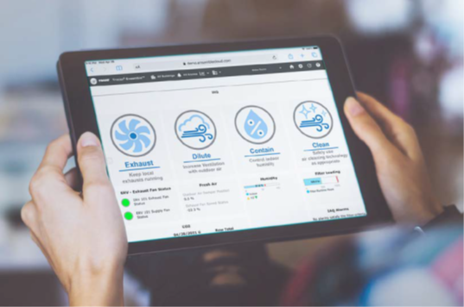

Trane NC3 Data Analytics Certification
Ten-hour curriculum that can be impeded
Ability to analyze data using data analysis software
Leverage data analytics in many fields of study
Opportunity to add additional certificates for Engineering and Science area
Train the trainer for faculty and staff in November 2023
https://www.nc3.net/wp-content/uploads/2022/09/NC3-Data-Analytics-Certification-1.pdf

Slide 7
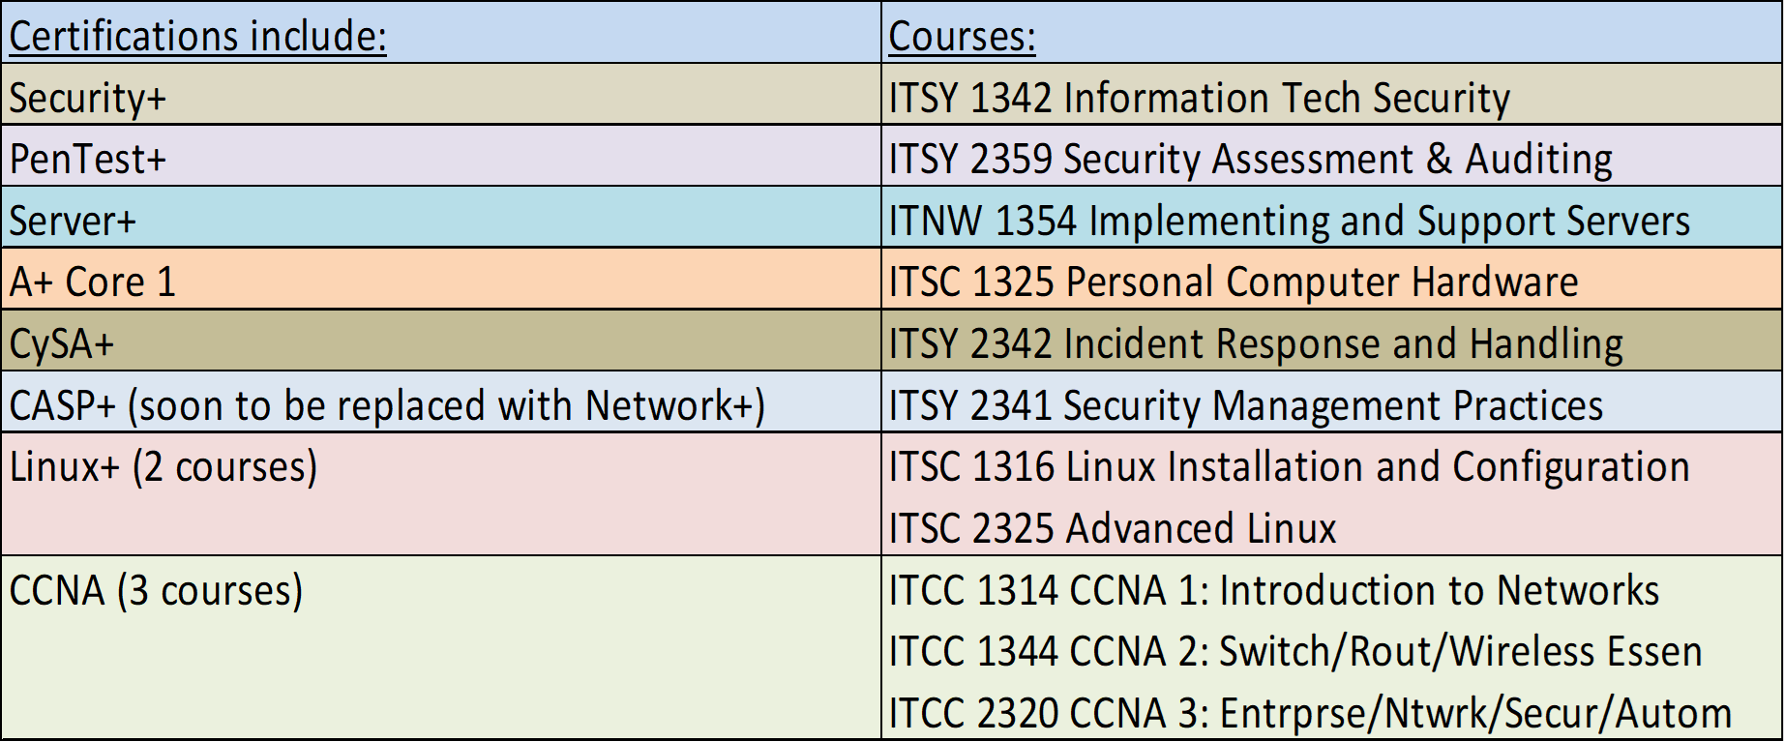
Computer Information System Imbedded Micro-credentials

Slide 8

Skills Verified Pilot Project – Trellis Foundation
Validation by 3rd party that our credentials are in alignment with industry needs
Helps educators understand and communicate their alignment with workforce needs
Skills Verified designation requires a tight alignment between the program curriculum, student learning outcomes, and competencies and skills needed for success in the workplace
Creates confidence in the capabilities of candidates/students
Programs being evaluated: Supply Chain Operation Management and Accounting
Workforce Talent Educators Association Talent Educators Association (WTEA)

Slide 9

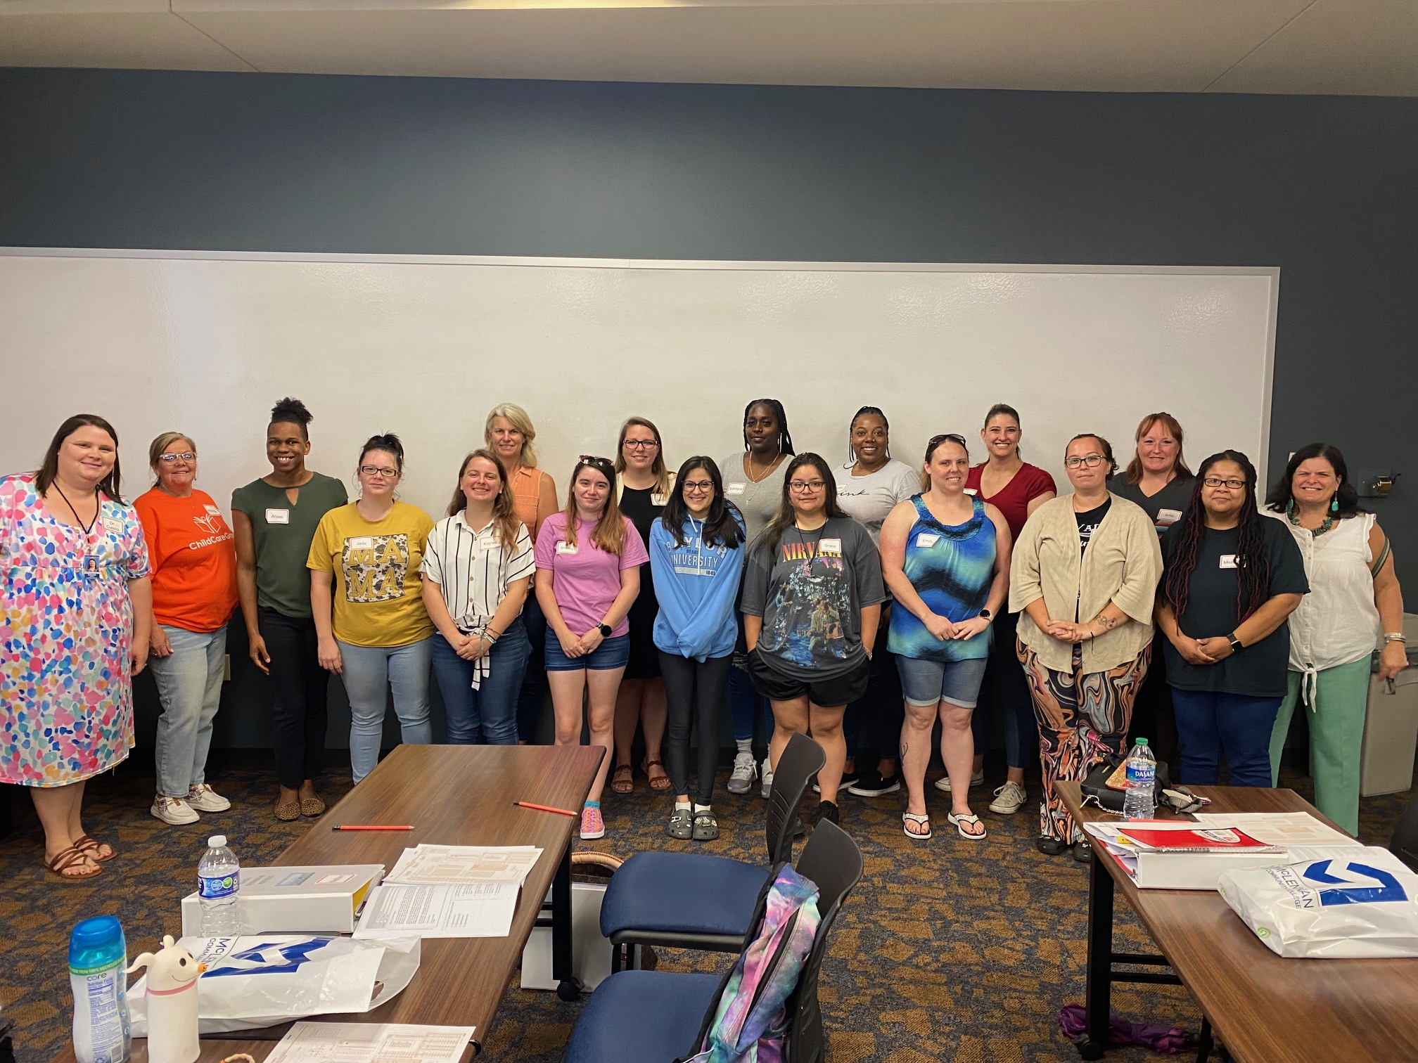
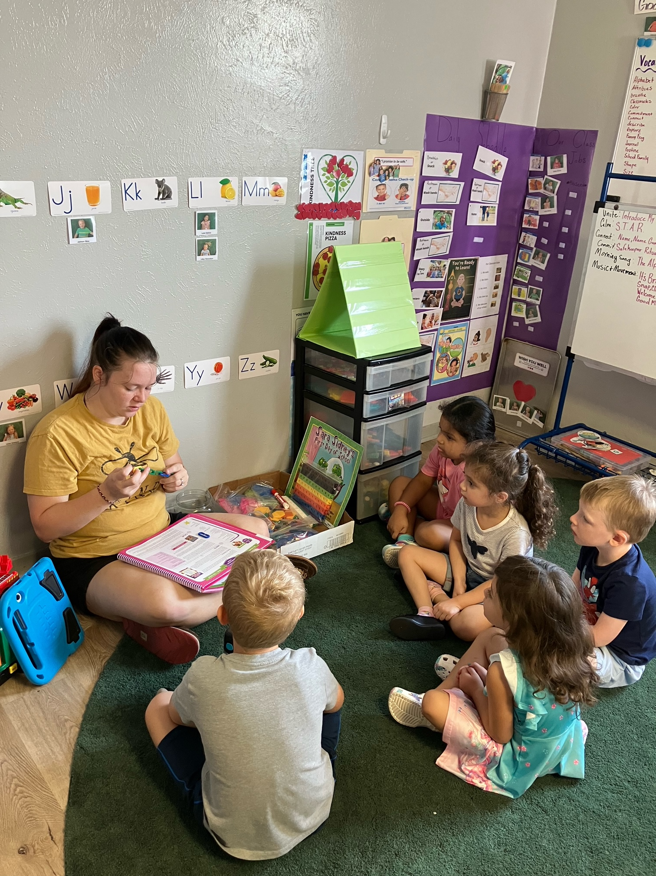
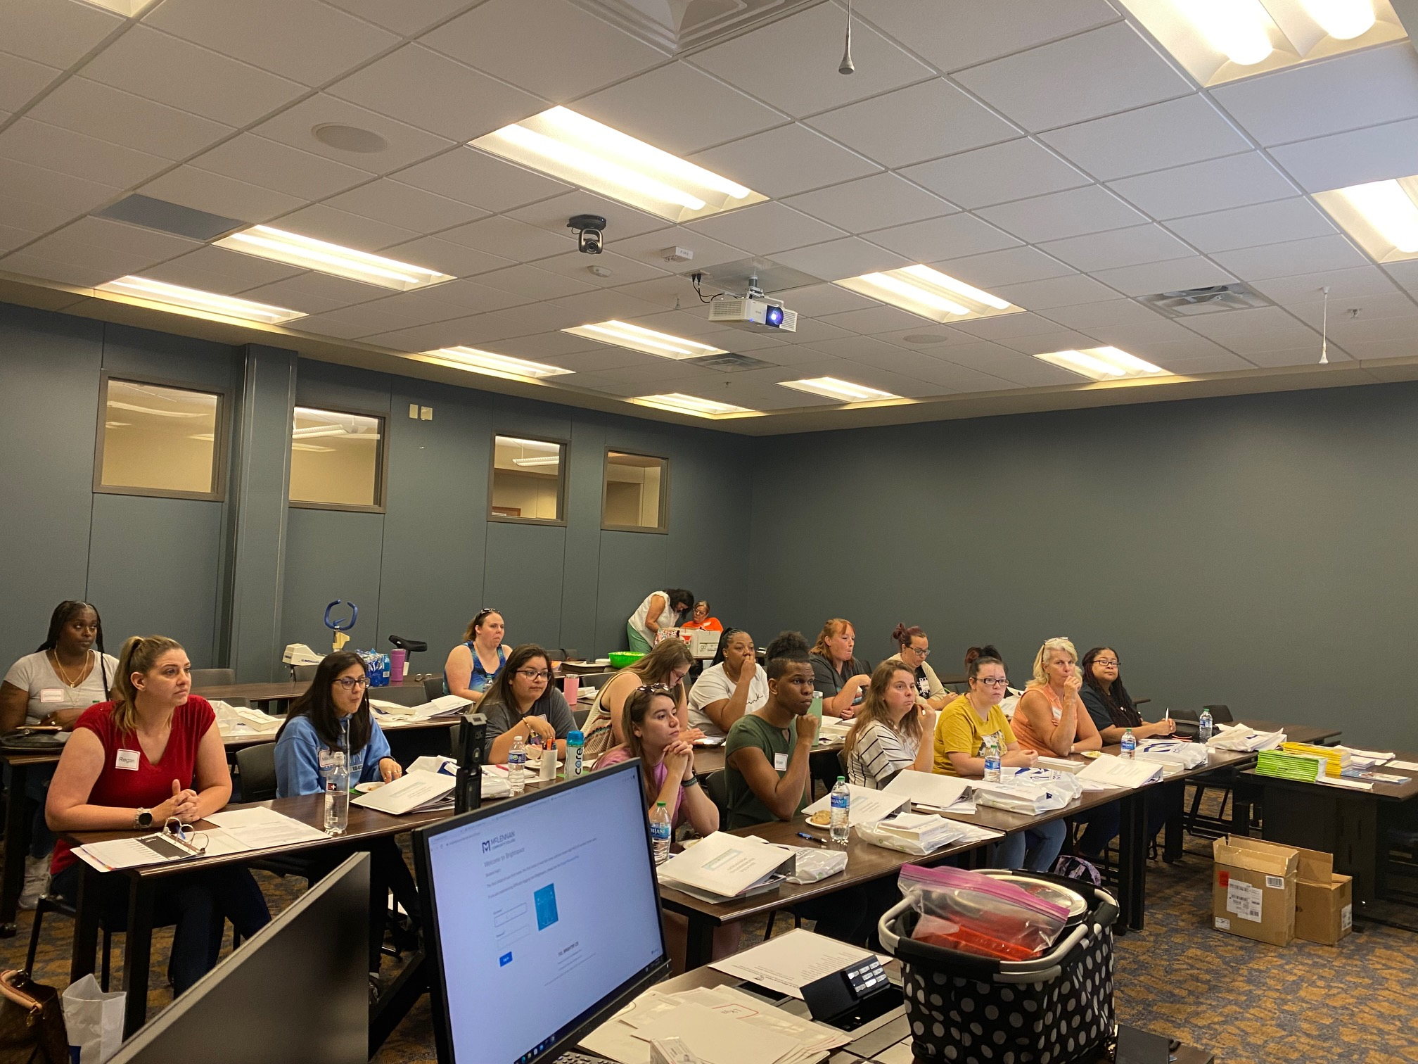
Early Childhood Education Apprenticeship Program Grant
Partnership with the Heart of Texas Workforce Board
Launched Summer of 2023
Micro-Credential earned Child Development Associate Certification
Level 1 Certificate
Waco Chamber Greater Waco Business Publication (Page 32)
https://wacochamber.com/advertising/

Slide 10
Michael & Susan Dell Foundation’s Community Colleges: Building the Texas Workforce Proposal
  Credential Attainment Coordinator
  Focus on apprenticeship and earn as you learn models
  Development of Career Maps
  Industry Liaison and document the engagement
  Three Year proposal to $236,873 total award

