Slide 1
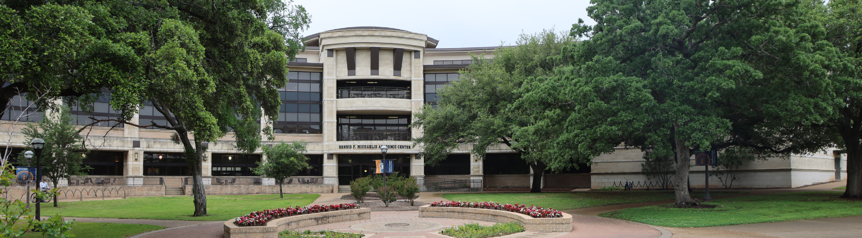

2023-24 Annual Priorities
January 30, 2024
Notes:
Overview:
What does it mean to be data informed?
What data does MCC have?
How do we use it?

Slide 2
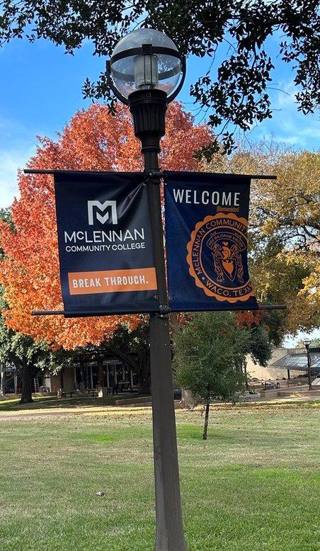
2023-24 Annual Priorities
Grow completion and graduation rates through the use of data, metrics, and high-impact practices to increase student success and to maximize benefit to the College and the community from the new Community College Formula Funding Model.
Increase collaborations with industry, educational, and community partners to assist with the initiation of beneficial opportunities and projects that meet the needs of the community and the College.
Increase credit and non-credit enrollment through Strategic Enrollment Management.
Standardize institutional policies to ensure currency with State and Federal legislation and best practices.

Slide 3










Support of Annual Priority I
High Impact Practices and
Top Instructional Practices
  Introduced in Fall 2023
  Kicked off Spring 2024 Faculty Gathering
  Held 5 trainings/planning meetings in January
  6 more scheduled for Spring
Notes:
There are eleven HIPs identified by the Association of American Colleges and Universities (AAC&U).
First-Year Seminars and Experiences , Common Intellectual Experiences, Learning Communities, Writing-Intensive Courses, Collaborative Assignments and Projects, Undergraduate Research, Global Learning, Service Learning, Community-Based Learning, Internships, Capstone Courses and Projects, Portfolios/ePortfolios
TIP include
Prior to the start of the semester
Email students before class starts, welcoming them and stressing your interest in their success and your willingness to help
Prior to the course census date:
Learn students’ names/preferred ways to be addressed and continue calling students by name throughout the semester.
Use a course orientation (and recommend Brightspace orientation).
Require an assignment for a grade. Follow up with students who do not complete the early assignment by:
Contact all students to provide encouragement, see if they have any questions, etc.
Throughout the semester:
Build relationships with students.
Give students the opportunity for connection (belonging):
Contact all students to provide encouragement, see if they have any questions, etc.
Communicate with students that are:
Respond to students in a timely manner
Grade assignments in a timely manner.
Incorporate current research/information from your field and help students make a connection to their life or situation.
Provide positive and constructive feedback.
Treat students with a high level of care.
At the end of the semester:
Congratulate students on their completion.
Encourage student for their future.
Remind students to register for the following semester.

Slide 4

Support of Annual Priority I
New planning and assessment software rollout – SPOL
  Trainings began January
  Over 100 employees have attended training
Notes:
The assessment of education programs at MCC is accomplished through (1) the Annual Unit Level Planning Process, which establishes a foundation for the planning process linked to the Annual Assessment of College Effectiveness/Student Learning Outcomes (ACE/SLO) Process; and, (2) Annual Program Reviews. Throughout this connected process, MCC identifies expected outcomes, assesses the extent to which it achieves these outcomes, and provides evidence of needing or achieving improvement based on analysis of the results.

Slide 5
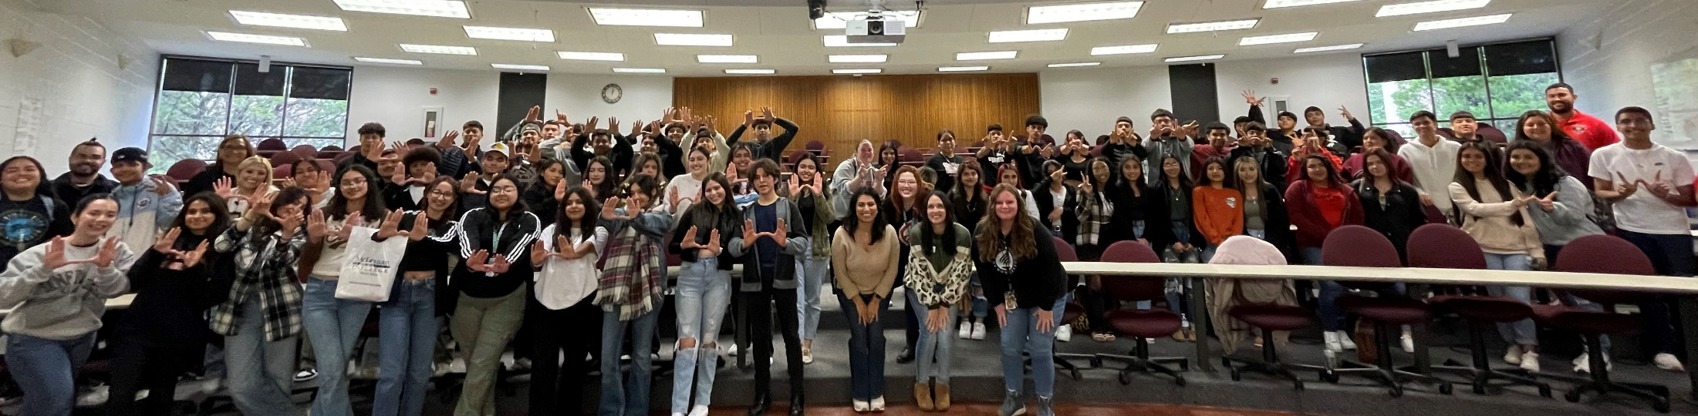
Support of Annual Priority I
Title V –
  Funded ESL Bridge program for incoming Hispanic students in Fall 2023
    In collaboration with the Hispanic Leaders Network
    Total of 90 students, junior and seniors Waco High School and University High School
Notes:
Campus Tour, Student Life Center Tour, University Center Presentation, panel of current students
Comments from participants included: By word of mouth, students said how inspired they felt after this event, how motivated they felt to actually go to college, how they felt like they connected with people and found a community, and how much fun they had. It was overall very good feedback!

Slide 6
Support of Annual Priority I
Academic Support & Tutoring -
  Expanded online and in-person tutoring access through Upswing
1,047 Essays Reviewed
841 Total Sessions
Notes:
111 MORE tutoring sessions then in Fall 2022

Slide 7
Support of Annual Priority I
Academic Support & Tutoring -
  Supplemental Instruction is a high impact practice using peers to lead study sessions within learning communities.
    Fall 2023:
      23 SI Leaders served 433 individual students
      Totaling 1,964 contact hours between SI Leaders and students
Notes:
Seventy-nine percent of respondents strongly agreed or agreed their SI Leader was knowledgeable on the subject matter and 77% stated the SI Leader created an environment conducive to learning. Seventy-four percent found the SI sessions were structured and collaborative, and 67% felt more prepared because of the SI sessions they attended. Sixty-two percent indicated they would attend SI sessions even if they were not required!

Slide 8
Increase collaborations with industry, educational, and community partners…
Educational Partnerships –
  Continues to meet with ISD partners
    22 ISD meetings in Fall 2023 & January 2024
    4 scheduled for February 2024
Emergency Services Education –
  Expanding Advisory Board Committee and public agencies
    11 new committee members across four programs
    Over 150 public agencies in all!
Notes:
CJ – 13
LEA – estimate 100-150+
EMS - 11
Fire - 5

Slide 9
Increase collaborations with industry, educational, and community partners…
Business Programs –
  Offered access to the entire list of Google Career Certificate training available to members of our advisory committees for their employees and all MCC employees free of charge.
    15 advisory member employees asked for invitations to participate. Of those 15, 12 have enrolled in training courses and, 3 have completed courses.
    34 MCC employees asked to be allowed to enroll. Of those 34, 27 enrolled, and 13 have completed courses.
  Industry-recognized credentials in courses:
    ITSC 1315 Project Management embedded Google Career Certificate in Project Management – 20 students earned the certificate. There are 26 currently enrolled and working towards their certificate for the Spring semester
    BUSI 2305 Business Statistics embedded Google Career Certificate in Data Analytics – 50 students completed the required courses to allow them to test for overall certification

Slide 10
Increase collaborations with industry, educational, and community partners…
Business Programs –
  Industry-recognized credentials (ICLC) in courses:
    CompTIA Server+ is embedded in ITNW 1354 – 1 certificate earned
    CompTIA Linux+ is embedded in ITSC 2325 – 3 certificates earned
    CompTIA Security+ is embedded in ITSY 1342 – 5 certificates earned
    CompTIA PenTest+ is embedded in ITSY 2359 – 1 certificate earned
    Trane NC3 10-hour certification in Data Analytics was embedded into courses this spring in Health Information Technology (26), Accounting (10), Office Technology Careers (14), and environmental science courses.
    Registered Health Information Technician (RHIT) certification, in 2023, 8 students sat for the exam and 6 were successful; 75% pass rate
    Real estate licensure certification were required to sit for the TREC salesperson license exam once eligible. The pass rate was 100%; 4 out of 4

Slide 11




Increase collaborations with industry, educational, and community partners…
Educational Assistance Partnership Program –
  Contacted over 200 businesses
  Hosted two lunch & learns and one webinar
    20 businesses have attended
  Sponsoring Chamber’s New Member Orientation
Notes:
Conducts outreach to local businesses in the area that offer tuition assistance letting them know how MCC can support their employees.
Hosts meeting with employers, lunch and learns, and a webinar
AMAZON – fall 2023 = 43 and spring 2024 = 30

Slide 12
Increase credit and non-credit enrollment through Strategic Enrollment Management.
Enrollment Services –
  Using Slate to engage with prospective students through mindful communications and touch points
  Partnered with an external company to coordinate a calling campaign. For the spring ’24 campaign, over 50% of those contacted enrolled

Slide 13
Increase credit and non-credit enrollment through Strategic Enrollment Management.
Marketing & Communications –
  For the Spring 2024 registration period, we invested $178,573 in various types of advertising targeting a specific audience in McLennan & Falls counties - individuals with little to no college education.
  November 2023 - January 2024 budget proportions:
    36% social media
    18% billboards & bus ads
    18% digital marketing
    12% TV
    6% creative productions
    4% sponsorships
    3% print
    3% radio
Notes:
Our focus was on three specific demographics: 18-24 year old, 25 and older, and 25-45 Spanish-speaking groups.
According to Slate's (CRM) Funnel Report, our efforts resulted in a significant increase in applicants for Spring 2024. Specifically, we saw an increase of 266 applicants for our 16-week courses compared to Spring 2023. Our advertising initiative through Niche, a college search website primarily used by high schools, generated a total of 1,085 inquiries about MCC. Out of those inquiries, 330 individuals applied to MCC. This is a new development for us, as we hadn't experienced this level of interest prior to 2022.

Slide 14
Increase credit and non-credit enrollment through Strategic Enrollment Management.
Continuing Education –
  Transitions current courses into Institutional Credentials Leading to Licensure or Certification
    Auctioneer
    Certified Patient Care Technician Bridge
    Certified Medication Aide
    Certified Nurse Aide
    Certified Patient Care Technician
    Basic Telecommunicator

Slide 15

Standardize institutional policies to ensure currency with State and Federal legislation and best practices.
Transitioning policies to TASB
  Currently in Phase 1
18-24 months process
Currently ~233 policies
  About 25-35% of current policies will be policies
  Remaining goes into Procedures

Slide 16
Standardize institutional policies to ensure currency with State and Federal legislation and best practices.
Fall 2022
Fall 2023
n=21,765
n=22,227
Source: MCC Grade Distribution Reports
Notes:
There were concerns of decreased success rates and higher failure rates with the implementation of the new attendance policy for fall 2023. However, overall fall success rate has increased 2%, while face to face increased 5%, internet increased 2%, and blended increased 4%.

Slide 17
Questions

