Slide 1

House Bill 8 Financial Aid for Swift Transfer (FAST)
January 2024 Board Presentation

Slide 2
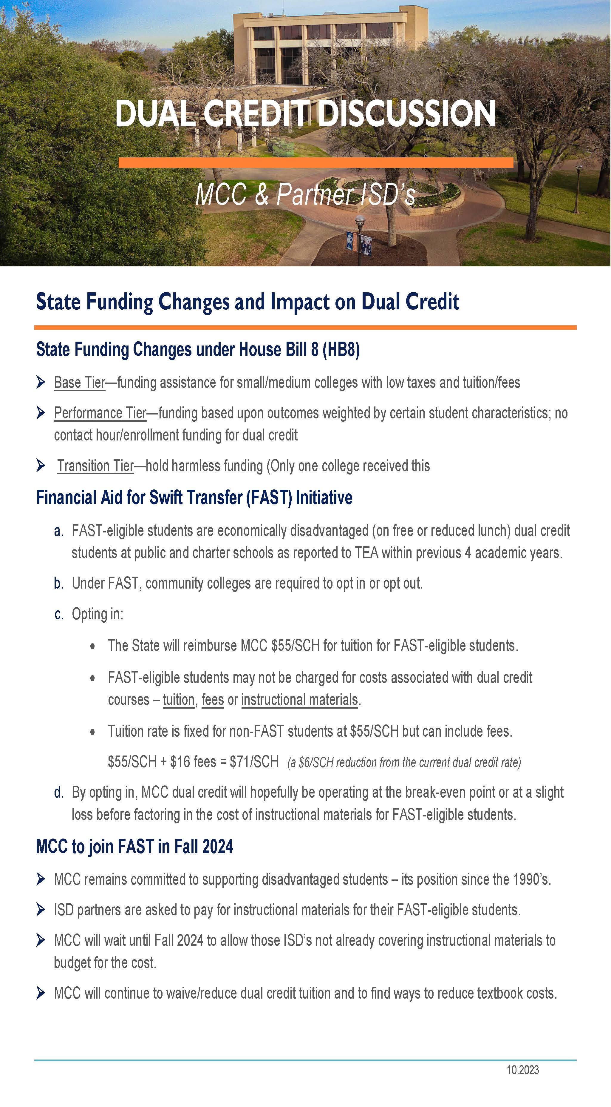

Slide 3
Financial Aid for Swift Transfer
FAST-eligible students are economically disadvantaged dual credit students (on free or reduced lunch) at public and charter schools as reported to the Texas Education Agency within previous 4 academic years.
Under FAST, community colleges are required to opt in or opt out.
Opting in:
The State will reimburse MCC $55/SCH for tuition for FAST-eligible students.
FAST-eligible students may not be charged for costs associated with dual credit courses – tuition, fees or instructional materials.
Tuition rate is fixed for non-FAST students at $55/SCH but can include fees.
$55/SCH + $16 fees = $71/SCH (a $7/SCH reduction from the current dual credit rate)

Slide 4
MCC to Join FAST in Fall 2024
MCC remains committed to supporting disadvantaged students – its position since the 1990’s.
MCC is requesting ISD partners pay for instructional materials for their FAST-eligible students.
MCC will wait until Fall 2024 to allow those ISD’s not already covering instructional materials to budget for the cost.
MCC will continue to waive dual credit tuition for those eligible for FAST, to reduce tuition for non-FAST students, and to find ways to reduce textbook costs.

Slide 5
ISDs Not Paying for Books Estimate from Fall 2022 – Summer 2023
High School | Free/Reduced Lunch on File | Estimated Textbooks for Eligible FAST Students | Estimated Textbooks for Non Eligible Students | Estimated Grand Total
AXTELL HIGH SCHOOL | 7 | $ 904 | $ 2,591 | $ 3,495
BOSQUEVILLE HIGH SCHOOL | 9 | $ 2,343 | $ 17,514 | $ 19,857
BRUCEVILLE EDDY HIGH SCHOOL | 4 | $ 831 | $ 2,008 | $ 2,839
CHINA SPRING HIGH SCHOOL | 27 | $ 6,798 | $ 47,327 | $ 54,125
CRAWFORD HIGH SCHOOL | 5 | $ 1,557 | $ 22,824 | $ 24,381
GHOLSON HIGH SCHOOL | 2 | $ 671 | $ 489 | $ 1,160
LORENA HIGH SCHOOL | 11 | $ 2,484 | $ 18,444 | $ 20,928
MCGREGOR HIGH SCHOOL | 15 | $ 3,133 | $ 4,374 | $ 7,507
MIDWAY HIGH SCHOOL | 62 | $ 22,214 | $ 96,737 | $ 118,951
PREMIER HIGH SCHOOL WACO | 2 | $ 446 | $ 92 | $ 538
RIESEL HIGH SCHOOL | 13 | $ 3,226 | $ 8,121 | $ 11,347
ROBINSON ISD | 14 | $ 2,766 | $ 13,011 | $ 15,777
VALLEY MILLS HIGH SCHOOL | 11 | $ 4,251 | $ 3,471 | $ 7,722
WEST HIGH SCHOOL | 16 | $ 5,138 | $ 24,949 | $ 30,087
Grand Total |  | $ 56,762 | $ 261,952 | $ 318,714

Slide 6
Private, Home Schooled & Early Admission Students
Not covered under the HB8 or the FAST program
Propose offering:
Private and Home School
Pay same tuition rate of $55/SCH + $16 fees = $71/SCH
Pay for instructional materials
Early Admissions students
Pay same tuition rate of $55/SCH + $16 fees = $71/SCH
FAST eligible early admission students from public/charter schools do not pay for tuition or fees
Pay for instructional materials
Use separate application
Rationale
MCC has been offering the discounted tuition prior to HB8.
Early Admission and public dual credit students often in the same classes.

Slide 7
Public ISDs Visited To Date
China Spring
Clifton
Axtell
Midway
Waco
Robinson
Bruceville-Eddy
Moody
La Vega
Connally
Crawford
Lorena
Riesel
Chilton
Marlin
Mart
West
Valley Mills
Bosqueville

Slide 8
Charter/Private Schools Visited To Date
Eagle Christian Academy
Methodist Children’s Home
Valor Academy
Vanguard Academy

Slide 9
Comparison of 2023-24 Dual Credit Income

Slide 10
Dual Credit Discount = $(707,823)
Total Discount = $(1,384,347)
2023-24
FAST Opt-Out
Free/Reduced Lunch = $(676,524)
$(129,746)
2023-24
FAST Opt-In Scenario
Dual Credit Discount = $(1,627,889)
FAST Reimbursement = $373,288
Total Discount = $(1,254,601)

Slide 11
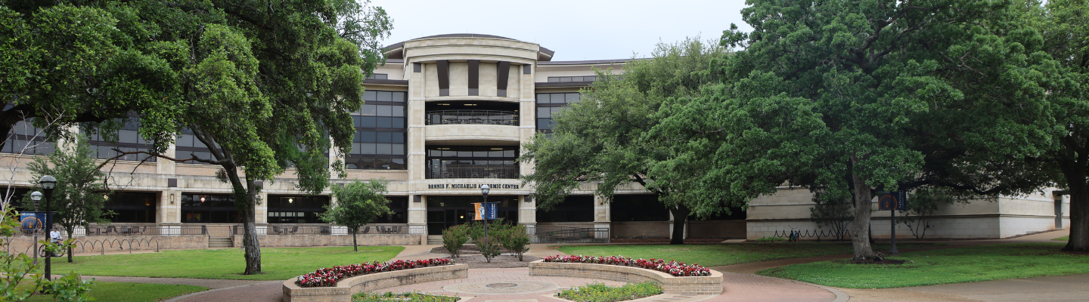
Questions

