Slide 1

TIPs
Top Instructional Practices
Notes:
Welcome back and Happy New Year!

Slide 2
Strategic Enrollment Management
Retention
Student
Support
Strategies
Classroom
Strategies
Notes:
Welcome back and Happy New Year!

Slide 3

Classroom Strategies Committee
Committee Members: Daelynn Copeland, Christi Esquivel, Elaine Fagner, Felicia Gladden, Michaela McCown, Christopher Morris, Paula Unger, Staci Taylor
Co-Chairs: Mandy Morrison and Laura Wichman
Dr. Stephen Benson and Dr. Fred Hills

Slide 4
Committee Goals
Retention Plan to Align with Strategic Plan
Publish TIPs
Share Research
Continue Innovation
HIPs and TIPs
Review and Update
Just-in-Time Reminders

Slide 5
Retention
Course Persistence
Course Completion
Graduation/Transfer

Slide 6
Top Instructional Practices
Enhance the learning experience and facilitate student success
Review research, experiment, and share

Slide 7
TIPs Outline
Prior to the start of class
Prior to the course census date
Throughout the semester
At the end of the semester

Slide 8
Just-in-Time
Reminders for Faculty

Slide 9
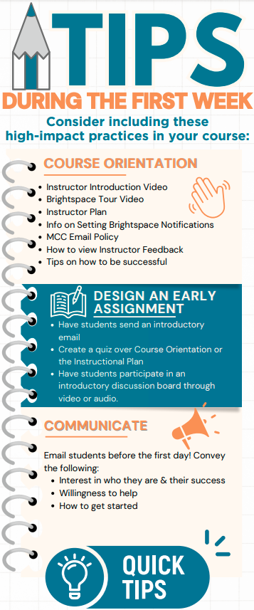
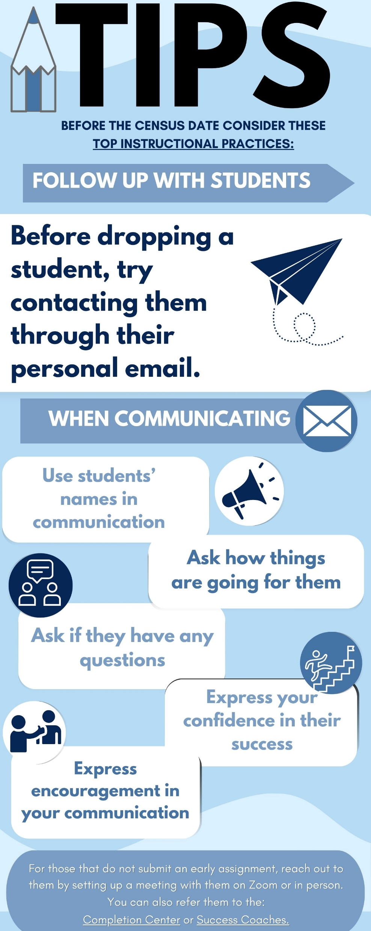
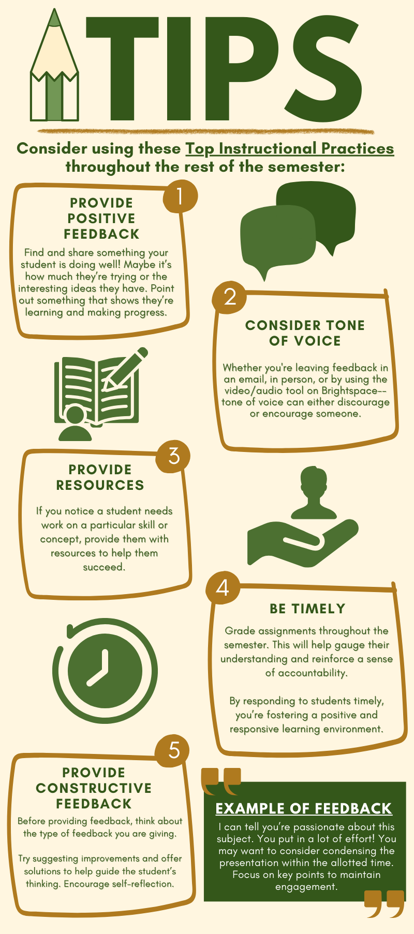

Slide 10
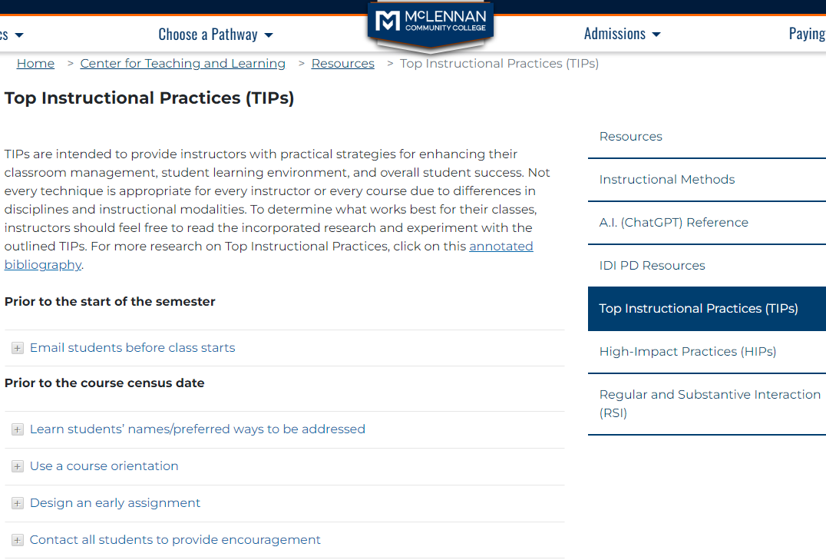

Slide 11
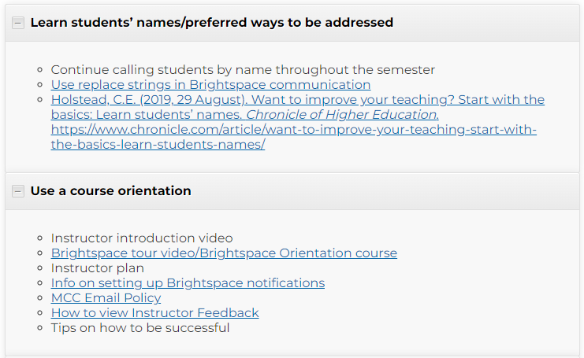

Slide 12

Engagement
Innovation
Curiosity

Slide 13

HIGH IMPACT PRACTICES
High Impact Practices (HIPs) are teaching and learning strategies that have been proven to significantly enhance student engagement, retention, and overall learning outcomes.
Especially true when implemented on a large scale. This is why we need your help!
Notes:
Good afternoon, I hope you all had a great break filled with kindness, love and generosity.
I am here to talk to you about High Impact Practices. Some of you hopefully have heard of HIPs by now and probably have an idea of what they are.
They are strategies used while teaching to increase student engagement, retention and overall student success.
According to the research, it is even more effective when it is performed on a large-scale which is what we are aiming for here at MCC. This is why we need each of you, because you are all important and have a direct impact on students and their success.

Slide 14

WHAT ARE
HIGH IMPACT PRACTICES?
High Impact Practices (HIPs) are evidence-based teaching and learning practices that have been widely tested and shown to be beneficial for college students from many backgrounds, especially historically underserved students, who often do not have equitable access to high-impact learning
(Kuh, 2008).
Notes:
Why are we doing HIPs?
HIPs are based in research and have been shown to benefit students like the ones we see at MCC. Those with various backgrounds, especially those who historically have been underserved.

Slide 15











HIGH IMPACT PRACTICES
High Impact Practices (HIPs) are teaching and learning strategies that have been proven to significantly enhance student engagement, retention, and overall learning outcomes.
Notes:
The 11 common HIPs are listed here and include:
Common Intellectual Experiences,
Global Learning,
E-Portfolios,
Capstone Courses/Projects,
Learning Communities,
Writing Intensive Courses,
Collaborative Learning,
1st Year Seminars (Learning Frameworks),
Undergraduate Research (Honors College/Scholar Day), and
Service Learning/Internships

Slide 16
KEY ELEMENTS SHARED BY HIGH IMPACT PRACTICES
  Experiences exposed to multiple perspectives, people and circumstances
  Real-world application
  Frequent, timely, and constructive feedback
  Performance expectations set at appropriately high levels
  Significant investment of time and effort by students over an extended period of time
  Interactions with faculty and peers about substantive matters
Notes:
Those 11 are not the only things however that can be classified as HIPs.
There are several elements that are common among HIPs. So if you are doing a project in your class which isnt one of the 11 but shares these elements, there is a good chance it too could be a HIP.
Here is a list of 6 of the common elements.
Performance expectations at a high level.
Significant amount of time over an extended period of time.
There are interactions with you, other faculty and students about noteworthy aspects of content.
Having exposure to multiple view points, people and thoughts.
Application to the real world.
Feedback on the project that is frequent and constructive.

Slide 17

BENEFITS OF HIPS
HIPS ARE POSITIVELY ASSOCIATED WITH
  Persistence and GPA
  Deep approaches to learning
  Higher rates of student‐faculty interaction
  Students take ownership of learning
  Increases in critical thinking, writing skills
  Greater appreciation for diverse viewpoint
  Higher student engagement overall, and “compensatory effects”
Notes:
There have been many positive attributes associated with HIPs. Listed are a few of those benefits which have been found it research.

Slide 18

IMPLEMENTATION
  Champions develop department HIP sessions.
  Offer sessions to each department/division with emphasis on data, creativity and implementation.
  Faculty create HIP assignment to implement the following semester.
Notes:
In regards to implementation each division has a HIP Champion which was selected or volunteered.
The HIP champion will develop and offer a session to their division which will discuss data, implementation and allow creativity and collaboration.
If you have any questions or need assistance you can contact your Champion or Instructional Design and Innovation.
Faculty will implement a HIP in a class in Fall of 2024.

Slide 19

RESOURCE LOCATION
Center for Teaching & Learning: HIP Website
  Annotated Bibliography
  Detailed information about each HIP
  Repository of MCC’s HIP (volunteer basis).
Notes:
If you would like more resources and research you can access it on the newly created HIP website. On the website we have two annotated bibliographies: one on Evidence & Outcomes and another on HIPs in the Classroom.
A big Thank You to the Library and Rachel Kramer for the creation of the annotated bibs.
You can also find more detailed information and links on HIPS, such as rubrics and examples.
We will be adding a repository of MCC HIPs at some point. The plan is to have examples of HIPs from you so that you can get ideas from each other. This will be on a volunteer basis for those who would be willing to share.

