Slide 1
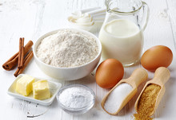
The chemistry of baking with flour
Dr. Ivanna Campbell

Slide 2
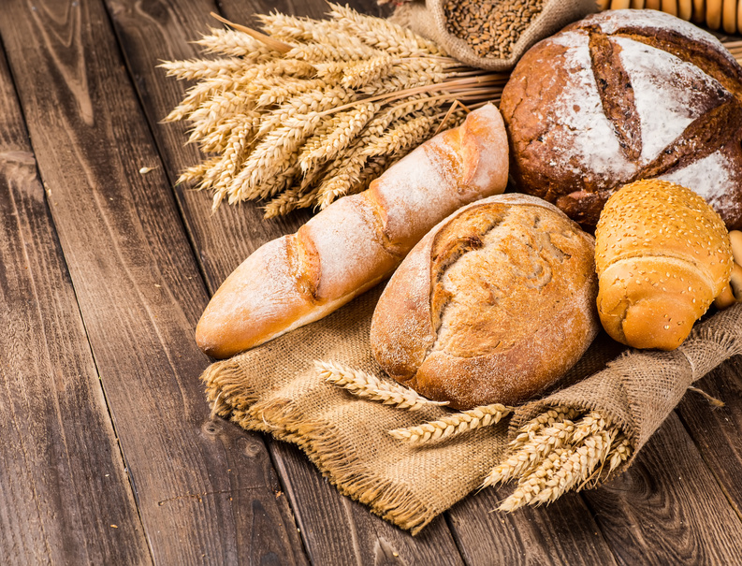
Baking
The action of cooking food by dry heat without direct exposure to a flame, typically in an oven.¹
Baking with flour:
Water
Leaven
Sugar
Fats and oils
¹Oxford Languages.

Slide 3
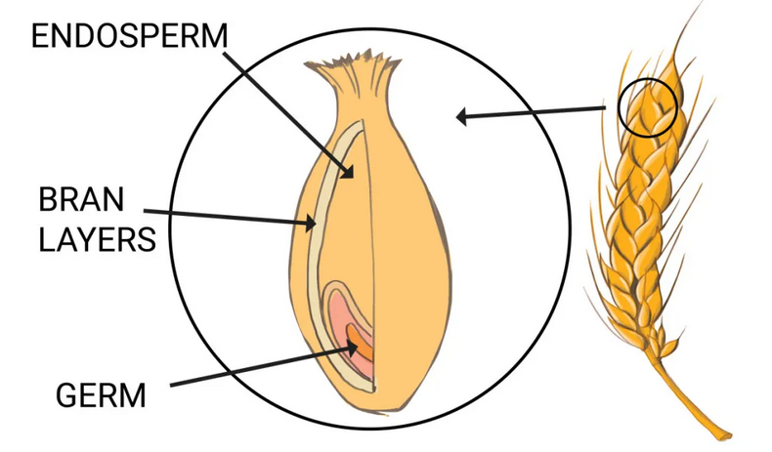
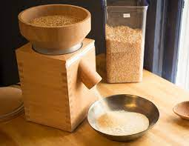
Wheat to flour
Refined flour
Endosperm
Whole wheat
Endosperm
Bran
Seed
Pictures: https://commons.wikimedia.org/wiki/File:Wheat_%28219038809%29.jpeg https://matthewjamesduffy.com/milling-your-own-fresh-flour/

Slide 4
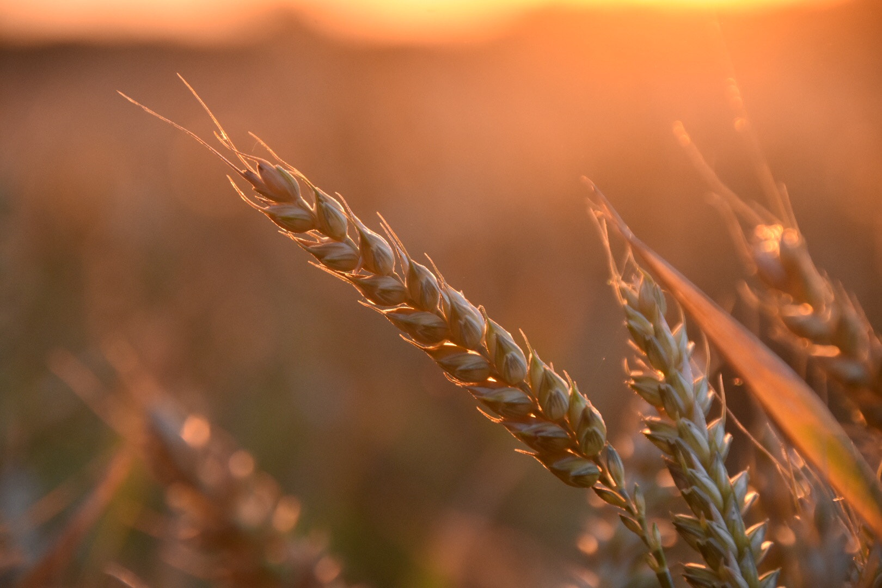
Flour: Bleached vs. unbleached
Bleached flour:
Whiter
Light texture
More elastic
Better for fluffy baked goods
Unbleached flour:
Slightly yellow
Denser
Better for baked goods that require structure
Oxidizing agent: KBrO₃, ClO₂ or benzoyl
Picture: https://commons.wikimedia.org/wiki/File:Wheat_%28219038809%29.jpeg

Slide 5
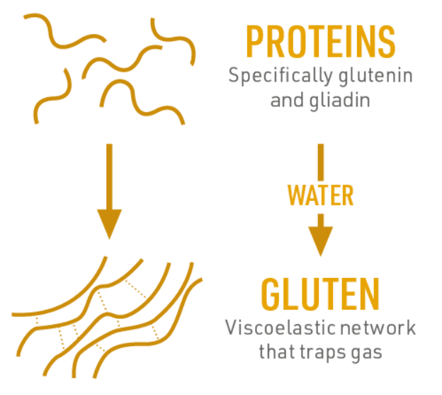
Flour and water
Proteins in flour = gluten
Hydrogen bonds
When heated the starch granulates swell
https://www.compoundchem.com/2016/01/13/bread/

Slide 6
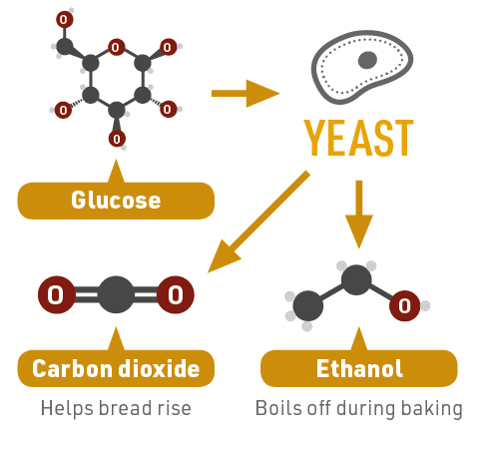
Leaven: Yeast
Yeast
A single-celled living organism that transforms sugar and starch into carbon dioxide and alcohol through fermentation.²
C₆H₁₂O₆ → 2 C₂H₅OH + 2 CO₂ + 2 ATP(energy)
²https://www.foodnetwork.com/how-to/packages/food-network-essentials/what-is-yeast

Slide 7
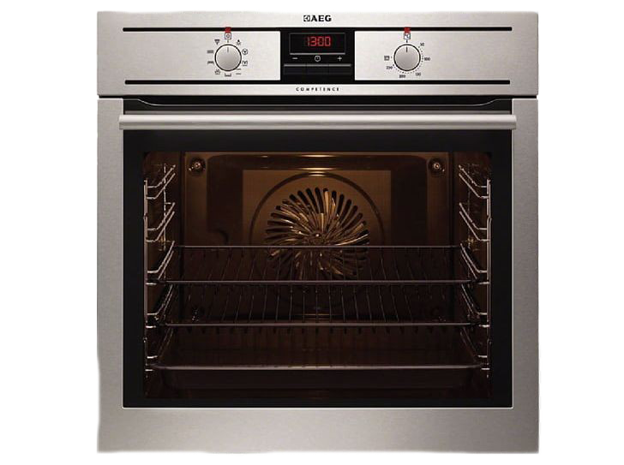
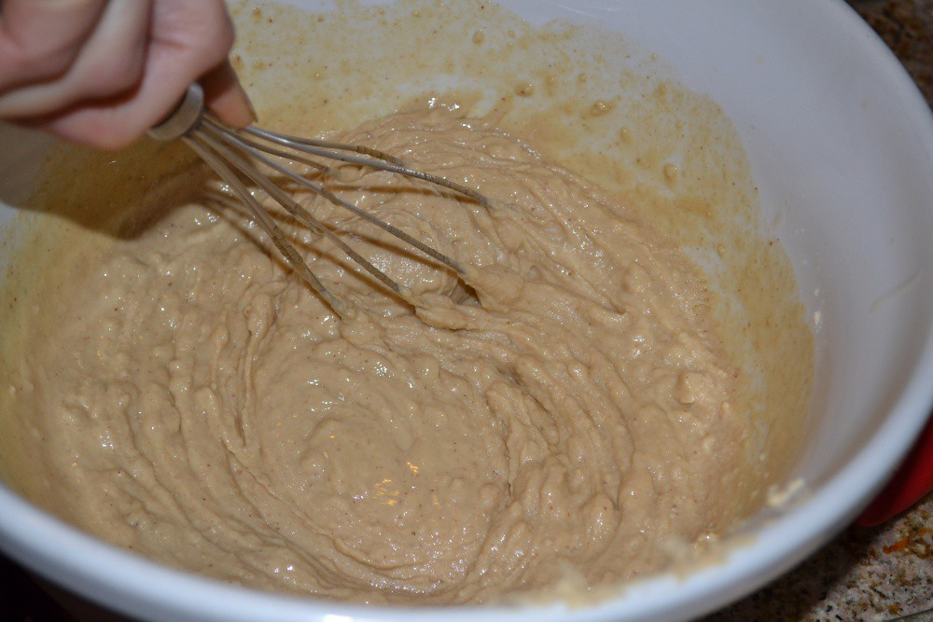
Leaven: baking powder
Baking powder
Is a chemical mixture of sodium bicarbonate and an acid or acidic salt.³
NaHCO₃ + H⁺ → Na⁺ + CO₂ + H₂O
Double Acting
³https://cen.acs.org/food/food-science/Periodic-Graphics-Baking-soda-versus-baking-powder/100/i14

Slide 8
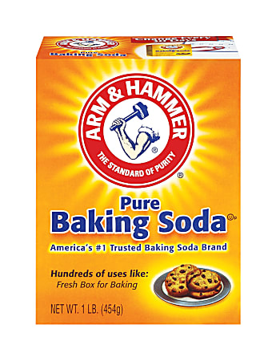
Leaven: baking soda
Baking soda
Is pure sodium bicarbonate.⁴ To work you need an acid or heat.
NaHCO₃ + H⁺ → Na⁺ + CO₂ + H₂O
heat
2 NaHCO₃ → Na₂CO₃ + CO₂ + H₂O
⁴https://www.thoughtco.com/baking-soda-and-baking-powder-difference-602090

Slide 9
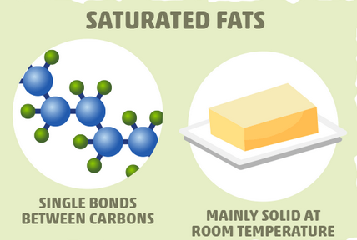
Fat
Butter
A pale yellow edible fatty substance made by agitating cream milk.⁵ Generally solid at room temperature.
Weaken the gluten
Increase loaf volume
Contributes to the flavor
Creates a light and tender texture
⁵Oxford Languages

Slide 10
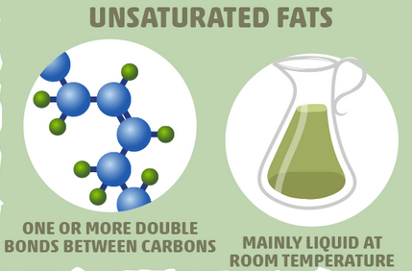
Fat
Oil
Is a plant-derived fat that remains liquid at room temperature.⁶
Weaken the gluten
Improves the texture
Increase loaf volume
⁶https://bakerpedia.com/ingredients/oil/

Slide 11
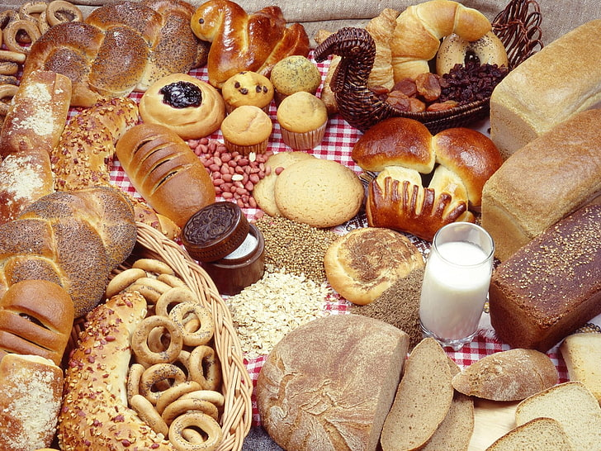
Conclusion
When baking with flour:
Water –viscoelastic properties
Leaven- rising of the dough
Sugar- yeast and flavor
Fats and oils- texture, flavor and volume
¹Oxford Languages.

Slide 12

The END

