Slide 1
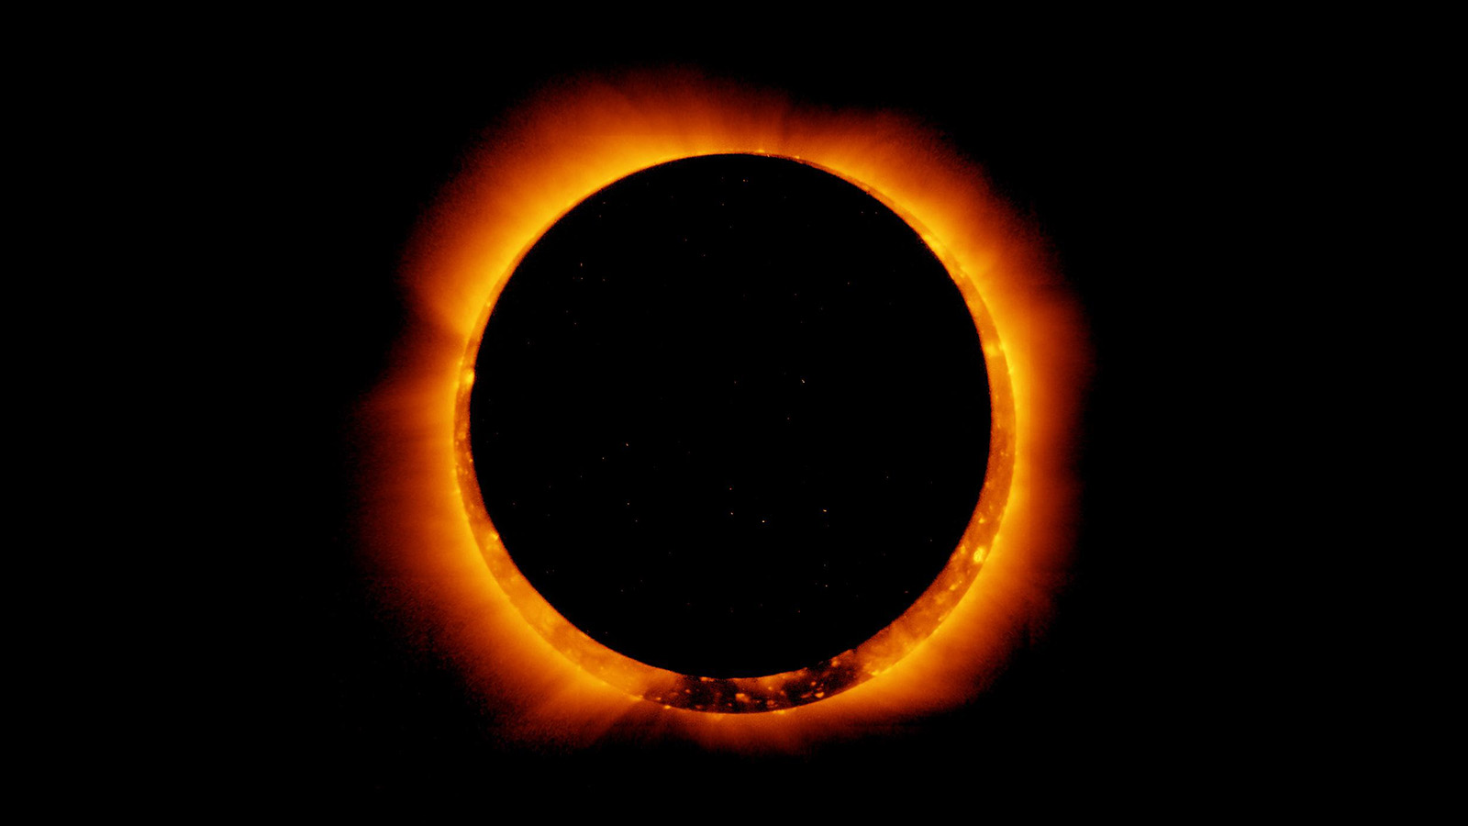
Astronomy & the Total Eclipse of 2024
Photo Credit: NASA Jet Propulsion Laboratory

Slide 2
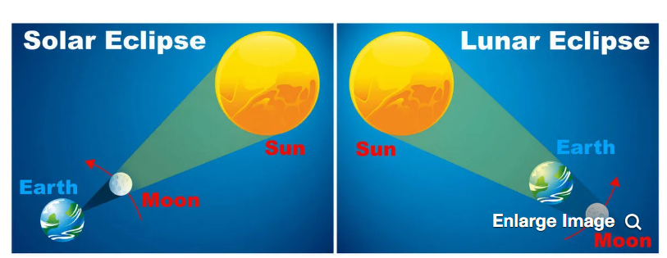
Eclipses
An eclipse occurs when one astronomical object moves in the shadow of another one, such as a moon or a planet.
There are two major types of eclipses: lunar (partial and total) and solar (partial, annular, and total).
Diagram Credit: NASA

Slide 3
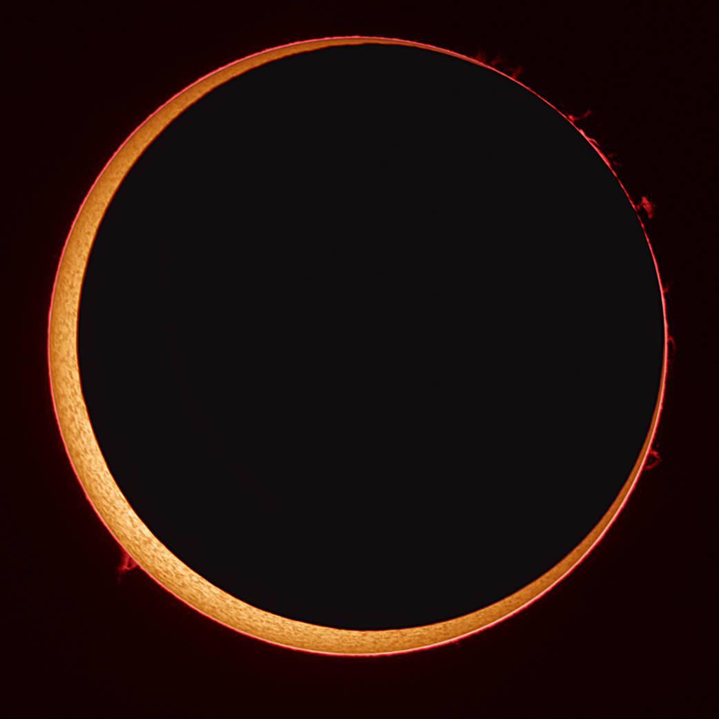
Eclipses: Annular Solar Eclipse
This occurs when the Moon moves between the Sun and Earth when it is at or near its farthest point from Earth (Apogee).
Because the moon is farthest away, it seems smaller and does not block the entire view of the Sun, which creates a ring around the Moon.
Photo Credit: NASA, Stefan Seip. Annual Eclipse in 2023.

Slide 4
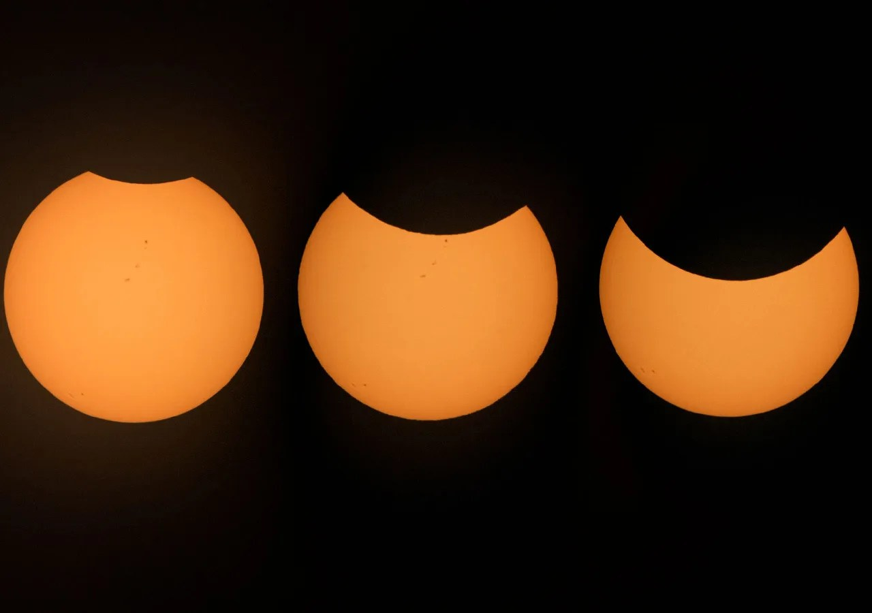
Eclipses: Partial Solar Eclipse
A partial solar eclipse happens when the Sun, Moon, and Earth and not exactly aligned. During a partial solar eclipse, a portion of the Sun will appear to be covered, giving it a crescent shape.
During a total or annular solar eclipse, people outside the area covered by the Moon’s inner shadow see a partial solar eclipse.
Photo Credit: NASA, Partial Solar Eclipse in 2022.

Slide 5
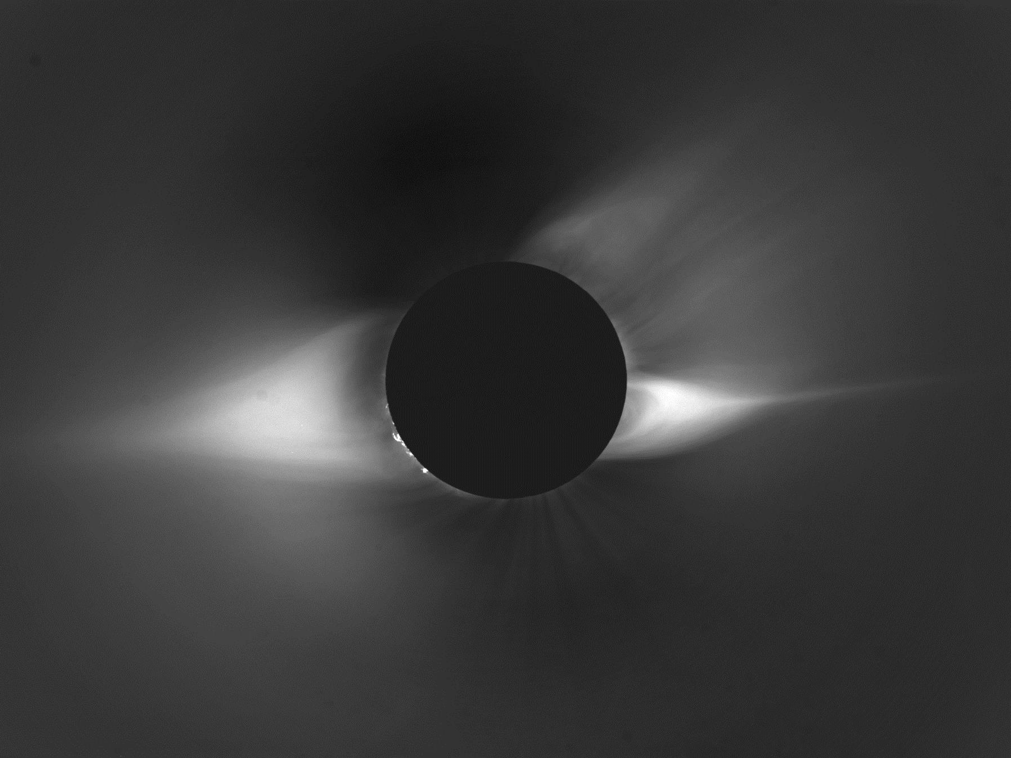
Eclipses: Total Solar Eclipse
This occurs when the Moon at New Moon phase passes directly between the Earth and the Sun, temporarily blocking out part of the Sun. This event only happens during the day.
People viewing the eclipse from locations where the Moon’s shadow complete covers the Sun are in the “path of totality”.
Photo Credit: NASA

Slide 6
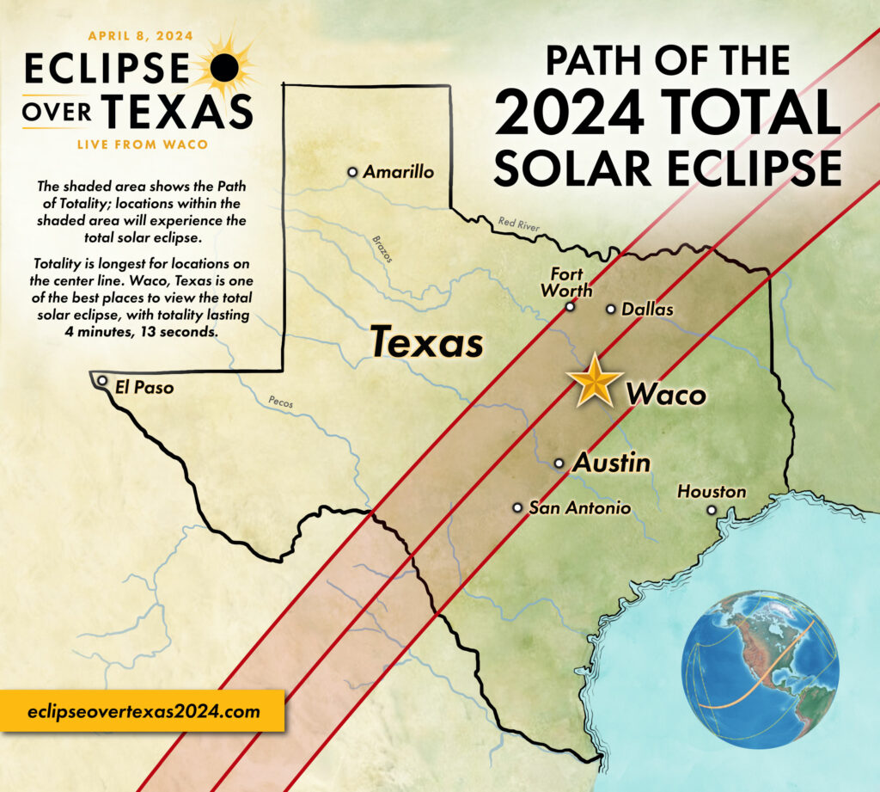
April 8th: Total Solar Eclipse
Waco is in the direct “path of totality” for this event making it a prime location to view this remarkable eclipse.
Waco will have 4 minutes and 13 seconds of totality (darkness).
Diagram Credit: ElcipseoverTexas2024.com

Slide 7
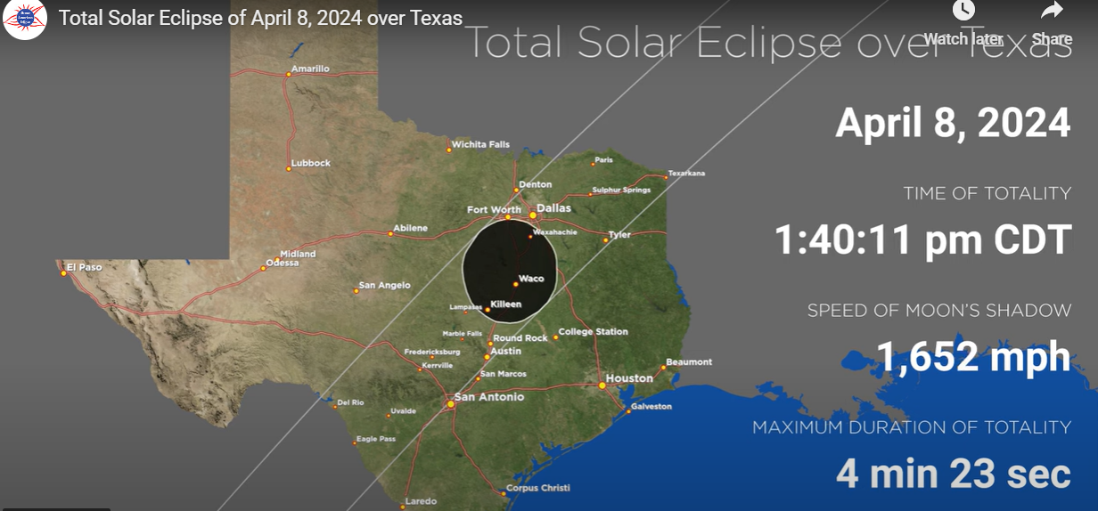
April 8th: Total Solar Eclipse
During totality, a total solar eclipse produces sunset conditions, which is dark enough to see planets, some stars, and Sun’s corona and prominences.
The eclipse schedule begins at 12:20 pm, reaches maximum totality at 1:40 pm; and ends at 3:00 pm.
Diagram Credit: from the greatamericaneclipse.com.

Slide 8
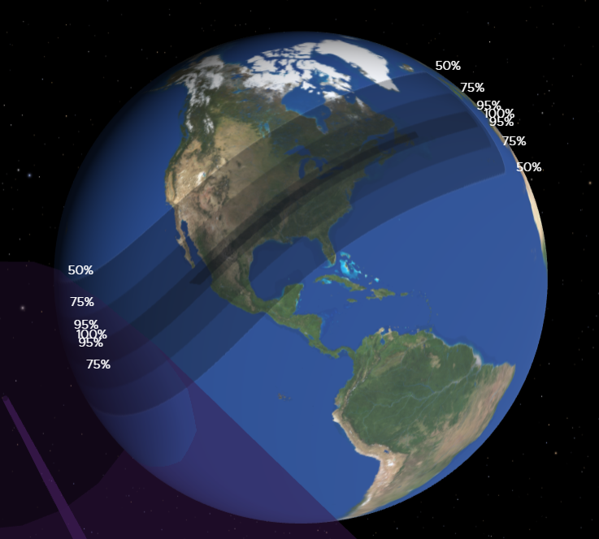
April 8th: Total Solar Eclipse
All 48 contiguous states in the U.S., Mexico and most of Canada will experience at least a partial solar eclipse on this date.
The same was true for the October 13, 2023 annular eclipse.
Diagram Credit: from science.NASA.gov/eclipses.

Slide 9
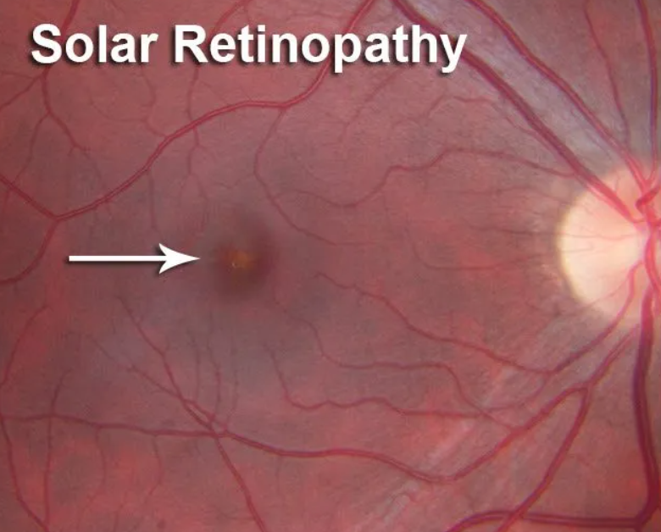
Eclipse Safety: Eye Protection
Looking at the Sun during a solar eclipse without proper eye protection can cause eclipse blindness also known as solar retinopathy.
This condition can involve a temporary loss or long-term impairment of vision, typically due to retinal burns.
Image Credit: candalleye.com/solar-eclipse-eye-safety.

Slide 10
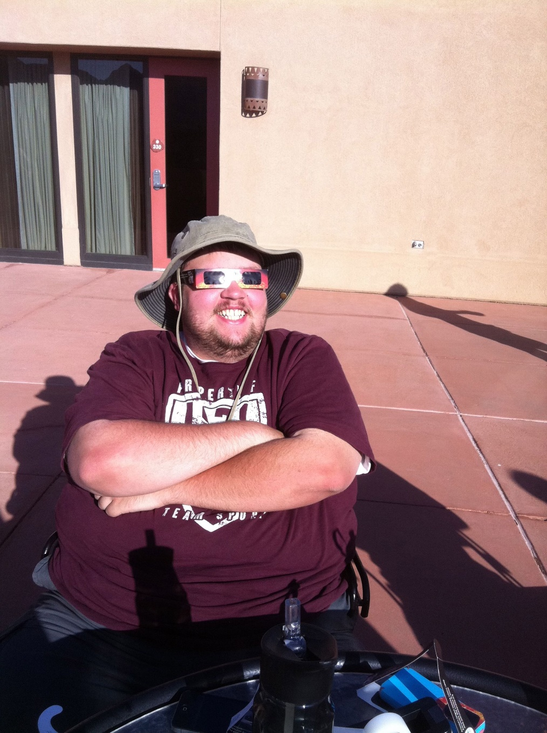
Eclipse Safety: Eye Protection
The only time it is safe to take off your eye protection during this event is for the period of totality.
You must look through safe solar viewing glasses or a safe handheld solar viewer during a solar eclipse. Sunglasses will not protect your eyes!
Any time before or after our 4 minutes and 13 seconds of totality, you should be wearing eye protection, such as Welder’s glasses or solar eclipse glasses.
Photo credit: Fagner, Annual Solar Eclipse in Sedona, Arizona.

Slide 11
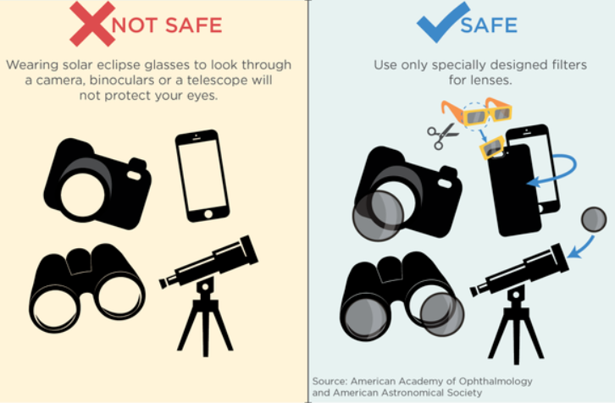
Eclipse Safety: Photography Protection
Be safe and only use specially designed filters for a camera, phone, binoculars, or telescope when viewing the eclipse. The eclipse can damage your camera or phone without a solar filter.
Even then, the concentrated solar rays can burn through the filter leading to eye injuries if you view the eclipse through a lens.
Diagram Credit: from the American academy of Ophthalmology and the American Astronomical Society.

Slide 12
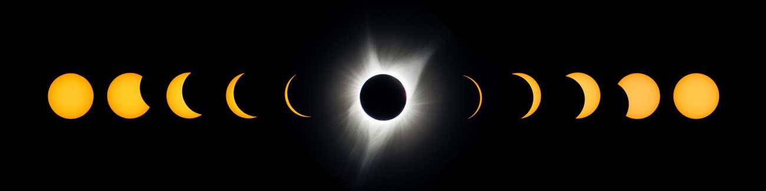
Questions…
Contact Information:
Dr. Elaine Fagner, P.G.
Professor of Geology, MCC
Office: 254.299.8442
Email: efagner@mclennan.edu
Eclipse Information:
Waco eclipse starts ~12:30 pm
Waco Totality starts ~1:40 pm
Waco totality Length is 4:13 minutes
Waco full eclipses ends ~3:00 pm
Photo Credit: Jeremy White, NPS.gov

