Slide 1
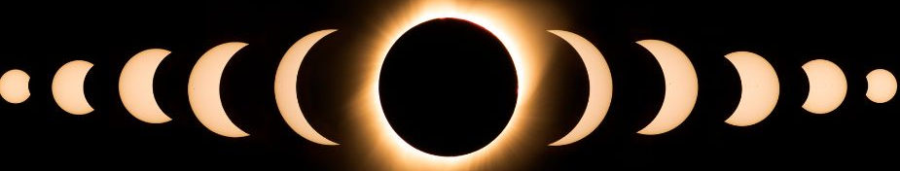

Waco Eclipse 2024:
Impacts and Response
March 26, 2024

Slide 2
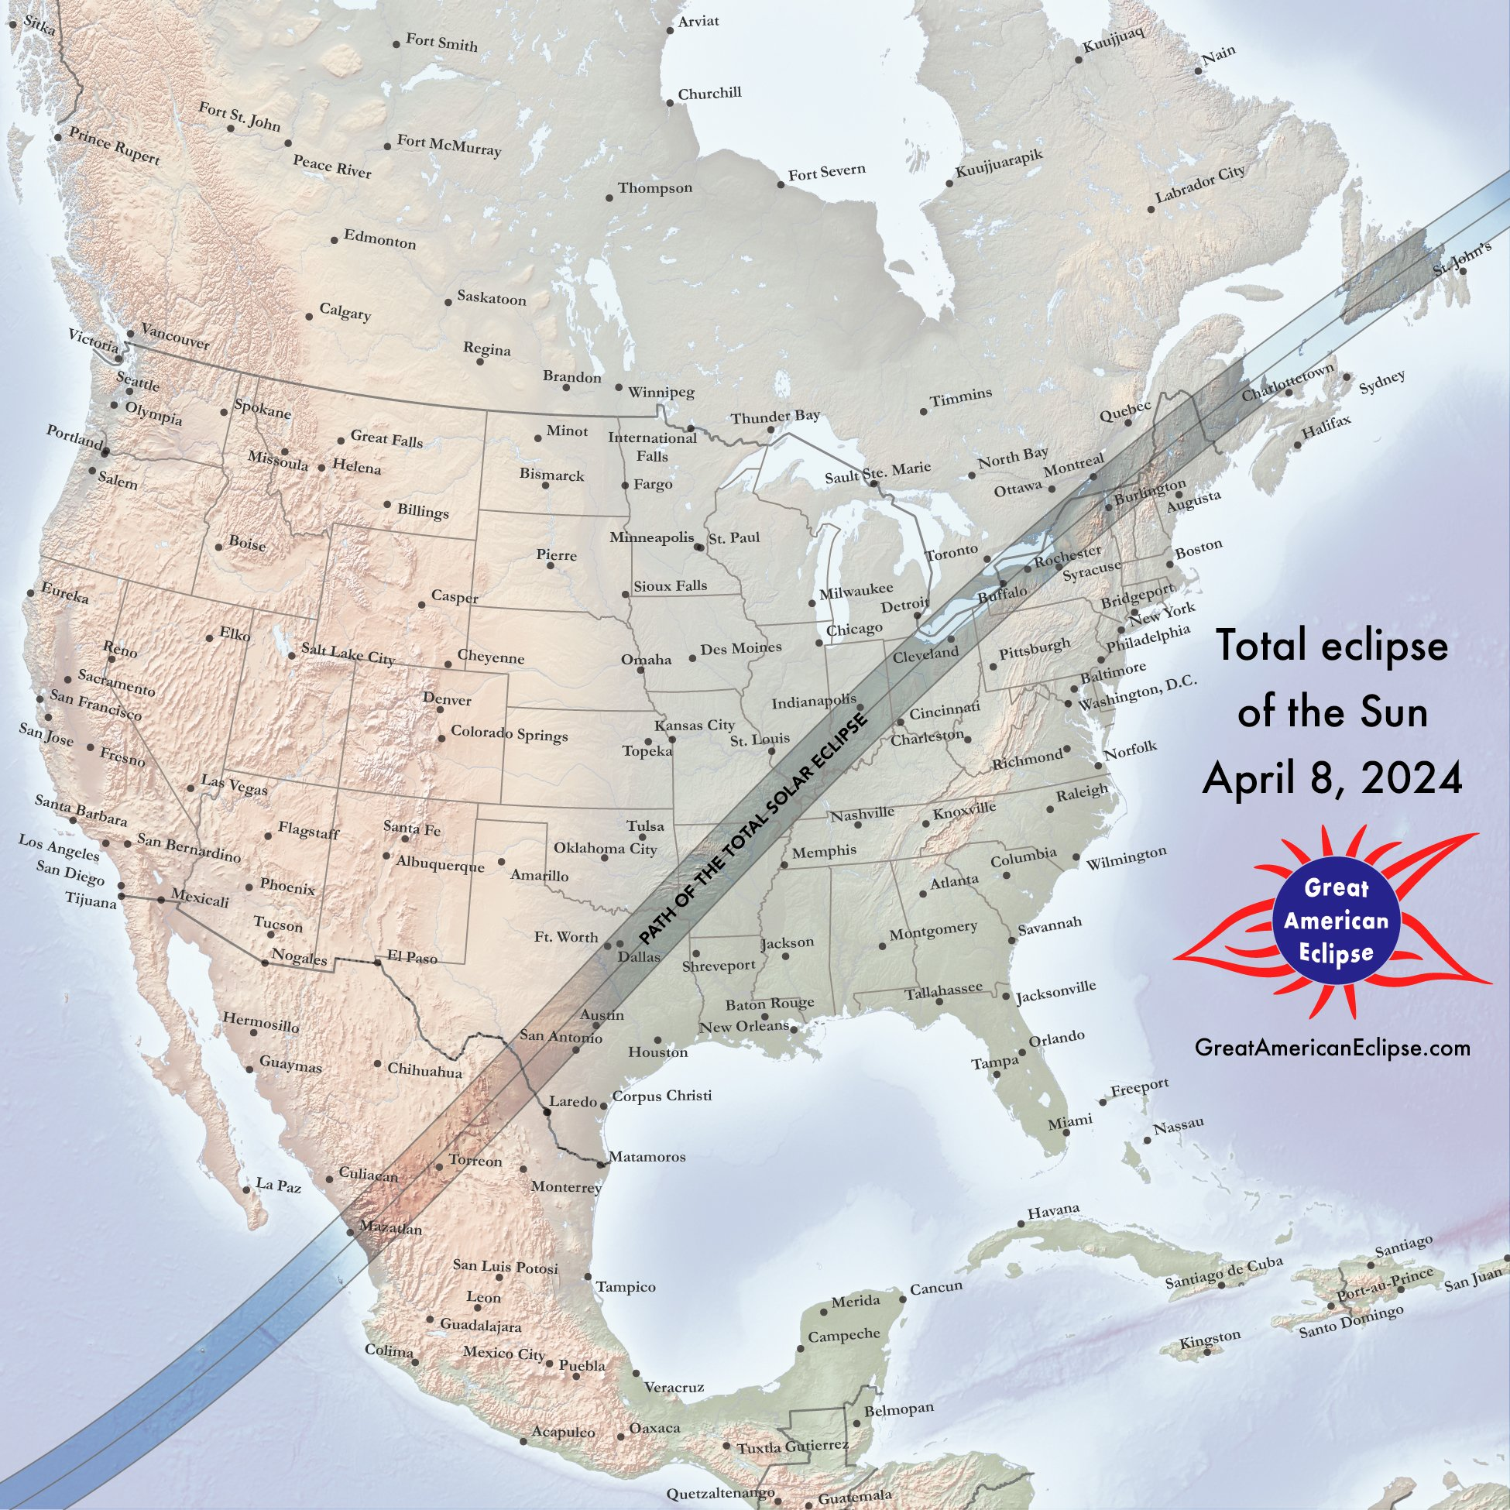
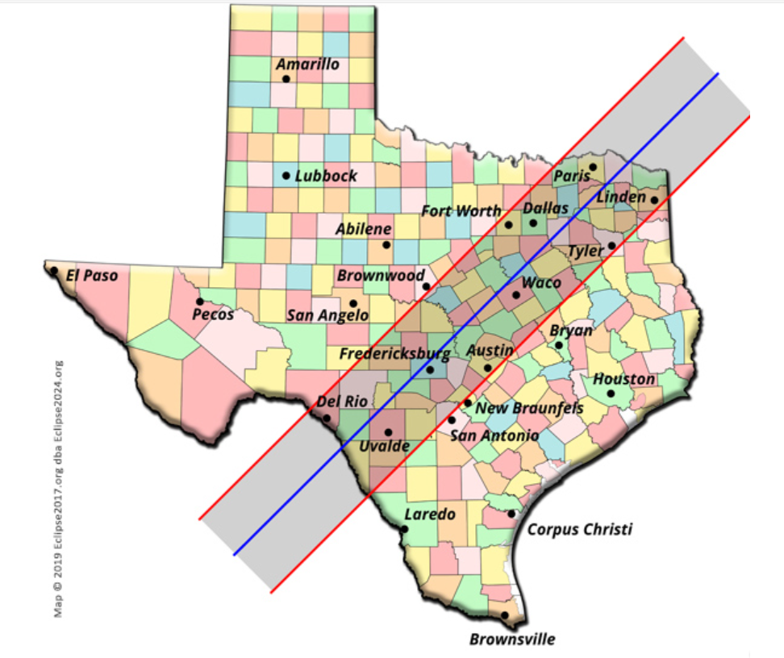

Slide 3
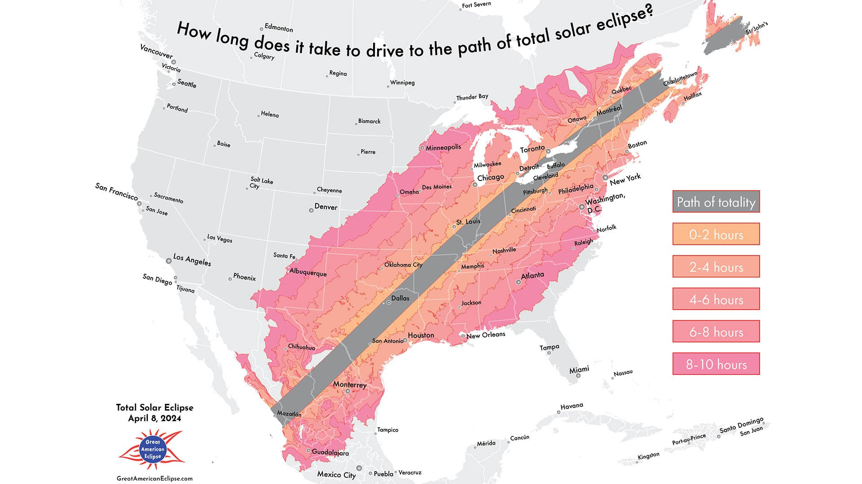

Slide 4
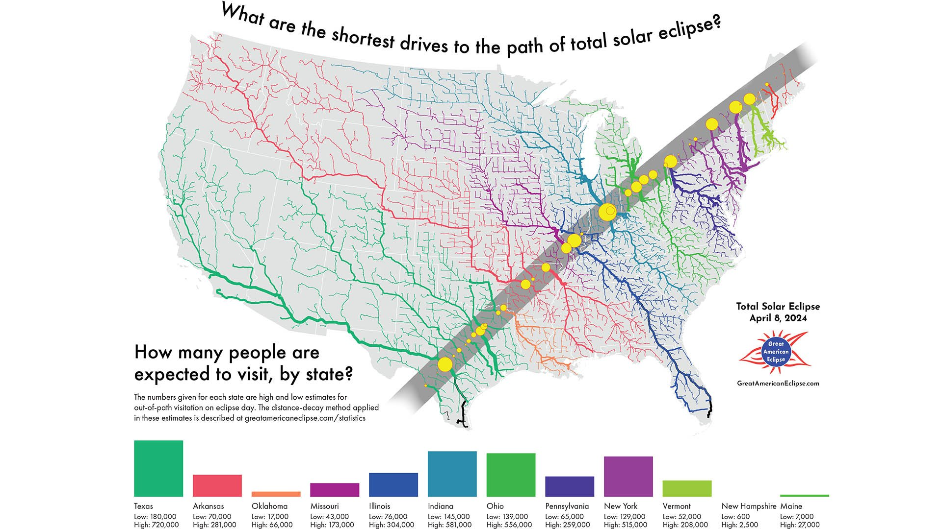

Slide 5

Full Eclipse Duration
Nazas, Durango | 4m 27s
Zaragoza, Coahuila | 4m 27s
Lampasas, TX | 4m 24s
Gatesville, TX | 4m 24s
Killeen, TX | 4m 17s
Waco, TX | 4m 13s

Slide 6
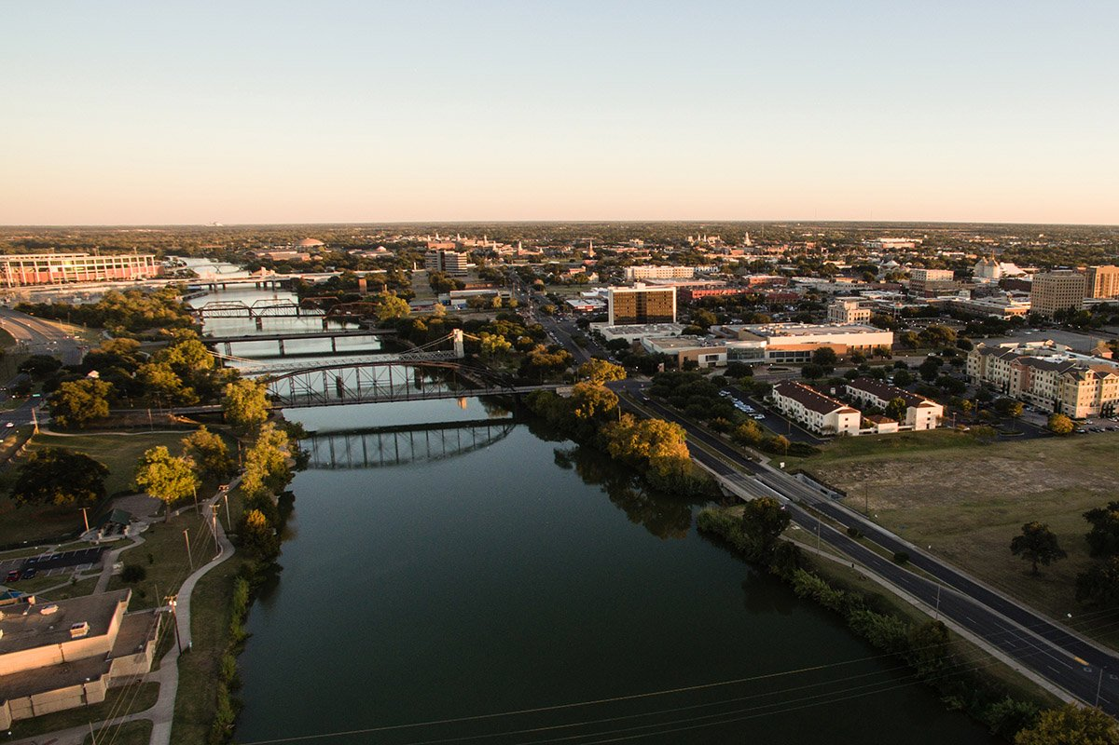
Waco, Texas
Partial Eclipse Begins at 12:20 pm
Total Eclipse Beings at 1:38 pm
Duration of Totality is 4 minutes, 13 seconds
Partial Eclipse Ends at 3:00 pm

Slide 7

But What if it is cloudy?
Eclipse will still happen
It will still get dark
Temperature will still drop
There is no rain delay

Slide 8

Expect 100,000 population increase over the 4-day period
Tickets sales for the event at Baylor have been strong
Hotels are booked at over 80%
Texas DOT is not permitting any construction or lane closures on the day of the eclipse (no restrictions prior to day of)
TXDOT is requiring all traffic from McLane Stadium to flow towards Hwy 77/LaSalle Ave (no traffic to I-35 from stadium)

Slide 9
Community Partners
HEB- 145 H-E-B locations within the path of totality
Adjusting schedules to account for increased business and traffic congestion.
Plan for “holiday-like” demand
Plan for extra deliveries prior to highest demand times.
Coordinate product deliveries to avoid highest traffic congestion times.
Many school districts have closed for the day
The county is closed with exception of certain departments
Waco McLennan County Office of Emergency Management will have the EOC (Emergency Operations Center) and a command post established on the day of the event.

Slide 10

AMR increasing staffing
McLennan County Sheriff and Waco PD increase staffing levels
What we are doing
Port-a-Potties at the intramural fields and CSC parking Lot M
Parking lots that have gates will be closed, including parking garages
The college will remote work that day.
Police, Emergency Management, and Physical Plant will be on campus.

Slide 11
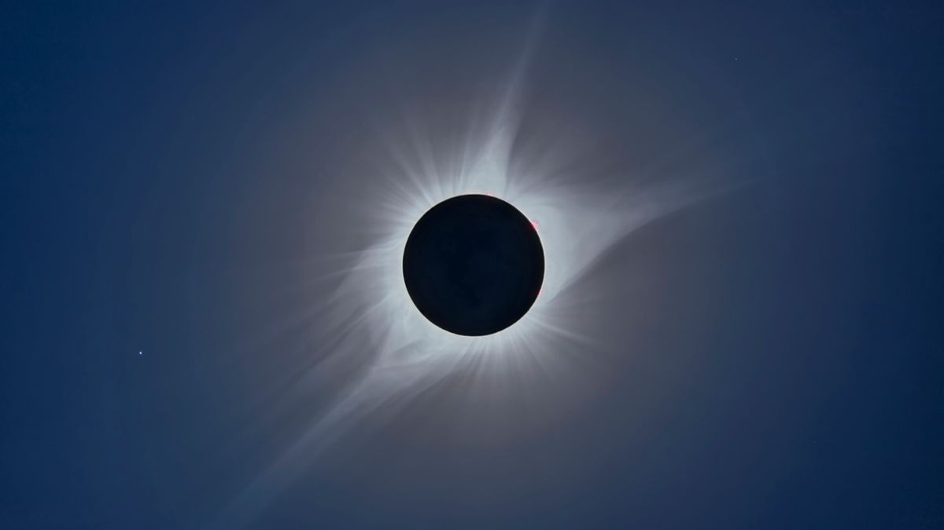
Questions

