Slide 1
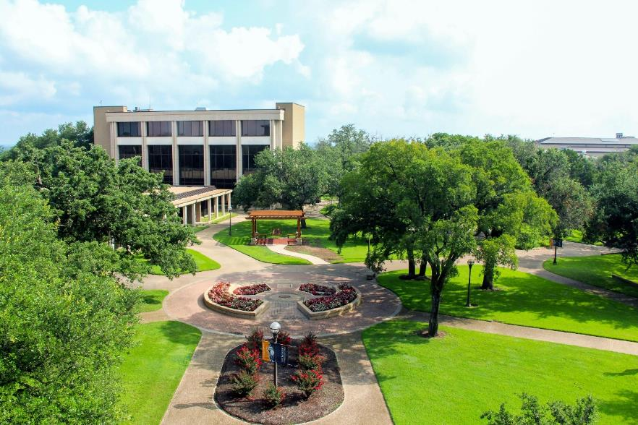

Presidential
Evaluation
May 28, 2024

Slide 2


Updates
Keeping the streamlined evaluation from last year
The President’s self-evaluation will remain more concise and within the instrument
https://mclennan.co1.qualtrics.com/jfe/preview/previewId/8e214d92-519d-4c6f-9d8e-645633255040/SV_darmIQBpi6Vuf1c?Q_CHL=preview&Q_SurveyVersionID=current

Slide 3
Evaluation Schedule
Dates | Activity
May 28 | Review, discuss and approve Evaluation Tool
May 28 – June 7 | Dr McKown works on self-evaluation
June 10 | Evaluation Opens to the Board
June 17 | Evaluation Closes
By June 20 | Compile results and provide results to the President and Board
June Board Meeting | Discuss evaluation results

Slide 4
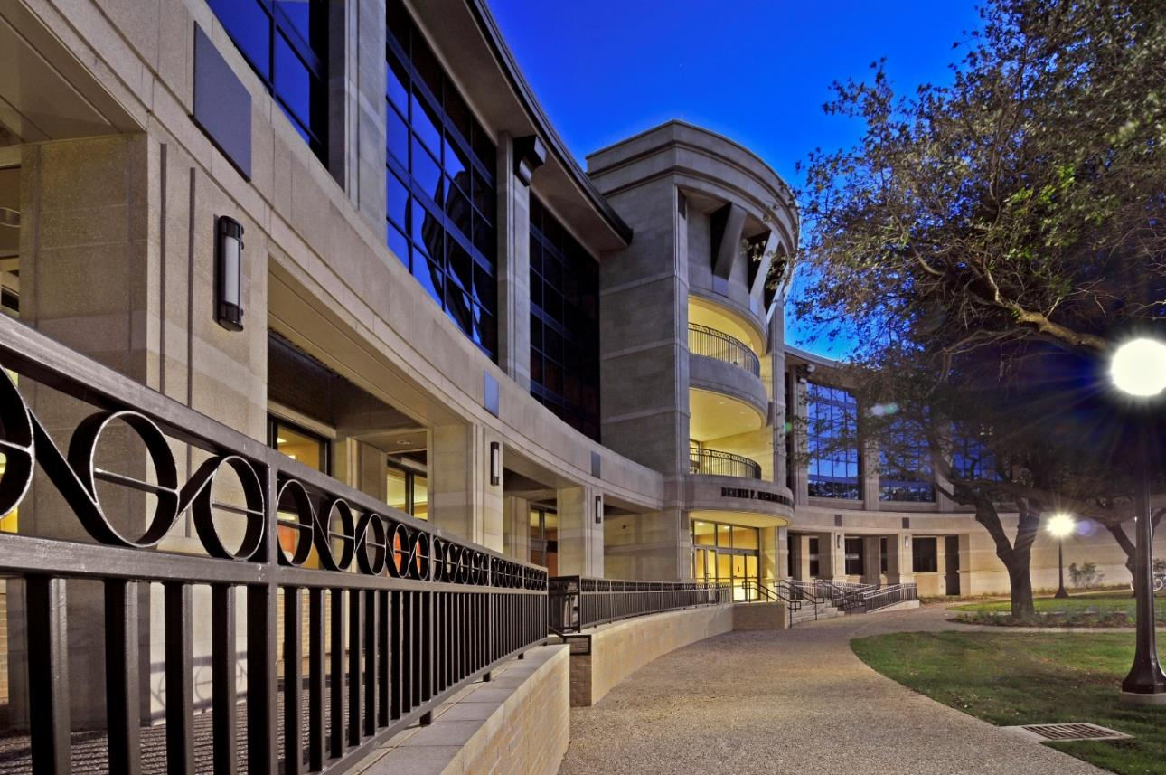
Questions?

