Slide 1
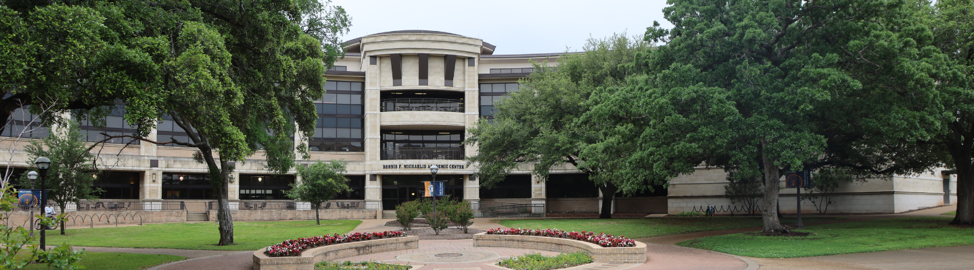

Spring 2024 Graduates
May 28, 2024

Slide 2
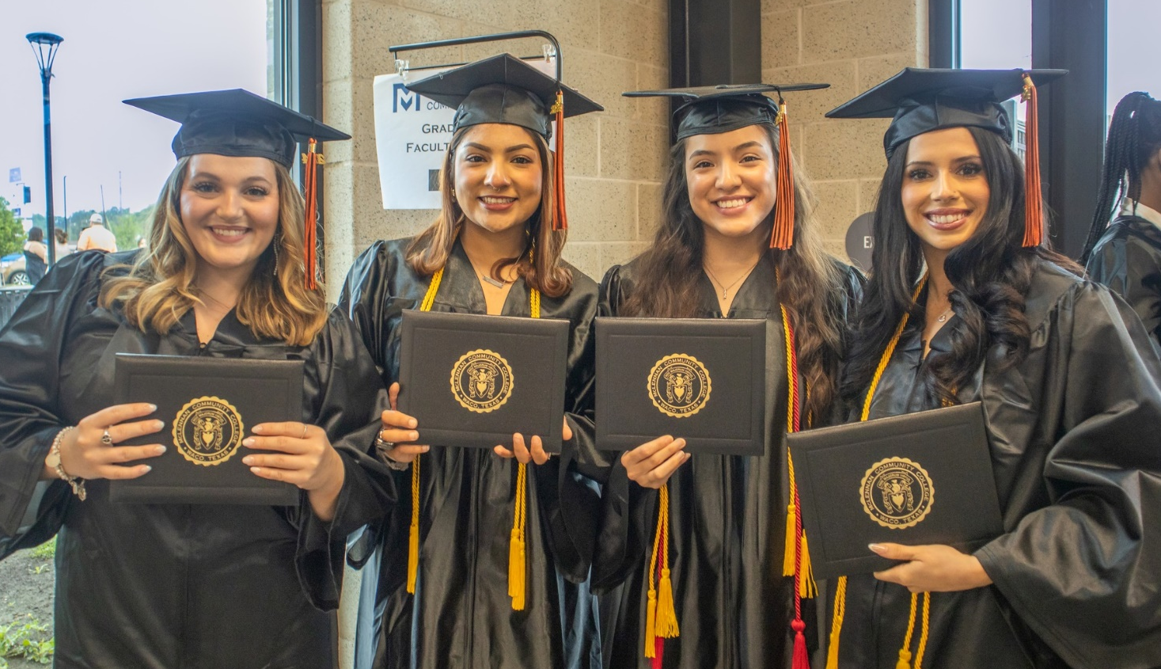
Spring 2024 Overview
721 Graduates
Awarded 805 Degrees and Certificates
Notes:
68% were female and 32% were male
45% were White, 38% Hispanic, 12% African American, and 5% from all other areas
Average Age was 26, youngest graduate was 17 and the oldest graduate was 63

Slide 3
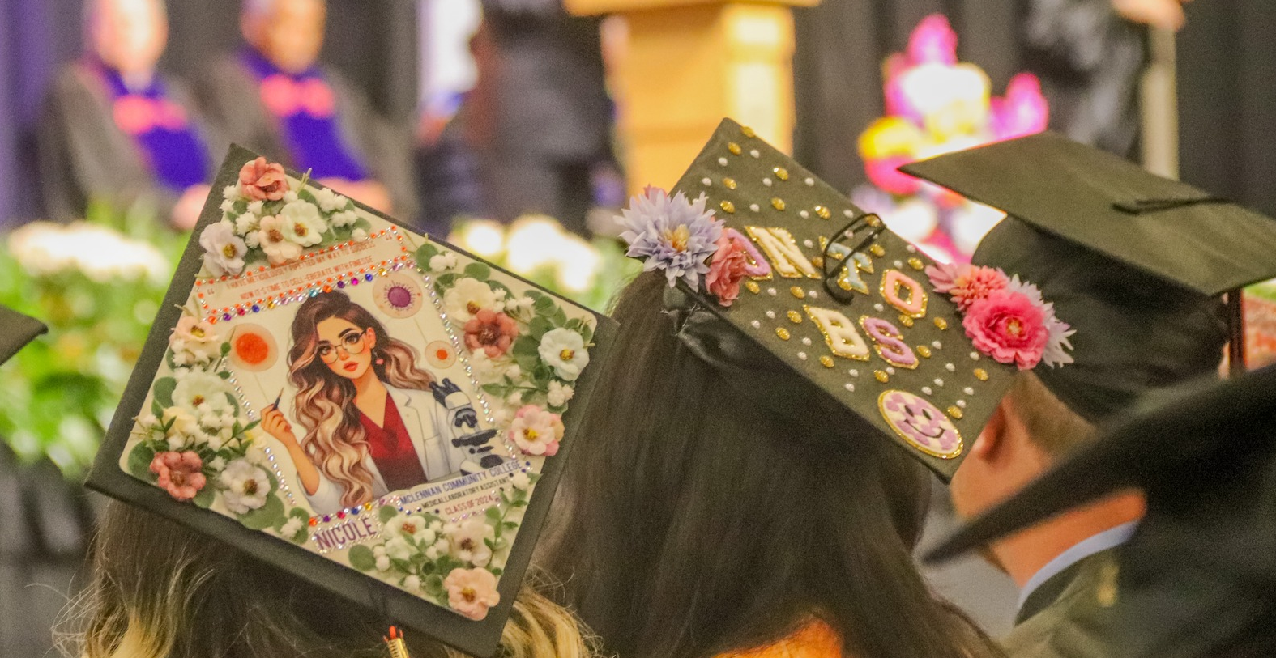


Associate Degrees
614 - 76%
Certificates & Field of Study
191 - 24%

Slide 4






191
24%
188
23%
186
23%
149
19%
75
9%
16
2%

Slide 5
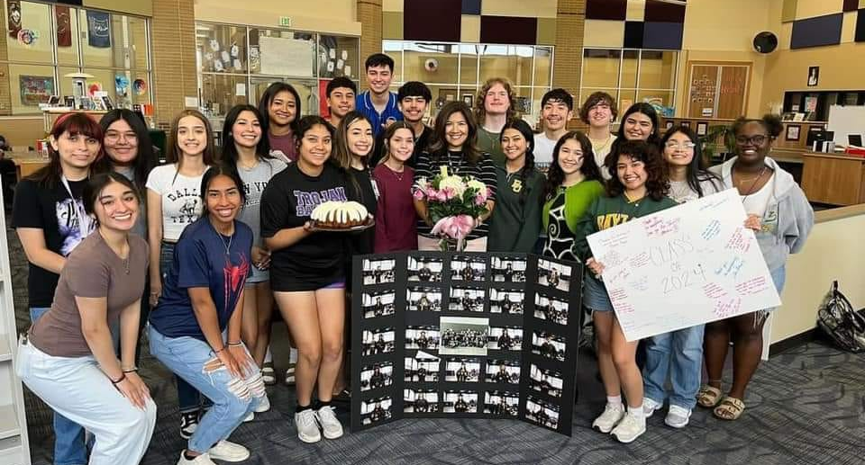
66 Dual Credit Students
Notes:
27 - University
22 - La Vega
8 - Waco High
3 - Harmony
2 - Midway
2 – Rapoport
2 - Homeschool

Slide 6
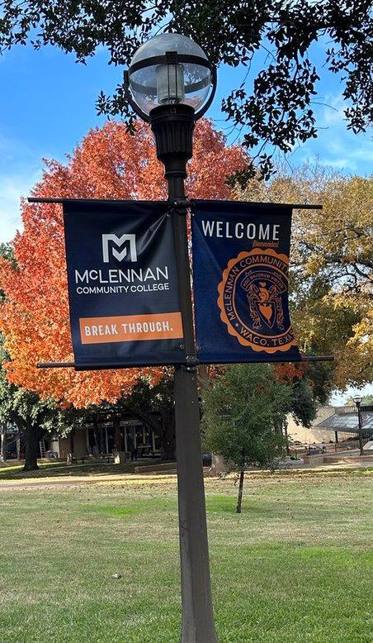
Spring 2024 Graduate Engagement
97% would choose MCC again
95% - had at least one professor who made them excited about learning
92% - felt their professors cared about them as a person
66% - had a mentor who encouraged them to pursue their goals and dreams

Slide 7
Spring 2024 Graduate Employment
61% - working full time
24% - working part time
70% - full time employment in Waco/McLennan county area
Notes:
Will you be working at a full time job after graduation?
26%, yes in a new job
35%, yes continuing in current job
35%, part time
15%, no job

Slide 8
Commencement Ceremony Kuddos
Two ceremonies for the first time
56 Employee Volunteers + Campus Police

Slide 9
Questions

