Slide 1

2024-25
Annual Priorities
August 13, 2024

Slide 2

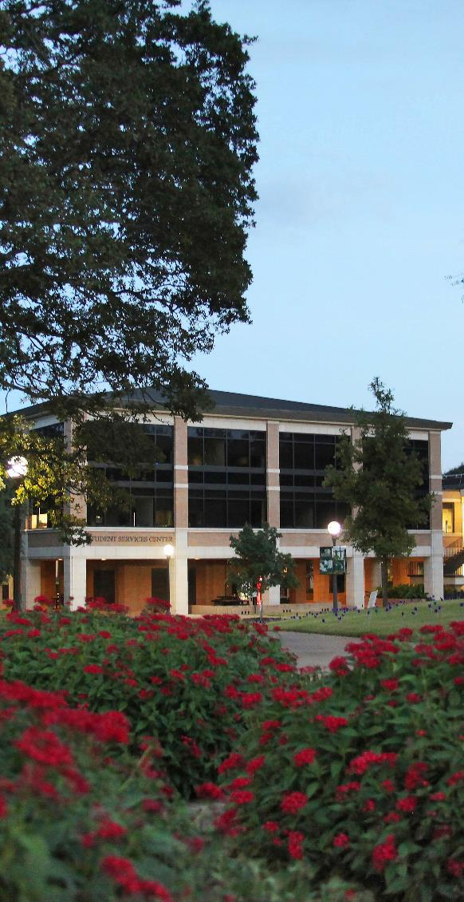

What are Annual Priorities?

Slide 3
2023-24 Annual Priority Highlights

Slide 4

2023-2024 Annual Priorities
Grow completion and graduation rates through the use of data, metrics, and high impact practices to increase student success and to maximize benefit to the College and the community from the new Community College Formal Funding Model.

Slide 5
2023-2024 Annual Priorities
Increase collaborations with industry, educational, and community partners to assist with the initiation of beneficial opportunities and projects that meet the needs of the community and the College.
Educational Partnerships & High School Pathways met with all ISD Partners
All workforce programs met with their Workforce Advisory Committees
Emergency Services Education Center severed over 150 public agencies
Business Programs offered access to Google Career Certificate trainings free of charge
Computer Information Systems, Business Statistics, Health Information Technology added Industry Recognized Credentials embedded in some courses

Slide 6
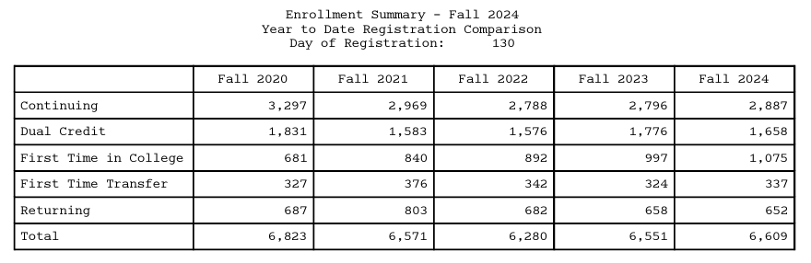
2023-2024 Annual Priorities
Increase credit and non-credit enrollment through Strategic Enrollment Management.

Slide 7
2023-2024 Annual Priorities
Increase credit and non-credit enrollment through Strategic Enrollment Management.
Institutional Credentials Leading to Licensure or Certification or Occupational Skills Award | Completions to Date
Auctioneer | 6
Basic Telecommunicator | 9
Certified Medication Aide | 18
Certified Nurse Aide | 142
Certified Patient Care Technician | 13

Slide 8
2023-2024 Annual Priorities
Standardize institutional policies to ensure currency with State and Federal legislation and best practices
Transitioning current policies and procedures to Texas Association of School Boards (TASB) Policy Online
8 months into 18 – 24 month process
Currently in Phase 2 received Phase 3 July 24

Slide 9
2024-2025 Annual Priorities
Focus on improving student enrollment, fall to spring retention rates, and course completion rates by expanding and implementing targeted marketing, interventions, and communications for students.
Begin the development of the Caring Campus model to create an environment where students have a strong sense of belonging and connection throughout their educational journey.
Improve the quality and frequency of interactions between students and instructors in distance education courses to enhance engagement, learning outcomes, and student satisfaction through the implementation of Regular and Substantive Interaction (RSI).
Update the College's strategic vision and plan to enhance the College's overall focus, innovation, effectiveness, and sustainability by ensuring growth, anticipating challenges, adapting to changes, and measuring progress.

Slide 10
Questions

