Slide 1

2025-30 Strategic Planning
December 2024
Notes:
4 Goals
25 objectives
People and departments struggle to understand where and how they fit in.
Caused a detached and disjointed process

Slide 2

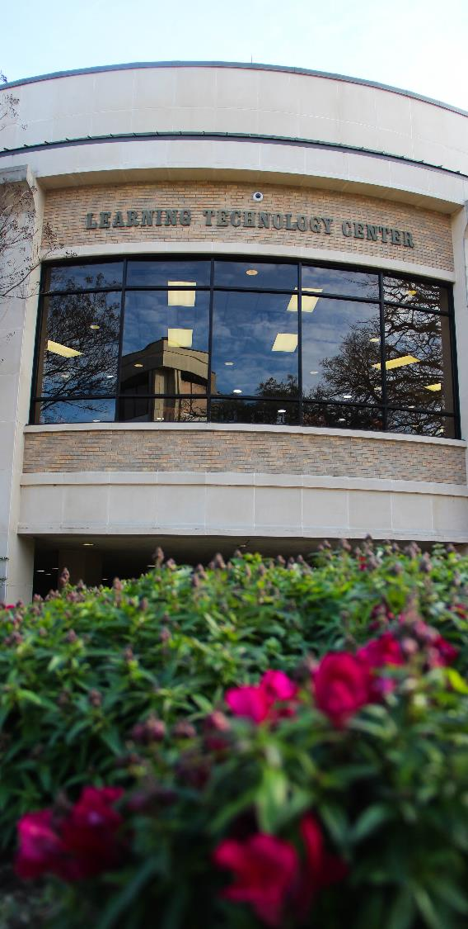
2025-2030 Strategic Plan Overarching Goal
By 2030 McLennan Community College will increase fall to fall retention rates of first time in college students by 10%.
Notes:
We have set several grant goals, initiative goals, committee goals, but never an institutional goal for the entire College to follow or work towards.

Slide 3
Analysis
Leadership Council
Work
Employee Listening Sessions & Surveys
Presidential Evaluations
Board of Trustee Evaluations
Higher Education
Trends
2025-30 Strategic Plan Draft #1

Slide 4
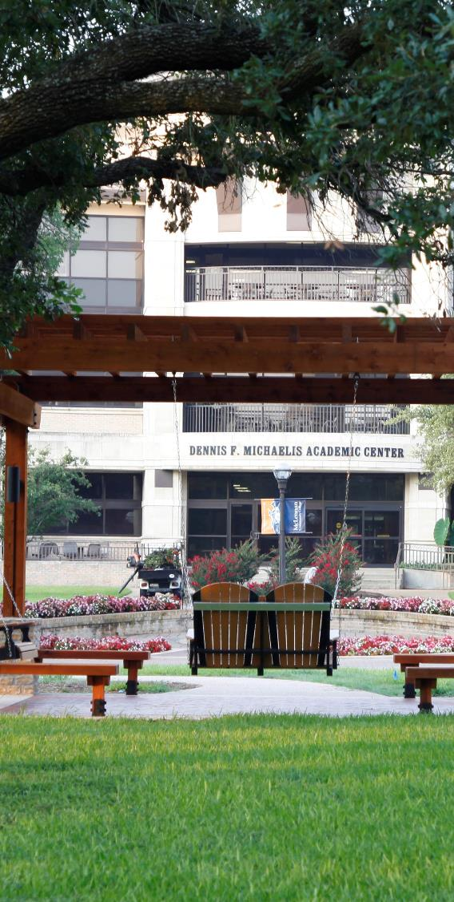
High Level Goals in Analysis
Enhance Student Success and Support
Promote Community Engagement and Workforce Development
Improve Resource Support and Development

Slide 5
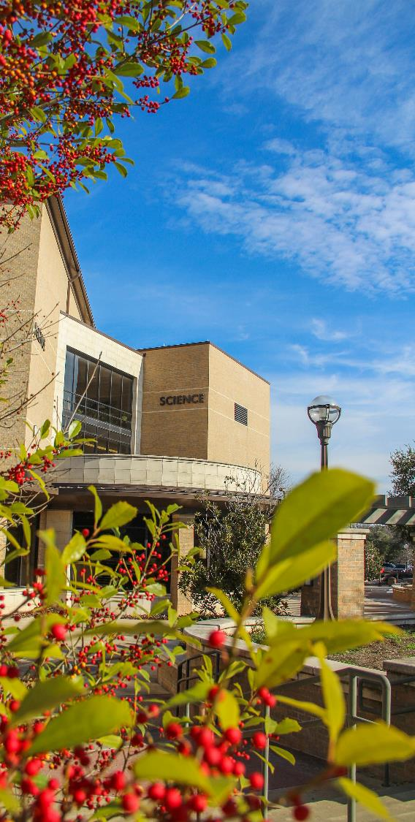
Enhance Student
Success and Support
By supporting strategies to empower first-generation students, low income students, adult learners, and students facing barriers to success.
By aligning curriculum and learning outcomes with educational and workforce pathways, needs, and trends.
By developing and enhancing credentials to align and support workforce needs.

Slide 6
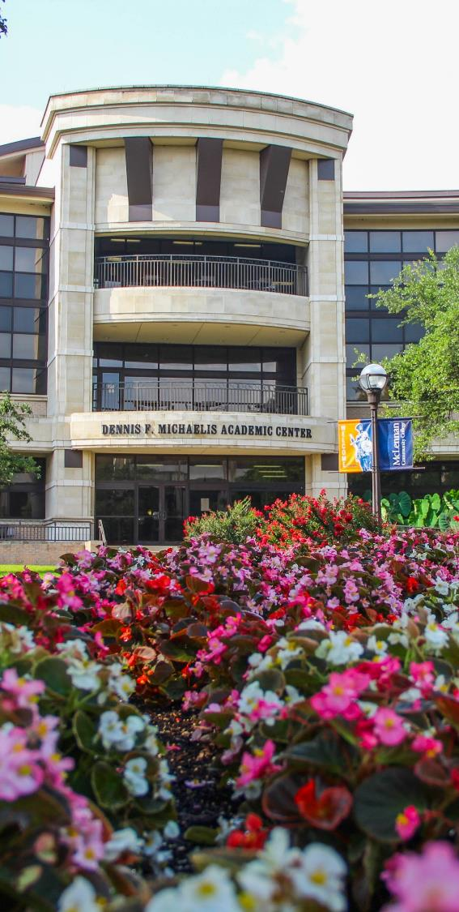
Promote Community Engagement and Workforce Development
By increasing the college’s visibility in the community.
By expanding industry partnerships, apprenticeships, and internships to align credit and non-credit programs with local workforce needs.
By strengthening ties with local schools and organizations through outreach programs and collaborative partnerships.

Slide 7
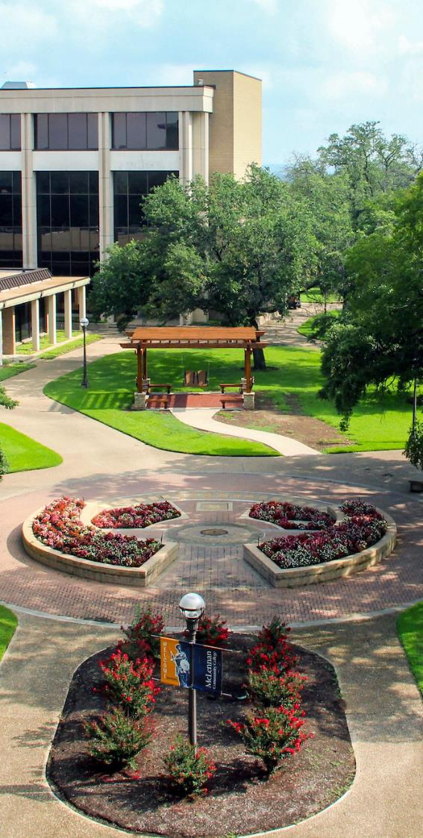
Improve Resource Support
and Development
By engaging in and investing in technology to enhance student learning, streamline processes, and improve efficiencies across the institution.
By investing in campus facilities and resources to create and maintain a modern, safe, responsive, dynamic, and supportive learning environment both in person and through distance education.
By building employee excellence through accountability, innovation, and professional development.

Slide 8
Next Steps
Input
Board
Leadership Council
Leadership Team
Blend
Input
Vision
Final Version
2025-30 Plan
Faculty & Staff

Slide 9
Enhance Student Success and Support
  By supporting strategies to empower first-generation students, low income students, adult learners, and students facing barriers to success.
  By aligning curriculum and learning outcomes with educational and workforce pathways, needs, and trends.
  By developing and enhancing credentials to align and support workforce needs.
Promote Community Engagement and Workforce Development
  By increasing the college’s visibility in the community.
  By expanding industry partnerships, apprenticeships, and internships to align credit and non-credit programs with local workforce needs.
  By strengthening ties with local schools and organizations through outreach programs and collaborative partnerships.
Improve Resource Support and Development
  By engaging in and investing in technology to enhance student learning, streamline processes, and improve efficiencies across the institution.
  By investing in campus facilities and resources to create and maintain a modern, safe, responsive, dynamic, and supportive environment both in person and through distance education.
  By building employee excellence through accountability, innovation, and professional development.

Slide 10

Feedback

