Slide 1

Workforce Program Development:
A Data-Informed Approach

Slide 2

“Community colleges have clarified existing program pathways, but they have not done enough to interrogate where those pathways lead.”
More Essential Than Ever – Jenkins, et al.

Slide 3

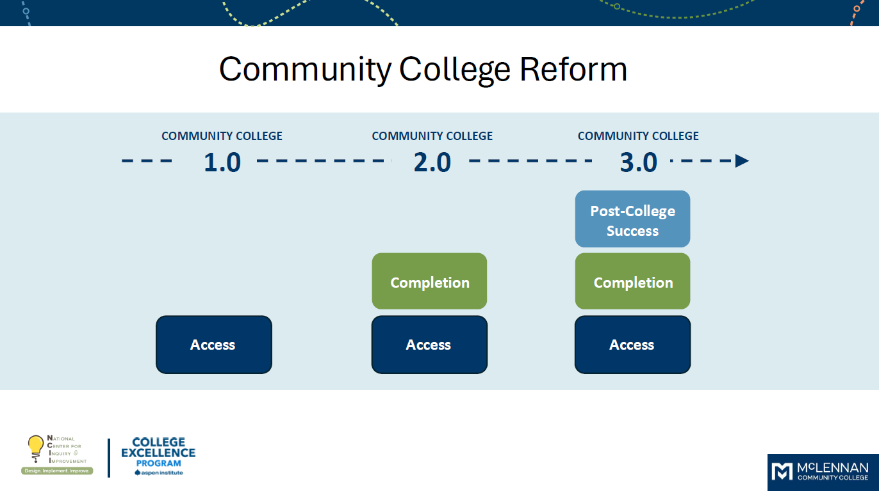
Community College 3.0
Copy here please thanks. Copy here please thanks. Copy here please thanks. Copy here please thanks. Copy here please thanks. Copy here please thanks. Copy here please thanks.
Copy here please thanks. Copy here please thanks. Copy here please thanks. Copy here please thanks.
Copy here please thanks. Copy here please thanks. Copy here please thanks. Copy here.
Copy here please thanks. Copy here please thanks. Copy here please thanks. Copy here please thanks. Copy here please thanks. Copy here please thanks. Copy here please thanks.
Photo name here.

Slide 4
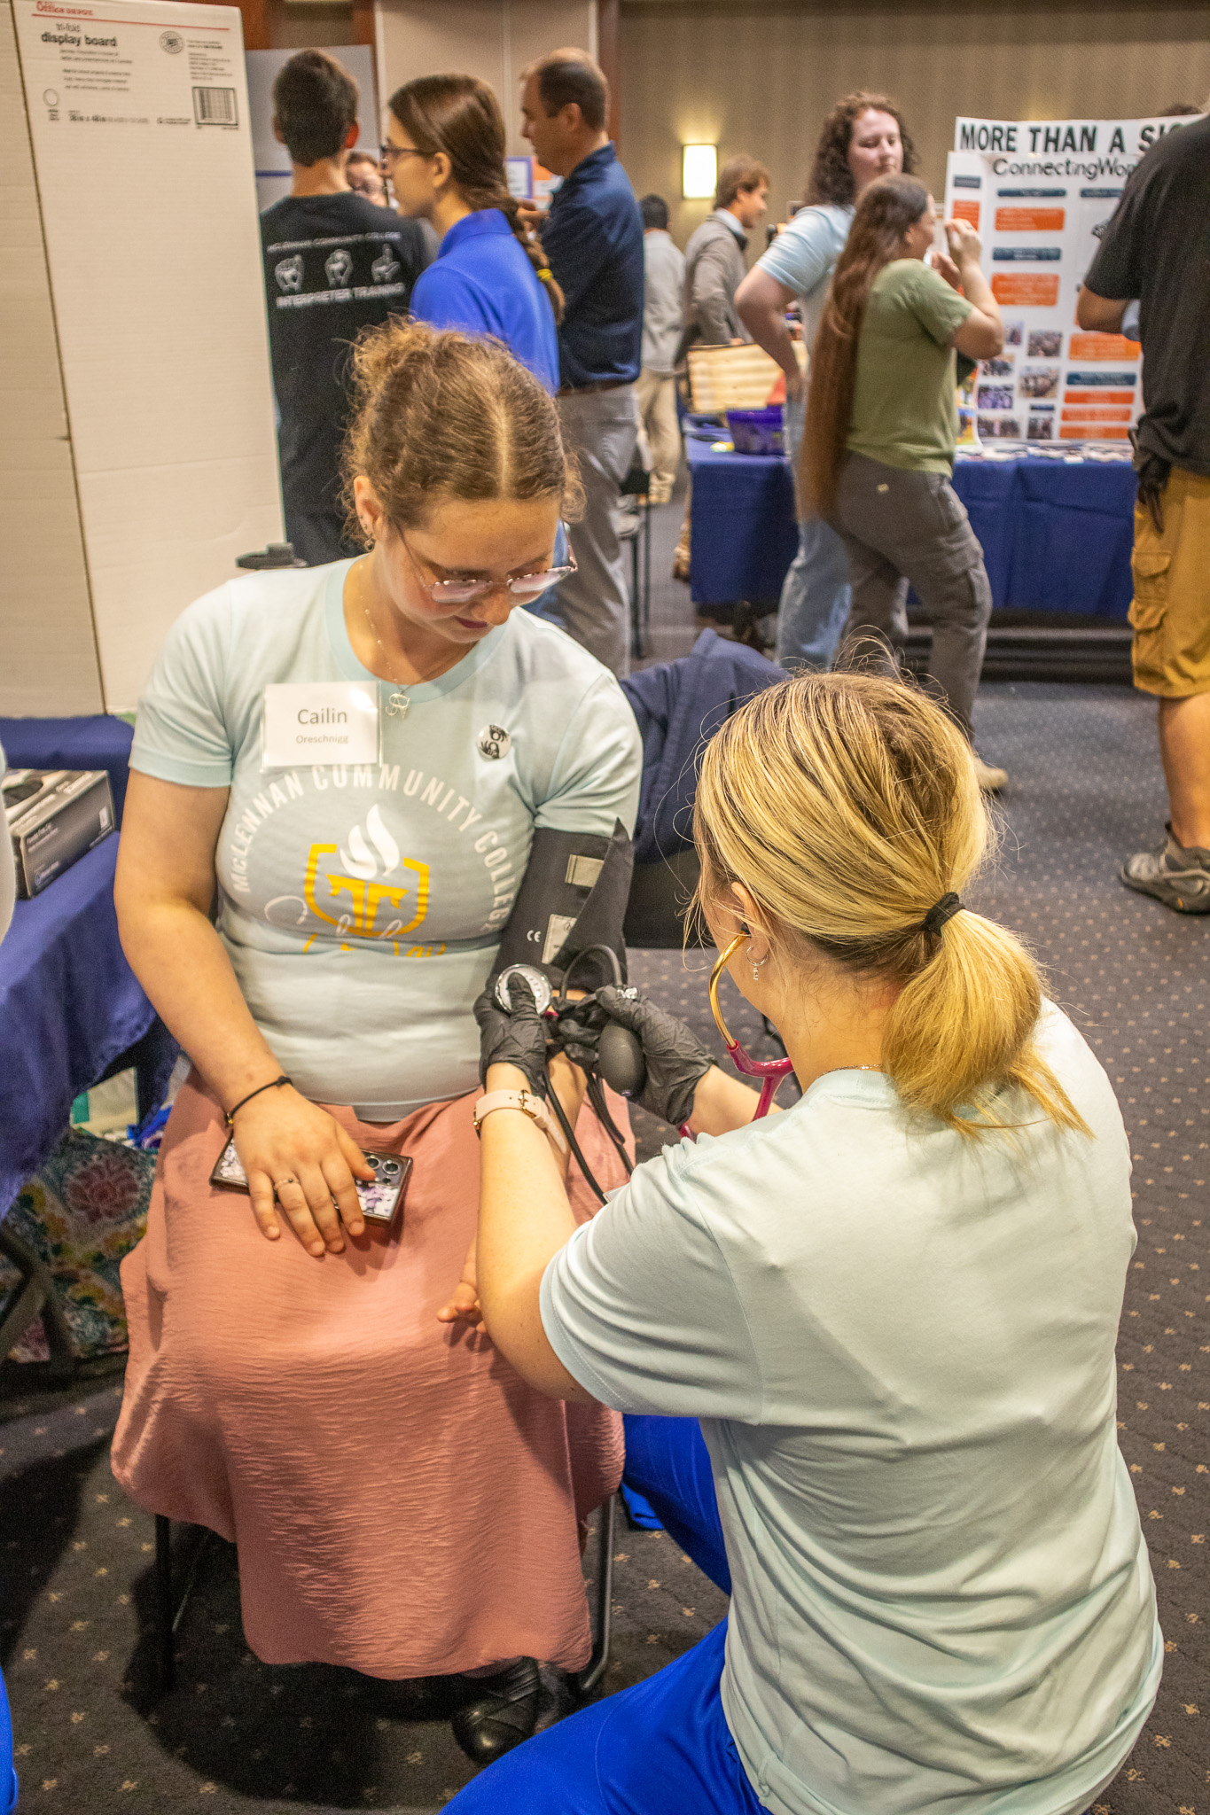
Annual Workforce Program Development Cycle
I. Program Analysis
II. Labor Market Analysis
III. Conversations – Leadership Team and Board
IV. Program Investment/Divestment

Slide 5

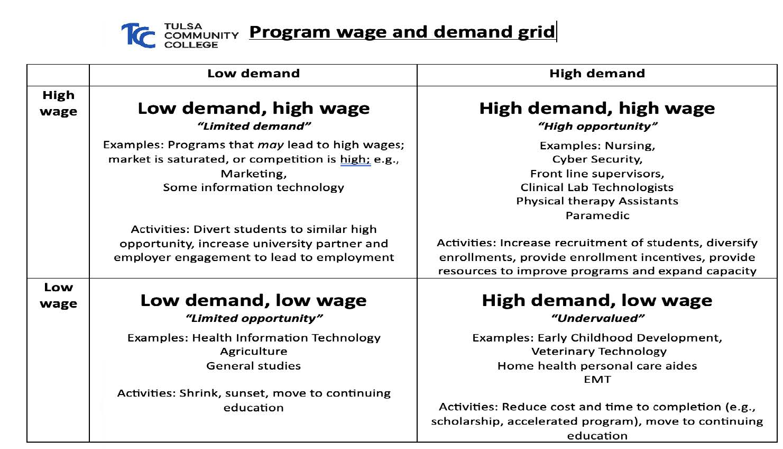
Program Analysis
Photo name here.

Slide 6
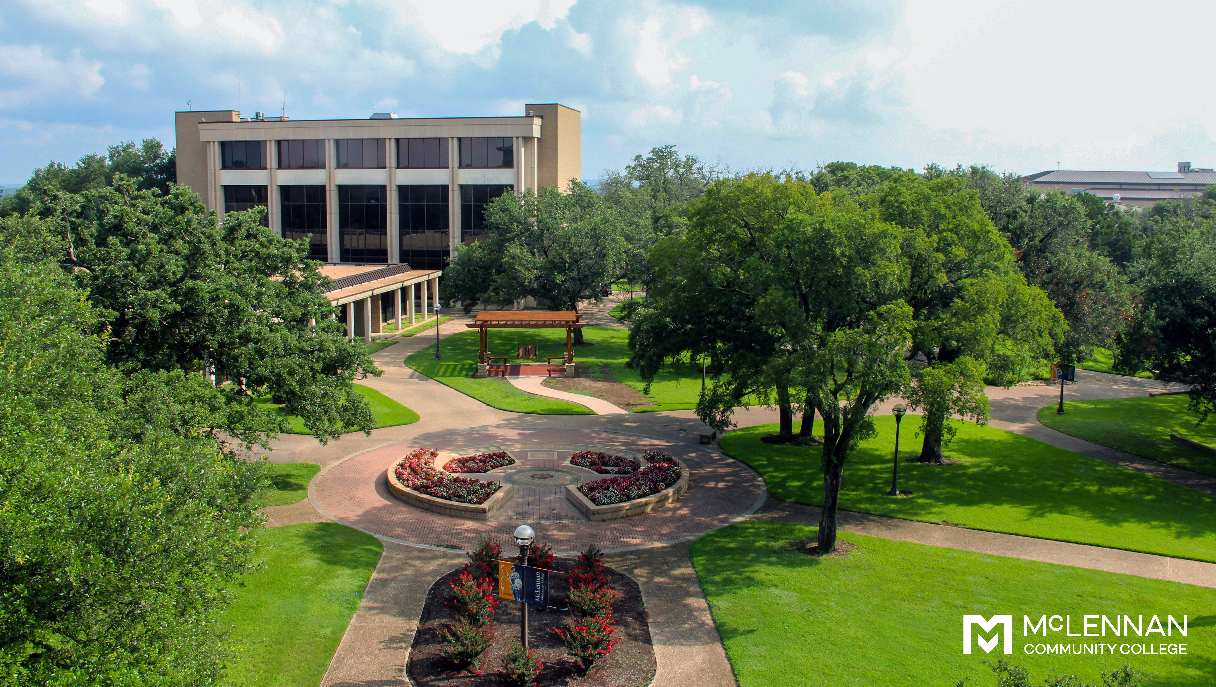
Labor Market Analysis
Multiple Data Sources:
Lightcast (see Aspen-provided data)
Rural Guided Pathways (occasional)
Statewide Sources (Texas Workforce Commission, O*Net, THECB, etc.)
Local Sources: Chambers, HOT Workforce Board, etc.

Slide 7

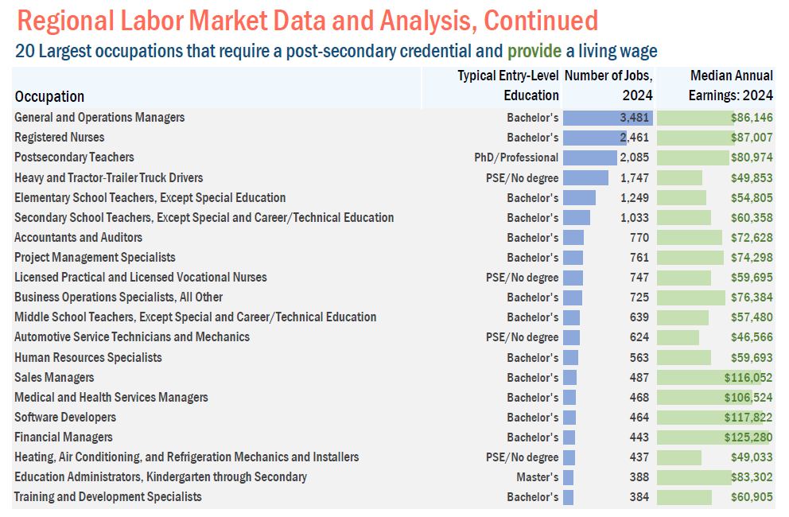
Heading
Copy here please thanks. Copy here please thanks. Copy here please thanks. Copy here please thanks. Copy here please thanks. Copy here please thanks. Copy here please thanks.
Copy here please thanks. Copy here please thanks. Copy here please thanks. Copy here please thanks.
Copy here please thanks. Copy here please thanks.

Slide 8

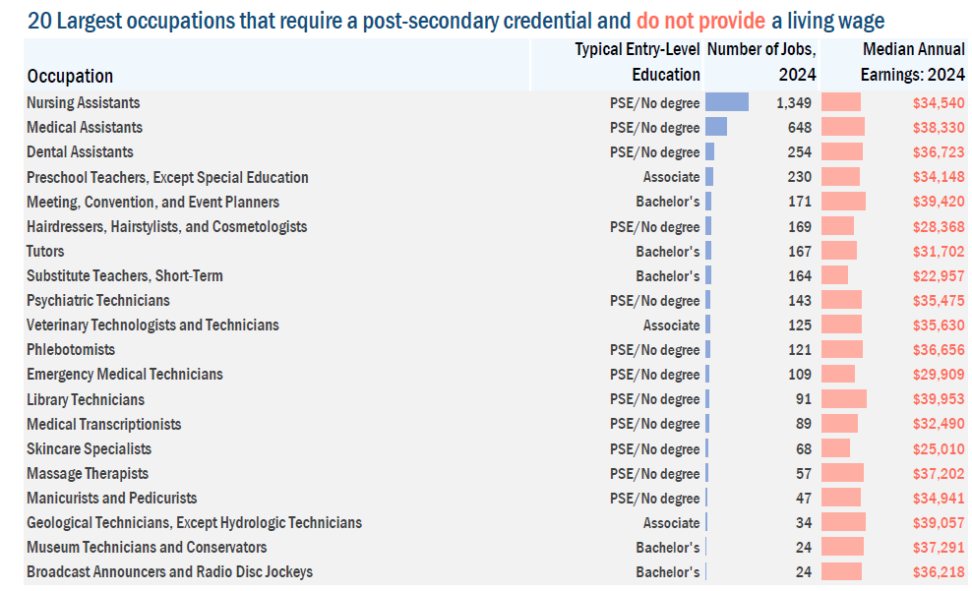
Heading
Copy here please thanks. Copy here please thanks. Copy here please thanks. Copy here please thanks. Copy here please thanks. Copy here please thanks. Copy here please thanks.
Copy here please thanks. Copy here please thanks. Copy here please thanks. Copy here please thanks.
Copy here please thanks. Copy here please thanks.

Slide 9
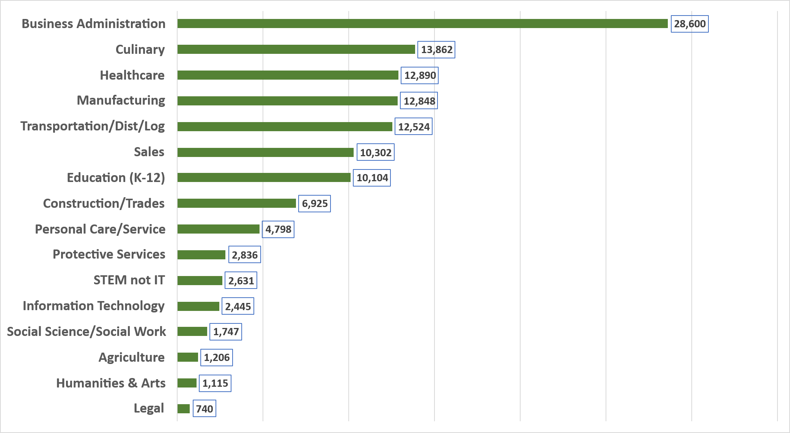

#3.1: What Career Fields Have the Most Workers in them in McLennan's 2-County Area?
PROJECT MANAGEMENT SLIDE
Notes:
NCII has coded these career areas from the 800+ Six-Digit SOC Codes
Note that these fields represent where workers are employed, not their academic program.

Slide 10
#3.4: Top 5 Jobs in Each COL-Adjusted Salary Range in McLennan's 2-County Area –
All Career Fields
Less than $35K
Fast Food & Counter Workers - 4,487
Retail Salespersons - 2,933
Cashiers - 2,462
Home Health & Personal Care Aides - 2,113
Janitors & Cleaners, Except Maids & Housekeeping Cleaners - 1,773
Customer Service Representatives - 3,060
Stockers & Order Fillers - 2,650
Laborers & Freight, Stock & Material Movers, Hand - 2,264
Office Clerks, General - 1,856
Miscellaneous Assemblers & Fabricators - 1,482
$35K to $50K
Notes:
Using 6-digit SOC codes, of which there are 800+
COL Index is 93.1
Heavy & Tractor-Trailer Truck Drivers - 1,747
First-Line Supervisors of Office & Admin Workers - 1,586
Elementary School Teachers, Except Special Ed - 1,249
Secondary School Teachers, Except Special Ed & CTE - 1,033
Sales Reps, Wholesale & Manufacturing, non-Tech/Sci - 788
General & Operations Managers - 3,481
Registered Nurses - 2,461
Claims Adjusters, Examiners & Investigators - 1,134
First-Line Supervisors of Production & Operating Workers - 786
First-Line Supervisors of Construction & Extraction - 776
$50K to $65K
More than $65K

Slide 11
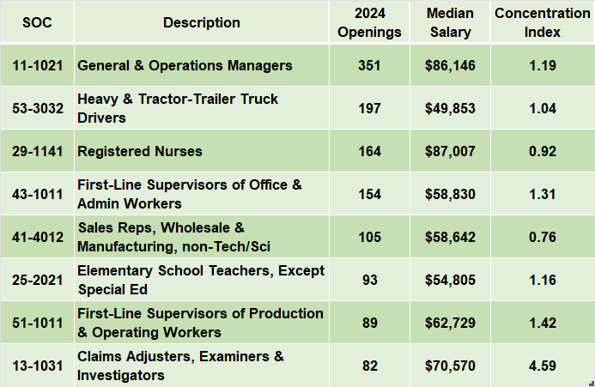
#2.3: What are the Occupations that Lead to “Good Jobs” with the
Most Openings in McLennan's 2-County Area?
PROJECT MANAGEMENT SLIDE
Notes:
1. Adjusted COL Index in McLennan's 2-County Area is 93.1
2. A “Good Job” has a Median COL-Adjusted Salary of $65K+ which equates to $61K+ in this region;
min salary $47K to be included on this slide
3. Occupations are based on Six-Digit SOC codes, of which there are about 850; a minimum of 500 jobs in SOC code to be included on the list.

Slide 12


Future
Conversation Opportunities

Slide 13

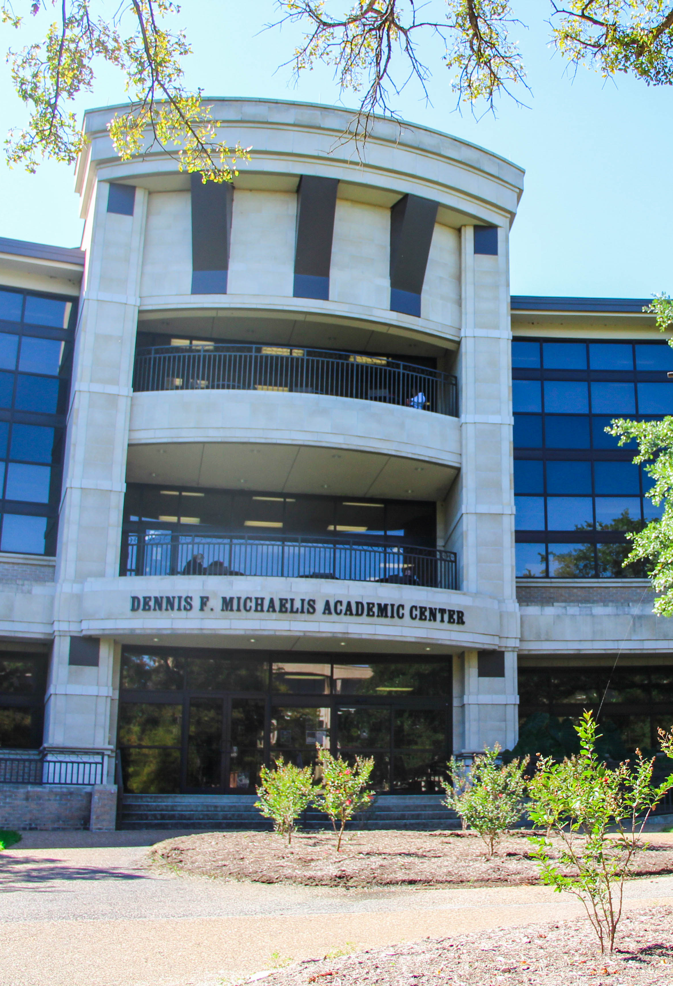
Decisions: Sunrise and Sunset
Aligning Opportunity
Copy here please thanks. Copy here please thanks. Copy here please thanks. Copy here please thanks.
Bulleted copy here.
Bulleted copy here.
Bulleted copy here.
Bulleted copy here.
Copy here please thanks. Copy here please thanks. Copy here please thanks. Copy here please thanks.

