Slide 1

MCC Credentials Update
Academic Year 2024/25

Slide 2

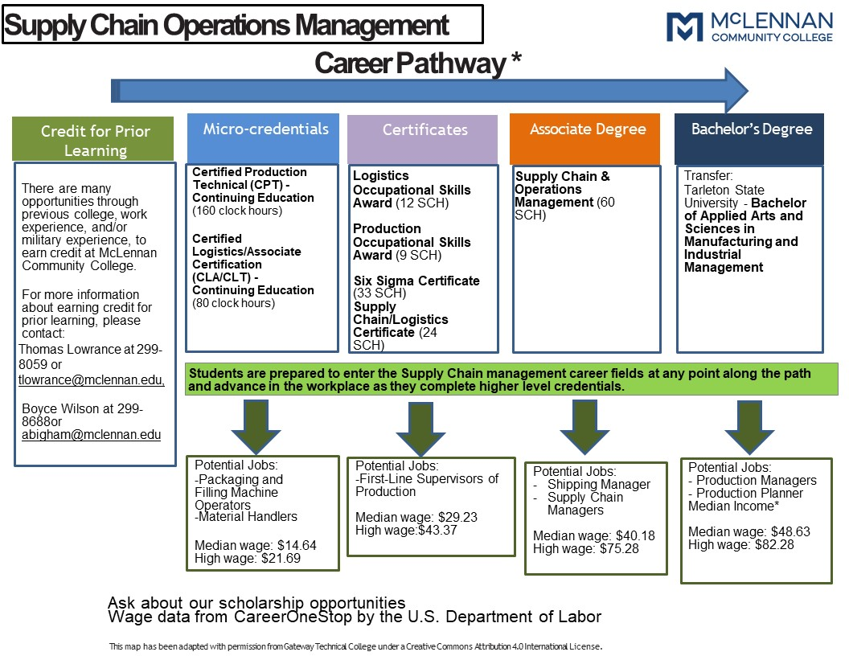
Credentials
Types
  Institutional Credentials that Lead to Licensure for Certificates (ICLCs)
  Level 1 and Level 2 Certificates
  Occupational Skills Awards
  Associate Degrees
Characteristics
  Stackable
  Portable
  Aligned with industry needs

Slide 3

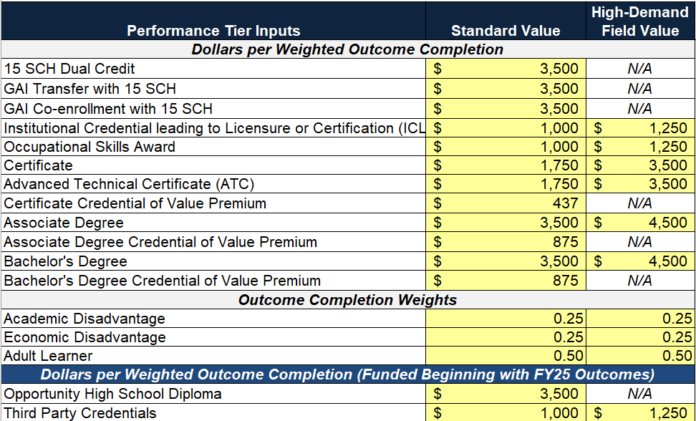
HB 8 Funding Outcomes

Slide 4
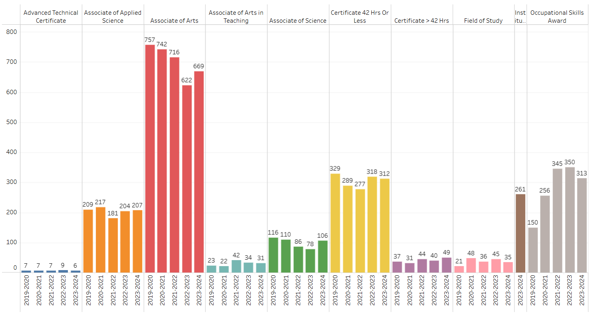
Outcomes to Date
ICLCs

Slide 5
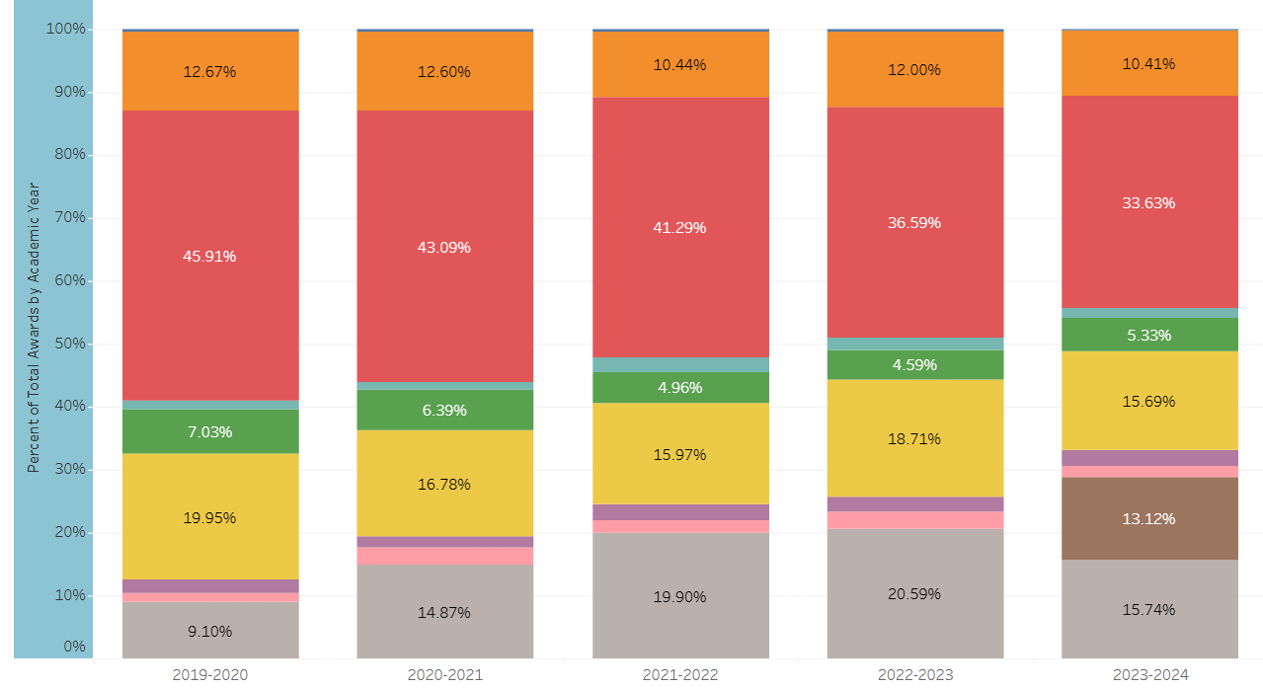
% of Total Awards per Year (see key above)

Slide 6

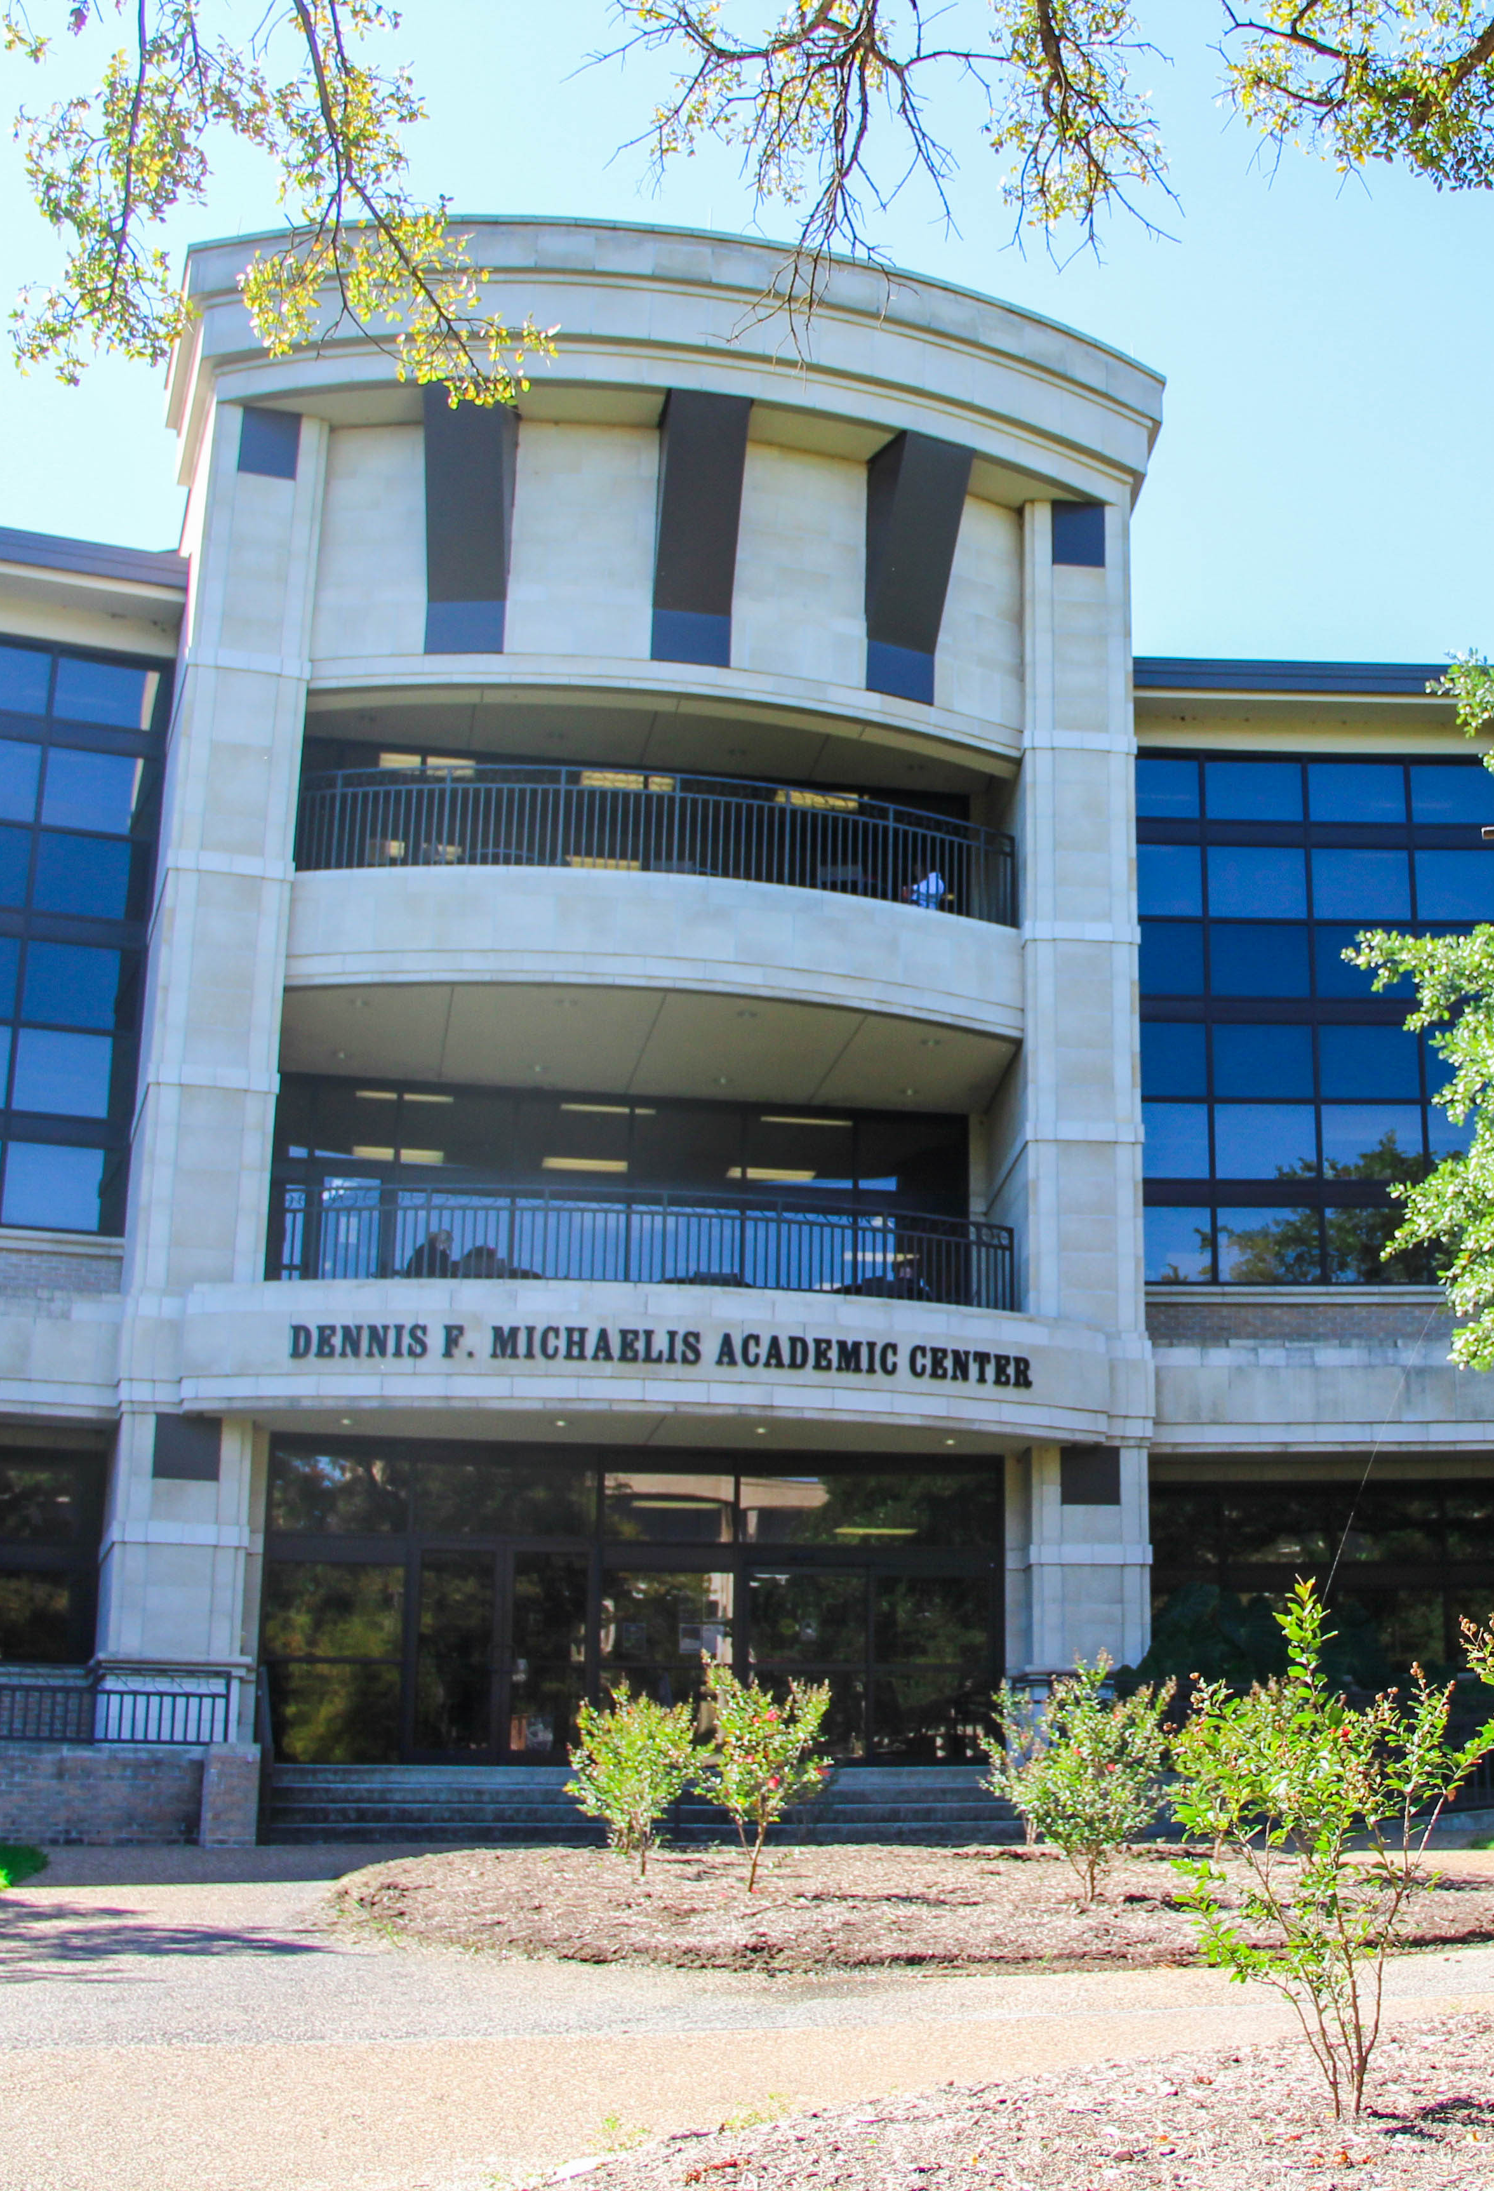
Past: Pre-2024 Credentials
Six Sigma certificate (Level 1 certificate)
Entrepeneurship certificate
ICLC – Certified Nurse Aide (but now funded)
Supply Chain Logistics certificate
Mental Health Social Work certificate

Slide 7


Present: AY 2024/25 Credentials
Certified Pharmacy Tech (certificate and OSA) – TRUE grant
Criminal Justice Peace Officer Certificate
Paralegal Studies OSA
A.A. – Theatre
Educational Aide II Level 1 Certificate
Patient Care Technician – TRUE grant

Slide 8
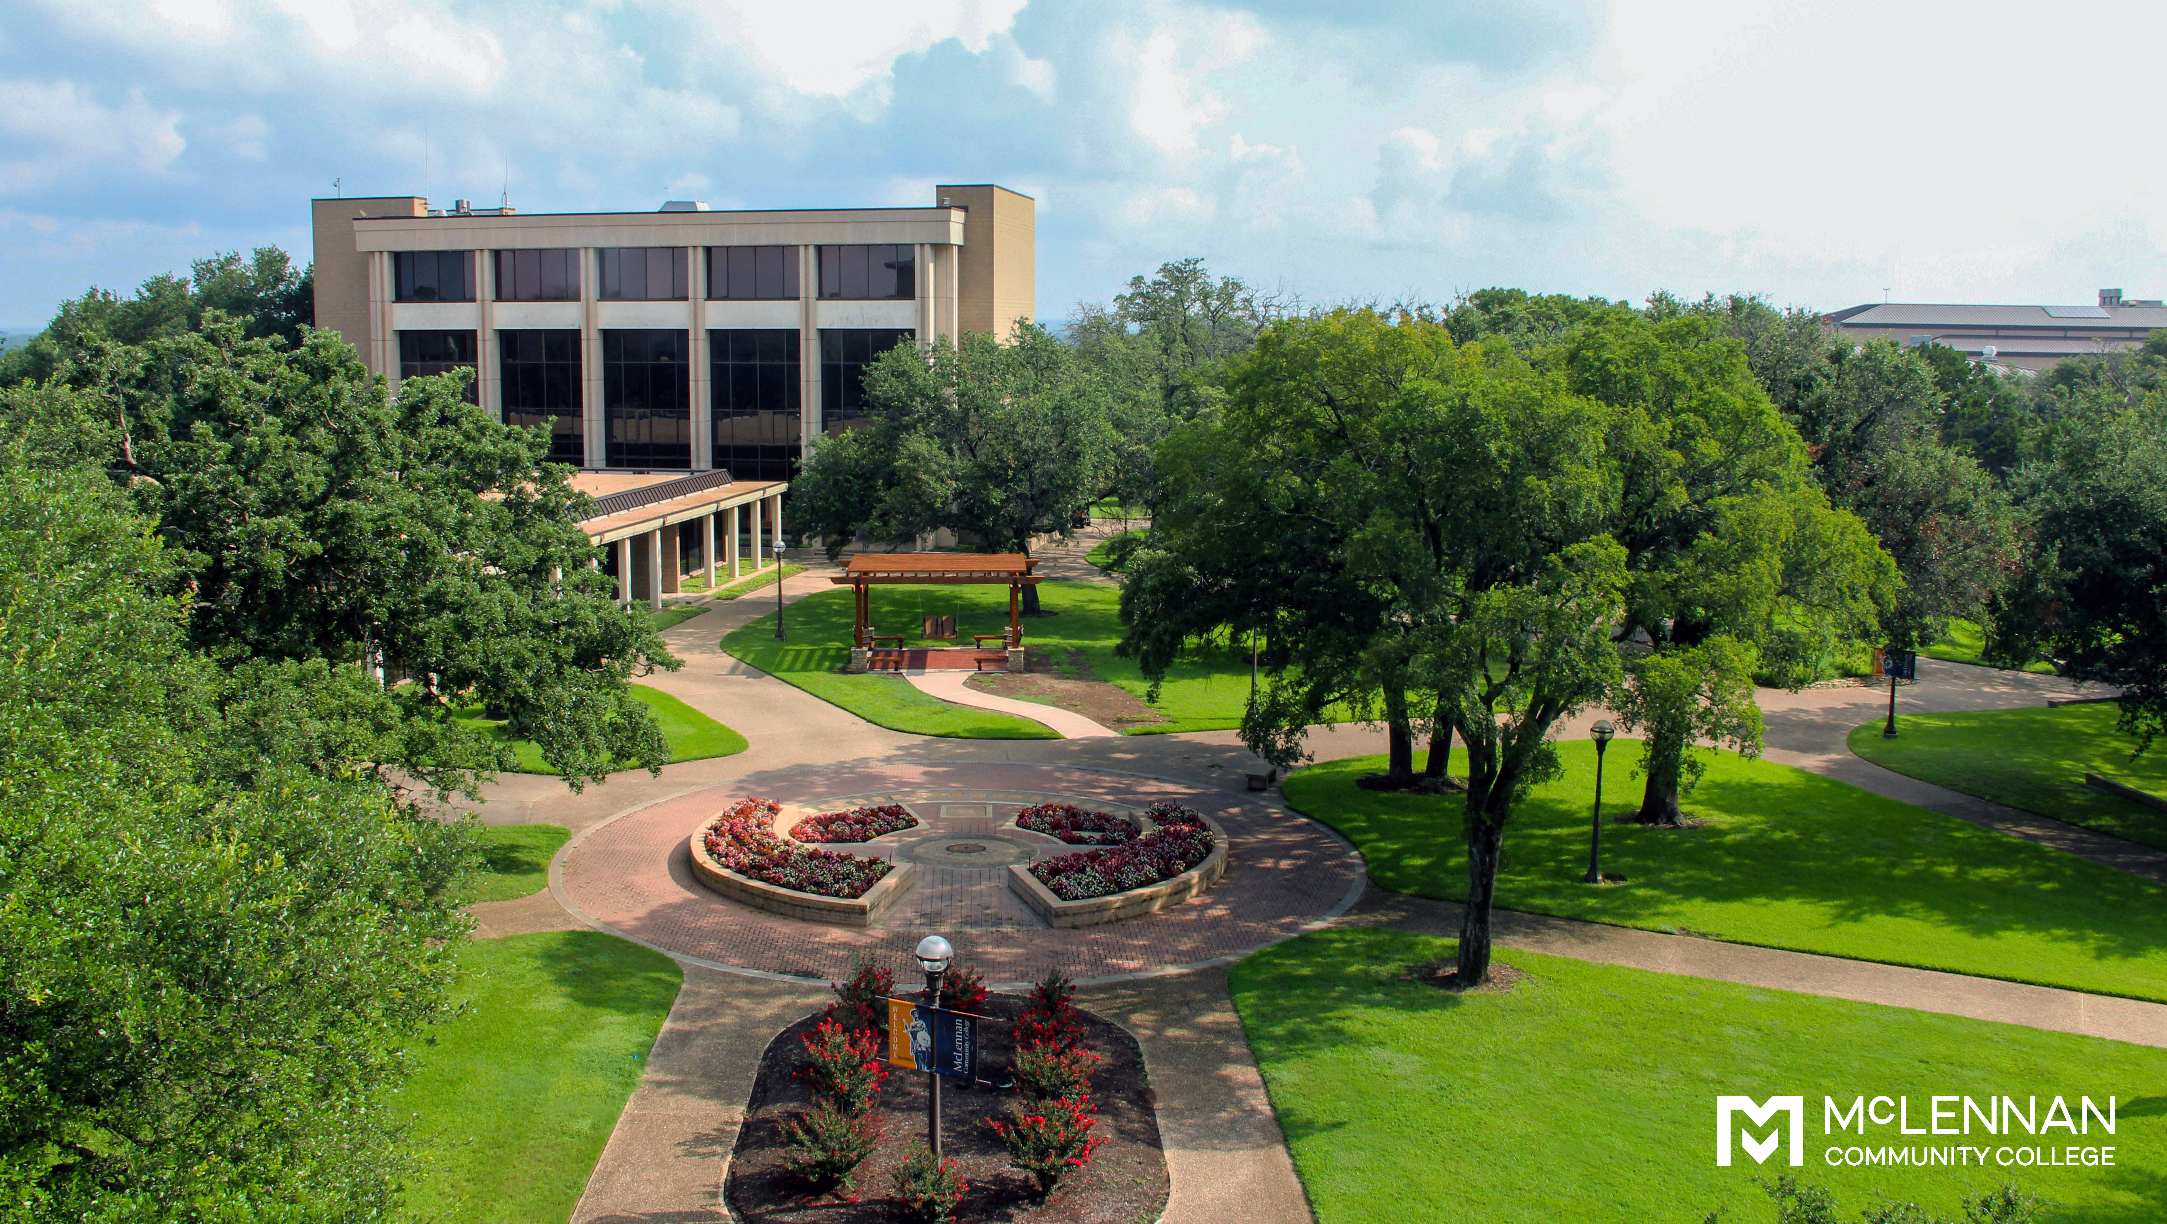
Future Credentials: AY 2025/26
Fiberoptic Certification (TRUE grant; summer 2025)
Agroecology Technician OSA (USDA grant; summer 2025)
Dental Assistance (in process via CE; anticipated Fall 2025)
Barber Certificate in Cosmetology (Fall 2026)

