Slide 1

House Bill 2110
Senate Bill 1786
Updates

Slide 2


Overview
House Bill 8 “Clean up bill”
Refining metrics

Slide 3
Private and Independent Universities
Include students who transfer to one of Texas’ private or independent institutions of higher education after completing 15 semester credit hours at a public junior college
  Ensure the outcomes-based funding model reflects and recognizes multiple student success pathways.
  Foster stronger transfer pathways, expanding opportunities for students to seamlessly continue their education across all types of higher education institutions.

Slide 4
Private and Independent Universities
FY26:
3,815
$13,353,181
FY27:
3,829
$13,400,882
Notes:
7 followed by an expected downward trend through fiscal year 2030.
($7,873,738) FY2030

Slide 5
Private and Independent Universities
Term to Transfer to Baylor | Students | Potential Funding
Fall 2024 | 33 | $115,500
Fall 2023 | 48 | $168,000
Fall 2022 | 39 | $108,500
Fall 2021 | 38 | $133,000

Slide 6
Credentials of Value
Determined by Return on Investment (ROI) and the graduate will earn at least $30,000 within 5-years of graduation
  $30,000 wage aligns with the Texas Workforce Commissions statewide median self-sustaining wage
  Healthcare and Education will remain as COV even if they fall below the ROI or wage threshold because they are considered critical workforce fields in Texas

Slide 7
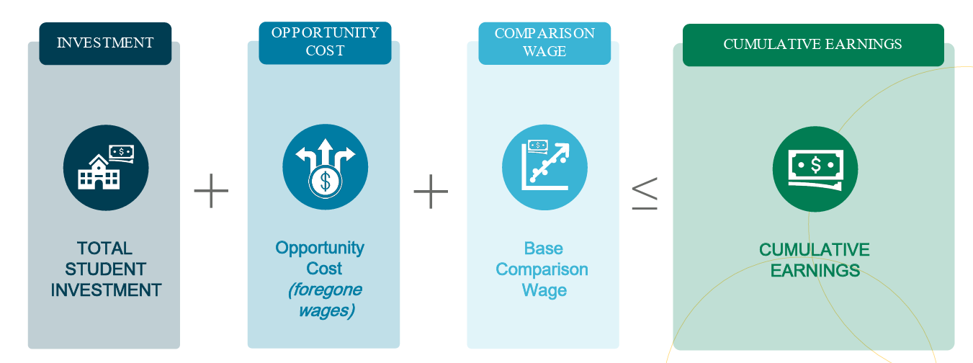
Credential of Value
Determined by Return on Investment (ROI) and the graduate will earn at least $30,000 within 5-years of graduation
  $30,000 wage aligns with the Texas Workforce Commissions statewide median self-sustaining wage
  Healthcare and Education will remain as COV even if they fall below the ROI or wage threshold because they are considered critical workforce fields in Texas
https://www.texas-air.org/wp-content/uploads/2025/03/F4-Credentials-of-Value-Methodology-Community-Co.pdf
Notes:
Total Student Investment = ({Tuition/Fees + Room & Board} * time enrolled ) – aid received
Opportunity Cost = [Median annual high school grad wages * real time to degree]
Comparison wage = [Median annual high school grad wages * years since postsecondary graduate (5 years) ]
Total Student Investment + Opportunity Cost + Comparison Wage <= Projected Cumulative Wage by Year 5

Slide 8
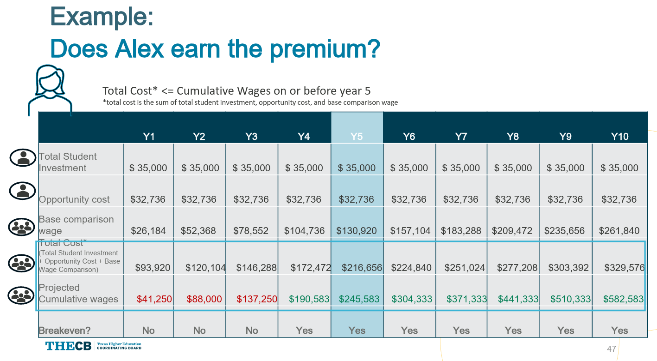
Credential of Value
https://www.texas-air.org/wp-content/uploads/2025/03/F4-Credentials-of-Value-Methodology-Community-Co.pdf

Slide 9

“
We will start by applying this refined method to associate degrees and over the next two years we would explore how to apply this definition to certificate programs; while continuing to ensure we are supporting credentials in high wage, high demand areas.
“
-THECB Commissioner Rosser
Notes:
So what can we do with this?

Slide 10
Questions

