Slide 1
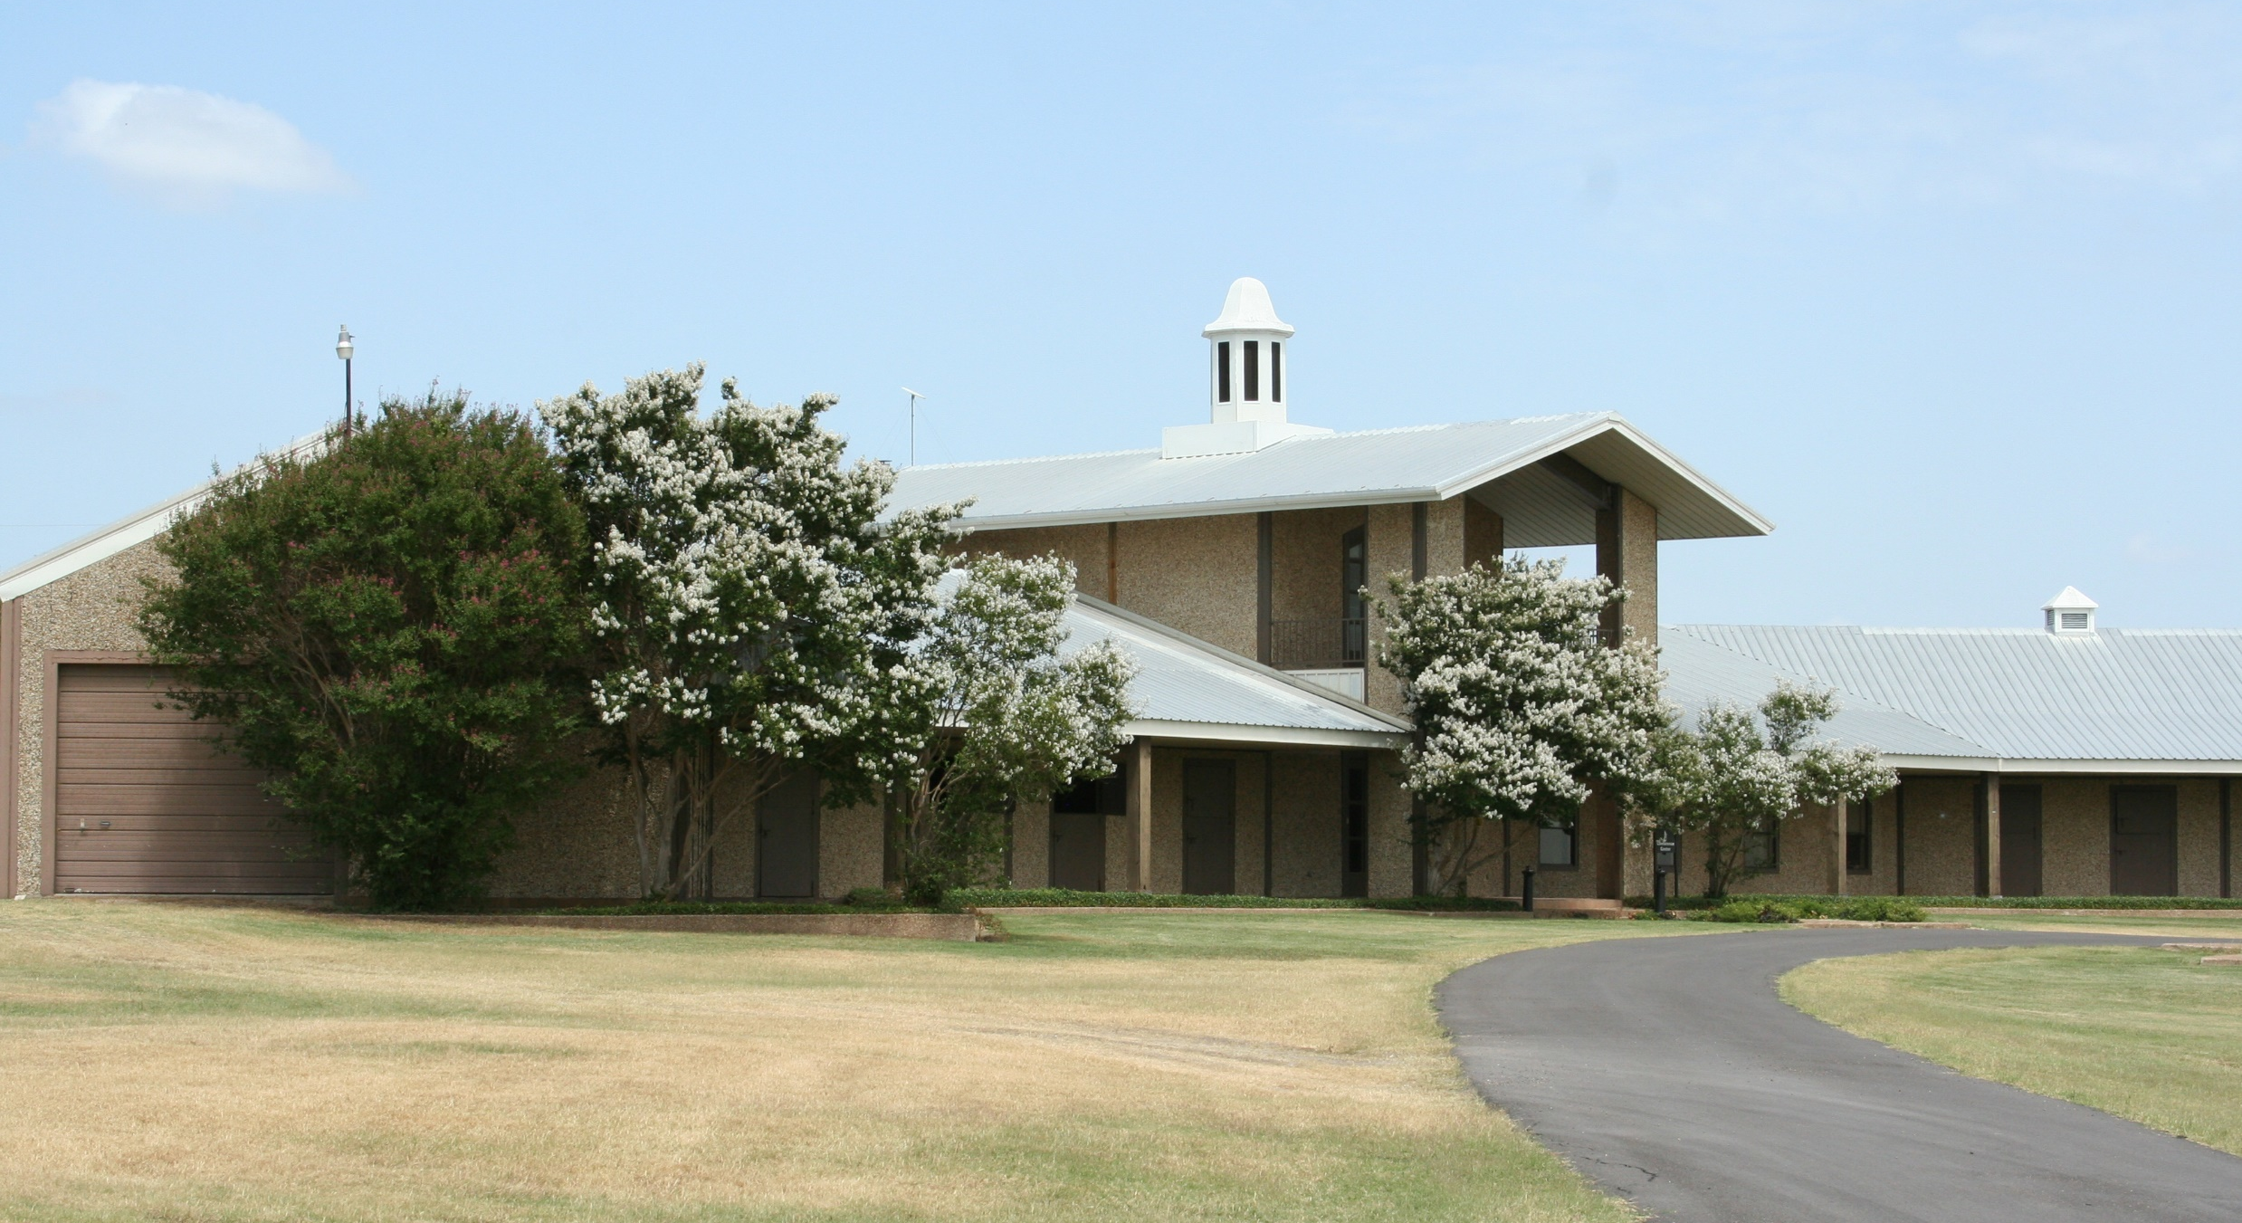

Board Update
June 30, 2025
Frank Patterson, Director, Emergency & Risk Management, & Ranch Operations

Slide 2
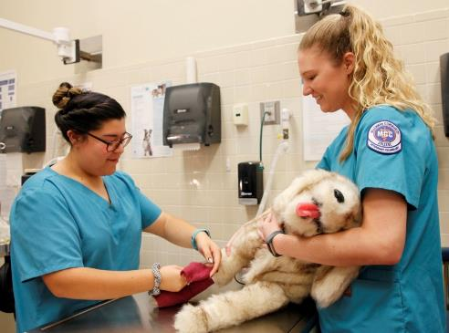
Ranch Review – Leadership, Community Engagement
Ranch Advisory Committee met March 18, 2025. No follow up meeting has been scheduled at this time
Provided updates to RAC members
Held discussion with Bosqueville ISD on potential partnership opportunities with plans to hold future meetings

Slide 3
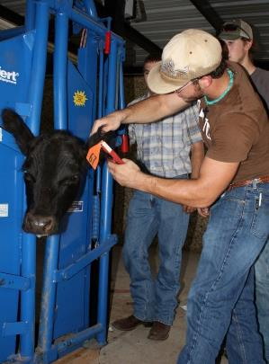
Ranch Review – Resource Management
Reorganized horse boarding
Increase in fees across the board which include horse boarding to begin with the new fiscal year.
Received quotes for identified work to be completed.

Slide 4
Ranch Review – Resource Management
Fixing water leaks through the pastures and in the stalls
Installed a canopy over the back door of the Vet Tech/Ag building which has helped with water infiltration
Repaired indoor arena perimeter fencing
Repaired one of the wash racks

Slide 5
Ranch Review – Resource Management
Purchase order issued to create two concrete ADA parking spaces with bathroom access at the large covered arena
Will begin repairs in the stall barn in the next few weeks
Requesting quotes to convert the ranch house garage into a classroom and the interior to offices for CE and horse boarding employees.

Slide 6


Ranch Review – Recent Steps Ag program
Developing an articulation agreement with guaranteed acceptance conditions for students to Texas A&M University-Kingsville (TAMUK).
A.S. with Emphasis in Agriculture to TAMUK’s Bachelor of Science in Agriculture – Agronomy.
Bachelor of Science in Agriculture – Horticulture,
Bachelor of Science – Environmental Science.
A.S. with Emphasis in Agribusiness to TAMUK’s Bachelor of Science in Agribusiness
Bachelor of Science in Agribusiness – Ranch Management.
Associate of Applied Science in Business Management to their Bachelor of Applied Arts & Science in Agribusiness.

Slide 7
Ranch Review – Recent Steps Ag program (cont.)
USDA Grant Agroecology Technician Certificate Program
Evaluated by Professor Dr. Theresa P. Murphrey, Texas A&M University, Department of Agricultural Leadership, Education, and Communication.
The Agroecology Technician Certificate Program represents a forward-thinking response to the evolving needs of the agriculture and conservation workforce. By aligning curriculum development with local and national labor market trends, MCC has created a model that integrates both academic rigor and real-world skills. The inclusion of the Ducks Unlimited Ecology and Conservation Certificate ensures students gain a nationally recognized credential, while the use of Highlander Ranch for monthly labs enhances student engagement through immersive, hands-on experiences. Early results suggest strong institutional support, meaningful stakeholder engagement, and thoughtful planning around instructional delivery.

Slide 8
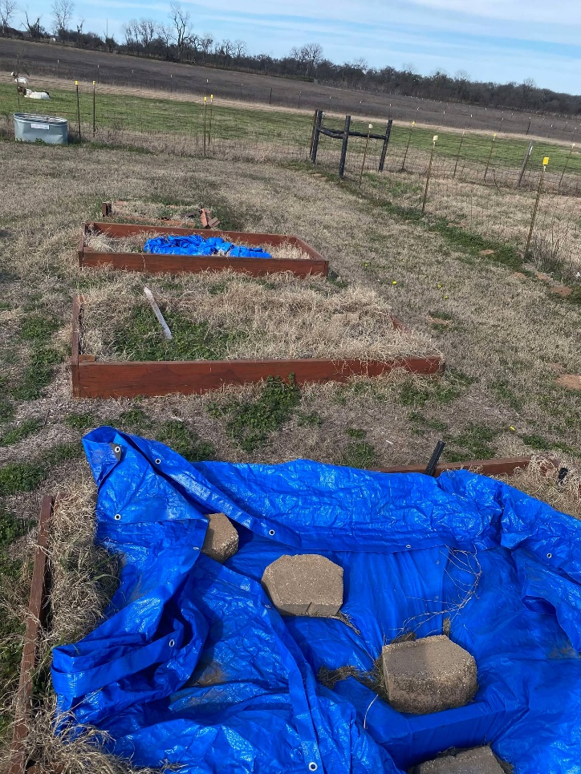
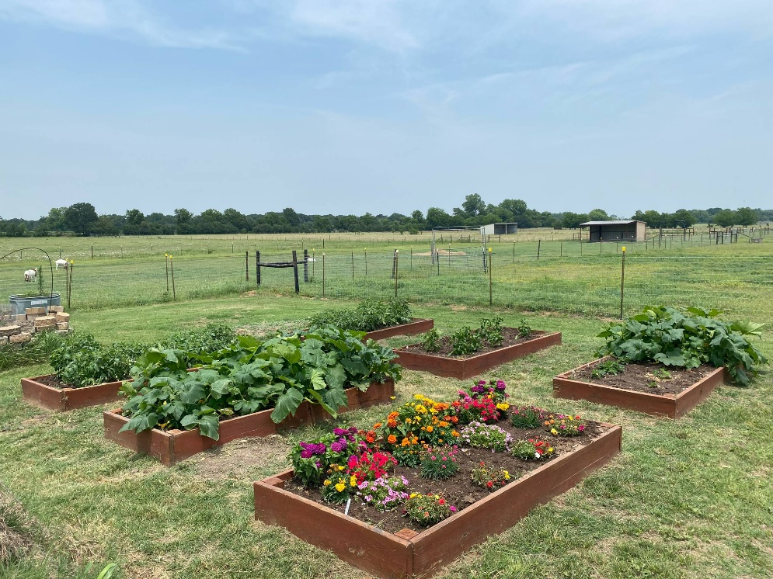
Ranch Review – Recent Steps Ag program (Cont.)
Ag Program: First year for heifers breeding program with the use of a contracted bull.

Slide 9
Ranch Review – Recent Steps CE program
CE will roll out the pilot for the Veterans program this fall.
Planning a farm to table certification to begin spring of 2026. This will consist of modules that will contain 4 classes each with a certificate that can be earned after completing 80 hours of classes. We will be working with the CEO of the Waco Farmers Market to help create some of the programming. Modules will include a block of 4 classes each on a specific topic such as backyard chickens, goat husbandry, State and Federal regulations and permits, small business planning, beekeeping, etc.

Slide 10
Ranch Review – Recent Steps Vet Tech program
Current enrollment and Fall new admission numbers:
Spring 2025 Graduates: 5 Vet Techs, with a 6th graduating in August. We had 5 Veterinary Assistants graduate.
Vet Tech current enrollment: 15 students are currently enrolled, and are anticipated to begin the fall semester as second year students.
Fall 2025 new starts: The Health Professions Admission Selection Committee met last week and selected a total of 20 Vet Tech students, and 3 Veterinary Assistant students to begin Fall 2025. 4 of the vet tech applicants had completed the Certificate of Completion in Veterinary Assisting in the spring.

Slide 11
Financials
Summary Financials are actual expenditures as of 05/31/2025 for FY2025, and total actual expenditures for FY2024.
Physical Plant payroll for Ranch work needs to be charged to individual departments. (This will start with the new fiscal year.)
Current CIF expenditures are not reflected in Financials. See summary below.
SUMMARY | Actuals as of 05/31/2025 | Actuals for FY2024
Revenue | 2025 | 2024
Continuing Education | $217,580 | $252,107
Horse Boarding | $201,015 | $245,344
Operational | $10,300 | $29,650
Veterinary Technology | $62,623 | $86,051
Agriculture | $30,400 | $44,738
TOTAL | $521,919 | $657,890
Expenses | 2025 | 2024
Continuing Education | $233,133 | $307,075
Horse Boarding | $137,692 | $170,681
Operational | $100,493 | $198,665
Veterinary Technology | $206,487 | $241,329
Agriculture | $23,583 | $25,261
Insurance Costs | $17,082 | $15,529
Unrelated Business Income Tax (UBIT) | $10,000 | $11,132
TOTAL | $728,470 | $969,672
Net | ($206,551) | ($311,782)
CIF SUMMARY | 2023-24 | 2024-25 | 2024-25
 | Actuals | Budget | Remaining
Road Work | $23,570 | $ 50,000 | $ 50,000
Landscape Improvements | $ 507 | $ 1,000 | $ 1,000
Maintenance and Fence Repairs | $17,411 | $ 15,000 | $ 4,247
Building Repairs | $26,672 | $ 90,000 | $ 86,370
Lighting |  | $ 10,000 | $ 10,000
Other Ranch Work | $18,922
TOTAL | $87,082 | $166,000 | $141,627
Notes:
Populated with figures through May 31. We don’t have any June payroll posted and still have invoices coming in.
Insurance line item is only for General property insurance and does not include horse boarding care custody and control or the liability insurance for CE riding lessons or shows.

Slide 12
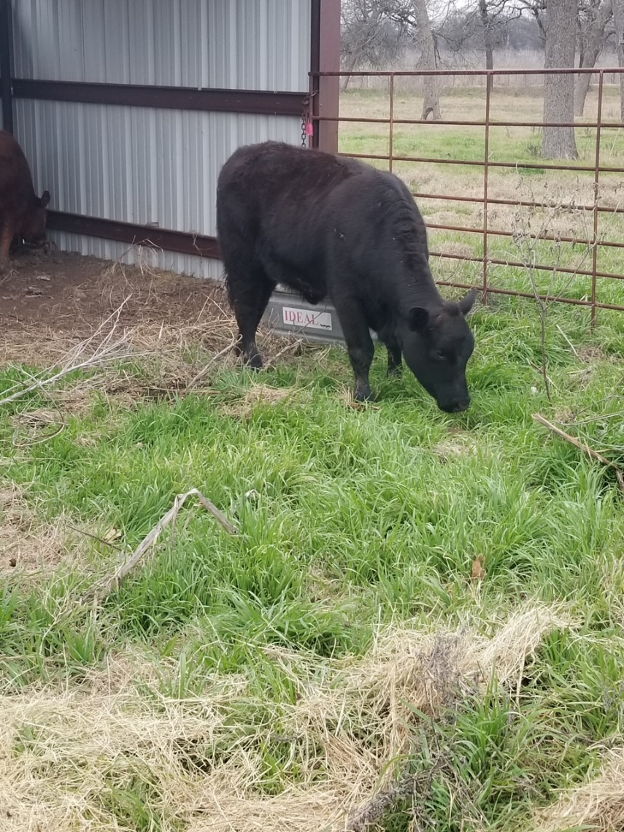
On going activities
Create a Utility & Infrastructure Map.
Improve Pasture Management to reduce feed costs and enhance land sustainability.
Evaluate our livestock and horses.

Slide 13
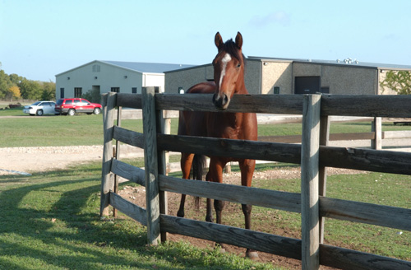
On going activities
Assess our current educational programs to ensure they align with the new state funding formula.
Rent facilities for activities to generate income and further enhance educational programs.
Ensure necessary repairs to maintain the Ranch's integrity.

Slide 14
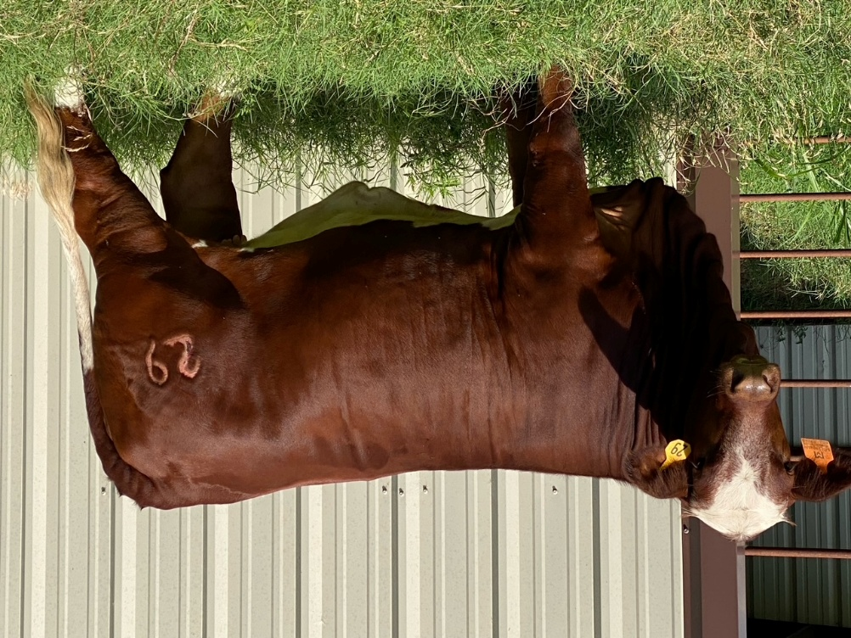
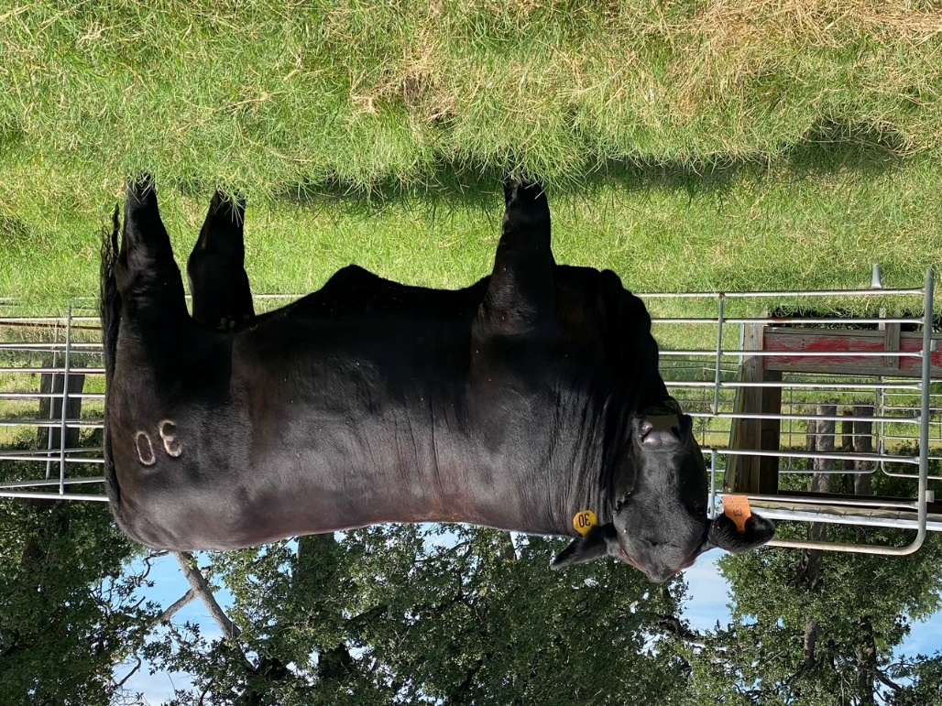
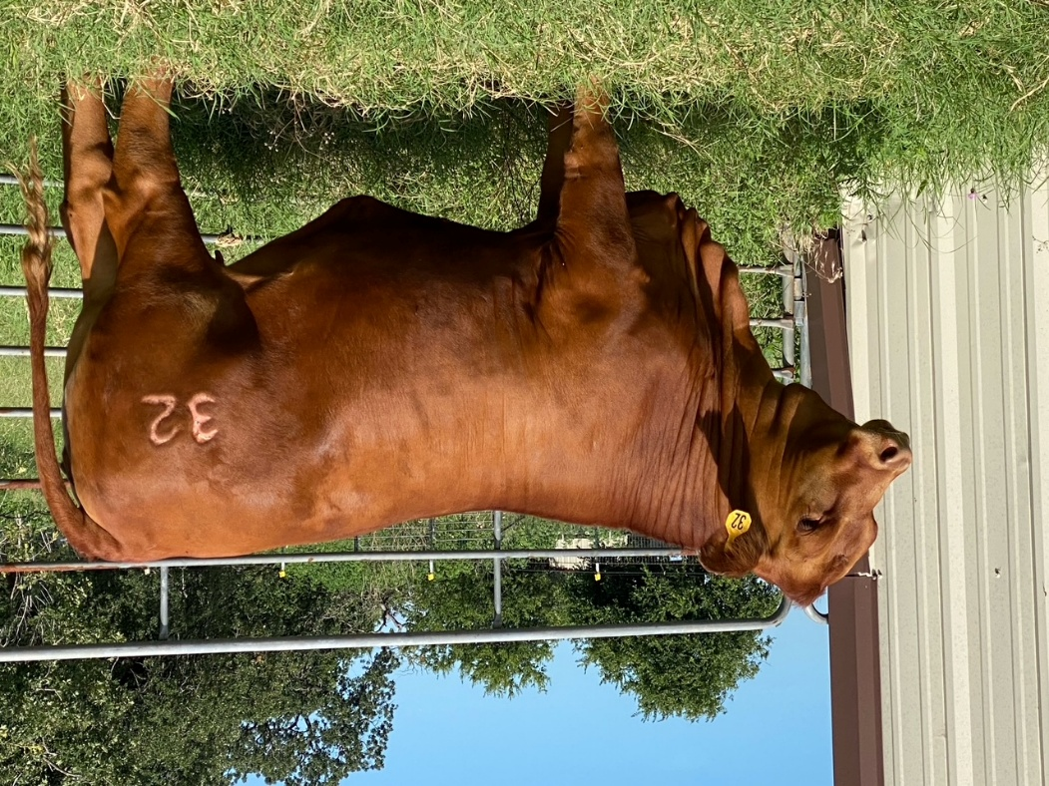
Heifer update

Slide 15
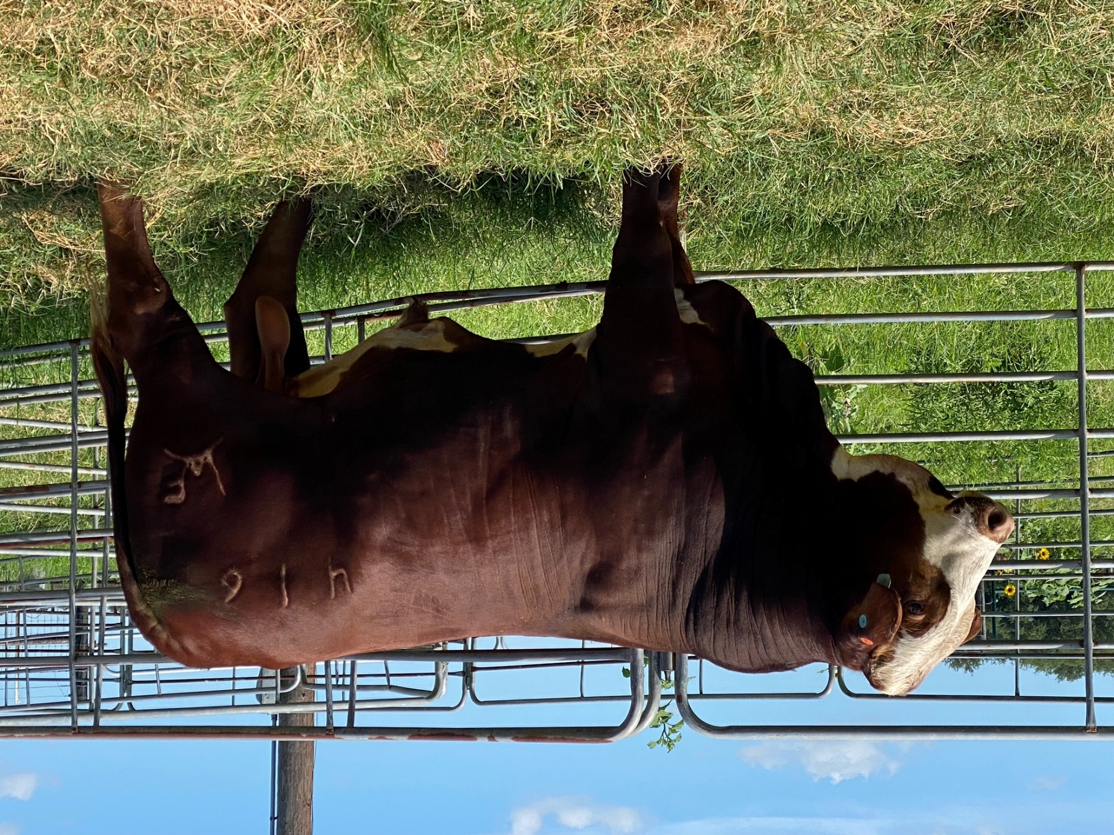
Heifer update

Slide 16

Questions?

