Slide 1
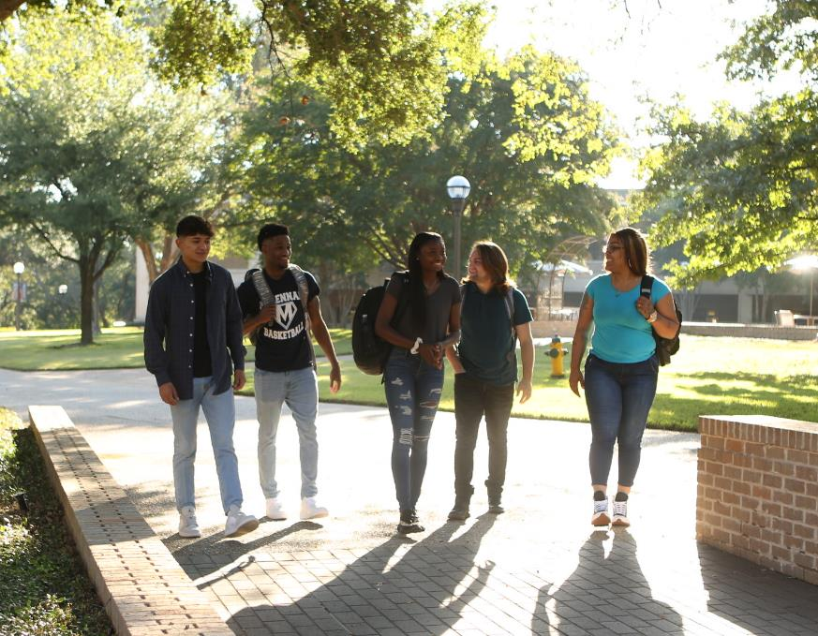


Monthly Financial Report
August 26, 2025
Mark Harmsen
VP, Finance and Administration

Slide 2
Balance Sheet – Assets
 | Jul | Jun | Jul | Difference
 | 2024 | 2025 | 2025 | Jun '25/Jul '25
ASSETS
Cash and Investments | $ 24,757,110 | $ 27,841,730 | $ 26,454,370 | $ (1,387,360)
Accounts Receivable | 10,345,381 | 10,020,229 | 11,694,410 | 1,674,181
Inventory | 21,670 | 4,718 | 6,968 | 2,250
Prepaids | 223,626 | 287,699 | 555,879 | 268,180
Deferred outflows related to GASB 68 | 6,956,830 | 7,941,096 | 7,941,096 | -
Deferred outflows related to GASB 75 | 5,608,379 | 3,152,709 | 3,152,709 | -
TOTAL ASSETS | 47,912,996 | 49,248,181 | 49,805,432 | 557,251

Slide 3
Balance Sheet – Liabilities and Fund Balances
 | Jul | Jun | Jul | Difference
 | 2024 | 2025 | 2025 | Jun '25/Jul '25
LIABILITIES AND FUND BALANCES
Accounts Payable | 4,031,158 | 4,515,313 | 4,129,680 | (385,633)
Net Pension Liability GASB 68 | 16,731,431 | 20,224,465 | 20,224,465 | -
Net OPEB Liability GASB 75 | 39,806,777 | 37,955,153 | 37,955,153 | -
Misc. Liabilities | 1,212,250 | 1,153,170 | 1,153,170 | -
Deferred Revenues | 7,028,384 | 5,468,548 | 7,833,761 | 2,365,213
Deferred inflows related to GASB 68 | 1,969,110 | 1,343,227 | 1,343,227 | -
Deferred inflows related to GASB 75 | 14,086,608 | 13,267,722 | 13,267,722 | -
TOTAL LIABILITIES | 84,865,718 | 83,927,598 | 85,907,178 | 1,979,580
Fund Balances | 16,748,551 | 16,623,852 | 16,623,852 | -
Adjustment for GASB 68 | (11,743,711) | (13,626,596) | (13,626,596) | -
Adjustment for GASB 75 | (48,285,006) | (48,070,166) | (48,070,166) | -
Operating Changes | 6,327,444 | 10,393,493 | 8,971,164 | (1,422,329)
TOTAL FUND BALANCE | (36,952,722) | (34,679,417) | (36,101,746) | (1,422,329)
TOTAL LIABILITIES & FUND BALANCE | $ 47,912,996 | $ 49,248,181 | $ 49,805,432 | $ 557,251
Notes:
When a company receives upfront payment from a customer before the product/service has been delivered; it is considered as deferred revenue. In short, Deferred revenue is recognized after cash is received.
Operating change from Oct 23 – 1.2 M in state appropriations and registration for fall starting Nov. 4th vs Oct 30th. Oct 23 vs 24 - $1.6 from spring tuition and $600K in state appropriations; $200K in taxes at this point this year.

Slide 4
Income Highlights
 | 2023/2024 | 2024/2025 | Cum. Inc./Exp. | % Received | Cum. Inc./Exp. | % Received | Difference | Difference
 | Revised Budget | Revised Budget | Thru Jul 2024 | or Disbursed | Thru Jul 2025 | or Disbursed | Jul '24/Jul '25 | Jul '25/Budget
Income
State Appropriations (Regular) | $13,526,366 | $13,328,529 | 13,526,367 | 100.00% | 13,319,453 | 99.93% | ($206,914) | (9,076)
State Appropriations (FAST) | 0 | 462,000 | 0 | 0.00% | 208,314 | 45.09% | $208,314 | (253,686)
State Appropriations (Hazlewood) | 0 | 0 | 64,583 | 0.00% | 59,602 | 0.00% | ($4,981) | 59,602
Tuition | 14,573,500 | 15,215,295 | 14,583,968 | 100.07% | 15,301,251 | 100.56% | 717,283 | 85,956
Summer Tuition | 3,843,000 | 3,964,000 | 4,059,652 | 105.64% | 4,309,891 | 108.73% | 250,239 | 345,891
Tuition--Non/Credit Community Programs | 28,000 | 28,000 | 22,271 | 79.54% | 24,572 | 87.76% | 2,301 | (3,428)
Tuition--Non Credit VOC | 137,000 | 94,000 | 104,504 | 76.28% | 118,719 | 126.30% | 14,215 | 24,719
Tuition--Teacher Certification | 28,000 | 28,000 | 18,469 | 65.96% | 13,450 | 48.04% | (5,019) | (14,550)
Tuition--Corporate Prof. Training | 209,750 | 70,250 | 233,976 | 111.55% | 19,917 | 28.35% | (214,059) | (50,333)
Pledged Tuition, Interest & Aux | (2,707,000) | (3,107,000) | (3,067,341) | 113.31% | (3,081,205) | 99.17% | (13,864) | 25,795
Pledged Tuition: Scholarship | (847,300) | (847,300) | (885,456) | 104.50% | (1,008,026) | 118.97% | (122,570) | (160,726)
Credit Fees | 2,750,602 | 3,081,450 | 2,728,801 | 99.21% | 3,154,696 | 102.38% | 425,895 | 73,246
Continuing Ed. Fees | 931,650 | 942,500 | 888,037 | 95.32% | 931,167 | 98.80% | 43,130 | (11,333)
Taxes | 31,314,861 | 34,056,467 | 30,540,577 | 97.53% | 33,859,787 | 99.42% | 3,319,210 | (196,680)
Transfer to CIF | (750,000) | (750,000) | 0 | 0.00% | 0 | 0.00% | 0 | 750,000
Interest Income | 1,400,000 | 1,800,000 | 1,939,882 | 138.56% | 1,744,174 | 96.90% | (195,708) | (55,826)
Grants, Donations, Etc | 316,952 | 316,952 | 272,406 | 85.95% | 426,950 | 134.70% | 154,544 | 109,998
Other Income | 1,227,847 | 1,326,258 | 1,140,980 | 92.93% | 1,193,134 | 89.96% | 52,154 | (133,124)
Miscellaneous Income | 427,400 | 247,400 | 164,930 | 38.59% | 455,789 | 184.23% | 290,859 | 208,389
Auxiliary
Bookstore | 100,000 | 100,000 | 23,718 | 23.72% | 89,814 | 89.81% | 66,096 | (10,186)
Food Services | 450,000 | 468,500 | 435,675 | 96.82% | 538,120 | 114.86% | 102,445 | 69,620
Auxiliary--Other income | 38,100 | 46,600 | 88,811 | 233.10% | 79,481 | 170.56% | (9,330) | 32,881
Total Income | 66,998,728 | 70,871,901 | 66,884,810 | 99.83% | 71,759,050 | 101.25% | 4,874,240 | 887,149

Slide 5
Expenses Highlights
 | 2023/2024 | 2024/2025 | Cum. Inc./Exp. | % Received | Cum. Inc./Exp. | % Received | Difference | Difference
 | Revised Budget | Revised Budget | Thru Jul 2024 | or Disbursed | Thru Jul 2025 | or Disbursed | Jul '24/Jul '25 | Jul '25/Budget
Expenditures
Salaries & Benefits | 47,589,732 | 50,191,140 | 43,660,360 | 91.74% | 45,766,304 | 91.18% | 2,105,944 | (4,424,836)
Operating Serv. & Supp. | 3,347,726 | 3,681,507 | 3,511,017 | 104.88% | 3,471,735 | 94.30% | (39,282) | (209,772)
Travel, Dues, Insurance | 3,905,770 | 4,614,671 | 3,950,790 | 101.15% | 4,315,401 | 93.51% | 364,611 | (299,270)
Technology | 3,344,266 | 3,779,649 | 2,665,304 | 79.70% | 2,887,526 | 76.40% | 222,222 | (892,123)
Reserve | 2,050,277 | 1,983,468 | 123,795 | 6.04% | 154,630 | 7.80% | 30,835 | (1,828,838)
Other Expenditures | 1,868,781 | 2,812,299 | 2,085,895 | 111.62% | 2,557,876 | 90.95% | 471,981 | (254,423)
Capital Expenditures | 784,749 | 438,744 | 592,958 | 75.56% | 524,740 | 119.60% | (68,218) | 85,996
Scholarships & Exemptions | 4,099,851 | 3,362,847 | 3,964,537 | 96.70% | 3,105,516 | 92.35% | (859,021) | (257,331)
Purchases for Resale | 7,576 | 7,576 | 2,710 | 35.77% | 4,158 | 54.88% | 1,448 | (3,418)
Total Expenditures | 66,998,728 | 70,871,901 | 60,557,366 | 90.39% | 62,787,886 | 88.59% | 2,230,520 | (8,084,015)
Net Operating Changes |  |  | $6,327,444 |  | $8,971,164 |  | $2,643,720 | 8,971,164

Slide 6
Bank Balances & Investments
 | Jul-24 |  |  |  |  | Jul-25
 | Unrestr. | Other | Tax Bonds | CIF | Total | Unrestr. | Other | Tax Bonds | CIF | Total
 | Funds | Funds | Debt Service | Reserve |  | Funds | Funds | Debt Service | Reserve
Bank Accounts
General Operating | ($10,859,924) | $917,537 |  | $9,855,947 | ($86,440) | ($10,844,526) | $2,428,221 |  | $8,638,559 | $222,254
Auxiliary Fund | 1,426 |  |  |  | 1,426 | 1,426 |  |  |  | 1,426
Payroll Fund |  |  |  |  | 0 |  |  |  |  | 0
Federal Fund |  | 95,694 |  |  | 95,694 |  | 29,387 |  |  | 29,387
Receivables | 89,409 |  |  |  | 89,409 | 98,009 |  |  |  | 98,009
Worker's Comp | 18,542 |  |  |  | 18,542 | 7,735 |  |  |  | 7,735
Total Bank Accounts | (10,750,547) | 1,013,231 | 0 | 9,855,947 | 118,631 | (10,737,356) | 2,457,608 | 0 | 8,638,559 | 358,811
Misc. Petty Cash Accounts | 3,412 |  |  |  | 3,412 | 2,753 |  |  |  | 2,753
Investments
TFNB ICS | 12,748,626 |  | 1,184,081 |  | 13,932,707 | 13,267,900 |  | 1,080,793 |  | 14,348,693
TFNB MMA | 9,477,262 |  |  |  | 9,477,262 | 9,939,918 |  |  |  | 9,939,918
TexPool | 260,952 |  | 58,967 |  | 319,919 | 291,504 |  | 35,458 |  | 326,962
Lone Star Investment | 219 |  |  |  | 219 | 229 |  |  |  | 229
Texas Range | 9,750 |  |  |  | 9,750 | 10,207 |  |  |  | 10,207
CDARS 26-week matures 8/8/24 |  |  | 4,101,956 |  | 4,101,956 |  |  |  |  | 0
CDARS 13-week matures 10/10/24 | 4,343,270 |  |  |  | 4,343,270 |  |  |  |  | 0
CDARS 52-week matures 1/9/25 | 8,664,166 |  |  |  | 8,664,166 |  |  |  |  | 0
CDARS 13-week matures 7/10/25 |  |  |  |  | 0 |  |  |  |  | 0
CDARS 26-week matures 8/14/25 |  |  |  |  | 0 |  |  | 4,592,399 |  | 4,592,399
CDARS 13-week matures 10/9/25 |  |  |  |  | 0 | 4,548,062 |  |  |  | 4,548,062
CDARS 52-week matures 1/8/26 |  |  |  |  | 0 | 9,131,153 |  |  |  | 9,131,153
Total Investments | 35,504,245 | 0 | 5,345,004 | 0 | 40,849,249 | 37,188,973 | 0 | 5,708,650 | 0 | 42,897,623
Total Cash & Investments | $24,757,110 | $1,013,231 | $5,345,004 | $9,855,947 | $40,971,292 | $26,454,370 | $2,457,608 | $5,708,650 | $8,638,559 | $43,259,187
Notes:
CDARS allows a business to invest in Certificates of Deposit [CDs] held by many different FDIC insured banking institutions, so it can achieve full FDIC coverage for the total sum. The MMA account and the ICS account provide a competitive monthly interest rate of 5.45%. All of our property tax receipts are deposited into our Texpool account which was getting a daily rate of 5.33% at the end of July. Texpool accounts have been the traditional investment vehicle because it is always at a guaranteed rate and consistent, regardless of whichever bank we use.
ICS – Insured Cash Sweep – FDIC protection - A sweep account is a bank or brokerage account that automatically transfers amounts that exceed a certain level into a higher interest-earning investment option at the close of each business day. Commonly, the excess cash is swept into a money market fund spread through multiple financial institutions. MMA – Money Market Account
----------------------------------- October --------------------------------------------------------------
Other funds includes CIF funds ($5.4M) with off setting negative costs including Financial Aid distributions to students compared to the timing of drawdowns. There was a drawdown in Sept. for refunds and a larger drawdown for tuition and fees in October.

Slide 7
Top Expenses (GENERAL/MISC OPERATIONS)
Payee | Purpose | Amount | Date
Target Solutions | Re-roof Projects | $ 305,148.16 | 7/28/2025
HCS, Inc. | Cameron Hall Project | 181,910.95 | 7/28/2025
Slate Construction Central Tex | Volleyball Locker Room | 107,577.42 | 7/14/2025
Citibank | Procurement Card-Departmental Charges | 96,947.02 | 7/17/2025
Comptroller of Public Accounts | Unclaimed property | 88,557.64 | 7/2/2025
Shell Energy Solutions | Utilities-Electricity | 87,761.71 | 7/21/2025
Red River Technology LLC | MFA Project | 80,062.00 | 7/2/2025
HCS, Inc. | Cameron Hall landscape | 59,233.69 | 7/21/2025
Continental Touring Solutions | Athletics Transport | 46,200.00 | 7/23/2025
Texas AirSystems LLC | Maintenance Supplies | 42,569.00 | 7/30/2025
City of Waco - Water Dept. | Water Bills | 42,490.46 | 7/7/2025
Shamrock Property Management | Student Housing Rent | 41,250.00 | 7/1/2025
Technolutions Inc | Software License | 37,500.00 | 7/7/2025
Engraving Concepts LP | Laser Engraver | 35,900.00 | 7/14/2025
City of Waco - Water Dept. | Water Bills | 31,147.71 | 7/31/2025
Continental Touring Solutions | Transportation | 31,000.00 | 7/21/2025
Amazon Capital Services | Amazon-Departmental Charges | 28,079.00 | 7/7/2025
Southern Aluminum Manufacturin | Tables Cameron Hall | 24,553.00 | 7/7/2025
Turnitin LLC | Feedback Studio | 24,530.00 | 7/14/2025
Notes:
The next three slides show the top expenses for general/misc. operations, physical plant and technology.
I can answer any questions.

Slide 8
Top Expenses (PHYSICAL PLANT/Property)
Payee | Purpose | Amount | Date
Target Solutions | Re-roof Projects | $ 305,148.16 | 7/28/2025
HCS, Inc. | Cameron Hall Project | 181,910.95 | 7/28/2025
Slate Construction Central Tex | Volleyball Locker Room | 107,577.42 | 7/14/2025
Citibank | Procurement Card-Departmental Charges | 96,947.02 | 7/17/2025
Comptroller of Public Accounts | Unclaimed property | 88,557.64 | 7/2/2025
Shell Energy Solutions | Utilities-Electricity | 87,761.71 | 7/21/2025
Red River Technology LLC | MFA Project | 80,062.00 | 7/2/2025
HCS, Inc. | Cameron Hall landscape | 59,233.69 | 7/21/2025
Continental Touring Solutions | Athletics Transport | 46,200.00 | 7/23/2025
Texas AirSystems LLC | Maintenance Supplies | 42,569.00 | 7/30/2025
City of Waco - Water Dept. | Water Bills | 42,490.46 | 7/7/2025
Shamrock Property Management | Student Housing Rent | 41,250.00 | 7/1/2025
Technolutions Inc | Software License | 37,500.00 | 7/7/2025
Engraving Concepts LP | Laser Engraver | 35,900.00 | 7/14/2025
City of Waco - Water Dept. | Water Bills | 31,147.71 | 7/31/2025
Continental Touring Solutions | Transportation | 31,000.00 | 7/21/2025
Amazon Capital Services | Amazon-Departmental Charges | 28,079.00 | 7/7/2025
Southern Aluminum Manufacturin | Tables Cameron Hall | 24,553.00 | 7/7/2025
Turnitin LLC | Feedback Studio | 24,530.00 | 7/14/2025

Slide 9
Top Expenses (TECHNOLOGY)
Payee | Purpose | Amount | Date
Target Solutions | Re-roof Projects | $ 305,148.16 | 7/28/2025
HCS, Inc. | Cameron Hall Project | 181,910.95 | 7/28/2025
Slate Construction Central Tex | Volleyball Locker Room | 107,577.42 | 7/14/2025
Citibank | Procurement Card-Departmental Charges | 96,947.02 | 7/17/2025
Comptroller of Public Accounts | Unclaimed property | 88,557.64 | 7/2/2025
Shell Energy Solutions | Utilities-Electricity | 87,761.71 | 7/21/2025
Red River Technology LLC | MFA Project | 80,062.00 | 7/2/2025
HCS, Inc. | Cameron Hall landscape | 59,233.69 | 7/21/2025
Continental Touring Solutions | Athletics Transport | 46,200.00 | 7/23/2025
Texas AirSystems LLC | Maintenance Supplies | 42,569.00 | 7/30/2025
City of Waco - Water Dept. | Water Bills | 42,490.46 | 7/7/2025
Shamrock Property Management | Student Housing Rent | 41,250.00 | 7/1/2025
Technolutions Inc | Software License | 37,500.00 | 7/7/2025
Engraving Concepts LP | Laser Engraver | 35,900.00 | 7/14/2025
City of Waco - Water Dept. | Water Bills | 31,147.71 | 7/31/2025
Continental Touring Solutions | Transportation | 31,000.00 | 7/21/2025
Amazon Capital Services | Amazon-Departmental Charges | 28,079.00 | 7/7/2025
Southern Aluminum Manufacturin | Tables Cameron Hall | 24,553.00 | 7/7/2025
Turnitin LLC | Feedback Studio | 24,530.00 | 7/14/2025

Slide 10
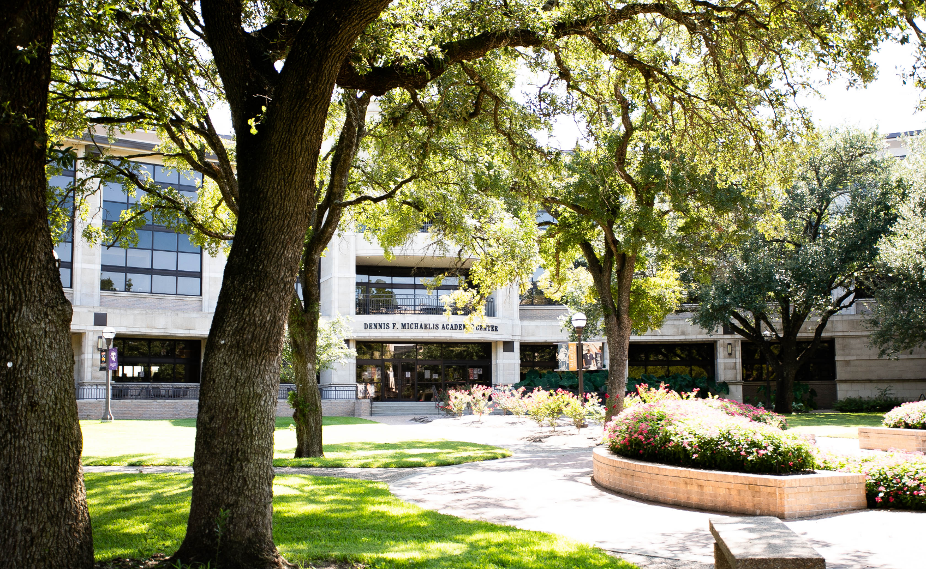
Questions? _________________________________________________________________________________________________

