Slide 1

TASB Policy Update

Slide 2


Texas Association of School Boards (TASB)
“One of the services TASB Community College Services offers to our localized colleges is the Policy Review Session (PRS). Through a PRS, TASB Community College Services will help your college keep its policy manual up to date with law and best practices.”
https://www.tasbcolleges.org/solutions-services/all-tasb-community-college-solutions-services/policy-review-sessions

Slide 3
TASB Policies
Legal policies
  Based on Federal and State statue
  Same for all Colleges and Schools
Local Board policies
  Based on TASB’s recommended best practices
    Templates (i.e. AJC, BJC, etc.)
  Based on MCC’s practices
    Keep templates as recommended
    Make changes to “X” policies

Slide 4
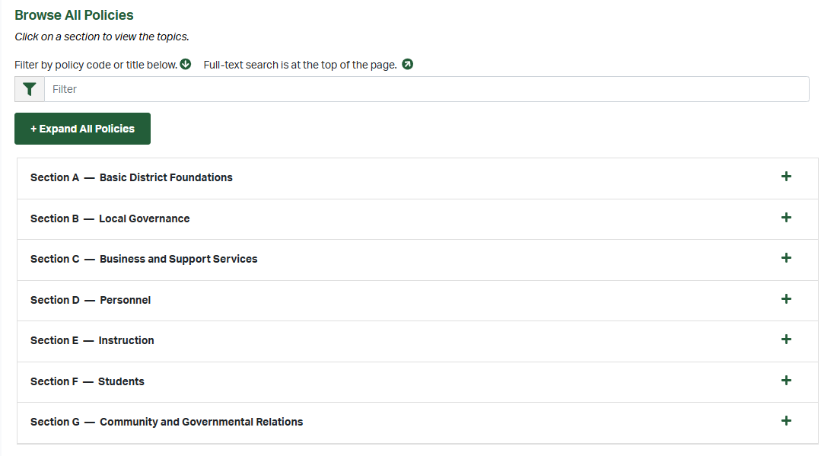

Slide 5
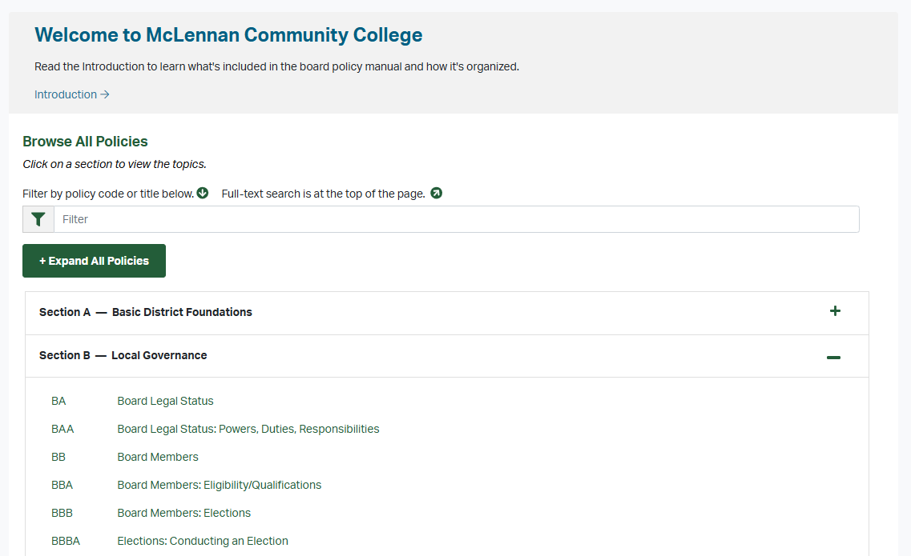

Slide 6
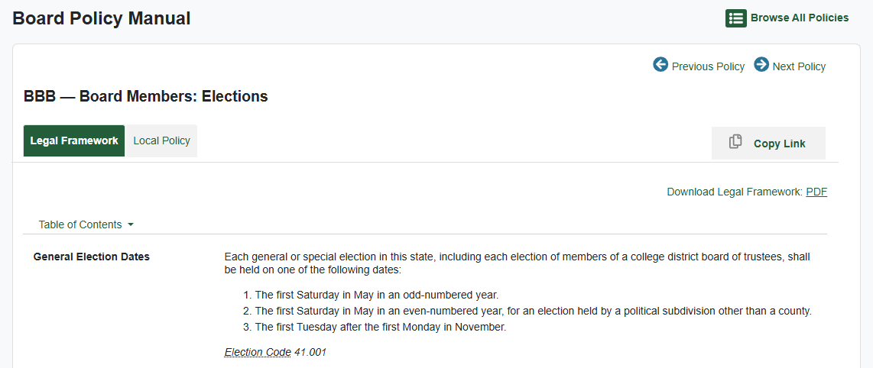

Slide 7
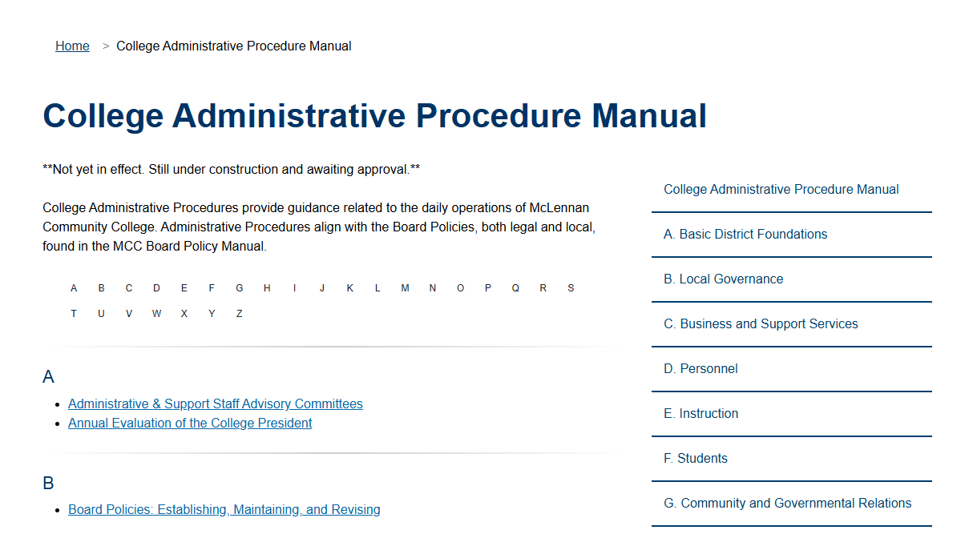
https://www.mclennan.edu/employees/procedure-manual/

Slide 8
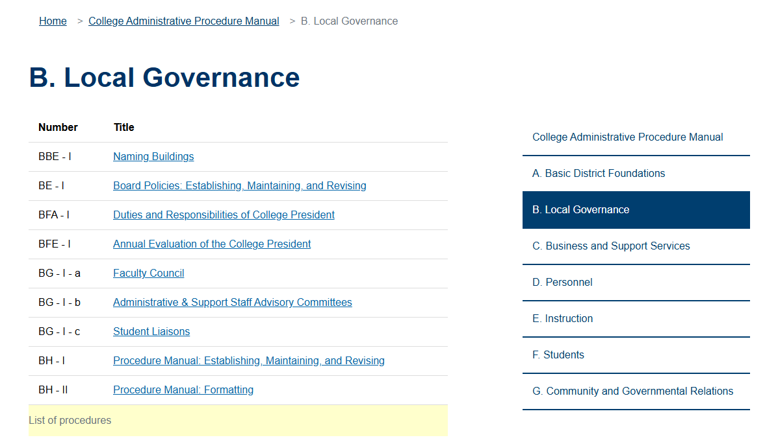
https://www.mclennan.edu/employees/procedure-manual/

Slide 9
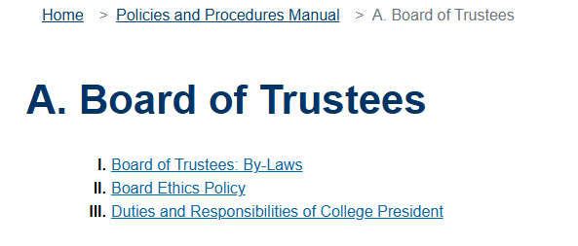
Board By-Laws
https://pol.tasb.org/PolicyOnline?key=858

Slide 10
Review & Editing Process
TASB Review & Suggestions
Major Review, Edits & Procedure Manual Creation
Departmental Review
& Edits
Legal Review & Edits
Board Review
Notes:
TASB Policy Consultant reviewed current policy and procedure manual
Sent MCC recommendations of edits to their local policies & best practices
Laura Wichman reviewed recommendations and made edits based on current policies & procedures
Created procedure manual
Worked with departments to review recommendations and made edits
Peter Rusek reviewed recommendations and made edits
Board reviewed recommendations

Slide 11
Approval Process
Rescind current policies
Adopt TASB

Slide 12
Next Steps
Email TASB edits
Procedure Manual Site ‘go-live’
MCC Policy Site ‘go-live’
Train Campus & Board

Slide 13

Questions
Notes:
We have a greater number of Board polices than we had in the past, however, there were polices that were Presidential policies in the past that are now Board policies with administrative guidelines. Overall, we have reduced the number of polices the College has; they are just all Board polices now. Prior to TASB we had 234 polices, now we will have 135 polices that are all Board policies. Those 135 policies will have 167 supporting procedures.

