Slide 1

Caring Campus Initiative:
McLennan Always Cares
Mandy Morrison
Crystal Johnson
Kelli Nehring
Notes:
Introductions

Slide 2



What is Caring Campus?
Institute for Evidence-Based Change
Over 14 years as a 501(c)3
Data-Informed Education and Caring Campus
Work in 28 states
Over 120 campuses implementing Caring Campus around the country
Caring Campus
Intentional systemic efforts to enhance campus culture, and increase student belonging
Coach, Dr. Martha Ellis
Institute for Evidence-Based Change logo
Caring Campus logo
Notes:
Intentional effort to welcome students and encourage their connection to the college
Engages staff who are often missing from student success efforts
Helps staff connect with one another and with other employee groups to create a positive college environment
Creates behavior change that influences culture change across campus
Causes the college to re-examine policy barriers to student success
Moves our work from transactional to relational
Leadership Support
Application Process
Commitment
Leadership Council
Empowerment of leaders across campus

Slide 3

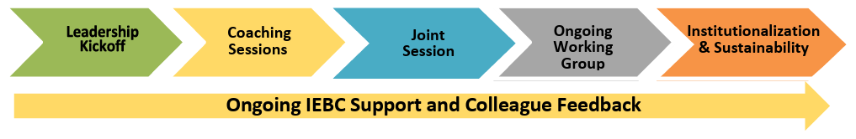
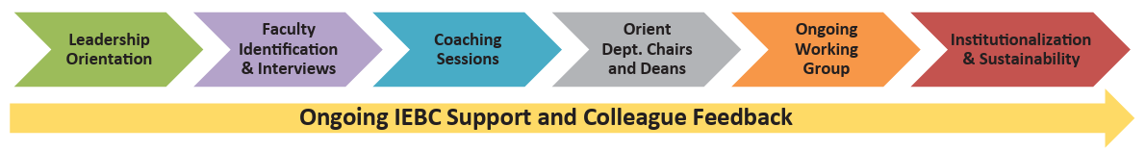
How is Caring Campus Implemented?
Two Processes:
Caring Campus Staff Process (Currently ongoing)
Caring Campus Faculty Process
We are here!!
Notes:
Faculty implementation coming in Spring of 2026!

Slide 4


Adapting Caring Campus to MCC
McLennan Always
Cares
(MAC)
McLennan Always Cares logo
MAC Webpage:
https://www.mclennan.edu/mclennan-always-cares/index.html

Slide 5

Caring Campus Behavioral Commitments
5 Behavioral Commitments
10 Foot Goal
Cross-Departmental Awareness
First Week
Name Tags
Warm Referrals
Notes:
Each has F2F and online components. Some still in progress.
10 Foot Deliverables:
2025: Do’s and Don’ts Flyer
2026: Coordinate with other departments to support communication standards via Mongoose, Email, etc.
Cross Departmental Deliverables:
2025: Department Quick Guide; “Who To Ask” Campus Contact List
2026: Departmental Videos
First Week Deliverables:
2025: In-person First Week of Fall Semester events and planning
2026: Continue in-person efforts but give greater focus to virtual environment
Nametag Deliverables:
2025: Name Badges
2026: Coordination with MarCom to circulate email signature brand standards
Warm Referrals Deliverables:
2025: Referral Card
2026: Bilingual Employee List

Slide 6
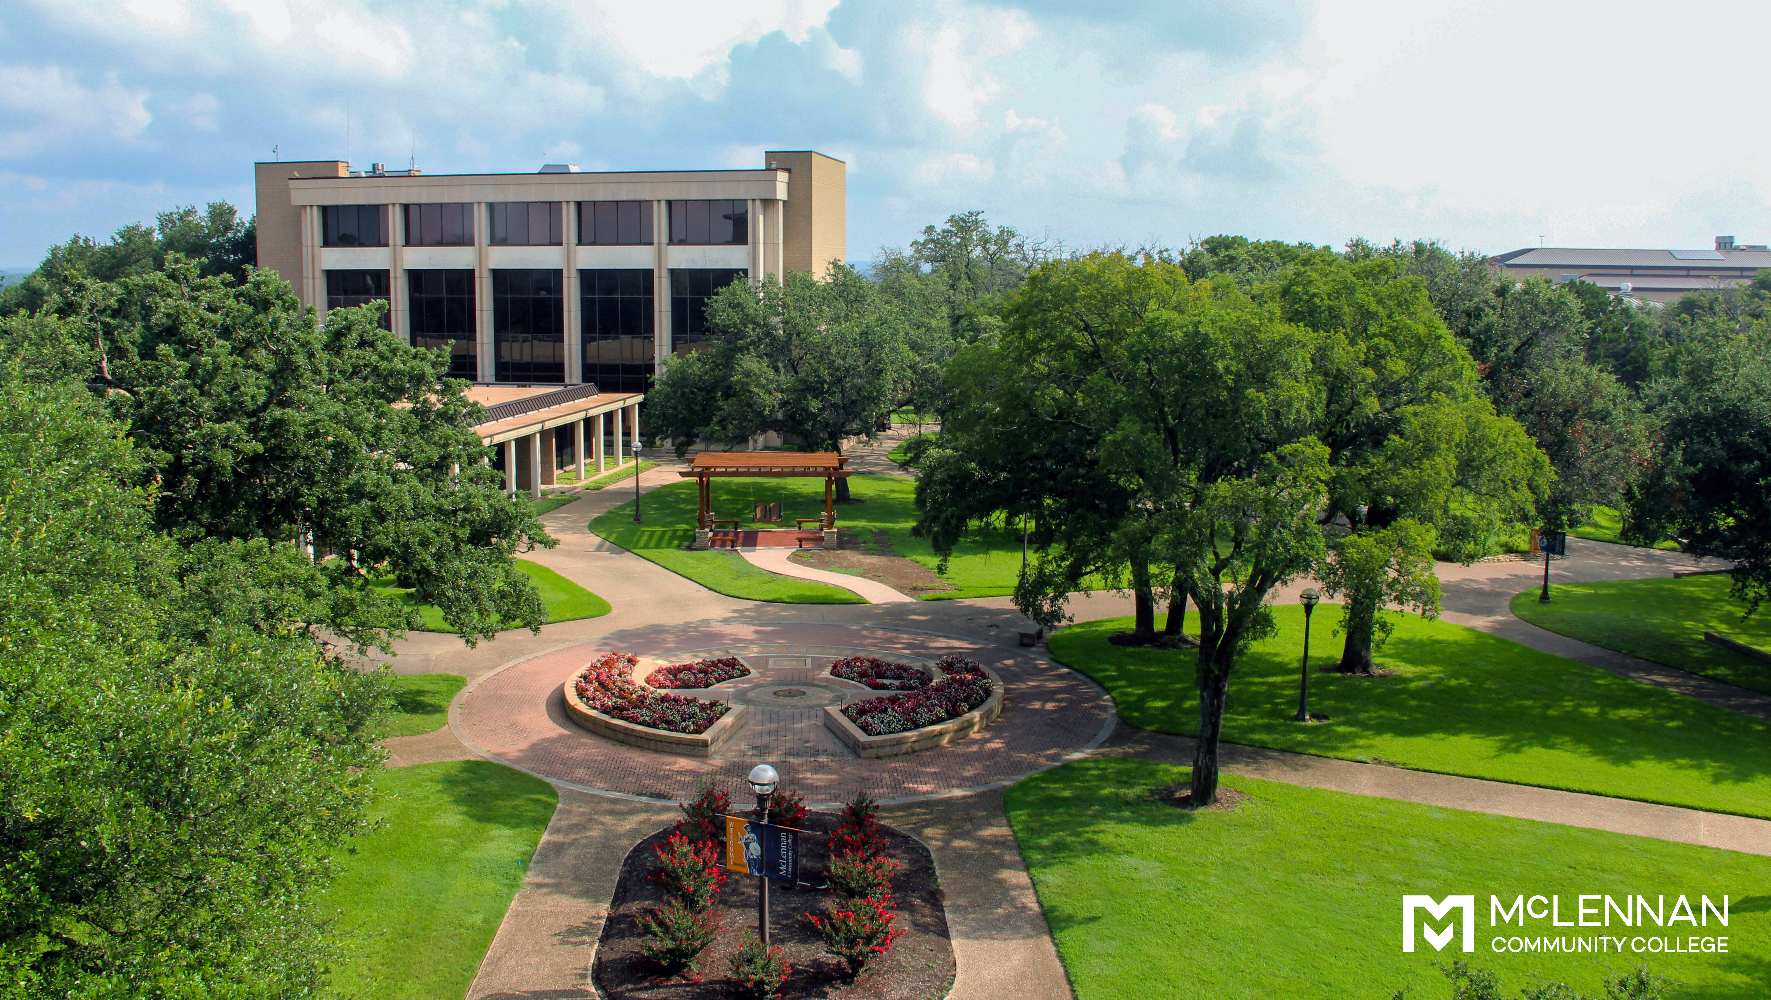
First Week
Warm Referrals
10 Foot Goal
Claire Wilkison – Lead
Rachel Kramer
Bryan Mohan
Danica Hertfelder
Elizabeth Perez
Elizabeth Garcia
Joe Hinojosa
Carol Lance
Amber Hardin
Lauren Pearsall
Joshua Estrada
Jayme Kubacak – Lead
Alma Jaramillo
Heather Smitheal
Jean Nixon
Larry Johnson
Fabion Luevano
Katie Vise
Jonathan O’Connor-Olivarez
Maggie Bryant
Zach Vanek
Jaclyn Owen – Lead
Selia Keim
Travis Cox
Elizabeth Stewart
Lauren Ryno
Cassy Stroud
Allyson Huntley
Ruben Salazar
Cross-Departmental Awareness
Nametags
VACANT – Lead
Mireya Zapata
David Contreraz
Sandy Butler
Shardae Kelly
Elizabeth Sheifley
Jamaal Greene
Sarah Chavez
Kristen Cook
Reggie Davis – Lead
Toni Nogalski
Angelique Erfurt
Ty DeGrate
Penelope Arias
Clayton Williams
Notes:
Started with a staff implementation team of 30 and expanded to 44 people in the current working groups.

Slide 7
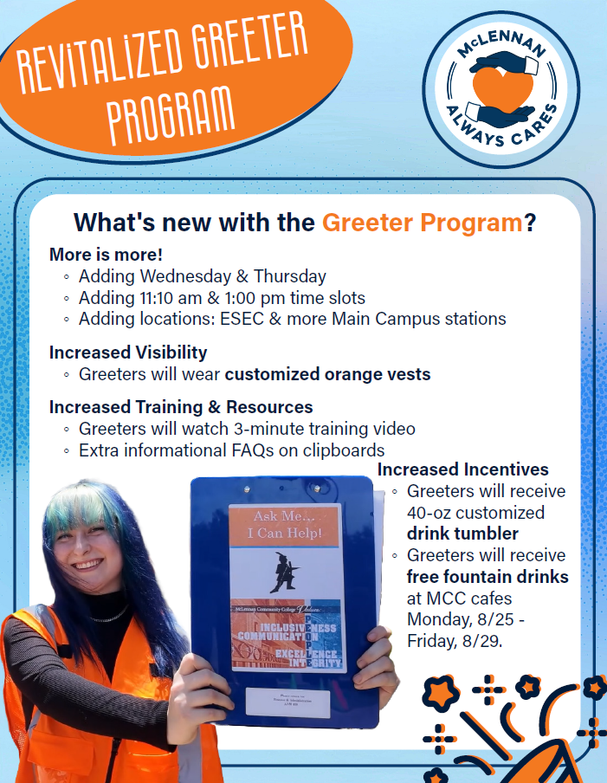
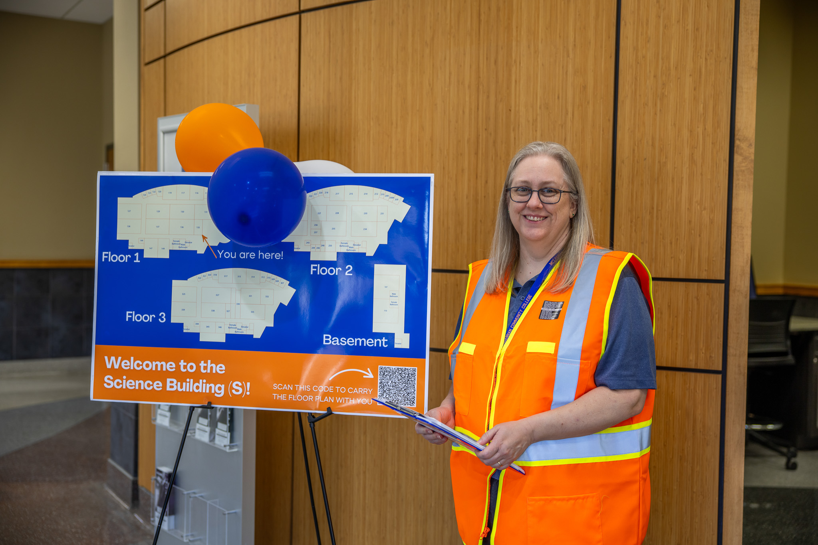
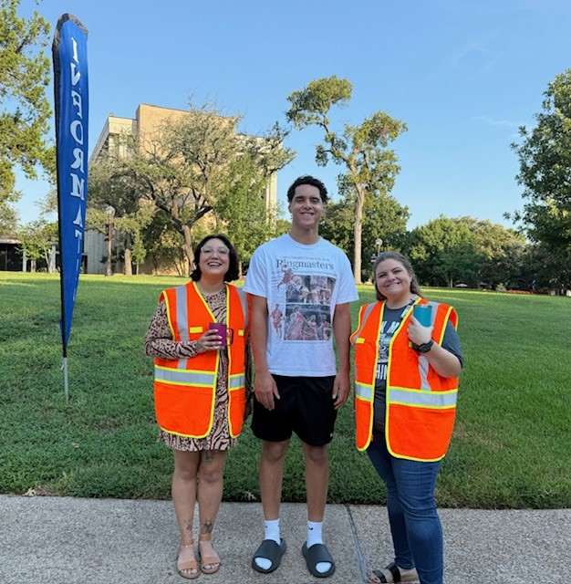
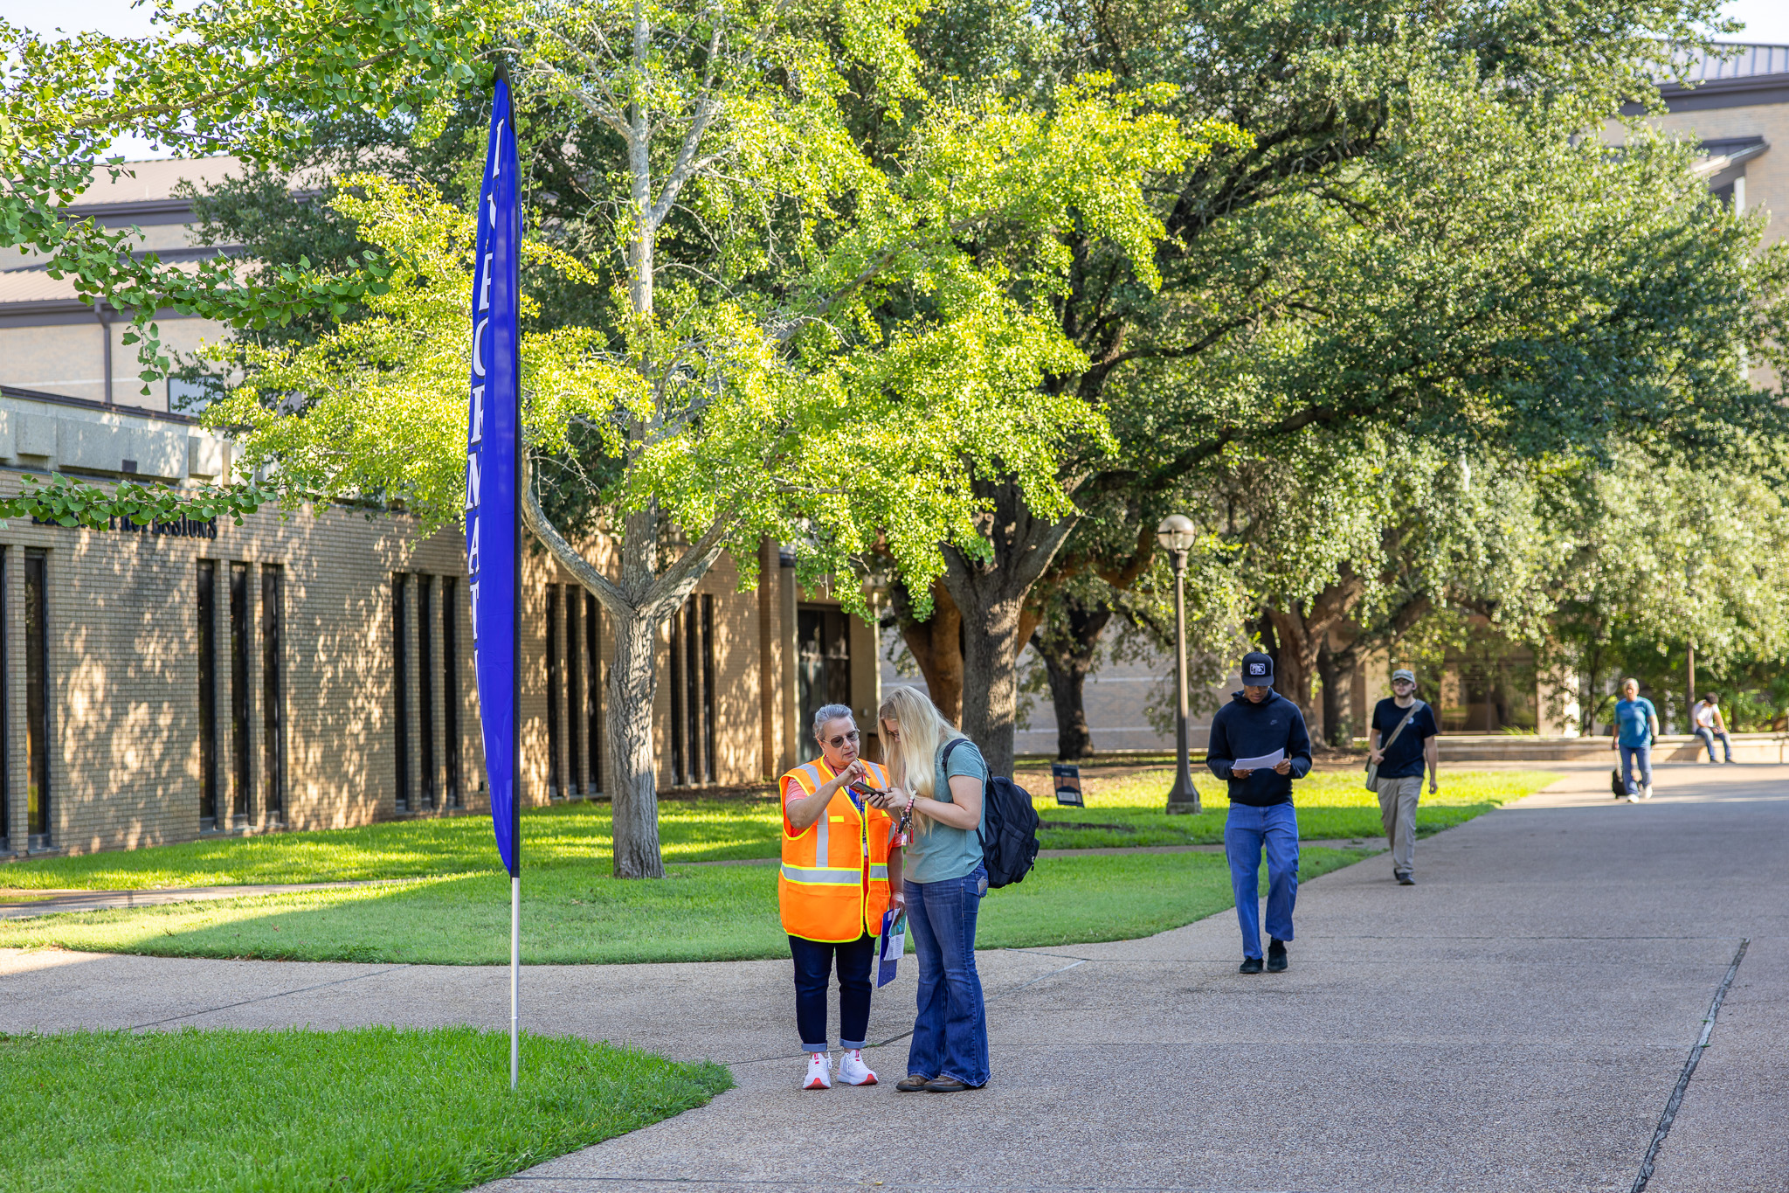

Campus Greeters
When:
Monday, August 25 –
Thursday, August 28, 2025
By the Numbers:
Greeters
175 unique individual greeters
Shifts
513 total shifts
Locations
32 locations across campus, inside and outside
Notes:
Greeter numbers
127 staff members
48 faculty members
407 of shifts were filled
Training and Resources
Training Video
Clipboards with FAQs and updated campus maps

Slide 8

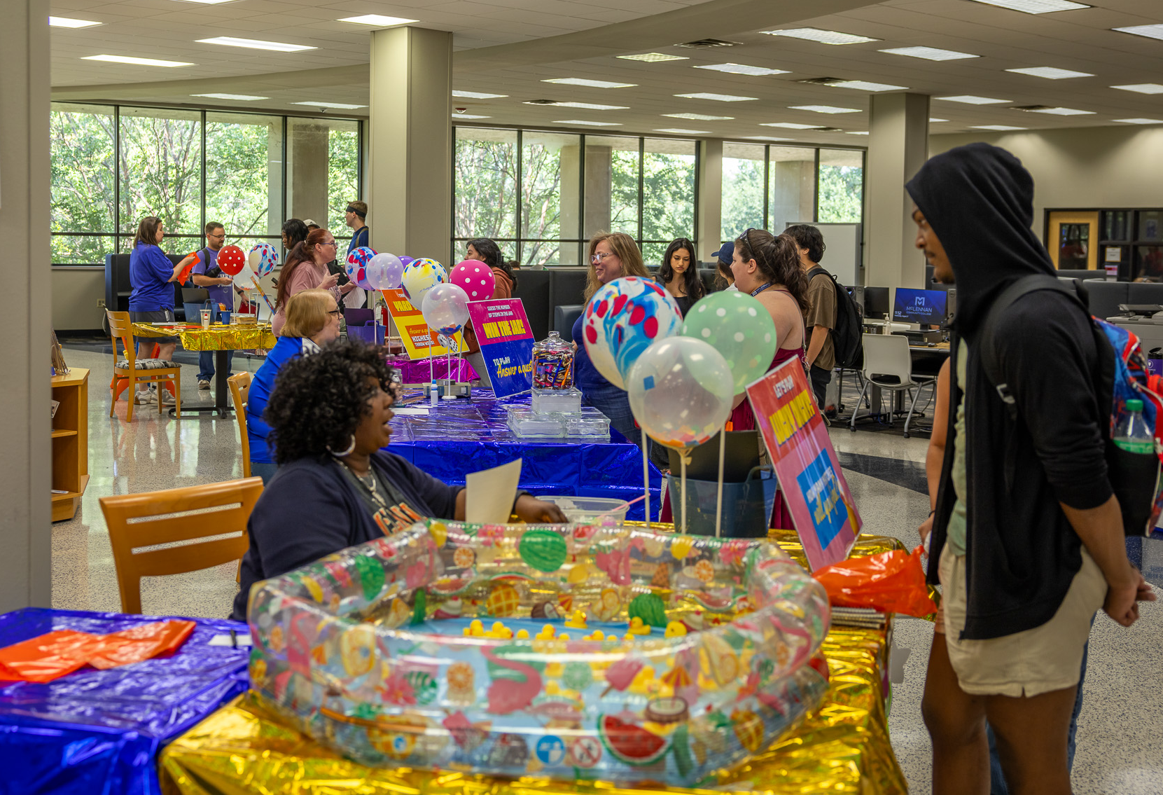
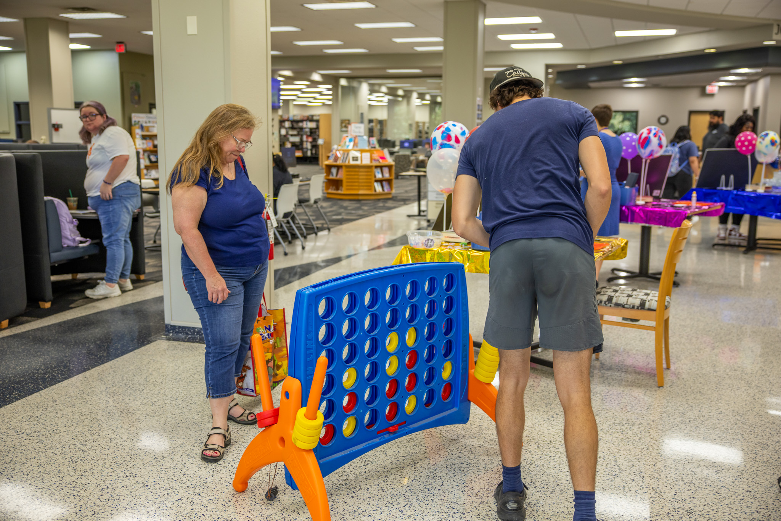
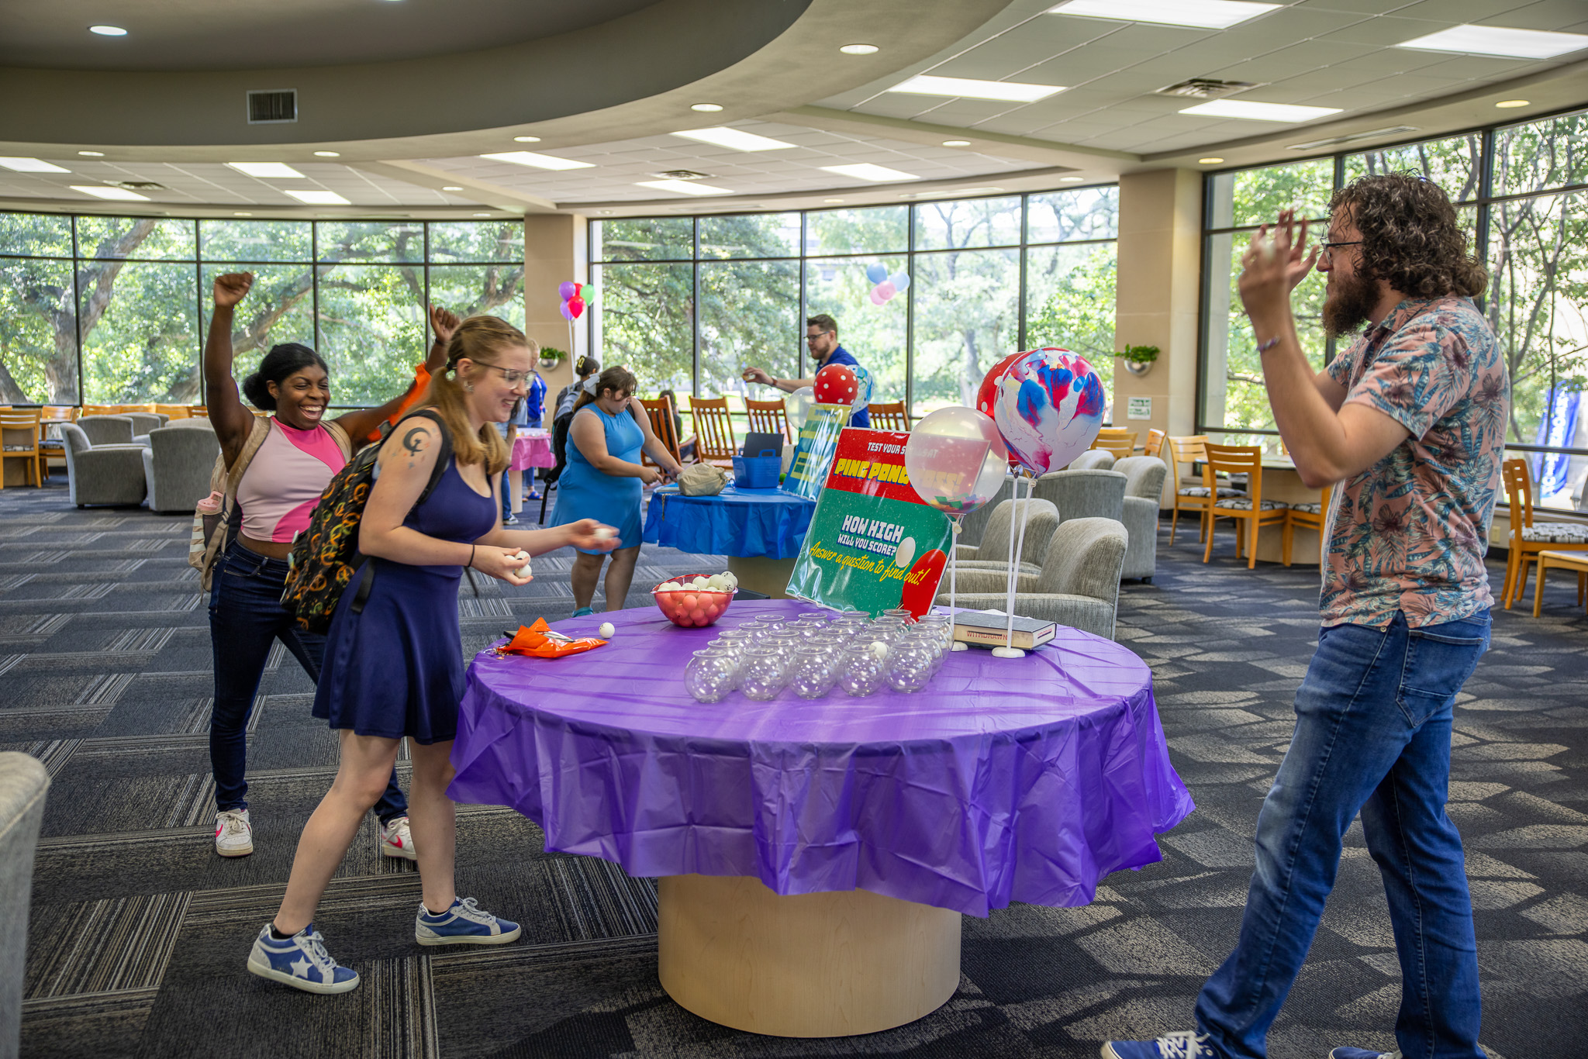
Learning Commons Welcome Fest
When:
Wednesday, August 27, 2025
Learning Technology Center
11:00 AM–1:00 PM
By the Numbers:
12 activities
Attendees
Approximately 120–130 students

Slide 9
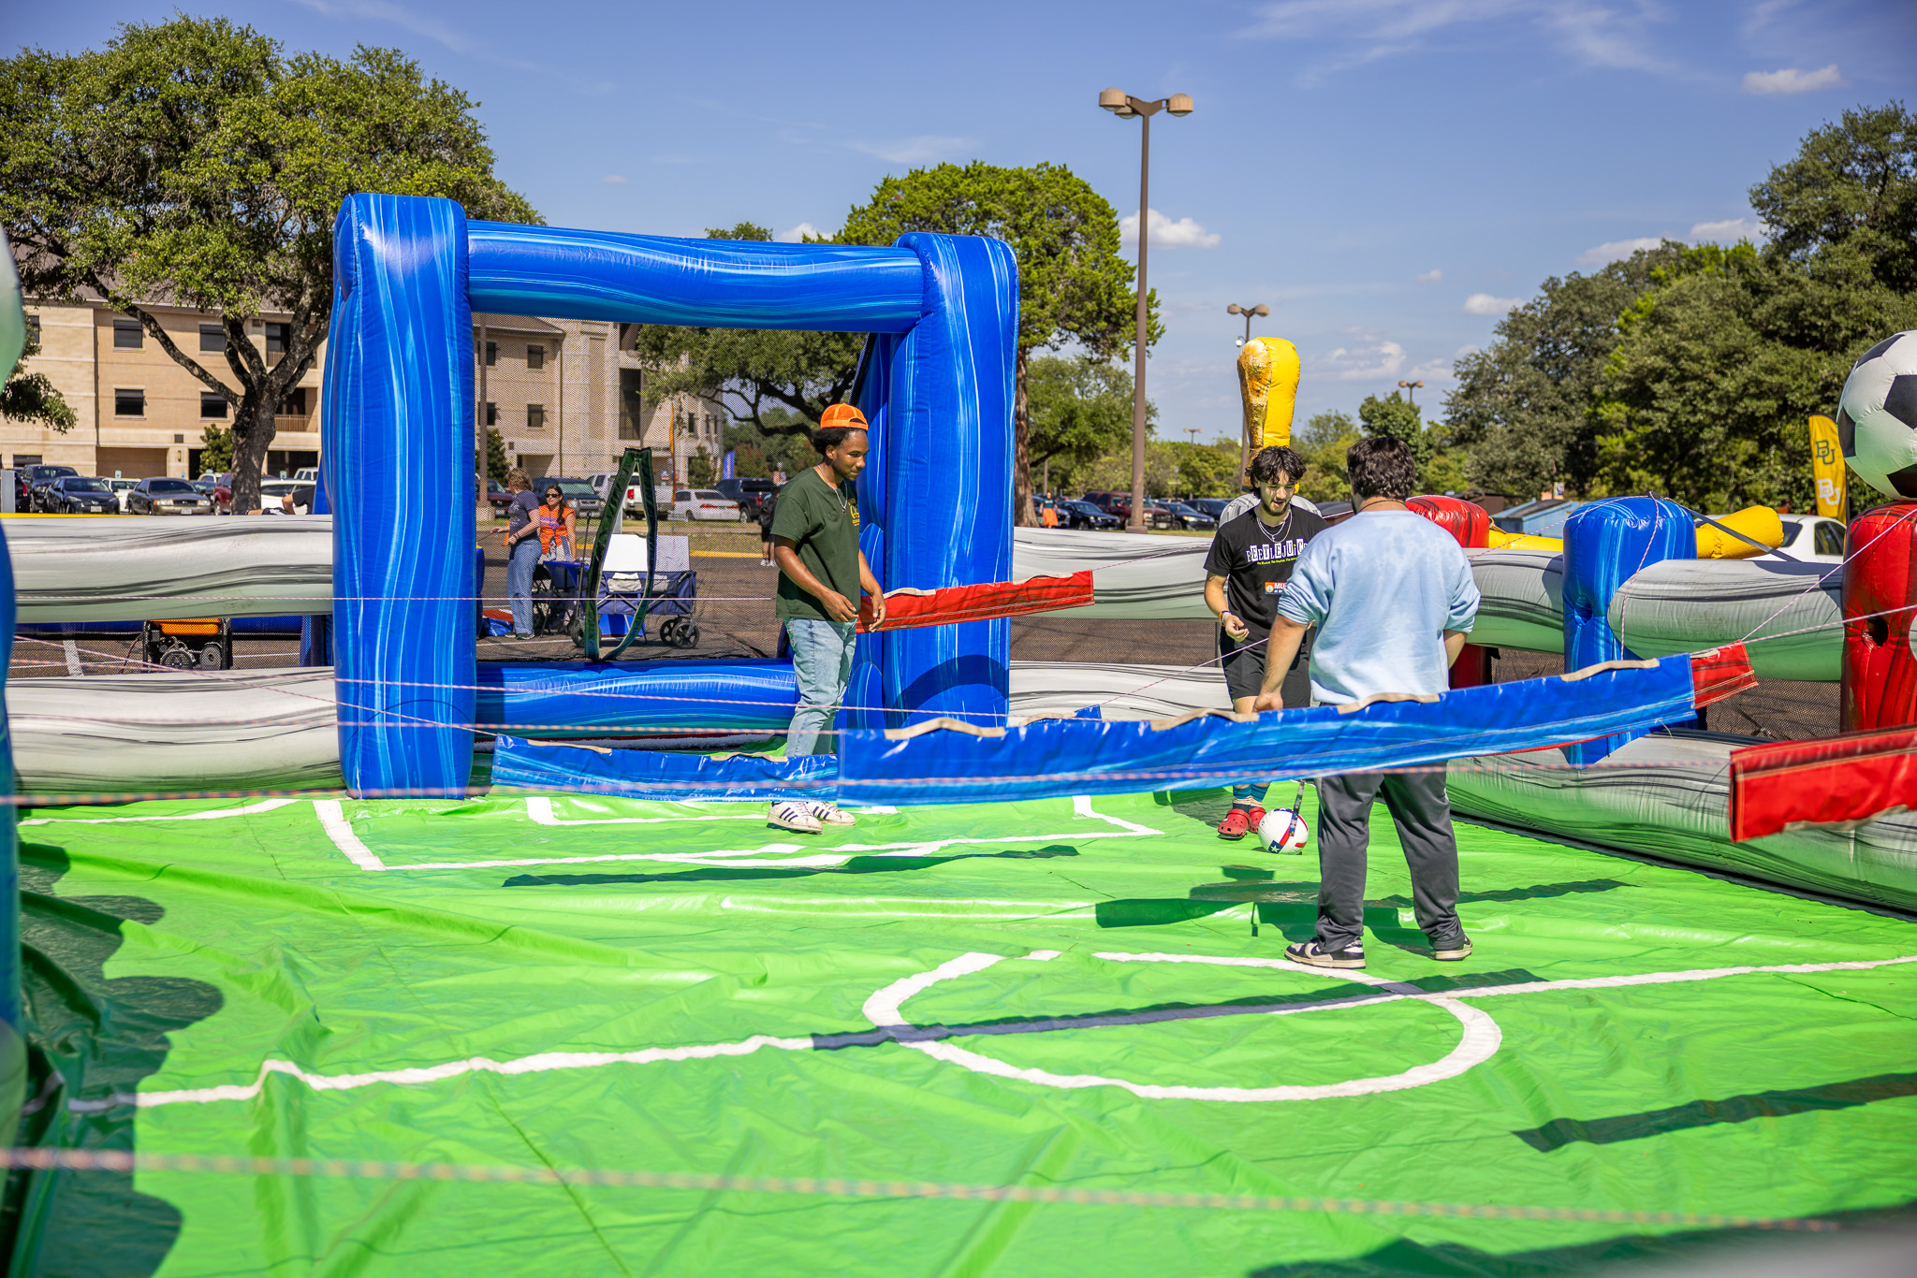

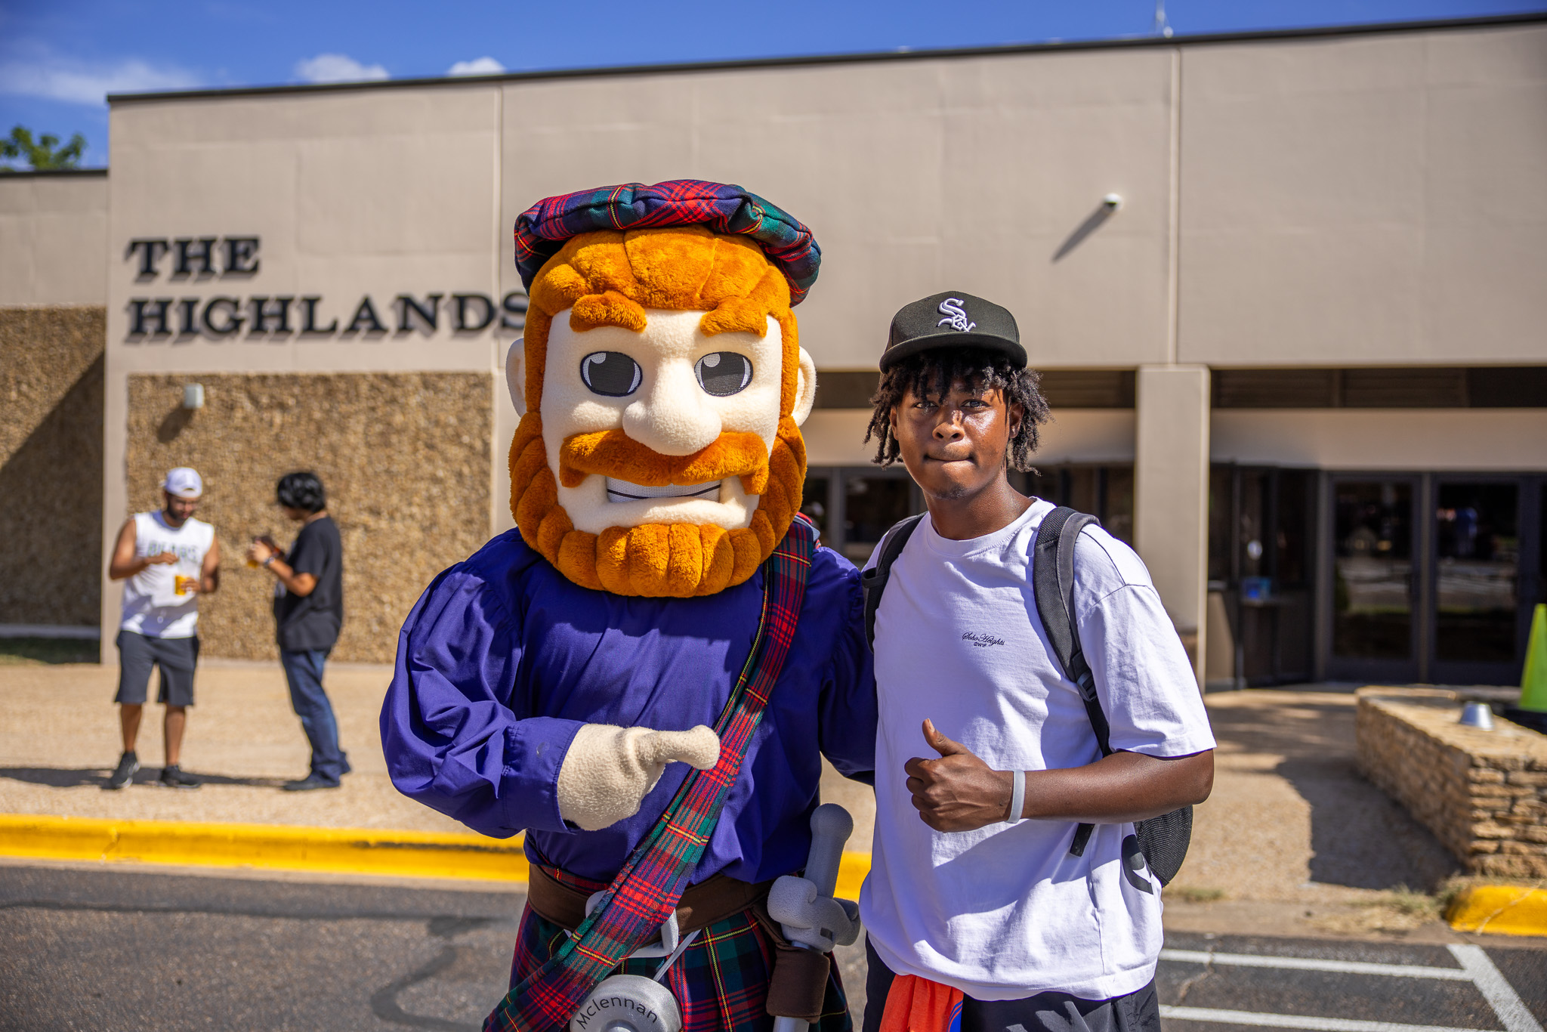
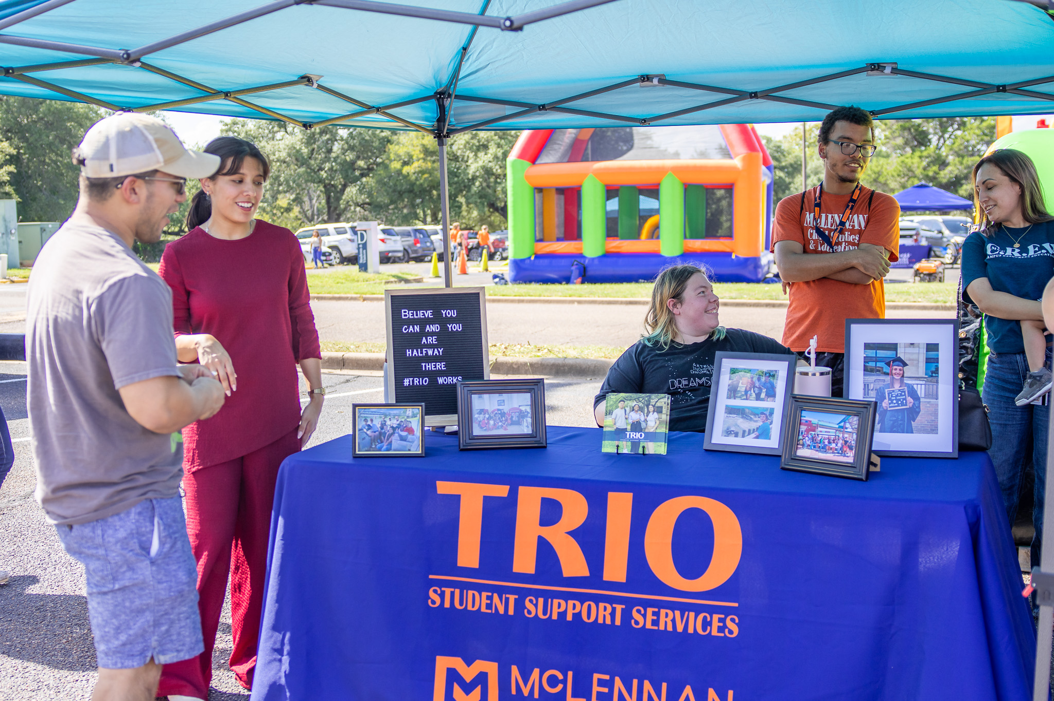
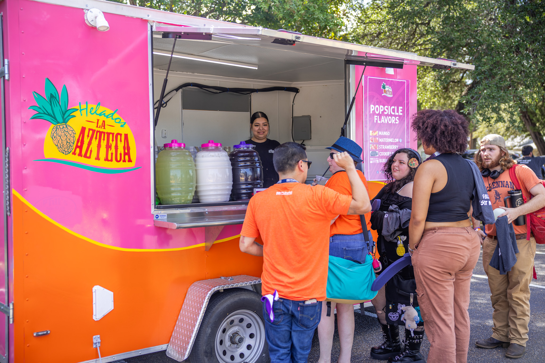
Mac’s Block Party
When:
Thursday, August 28, 2025
Highlands Gym
4:00 PM – 7:00 PM
By the Numbers:
Attendees
Approximately 500-600

Slide 10

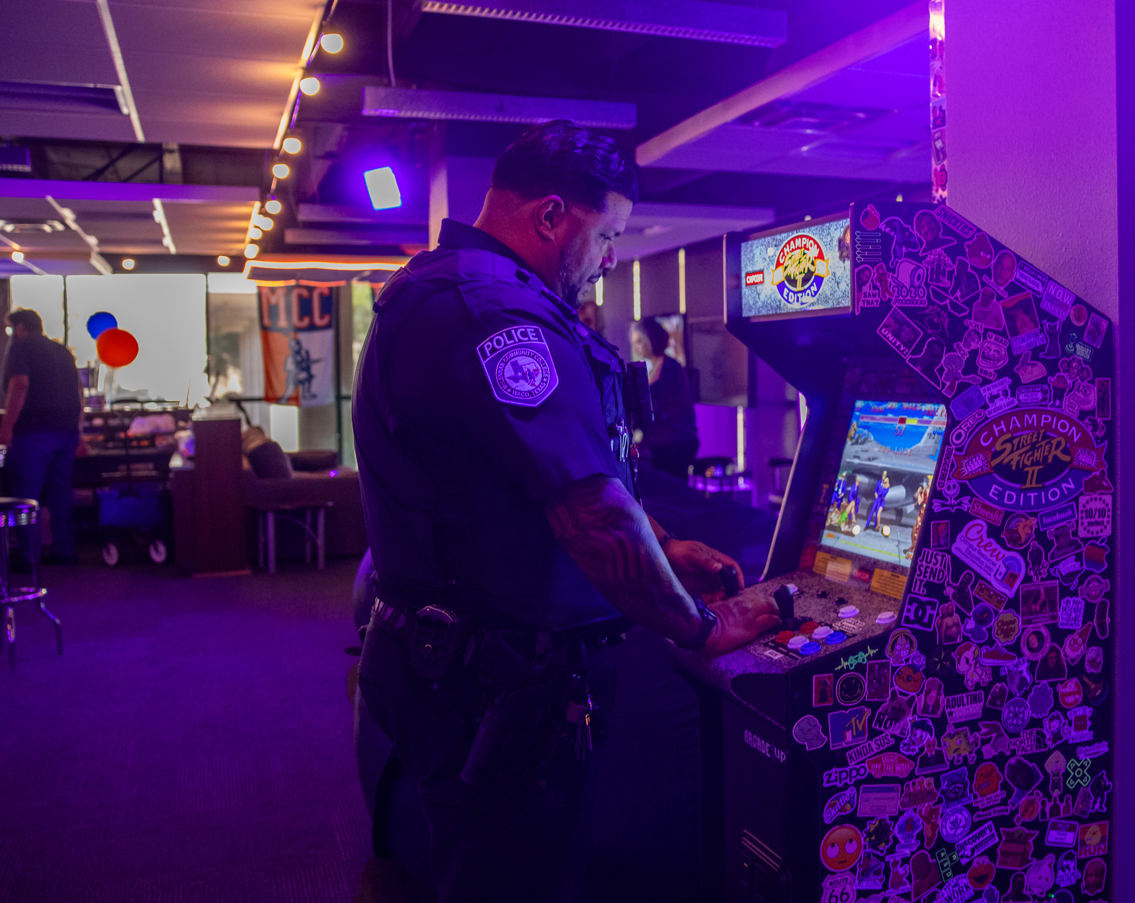
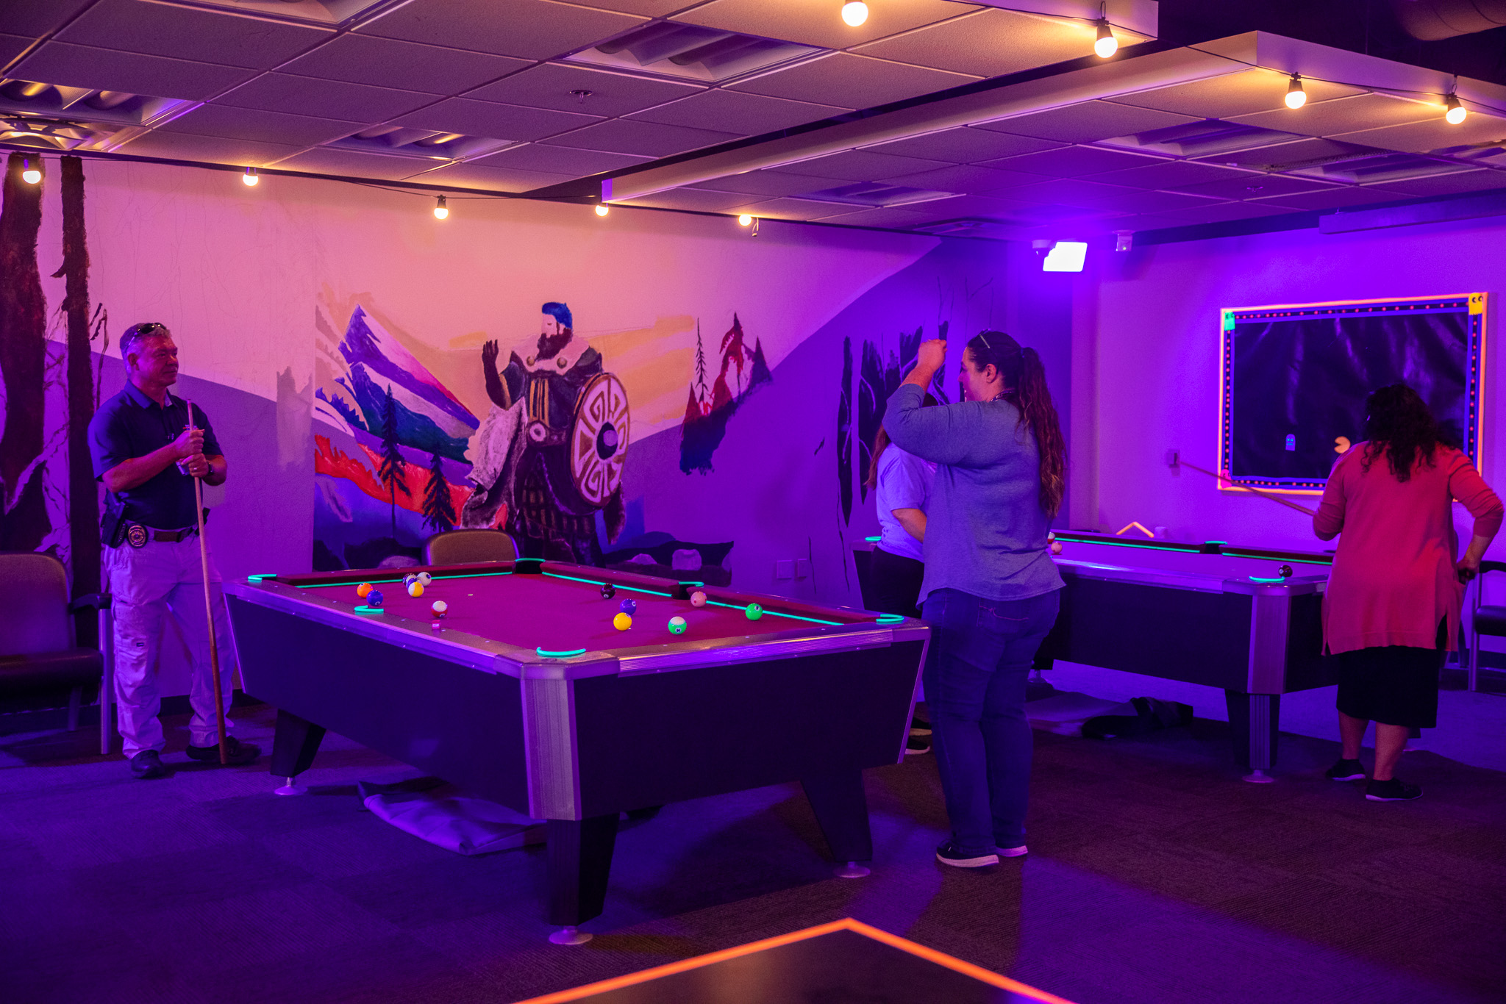
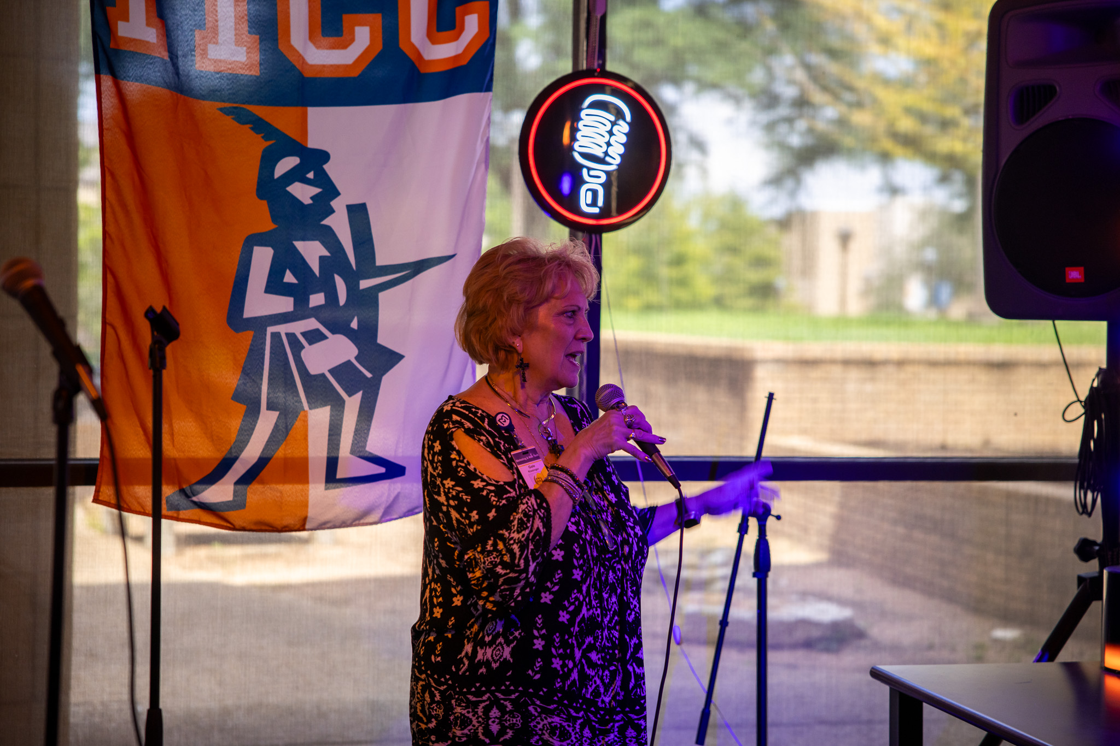
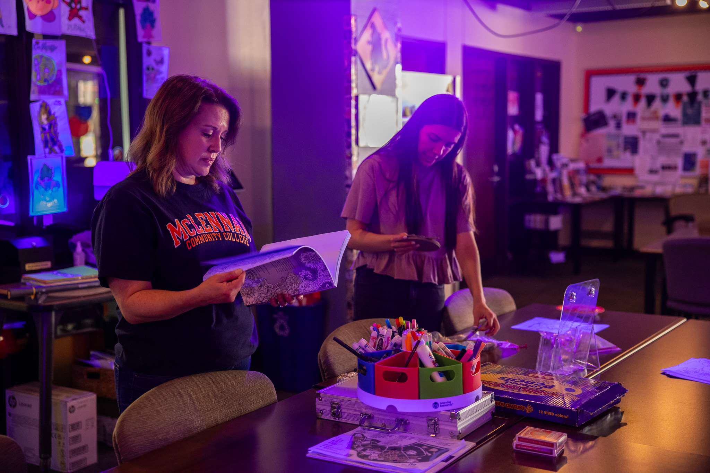
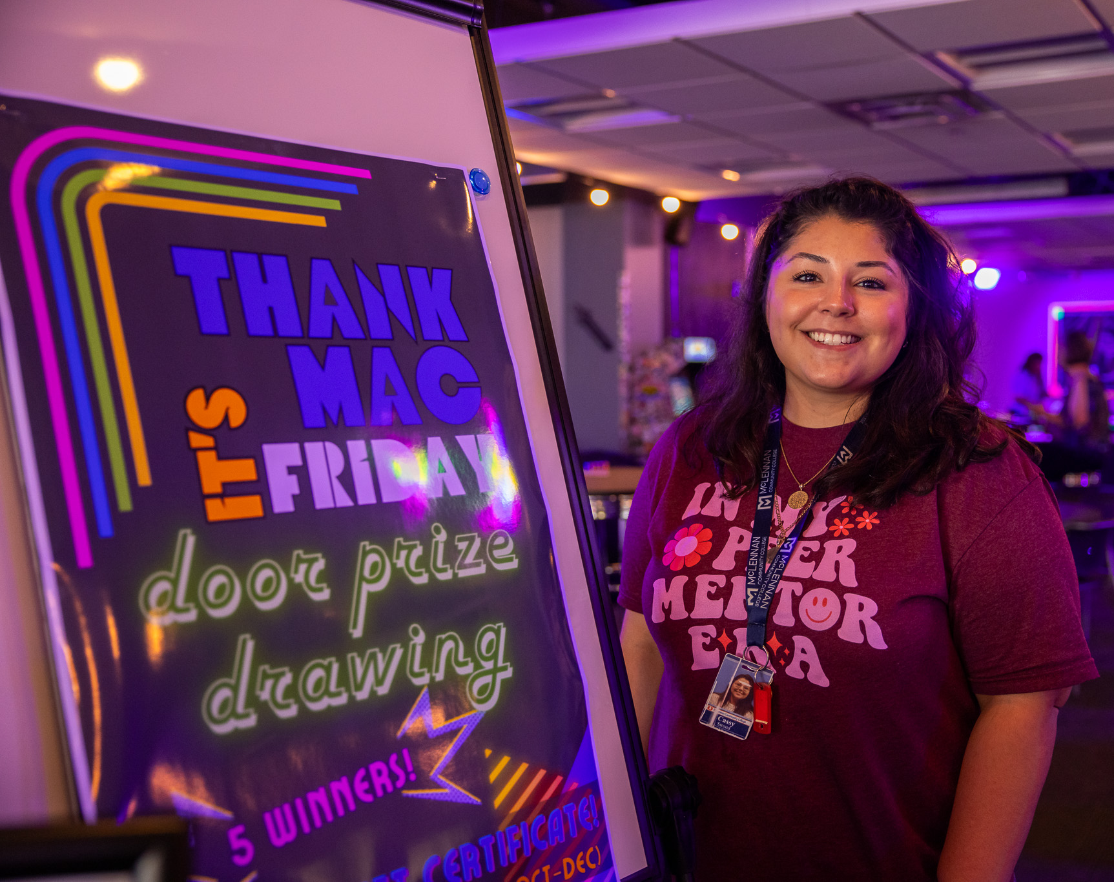
Thank MAC It’s Friday!
When:
Friday, August 29, 2025
Student Life Center
By the Numbers:
Attendees
Approximately 90-95 employees
Notes:
Come and go event

Slide 11
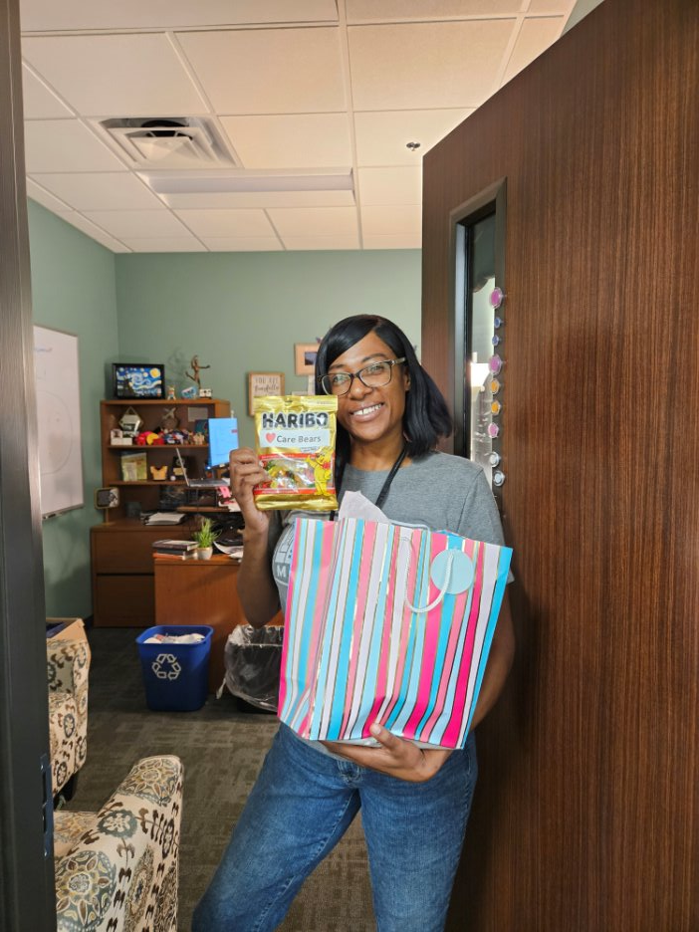
MAC Moving Forward!
Continuing
Caught You Caring Kudos
Data Collection
Continue building a culture of care
Upcoming
Faculty Implementation
Institutionalizing McLennan Always Cares
Presenting at National Caring Campus Conference
Our experiences and learning opportunities
McLennan Always Cares Webpage
http: //www.mclennan.edu/mclennan-always-cares/index.html
Notes:
Nametags: Making Connections Visible
Ten Foot Goal: Proactive help within ten feet—or ten seconds
Cross-Departmental Awareness: One College. Many Doors. One Purpose.
Warm Referrals: Welcoming. Attentive. Responsive. Mindful.
First Week: The Start of Something Great
Continue working with MAC Team to build a culture where students, and employees thrive in and outside the classroom.
Presenting at National Caring Campus Conference in November
- "When Caring Gets Complicated: Bumps, Breakthroughs, and Building Buy-In“
Caring Campus Proposal Abstract: Implementing Caring Campus has the power to create lasting cultural change, but the journey is rarely straightforward. McLennan Always Cares revealed challenges that many campuses may also face, such as carving out time and space for staff to participate, shifting to a staff-led (rather than administrative-driven) model, managing logistics, preparing new members, ensuring board and leadership understanding, sustaining communication, and maintaining momentum after setbacks.
In this interactive session, we will share candid reflections on these pitfalls and the lessons learned along the way. Participants will then engage in scenario-based activities to practice tackling dilemmas similar to those we encountered, building confidence in their ability to respond effectively on their own campuses.
Attendees will leave with both insights and practical strategies for empowering staff as leaders, fostering broad institutional buy-in, and sustaining Caring Campus initiatives in ways that ensure cultural change takes root and grows over time.

Slide 12
Questions?

